Slide 1
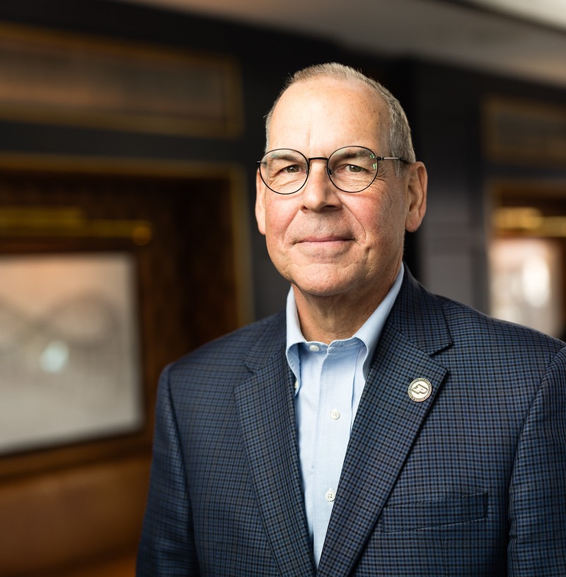
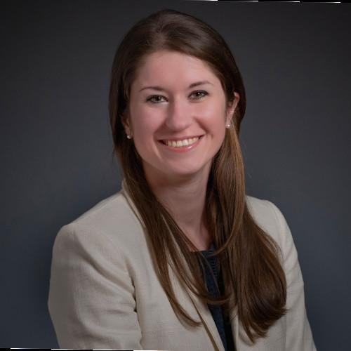

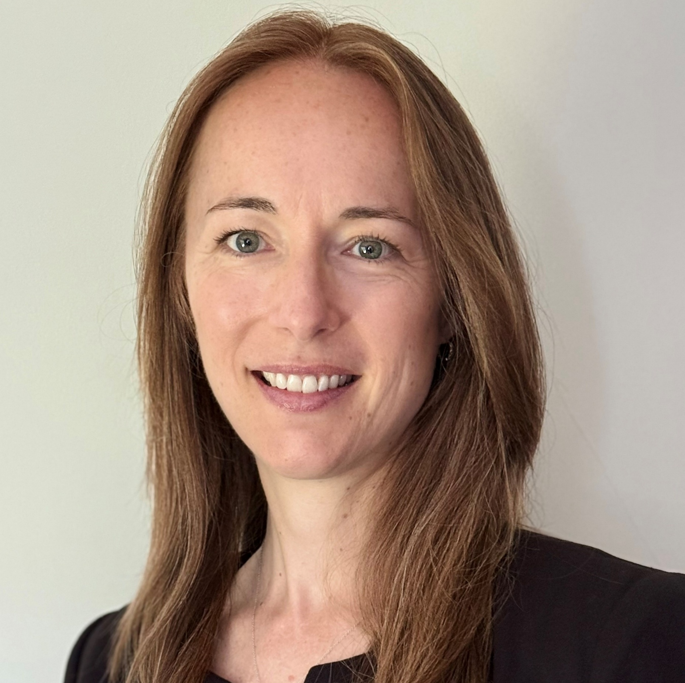



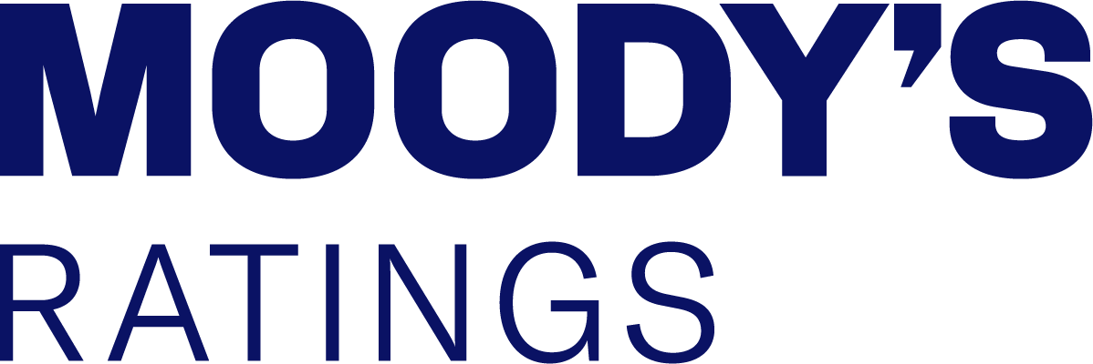


HAS CONGESTION PRICING’S TIME FINALLY ARRIVED?
Richard Ryffel
Professor of Practice & Executive Director of Business Leadership
Kirsten Chalke
Senior Vice President
Gabrielle Facquet
Executive Director
Baye Larsen
Vice President/Senior Credit Officer
Ben Zou
Associate Professor of Economics

Slide 2
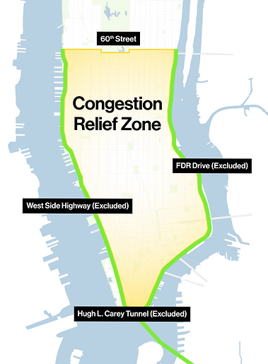
NEW YORK CITY CONGESTION PRICING PROGRAM: BY THE NUMBERS (SO FAR)
1st congestion pricing program in the U.S.
$15 billion of funding expected to be generated for transit improvements in the NYC metro region
-11% traffic reduction (67,000 vehicles daily) in CRZ
Traffic delays down by:
  -25% Congestion Relief Zone (CRZ)
  -9% Metropolitan Region
  -10% in the Bronx
  -14% in parts of Bergen County, NJ
  -65% Holland Tunnel rush hour
-12% time lost to traffic jams, giving 7 minutes for
every hour spent in traffic in 2024 back to commuters
-14% crashes in the CRZ
-45% honking and vehicle noise complaints
All MTA modes of public transportation have had post-pandemic record high ridership in the first half of 2025:
  +7% Subway
  +12% Bus
  +8% LIRR
  +6% Metro-North
  +21% Access-A-Ride
MTA “ICYMI: Six Months In, Governor Hochul Highlights Success of Congestion Pricing: Traffic is Down, Business is Up, and Critical Investments Are Being Made to Improve Transit,” July 5, 2025

Slide 3
FTA’s 2025 TRANSIT STATE OF GOOD REPAIR AND NATIONAL BACKLOG ANALYSIS
Growing Backlog in Deferred Maintenance on U.S. Public Transit Systems ($bn)
The total replacement value of the country’s transit assets is estimated to be $1,338.4 billion (in 2022 dollars), including $1,126.0 billion of rail assets (84%) and $212.4 billion (16%) of bus/non-rail or multi-mode assets
  An estimated $140.2 billion of total transit assets by value (10%) are not in a state of good repair
  Backlog represents a 38% increase since 2018 or 56% over the last ten years
  Inflationary cost pressures is estimated to be the largest cause of the increased state of good repair backlog, accounting for approximately $18.6 billion or 48% of the increase since 2018
  USDOT FTA “Transit State of Good Repair National Backlog Analysis,” January 2025
  Pew “Cost for Repairs to U.S. Transit Assets Estimated at $140.2 Billion,” June 25, 2025.

Slide 4
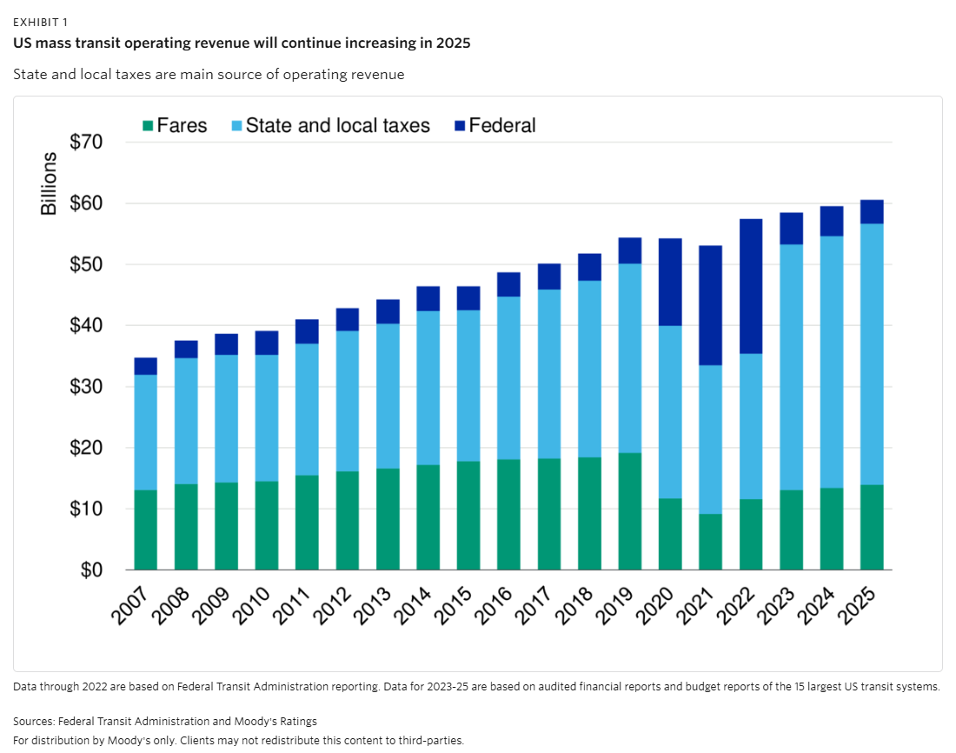
TRANSIT SYSTEMS INCREASINGLY RELY ON SUBSIDIES
The reliance on taxes began to grow in the mid-2000s as ridership stagnated.
Across the sector, state and local taxes now account for 70% of operating revenue.
The transition has been harder for big urban systems that were historically more fare dependent.

Slide 5
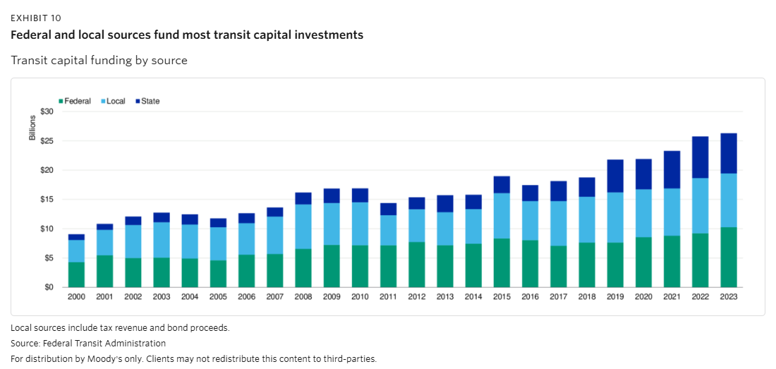
CAPITAL PROJECTS RELY ON FEDERAL GRANTS
New federal policies will increase pressure on transits to find new funding

