Slide 1
Fragile and Conflict Affected Situations (FCS):
Setting the Context
Homi Kharas
October 11, 2024

Slide 2
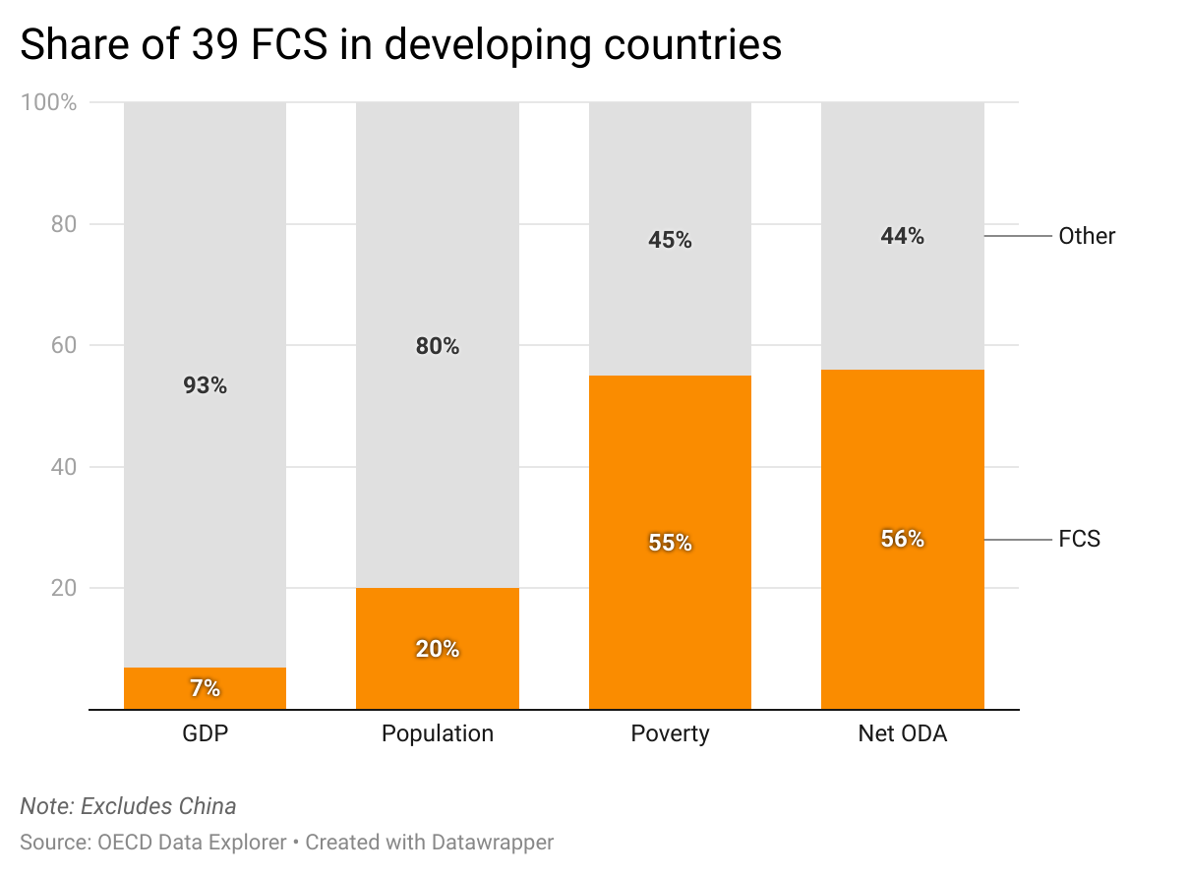
Why FCS are important for development assistance
“FCS suffer more severe and persistent GDP losses than other countries due to climate shocks because their underlying fragilities amplify the impact of shocks, in particular in agriculture. At the same time, climate shocks worsen underlying fragilities, namely conflict.” (IMF, 2023)
GDP
Population
Poverty
ODA
Notes:
https://www.worldbank.org/en/topic/fragilityconflictviolence/brief/classification-of-fragile-and-conflict-affected-situations

Slide 3
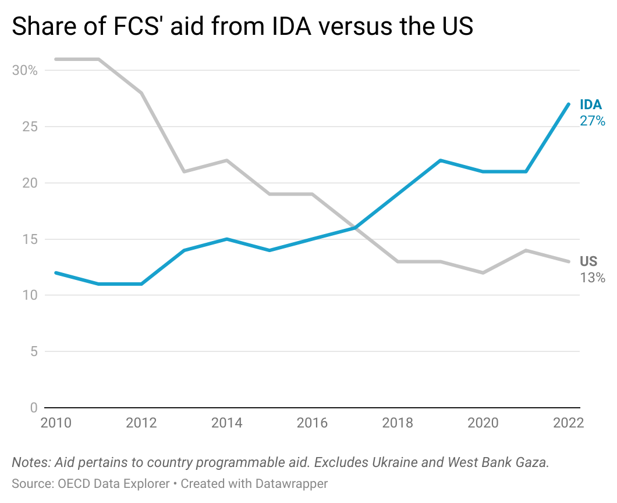
IDA has prioritized lending for FCS
FCS have become relatively more reliant on IDA
IDA 27%
FCS 41%
US
13%
In 2022, IDA was the top donor to 13 of the 39 Fragile States, and in the top 3 donors for 22 of the 39
IDA has contributed over 20% of all CPA to Fragile States in the last 5 years

Slide 4
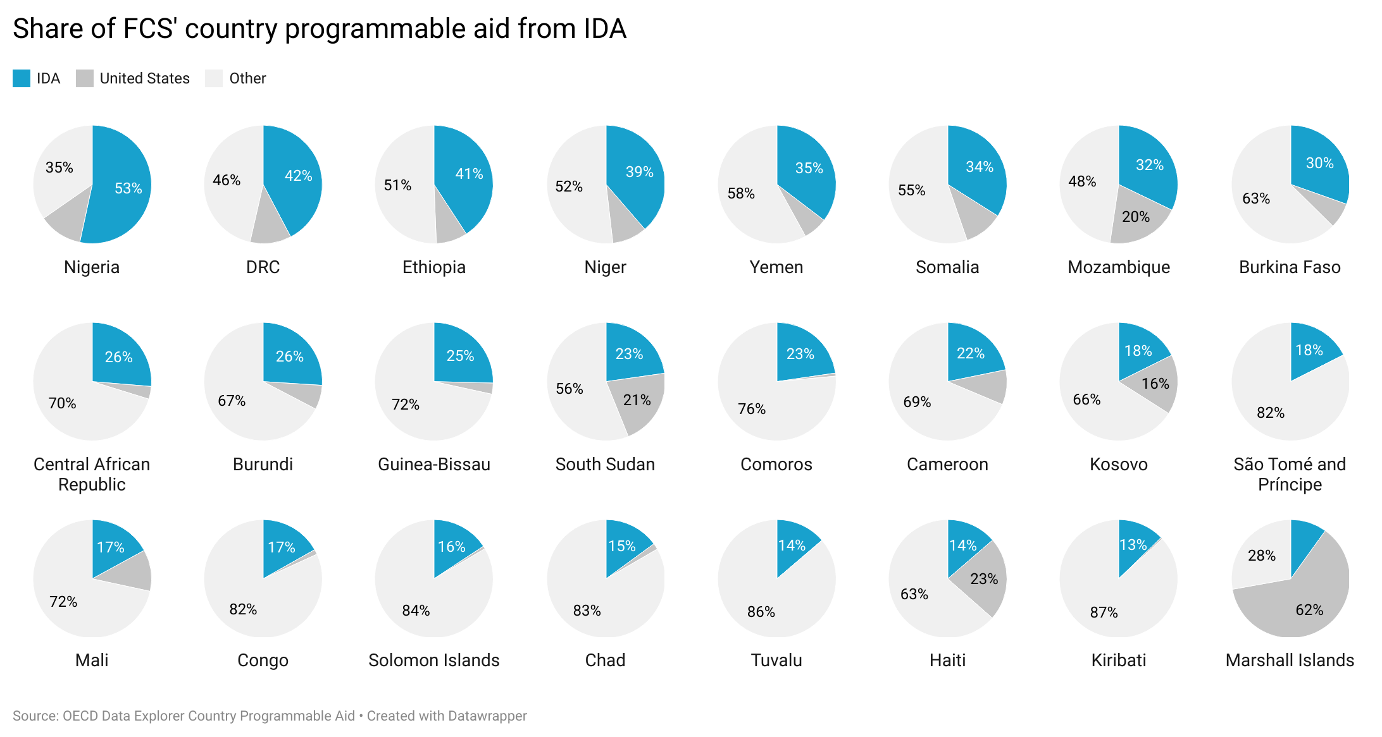

24 FCS with 10% or more of their aid coming from IDA in 2022

