Slide 1
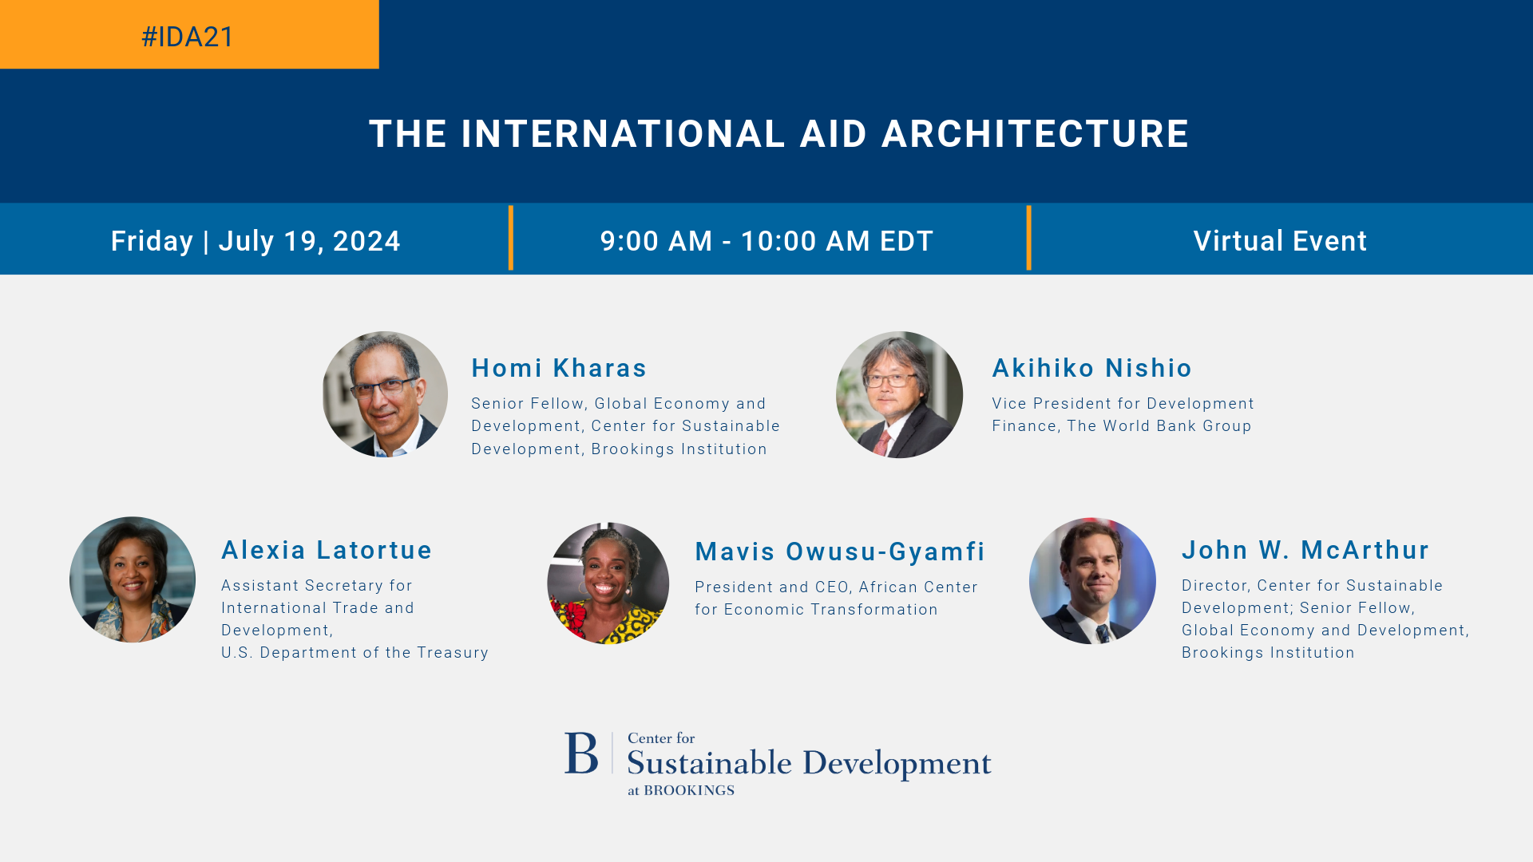

Slide 2
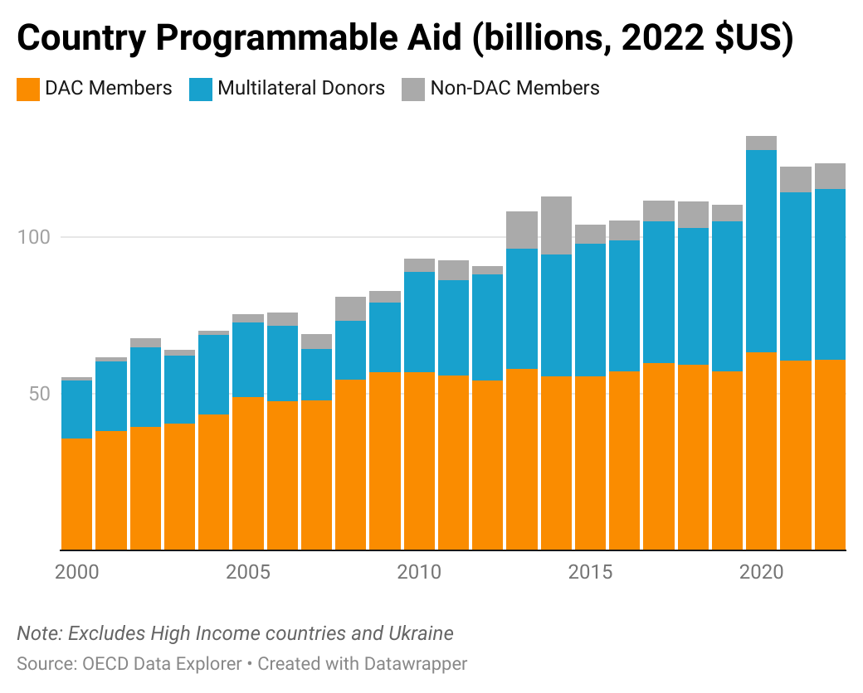
$124
Notes:
Data Wrapper
https://app.datawrapper.de/chart/OK5mW/visualize#refine
124 label

Slide 3
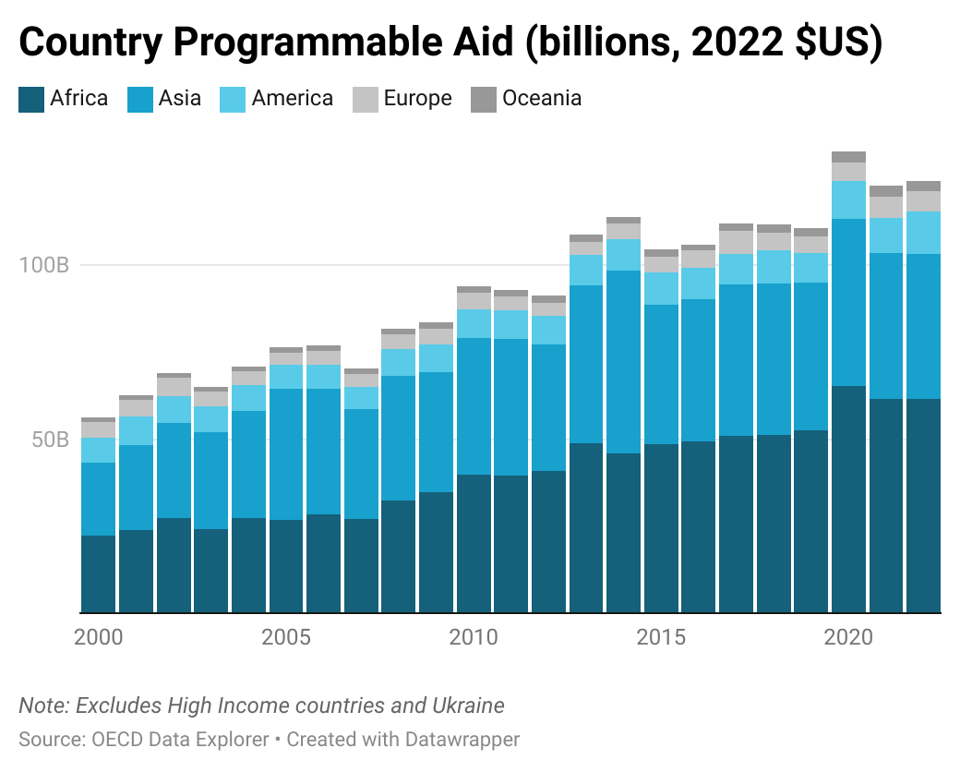
$124

Slide 4
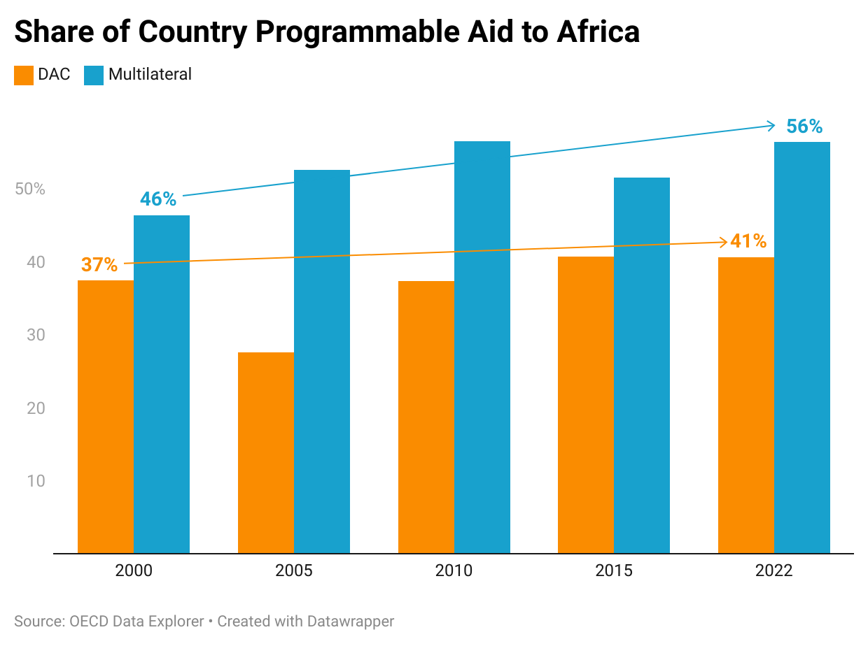
Notes:
CPA OECD by region

Slide 5
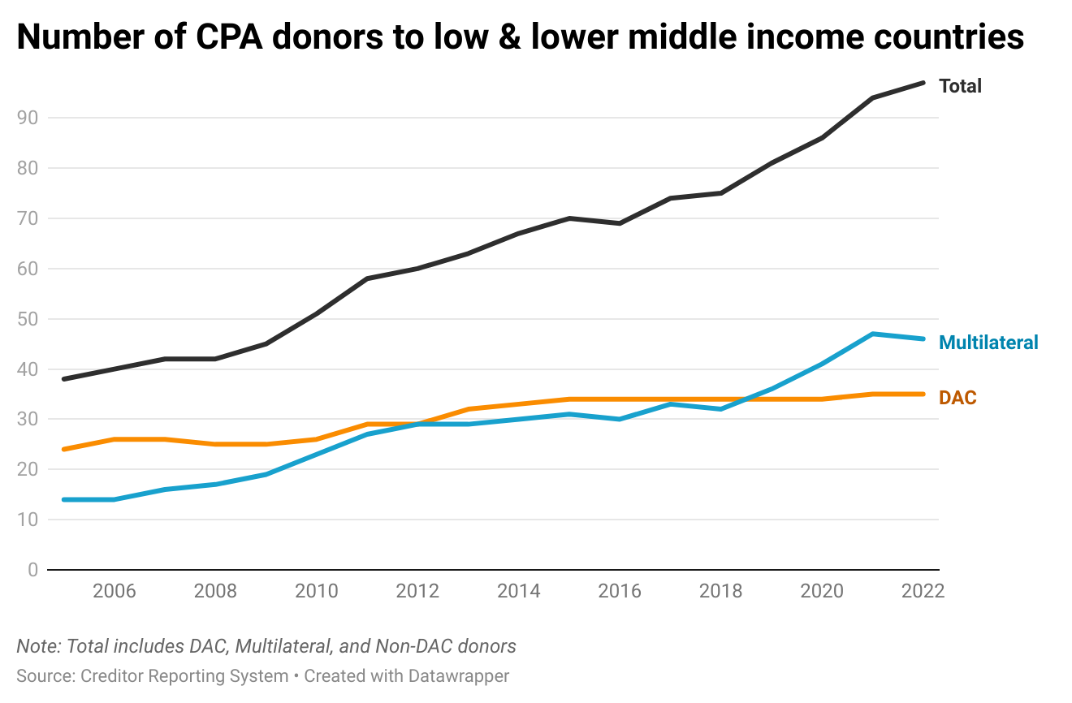
Notes:
Data Wrapper Chart
https://app.datawrapper.de/chart/F7EyC/visualize#refine
Dataset Specifications
Creditor Reporting System bulk download files on 6/18/2024
Rows where USD_Commitment_Defl was not missing / NA.
Low or lower middle income countries only
Country Programmable Aid: Excludes sectors (humanitarian, refugee, development food aid), purposes (promotion of development awareness (non-sector allocable)), aid types (debt relief, admin costs, imputed student costs, etc), channels (aid from local governments), and flow types (keeps only “ODA Loans” and “ODA Grants”)
Chart Specifications
Non-DAC taken out because it is small
Total is Multilateral + DAC ← should total include Non-DAC?

Slide 6
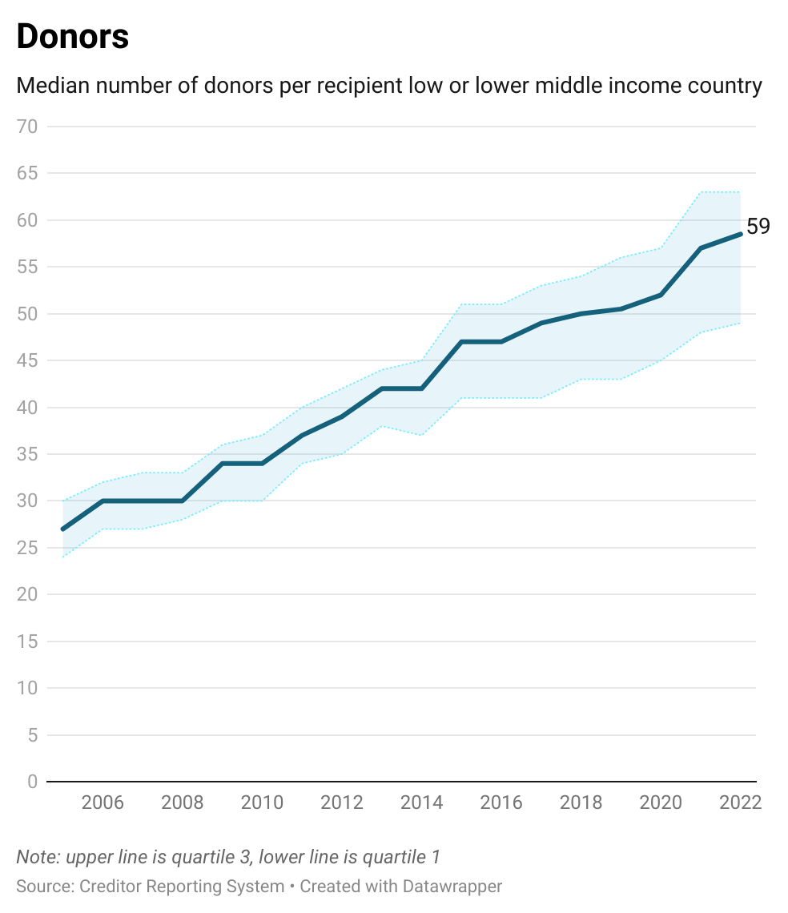
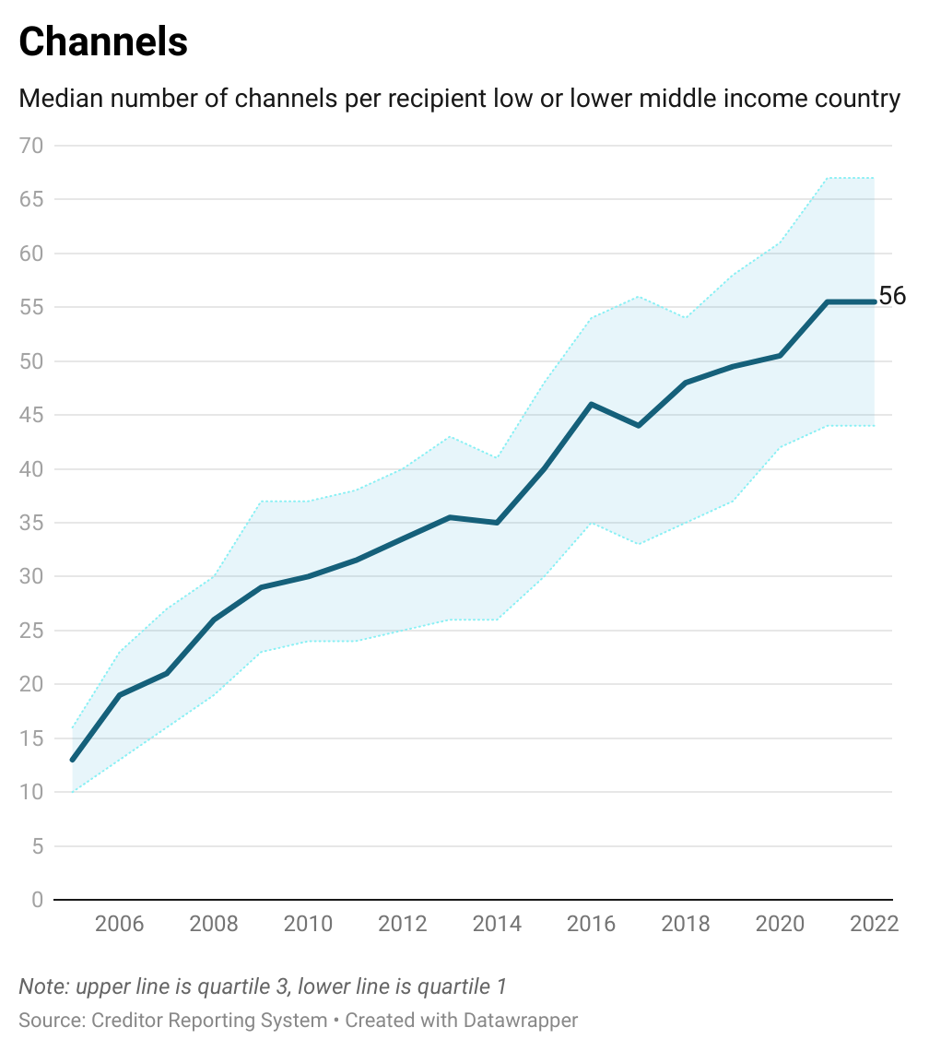
How many donors and channels does the average country deal with?
Median number of donors/channels per low or lower middle income country
Notes:
Chart Specifications
This includes DAC, Multilateral, and Non-DAC donors. Because I’ve filtered for CPA (w/ filters and FlowName “ODA Grants” and “ODA Loans”), it would not include private donors.
Dataset Specifications
Creditor Reporting System bulk download files on 6/18/2024
Rows where USD_Commitment_Defl was not missing / NA.
Low or lower middle income countries only
Country Programmable Aid: Excludes sectors (humanitarian, refugee, development food aid), purposes (promotion of development awareness (non-sector allocable)), aid types (debt relief, admin costs, imputed student costs, etc), channels (aid from local governments), and flow types (keeps only “ODA Loans” and “ODA Grants”)

Slide 7
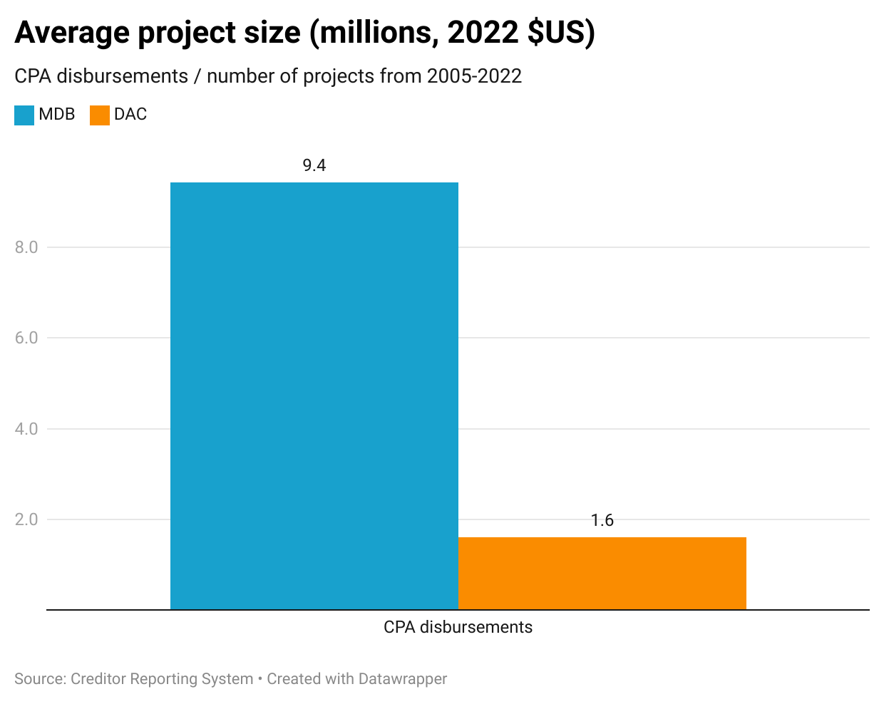
Notes:
Dataset Specifications
Creditor Reporting System bulk download files on 6/18/2024
Rows where USD_Disbursements_Defl was not missing / NA.
Low or lower middle income countries only
Country Programmable Aid: Excludes sectors (humanitarian, refugee, development food aid), purposes (promotion of development awareness (non-sector allocable)), aid types (debt relief, admin costs, imputed student costs, etc), channels (aid from local governments), and flow types (keeps only “ODA Loans” and “ODA Grants”)

Slide 8
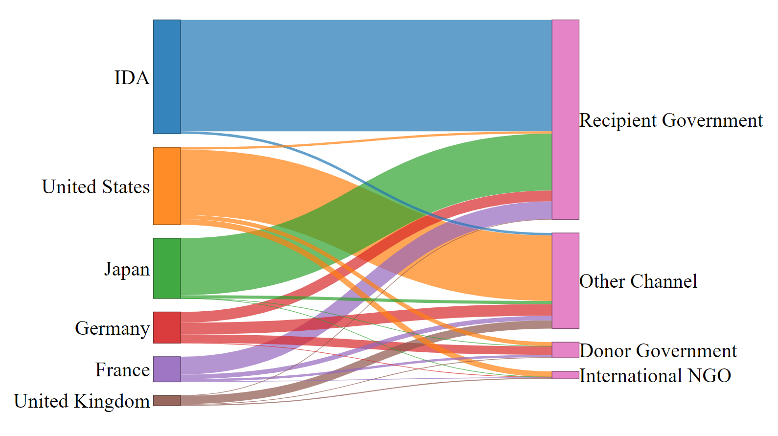
Selected Donors’ Channel for CPA disbursements in 2022
Source: OECD Creditor Reporting System

Slide 9
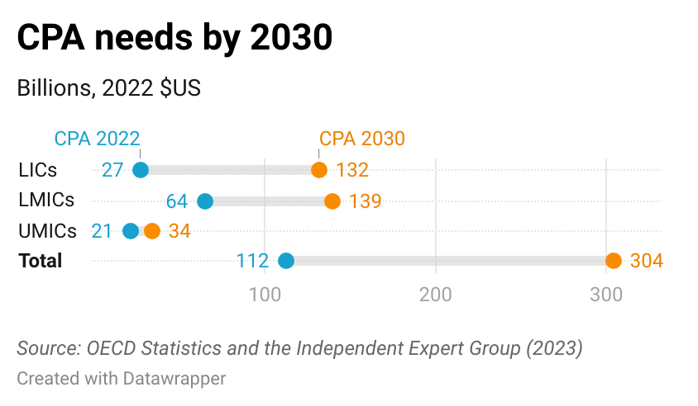
Notes:
CPA needs by 2030

Slide 10
Major Issues
Large needs for incremental CPA by 2030
Shift towards Africa?
Countries have to deal with many donors and channels
Average project size of bilaterals is small
Bilateral shares going through recipient country budgets are small

