Slide 1
© VOICE 4 Girls
Notes:
Hi everyone, I am Anusha Bharadwaj and I come from India. Today I am going to on a journey in the lives of adolescent girls, what are their challenges but also how they are finding their voice and strengthening their agency.

Slide 2
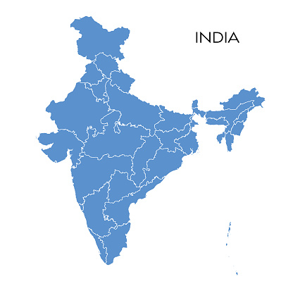
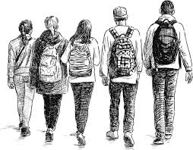
40% under
25 years
Adolescent -
10 to 19
years
(WHO)
76% of the US population
253 million adolescents
This Photo by Unknown Author is licensed under CC BY-SA-NC
Notes:
Why are we talking about this now? India has a large population that is young. Specifically if you see, 243 million adolescents, to give you context that’s 76% of the entire population of USA. But the subsection is 120 million adolescent girls and you can see…

Slide 3
Cycle of Denial –
Intergenerational transfer of oppression
Notes:
…girls are already having negative health, education and life outcomes.
However, I want to draw you attention to two factors:
1 in 5 girls gets married before the legal age of 18 years
India is home to maximum number of child brides in the world
Painting that picture it is likely that minor girls are marrying into
1 in 5 births in India is to girls who are physically and mentally not ready
If you draw a story of a child bride, she is most likely married into a traditional patriarchal family with little to no access to reproductive health and most likely unable to make decisions for herself or the children she will bear.
I call this the Cycle of Denial, where if we deny adolescent girls their rights to education, health and a safe future, this is likely manifest as an intergenerational transfer of oppression.
This led me to my research questions…

Slide 4
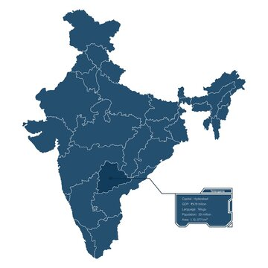
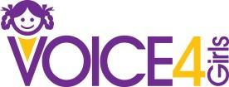
Research Methodology
Mixed method study
Adolescent girls, parents, educators and ​Civil Society Organizations (​CSOs​).​
How to strengthen the agency of adolescent girls
Adolescent girls
12-15 & 16-18 years
Survey 1681
2FGDs
This Photo by Unknown Author is licensed under CC BY-SA-NC
Notes:
…
What ecosystem barriers trap adolescent girls
And through an evidence to impact case study from VOICE 4 Girls, an NGO in India, we can see this cycle being broken.
This research was done in Telangana, South India.
A mixed method study was done where we collected quantitative data from 1681 adolescent girls who have not yet attended a VOICE 4 Girls program and then 2 FGDs with girls who have finished a VOICE program.
And this is what we learned…

Slide 5
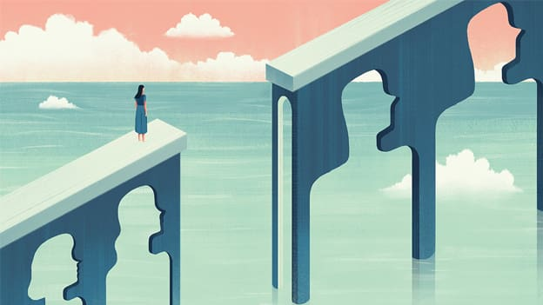
What did we learn?
Puberty exacerbates gender discrimination
Decreased access to education, mobility, resources, etc.
Reduced decision-making
GBV is normalised
The world
is shrinking
This Photo by Unknown Author is licensed under CC BY-SA-NC
Notes:
Girls shared that from a very early age they were being socialized to gender roles.
However, onset of puberty exacerbated this gender discrimination.
Whether it is everyday decisions like what to wear and who they can hang out with to life decisions like what they can study, the career choices available to them or who and when they can marry; it is family and community that decides.
One girl specifically said that with the period, the world was suddenly shrinking for her and other girls echoed as well.
But if that age is so critical where so many things were happening, were they prepared?

Slide 6
“We are not allowed to play or talk with the boys. If we do so, we are labelled as bad girls.”
“In my village, three girls were married off as soon as they hit menarche.”
© VOICE 4 Girls
Notes:
So it is clearly indicative that puberty is a maker for these girls but this set of data will indicate that they aren’t prepared for this important phase in their life.
Half the AGs did not know the physical and emotional changes to expect during puberty, more 60% are not aware of the process.
Socio-cultural and religious taboos reflect on the strict norms' girls must adhere to during menstruation. For e.g. 80% girls believe that menstrual blood is bad and hence they are unclean during their periods.
They shared the many social restrictions such as attending religious ceremonies, visiting religious spaces, not being allowed to enter the kitchen or handling food.
Girls also mention that with the start of their menstruation there are constant pressures to marry.
Marriage is positioned as the destination for the girls while career and financial responsibility is indicated for the boys.

Slide 7
“I was warned not to go out alone. Girls are being kidnapped and trafficked”
“I believe that girls who wear short clothes may get assaulted.”
“In my village many men drink alcohol and beat their wives.”
© VOICE 4 Girls
Notes:
We also asked girls about safety from violence.
As you can see, 70% of the girls were unable to recognise the forms of violence
In fact, GBV is normalised in the communities as you can see here. Girls shared that inter-familial violence is common but normalised
For example like “If the wife makes the same mistake many times, who else will she learn unless the husband teaches her a lesson?” or “Women get beaten because the husbands come home after consuming alcohol”
It can be concluded that they accept violence as an immutable part of their lives.
At the same time girls do not know the laws governing their safety at homes, in schools and the community.

Slide 8
“My father wants me to do commerce but I want to study science.”
“I want to be a fashion designer, what should I study?”
© VOICE 4 Girls
Notes:
But we also spent time hearing from them about their dreams and aspirations about their futures
One girl shared she wanted to be a runway model but her family doesn’t approve as they believe that girls from ‘good’ families do not do that profession
Another girl shared she wanted to be a lawyer and asked us if we know what she must study after tenth grade
The data collected said the same thing too. While 85% girls aspire for higher education over 70% lack the knowledge of how to pursue higher education.
In conclusion, they feel a lack of agency to pursue their needs, desires and goals. At the same time they mention that they need a ‘safe space to understand the complexities in their life. They do not feel that they can approach adults/ teachers in their schools and community without fear of judgement or retribution.

Slide 9
Lack of a Safe Space
Notes:
They clear mentioned that they ‘want more information and knowledge that can help them make decisions about their future
At the same time, a space to exercise that agency.
And a support system of girls like her and role models to look upto
They LACK SAFE SPACES where this can happen
With that, I will lead you to the second research question: What if there is a safe space?

Slide 10
What if there were a safe space?
Evidence of impact –
A case study of
Research was supported by:
Vanitha Prabhu, Nayonika Roy, Lalasa Mokkapati and Priyanka Toomkunta.
Photo Credit: Anusha Bharadwaj (Presenter)
Notes:
VOICE 4 Girls is an NGO I founded and we have worked in nine states in India.
VOICE does adolescent girl programming and has impacted the lives of a over quarter of a million girls.
VOICE creates adolescent-friendly curriculum that is delivered by young college students through camps
The VOICE Class rooms are safe spaces in government funded public schools where the most vulnerable marginalied adolescent girls receive education.
When we spoke to girls who have been through VOICE camps, they shared that VOICE Camps were a very critical part of their adolescence
They described their journey in three phases…

Slide 11
© VOICE 4 Girls
Notes:
The VOICE classroom is the first time they received information about gender and sexuality, health, safety and rights.
They felt ‘safe’ in the VOICE classrooms to share their experiences, ask questions about ‘sensitive’ topics.
One girl shared and I quote, “We have gained the confidence to tackle problems, navigate challenges, and address instances of harassment. We now possess the knowledge and assurance to effectively handle such situations and interact with others while on the road”
They said that this critical knowledge was made accessible using the lifeskills they learnt at camps like negotiation and decision-making. But girls also shared instances of exercising their agency outside camps. One girl shared that she took the help of her mother to stop a child marriage in her village while another girl shared that she convinced her mother to stop using old rags during her periods but to use sanitary napkins.
There are many stories like this, please look out for my policy brief for more.
Girls also felt supported in the VOICE classroom and that through shared lived experiences girls find solidarity and also find agency to recreate these safe spaces for other girls
This leads me to my main recommendation…

Slide 12
© VOICE 4 Girls
Notes:
…To create Gender-transformative safe spaces
They spaces must be created in schools and community centers to conduct adolescent-friendly programming.
The objectives of the programming should incorporate components of
(a) A girls leadership program with life-skills and critical topics around sexual and reproductive health and rights (SRHR), gender based violence (GBV), careers and futures, rights and self-awareness;
(b) A young mentor-to-girl led approach so that girls open up, receive and respond to information in a safe space while this creates role-modelling of peer-to-peer social networks;
At the same time a multi-stakeholder approach must be taken.
Government funded public schools cater to the most vulnerable adolescent girls.
Hence, these schools can become a great entry point to large scale and sustainable adolescent girl programming.
Especially in India where there has historically been a rich culture of CSO participation in large scale implementation, they can bring innovative curriculum and pedagogy and the critical project support to tie actors together and provide quality control.

Slide 13
© VOICE 4 Girls
Notes:
Similar program as with the girls, boys also need a safe space to get information about SRHR. But one main difference will be while with the girls we want to focus on solidarity and leadership; with the boys we focus on allyship so we can create gender ambassadors in the community.

Slide 14
© VOICE 4 Girls
Notes:
Rights – 85% of the girls surveyed did not know about the laws in place that protect their rights.
Parents need to be mobilised to create enabling conditions for adolescent girls.
Again, 70% of the girls surveyed did not know how to plan their futures.
It would be imperative to have FP hubs in their schools to provide information, counselling and continued support
Inadequate data collection is an undeniable reason for missing gender data BUT even where data is available for girls, very little is available that goes to understand their dreams and aspirations.
Ultimately as girls rights advocates we must strive to be catalysts in their futures that girls want for themselves. After all….next slide.

Slide 15
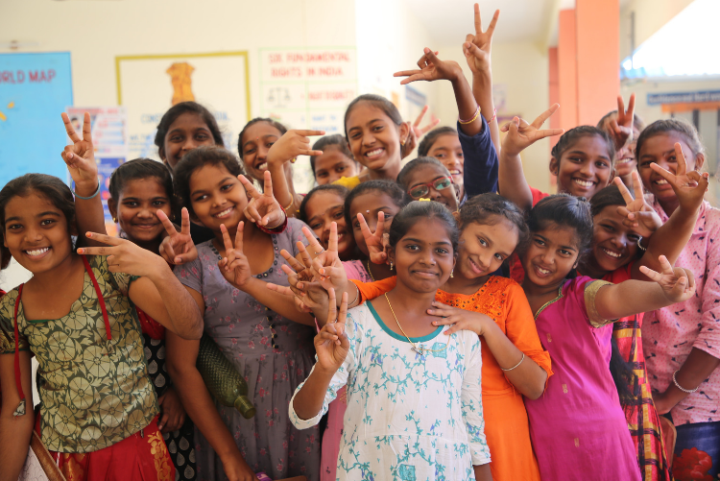
When a girl finds her voice,
the world around her begins to change.
© VOICE 4 Girls

