Slide 1
Banking, Credit, and Economic Fluctuations
Nobel Lecture
Ben S. Bernanke
Distinguished Senior Fellow, Brookings Institution
December 8, 2022

Slide 2
CREDIT MARKET STRESS AND THE ECONOMY
At times, banking and credit markets become stressed, increasing the cost of borrowing and reducing the availability of credit.
Credit market stress has macroeconomic consequences:
Contributed importantly to the Great Depression of the 1930s
Helps explain why the recession that followed the global financial crisis of 2007-2009 was so severe
Helps explain the persistence of even “garden-variety” recessions
Helps explain the potency of monetary policy
Justifies a strong response to systemic financial crises when they happen and effective financial regulation to ensure that they happen less often

Slide 3
THE SIMPLE ECONOMICS OF LENDING
Lending to private borrowers typically involves imperfect and asymmetric information. Borrowers know more than lenders about their own financial capacity, plans, and risks. Because of asymmetric information, lenders face adverse selection (the riskiest borrowers have the strongest incentives to apply) and moral hazard (borrowers have insufficient incentive to take care).
Banks and other lenders specialize in overcoming information problems through longer-term relationships, screening, monitoring, imposing restrictions on borrowers (covenants), and requiring collateral.

Slide 4
THE SIMPLE ECONOMICS OF LENDING (2)
The external finance premium (EFP) is the all-in cost of a loan for a given borrower (including costs created by covenants and collateral requirements, etc.), less the safe rate of interest (for example, yields on government securities).
The EFP reflects the lender’s cost of credit intermediation for that borrower. EFPs typically differ by borrower: A small business will have a higher EFP than a financially strong corporation.
However, EFPs tend to move together as the economy changes. When we talk about “the EFP,” we mean the typical or average EFP across the economy. A higher EFP corresponds to more stressed credit markets.

Slide 5
THE SIMPLE ECONOMICS OF LENDING (3)
Banks also must borrow from ultimate savers. For reasons explored by laureates Diamond and Dybvig, banks typically rely on short-term funds (deposits, uninsured commercial paper, or repurchase agreements). Lenders to banks like the liquidity (easy conversion to cash) of their short-term loans.
However, reliance on short-term funding makes banks vulnerable to panics (runs), in which (uninsured) providers of short-term funding lose confidence and rush to withdraw their funds.
Panics, or the threat of panics, make lenders more cautious (the flight to quality). They become less willing or able to use their accumulated information, relationships, etc. to extend credit to otherwise trustworthy borrowers.
5

Slide 6
THE SIMPLE ECONOMICS OF LENDING (4)
A key insight is that the cost of lending (EFP) depends importantly on the financial health (net worth) of both borrowers and lenders.
When the net worth of borrowers is high, borrowers can bear more of any losses, creating a financial cushion for lenders and incentivizing borrowers to take care. For example, banks prefer to extend credit to homebuyers who make large down payments.
Lender net worth also matters. For example, banks with lots of capital and cash on hand available to absorb losses find it easier to attract funding and avoid panics.

Slide 7
THE SIMPLE ECONOMICS OF LENDING (5)
The (average) EFP both affects and is affected by the state of the economy:
A higher EFP (more stressed credit markets) implies tighter credit standards and reduced lending, which slows the economy.
A weaker economy in turn reduces the financial health/net worth of both lenders and borrowers, raising the EFP.
7

Slide 8
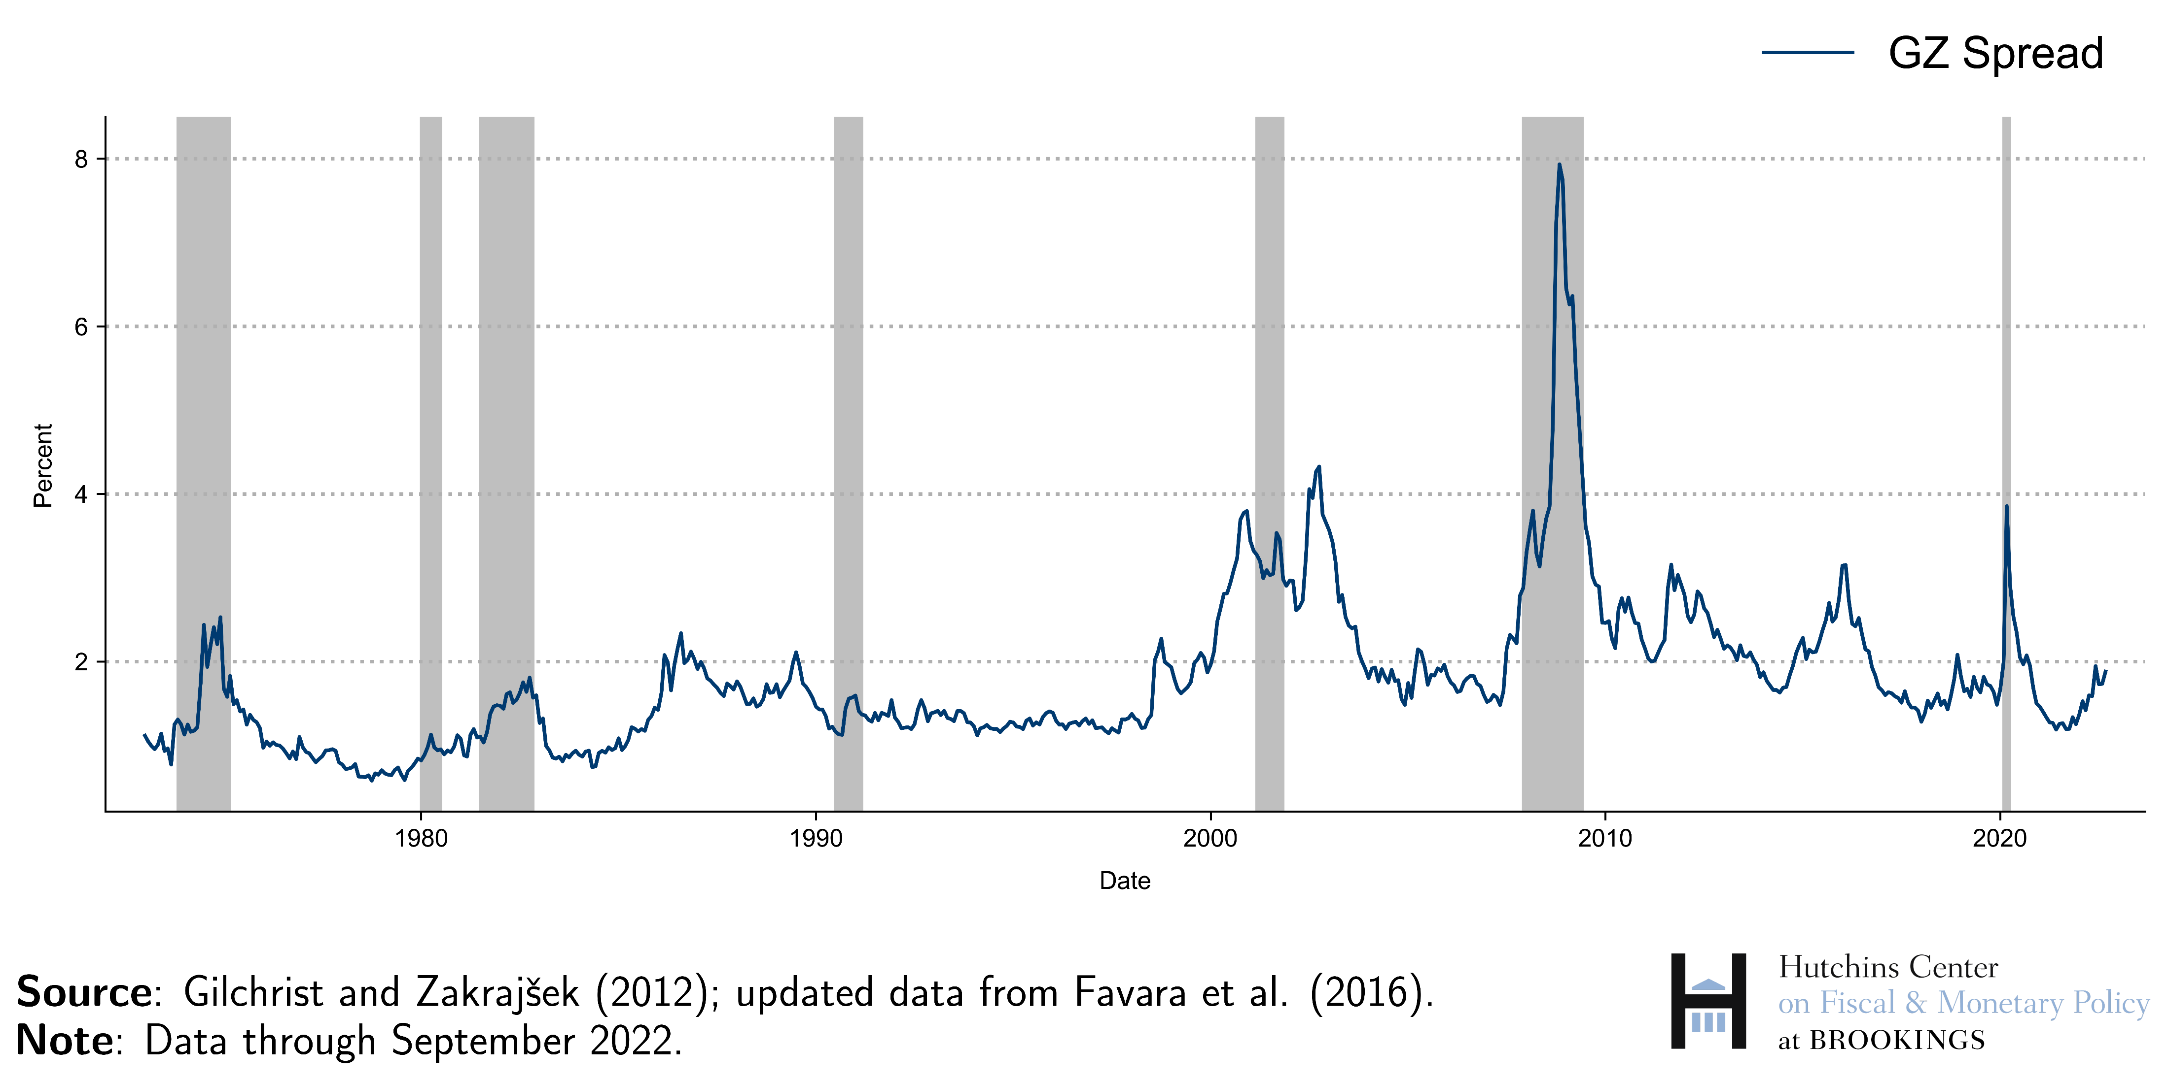
A MEASURE OF THE EXTERNAL FINANCE PREMIUM

Slide 9
THE GREAT DEPRESSION
The global Great Depression was the defining economic event of the twentieth century.
Most economists now agree that a malfunctioning international gold standard was a major source of the Depression. Reconstructed after World War I, the gold standard had critical flaws that caused it to collapse in the late 1920s and early 1930s. This led to global contractions in money supplies and to declining price levels (deflation), followed by declines in output.
Countries that left the gold standard earlier (Great Britain, Japan, Scandinavian countries) recovered much more quickly than those that left later (France, Switzerland).
Questions remain: What was the mechanism? Why was the recovery so slow in the US and some other countries?

Slide 10
THE GREAT DEPRESSION (2)
Together with the gold standard, credit market stress was also an important cause of the Depression.
The Depression saw a near-collapse of banking and credit markets in the United States and other countries (Bernanke, 1983).
About 40 percent of the more than 25,000 U.S. banks disappeared (failed, merged) during the banking panics of 1929-1933. Surviving banks became extremely cautious, shifting from risky loans to safe assets.

Slide 11
THE GREAT DEPRESSION (3)
Default and insolvency among debtors were also widespread in the 1930s, in part reflecting a large buildup of debt in the 1920s.
In 22 cities, mortgage delinquency rates in 1933 ranged from 21 percent to 62 percent
About half of all farm mortgage debt was delinquent in 1933
Total corporate profits after tax were negative every year from 1930-33.
Baa-Treasury bond spreads went from 2.5 percent in 1929-30 to 8 percent in mid-1932
Surveys documented banks’ attempts to liquidate existing credits and refusal to extend new credit except to the very safest borrowers
11

Slide 12
THE GREAT DEPRESSION (4)
The credit-based analysis of the Depression helps explain some important facts:
Why the nascent recovery of 1929-30 stalled (first banking crisis) and the subsequent decline was so sharp
Why credit fell faster than output, and fell even faster during banking crises
Why the 30 percent cumulative deflation of 1931-33 was so damaging (effect on debtors)
Why a strong recovery began in 1933 (the bank holiday, deposit insurance)
Why the recovery subsequently slowed (lender caution, debtor insolvency)
Why countries with severe banking crises in the 1930s (United States, Germany, Austria) fared worse than those whose banking systems remained viable (Sweden, Japan, Netherlands), all else equal (Bernanke and James, 1991)

Slide 13
THE GREAT RECESSION
The Great Recession of 2007-2009 was the result of credit disruptions to an even greater extent than the Depression.
The financial system of 2007 looked very different from 1929. Commercial banks were no longer dominant. A large share of credit was provided by the “shadow banking system,” for example, investment banks, mortgage companies, money market funds, off-balance-sheet investment vehicles.
The shadow banking system, ineligible for deposit insurance or (normally) for Federal Reserve loans, nevertheless relied heavily on uninsured, short-term funding (commercial paper, repurchase agreements) and thus was vulnerable to runs.

Slide 14
THE GREAT RECESSION (2)
The infamous subprime mortgages were not a large asset class in themselves. But uncertainty about who was exposed to mortgage losses led to widespread runs on shadow banks, particularly after the collapse of Lehman Brothers in September 2008.
Companies that lost their funding in the panic dumped their assets on the market (“fire sales”). Indiscriminate selling depressed the values of all types of credit, not just mortgages, and helped bring many large institutions—including major banks in both the US and Europe—to the brink of insolvency.

Slide 15
THE GREAT RECESSION (3)
As in the Depression, borrowers as well as lenders came under great stress.
After the bursting of the housing bubble, a sharp decline in house prices put many borrowers, even prime borrowers, “under water” (the outstanding mortgage exceeded the house value). Delinquency rates rose sharply, and consumer spending plunged.
Small firms were especially hard hit. But even large businesses had difficulty funding themselves. Delinquency rates on business loans spiked. The government rescued two large automobile producers.
15

Slide 16
THE GREAT RECESSION (4)
As in the Depression, both the near-collapse of many lenders and the financial troubles of borrowers contributed to the downturn.
My research (Bernanke, 2018) finds that variables that measure the course of the panic (e.g., bank funding costs) predict variables like output, employment, and consumption better than measures of the financial health of borrowers (e.g., mortgage delinquencies).
I concluded that the financial panic was the primary cause of the Great Recession. Employment and output dropped sharply after the collapse of Lehman and the ensuing intensification of the panic.

Slide 17
THE GREAT RECESSION (5)
17

Slide 18
POLICY IMPLICATIONS
These findings explain why it was necessary to prevent the collapse of the financial system in 2008-2009. In general, ending a systemic crisis requires assistance for both lenders and borrowers. Central banks and treasuries need the tools to do this.
Avoiding future crises requires effective financial regulation to ensure that lenders are “safe and sound” and borrowers are not over-extended. A macroprudential, or system-wide approach to regulation, can better identify developing threats.
Globally, regulation has made banking systems stronger since the crisis. Despite a new crisis in March 2020, however, not enough has been done to ensure the stability of shadow banking in the US.
18

Slide 19
THE FINANCIAL ACCELERATOR
Changing levels of stress in banking and credit markets have a role to play in analyzing and forecasting “garden-variety” business cycles.
For example, an economic downturn typically depresses the net worth of both lenders and borrowers. Lower net worth raises the average external finance premium (EFP) and reduces the availability of credit, thus amplifying the initial shock.
The tendency of credit factors to amplify recessions and booms has become known as the financial accelerator.
Bernanke, Gertler, and Gilchrist (1999) showed how to incorporate the financial accelerator into a quantitative model of the economy, finding that doing so improved the model’s fit to the data.

Slide 20
THE CREDIT CHANNEL OF MONETARY POLICY
How does monetary policy affect the economy?
Gertler and Karadi (2015) find that monetary actions work mostly by affecting the costs of credit intermediation rather than through their effects on safe interest rates.
According to the credit channel of monetary policy hypothesis (Bernanke and Gertler, 1995), monetary policy can raise or lower the EFP by (1) affecting borrowers’ net worth and cash flows and (2) affecting bank capital and banks’ cost of funds.
Gertler and I argued that, in general, the effects on borrowers are more important for the transmission of monetary policy.

Slide 21
CONCLUSION
Standard macroeconomic models such as the real business cycle model or the new Keynesian model do not typically have a role for variations in credit market stress. These models consistently underestimated the effects of the global financial crisis on the U.S. economy.
Taking variations in credit conditions into account can improve our understanding of both financial crises and the behavior of the economy in normal times.
From a policy perspective, this approach implies a need for effective regulation to make the financial system more resistant to shocks, a macroprudential perspective, and adequate tools to fight crises when they happen.

