Slide 1
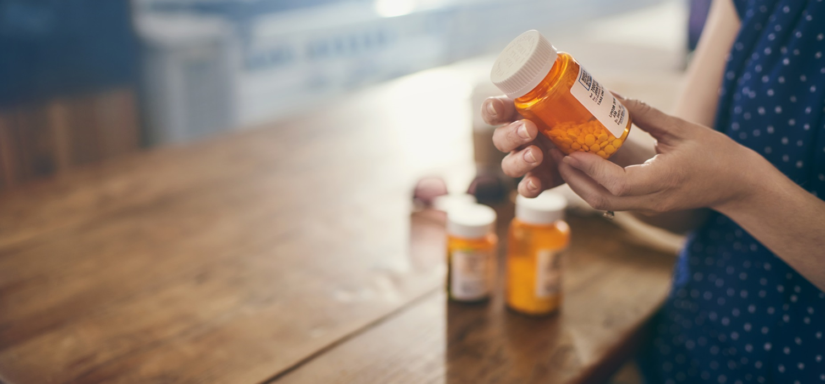
Refocusing the conversation on pharmaceutical affordability
Matt Perlberg
Senior Vice President, Supply Chain
Express Scripts
July 27, 2021

Slide 2
~90
of total Medicare pharmacy claims are for generic medicines

Slide 3
Many Categories Have High List Prices

Slide 4
 | Without Rebate | With 20% Rebate
List Price | $100,000 | $100,000
After Rebate | $100,000 | $80,000
5% Beneficiary OOP | $5,000 | $4,000
$4,000 is better than $5,000, but it is still not affordable for beneficiaries

Slide 5
How We Can Meaningfully and Effectively Lower Costs
Biosimilars and generics
Ending patent abuse and pay for delay
Value-based programs
Flexible formulary design
Benefit designs that limit patient OOP exposure

