Slide 1
Comments on “Sizing up corporate restructuring in the COVID crisis” Robin Greenwood, Ben Iverson, David Thesmar
Discussant: Edith Hotchkiss, Boston College
Brookings Papers on Economic Activity
24th September 2020

Slide 2
Overall strategy & summary:
How widespread is financial distress due to the Covid shock?
default rate and filing predictions indicate a “surge” is likely to come
impacts both small businesses and large corporations
What happens in distress? Will this differ in the current crisis?
firms are more likely to be inefficiently liquidated, especially small firms
costs of distress are large; who bears them varies with firm size
Many policy proposals – guided by the source of inefficiency in restructurings
encourage out of court solutions (smaller firms)
reduce costs of resolution in court (bankruptcy)
only some involve government support

Slide 3
1. Sizing up the problem: Evaluating the evidence
Where we are:
Large increase in large corporate bankruptcy filings
many are in already distressed industries (retail, energy)
Large impact on small business (Census – Pulse survey)
small business often do not use the bankruptcy process
Where are we headed:
Change (vs historical) in revenues & earnings, and analyst forecast
revisions show a large shock, but less dispersion than 2009
Bond/loan default forecasters still expect a large increase
*Business bankruptcy filings are forecast to increase based on
expected unemployment

Slide 4
1. Sizing up the problem: Industry level evidence
Already distressed industries – risk of exacerbating excessive continuation
# Chapter 11 filings*
# Chapter 11 filings
Implications for this paper:
Impact of Covid (comparing 2020Q2 to 2019Q2): Revenues/earnings may already be projected to decline These industries span both large and small businesses
* Source: New Generation Research

Slide 5
1. Sizing up the problem: Default prediction
Forecasts of bond/loan defaults
expect 5-6% default rate (300% increase) in large firm defaults 2020H2
based on the universe of rated (larger) firms
realized defaults may be lower if credit markets remain “easy”
ex: Moody’s Feb ‘09 HY default forecast 16.4%; realized defaults were < 12%
“implied” default rates may be low, based on current credit spreads
** Forecasts of business bankruptcies
including some smaller firms, based on expected unemployment
expect 140% increase in total bankruptcies, number is driven by small firms
depends on continued (?) government support & time until recovery (?)
aggregate costs are undoubtedly large (even if missing smallest firms);
would like to see estimates for size groups

Slide 6
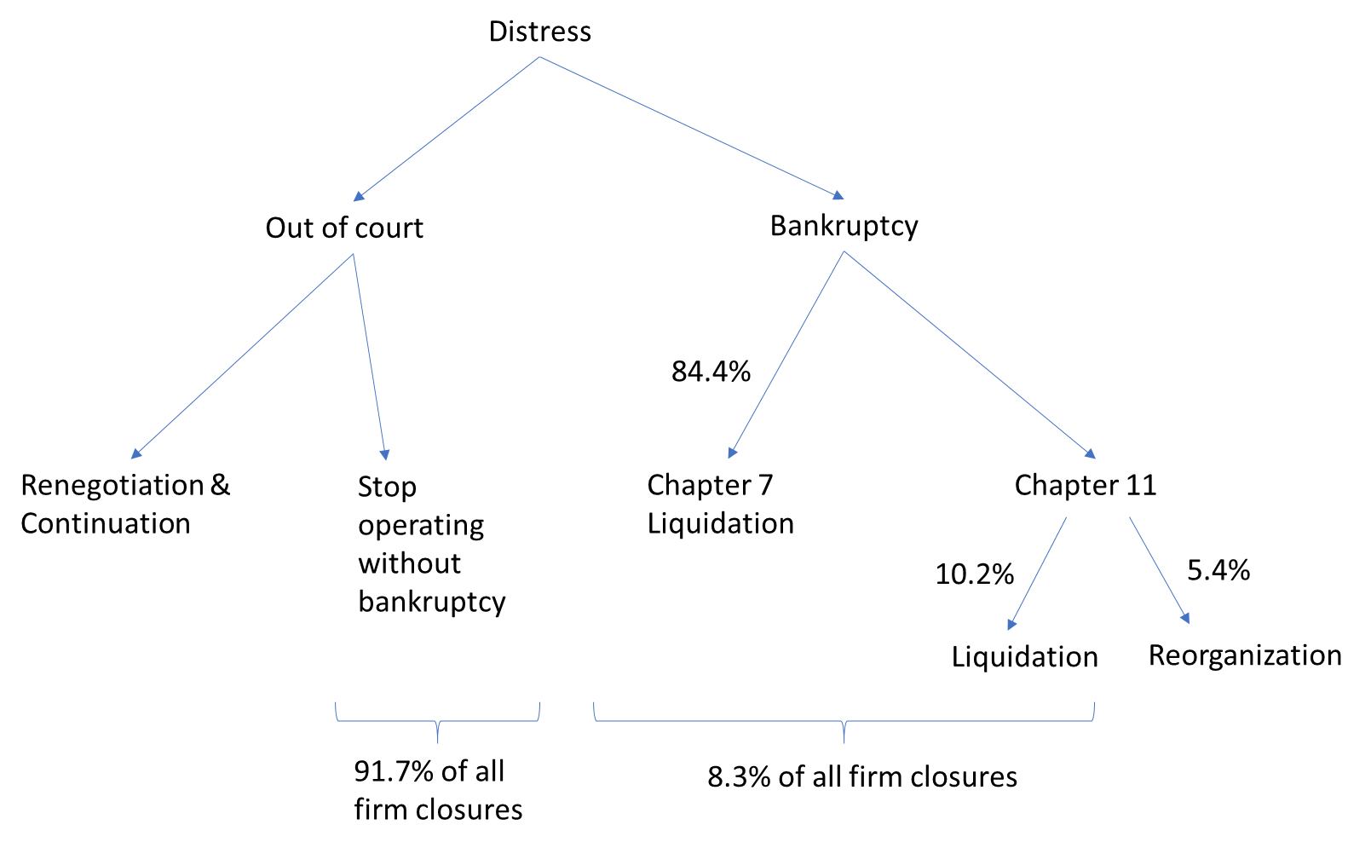
2. Restructuring outcomes: evidence
System needs to balance excessive “dismemberment” vs excessive continuation
Evidence from large Chapter 11 cases: trend towards sales in bankruptcy
Large Chapter 11 case outcomes (Gilson, Hotchkiss, Osborn, 2016):
10.9%
67.7%
10.9%
Sales of going concern
Notes:
Our M&A results, Liquidation vs redeployed?
Strengthens the large vs small firm gap

Slide 7

2. Restructuring outcomes: time in bankruptcy
Market trends/innovations include:
prepackaged or prenegotiated bankruptcy
restructuring support agreements (RSA)
increasing sales of all assets as a going concern
Median Days to Confirmation, by Petition Year* :
2000: 457
2005: 363
2010: 206
2015: 218
2017: 184
2019: 130
2020: 103
Short-Order Reorganization: Sungard’s 24-hour Bankruptcy Case
* Source: New Generation Research

Slide 8
2. Restructuring outcomes: Capital availability
Restructuring requires capital
out of court (recapitalize firms)
record levels of (gross) debt issuance March-June 2020 (Hotchkiss, Nini, Smith, 2020)
in bankruptcy (DIP financing, exit financing)
capital appears available for DIP financing; most small firms don’t obtain DIP loans or do so from bank
Private equity (PEs) as stabilizers (because they can provide capital; “dry powder” estimates)
Hotchkiss, Smith, Strömberg (2016); Bernstein, Lerner, Mezanotti (2018); Ma, Johnston-Ross, Puri (2020)
currently investing in distressed debt, equity (PIPEs)
But, problem again is smaller firms –
bank balance sheets are ok, but will banks continue to lend to distressed SMEs?
availability of non-bank financing?

Slide 9
3. Potential Policy Responses
What is the source of frictions/inefficiencies and who bears the costs (deadweight costs of restructuring; costs of excessive liquidation/reorganization; potential spillover effects) ?
large fixed costs
inability to renegotiate (holdouts, complexities in capital structure) or bring in new capital (debt overhang)
Search costs and financing frictions in asset redeployment
Which are exacerbated by the crisis? Excessive liquidation is more likely in crisis?
Proposals guided by the source of inefficiency, focus on smaller firms:
Lower costs of in court restructurings (fixed costs)
target smaller firms (SBRA, lowered size threshold); extend deadlines
required expertise of specialized lenders, other investors, advisors (govt prepaks)?
add court resources (maybe)
PPP to Chapter 11 firms
Encourage out of court restructuring (simplify renegotiation -> less excessive liquidation)
moratoria, payment deferrals, tax credits to lenders/landlords
capital availability (subsidizing loans/direct grants)

