Slide 1
Sizing up restructuring in the covid crisis
Robin Greenwood, Ben Iverson, and David Thesmar
September 2020

Slide 2
The impact of covid-19 on US businesses
Enormous macro shock: on par with GFC
But, pace of bankruptcy filings, particularly among small firms, has been low
Among large firms, bankruptcy filings have been mostly among industries that were struggling pre-COVID-19
This paper: What happens next?

Slide 3
Analysis in three steps
How large is the COVID shock for US businesses and where did it hit?
Industries, comparison with 2009
Long vs. short run forecasts
Small vs large firms
Forecasting defaults and bankruptcy filings
The triage process of financial distress
~400,000 establishments fail each year. What happens when businesses fail?
Continuation, voluntary exit, Liquidation, reorganization
what prevents efficient triage: permanent shock, court congestion, small firm frictions, outside funding
Policy
Keep firms alive
Avoid court system for failing firms
Improve the bankruptcy process itself

Slide 4
Part I: assessing the damage

Slide 5
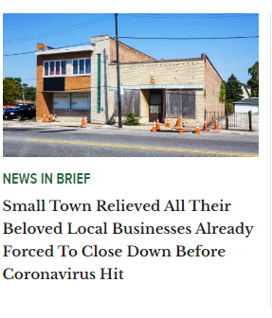
Bankruptcies: news headlines
Hertz ($24 billion)
Latam Airlines ($18 billion)
Frontier Communications ($21 billion)
Intelsat ($16 billion)
McDermott ($10 billion)
JC Penney ($ 7 billion)
Chesapeake Energy ($9 billion)
Neiman Marcus ($7 billion)
Diamond Offshore Drilling ($2.6 billion)
Other notable
Jos. A Bank, Lucky Brand Jeans, Lane Bryant, Pier 1, Le Pain Quotidien, Dean and Deluca, Chuck E. Cheese, Dollar Thirty, Century 21, California Pizza Kitchen, Brooks Brothers, J Crew, Lord and Taylor, Sur La Table

Slide 6
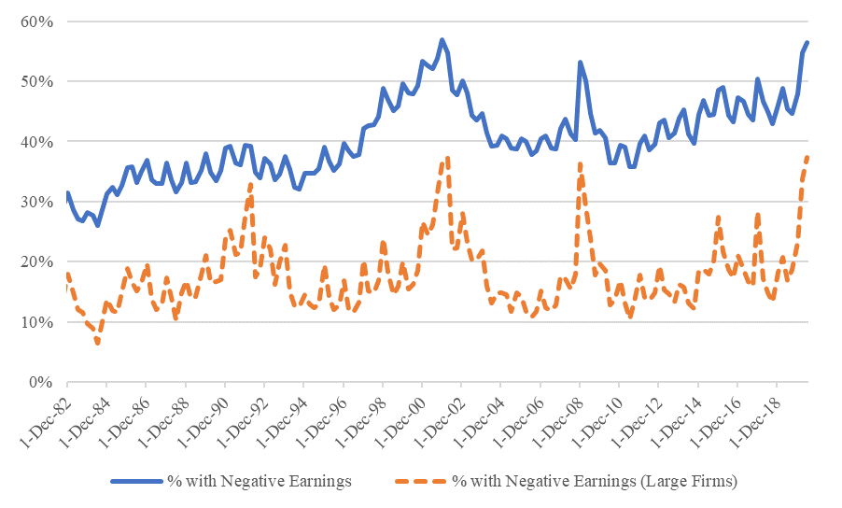
Publicly listed firms: Big jump in % of firms with Earnings<0, but not worse than 2009
Most impacted public
businesses:
Restaurants, Hotels
Entertainment
Energy
Transportation
Source: Compustat

Slide 7
Forecasts by industry: more benign than in 2009
 | % Growth in Expected Earnings between Jun 2008 and Mar 2009 |  | % Growth in Expected Earnings between Feb 2020 and May 2020
Forecast horizon: | FY 2009 | FY 2011 | FY 2020 | FY 2022
Revision of industry forecasts:
Communication | -50 | -35 | -19 | -13
Consumer Discretionary | -75 | -47 | -25 | -17
Consumer Staples | -13 | -15 | -10 | -7
Energy | -40 | -24 | -19 | -20
Financials | -16 | -21 | -25 | -13
Health Care | -18 | -31 | -15 | -5
Industrials | -37 | -32 | -24 | -15
IT | -44 | -19 | -12 | -9
Materials | -47 | -28 | -19 | -9
Real Estate | -71 | -32 | -33 | -7
Utilities | -17 | -13 | -03 | 0
Aggregate Statistics:
Mean: | -39 | -27 | -19 | -10
Cross-sectional dispersion: | 22 | 10 | 8 | 6
→ Bottom line: it’s a big shock for large firms, concentrated on few firms / industries
but overall, not worse than 2009 (as far as we can tell)
➔ let us now discuss smaller businesses

Slide 8
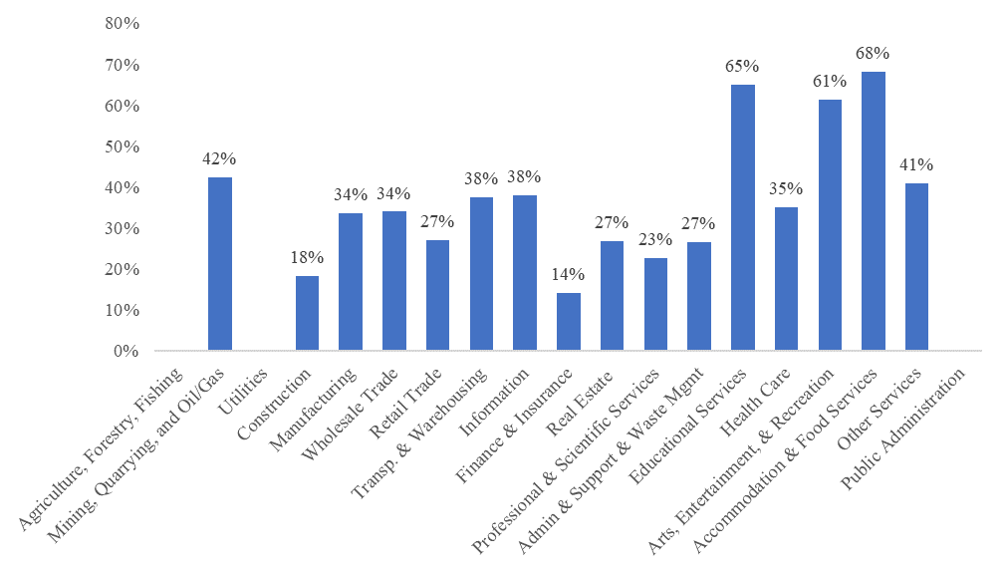
% of small businesses in a sector reporting severe impact of pandemic on business
Most impacted small
businesses:
Restaurants, Hotels
Movies, Parks
Education (!)
Energy
Transportation
Source: Census (Pulse survey)

Slide 9
Effect of COVID on small firm leverage: Simulation
Aggregate data from IRS balance sheets on small business
Exercise à la Crouzet-Gourio (2020): mechanical effect of sales shock on small business leverage
 | Firm Assets:
 | 0.5-$1 M | <$5 M | <$10 M | <$25 M | <$50 M | <$100 M
E ($ billions) | 264 | 881 | 497 | 755 | 667 | 828
A ($ billions) | 78 | 305 | 183 | 304 | 250 | 366
E/A | 30% | 35% | 37% | 40% | 37% | 44%
Revenues/A | 252% | 208% | 194% | 181% | 140% | 106%
COGS/Revenues | 51% | 59% | 66% | 70% | 69% | 67%
Other Expenses/Revenues | 45% | 37% | 31% | 27% | 28% | 30%
D/A | 70% | 65% | 63% | 60% | 63% | 56%
Forecasts After 30% Revenue Drop:
D/A (After) | 97% | 84% | 77% | 71% | 72% | 63%
∆ [D/A] (After – Before) | +27% | +19% | +14% | +11% | +9% | +7%
→ Bottom line: small firms especially hard-hit

Slide 10
Forecasting financial distress and bankruptcy
Approach 1:
Forecast Corporate Bond Defaults
Approach 2:
Forecast Business Bankruptcies
Following Ma (2020) and Altman (2020)
Use historical transitions between different credit ratings categories to forecast transition probability as a function of economic conditions
Use forecast economic conditions to get fitted values
Large increase in defaults compared to where we are
Correlate business bankruptcies (Chapter 7 and Chapter 11 filings) with economic conditions
Use current unemployment rate or future expected unemployment to forecast bankruptcy filings

Slide 11
Forecasting Defaults: +300% in 2020H2
Following Ma (2020)
Altman (2020) has similar estimates
Estimate time series regressions to forecast probability of a downgrade from a ratings class to a lower one
Predictors: GDP growth, unemployment rate
R-squared 0.05 – 0.13
4,476 issuers at start of 2020
As of June 2020
1.4% have defaulted
3.4% have withdrawn rating
➔ Forecasts
Based on forecasts of unemployment rate and GDP growth from SPF
6.3% will default, i.e., an additional 4.9%
15.5% will withdraw rating

Slide 12
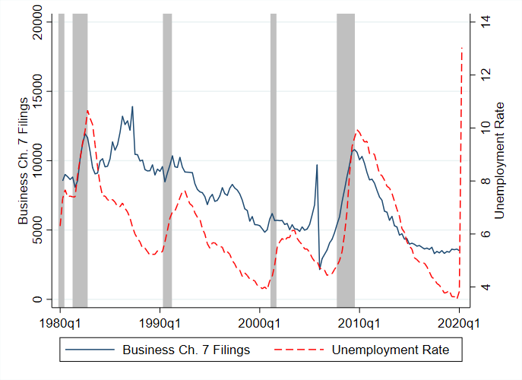
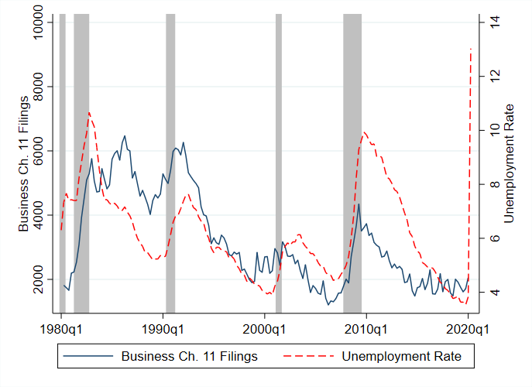
Forecasting business bankruptcies: +140% relative to 2019
Ch 7 filing = liquidation ≈ small firms
Ch 11 filing ≈ large firms
➔ Aggregate bankruptcy count = mostly small firms

Slide 13
Summary of Part I
The short-run impact on firm balance sheets is:
Large but similar to 2009 for larger, publicly held firms
Bigger, more concentrated, for smaller firms.
More toxic effect on small firms’ leverage (fixed costs)
“calm before the storm”
Expect +300% increase in large firm defaults in 2020H2
Expect +140% increase in total bankruptcies in 2020
Mostly small firms

Slide 14
Part II: The triage process of financial distress

Slide 15
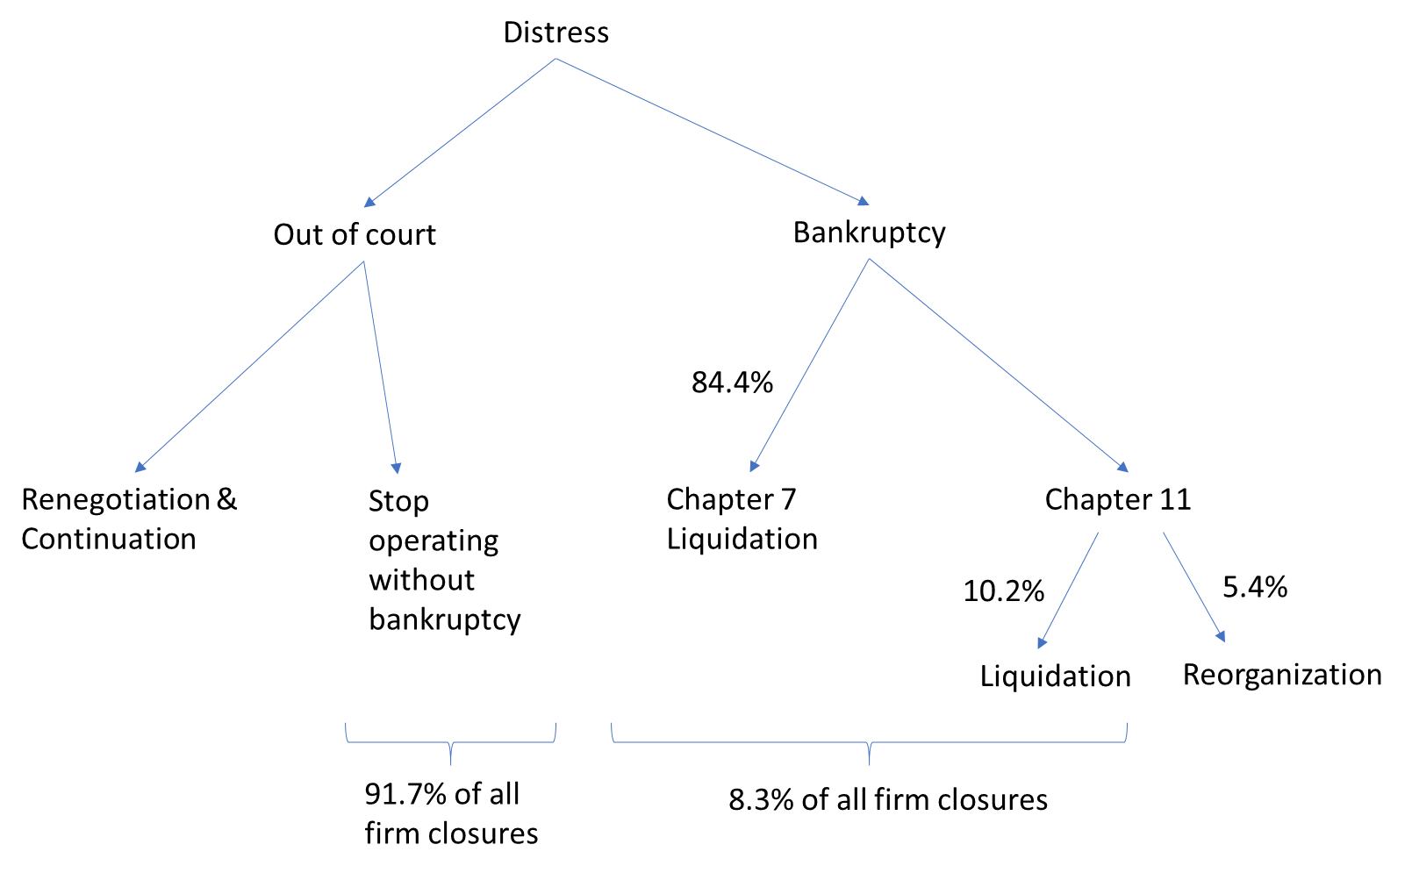
What happens to firms in distress?
~400,000 establishments close every year

Slide 16
Baseline macro estimates of costs of financial distress
Costs of financial distress = value destroyed when firms have problems paying their debts:
Customer attrition and brand value
Suppliers and trade credit
Access to talent
More expensive financing
Debt overhang / underinvestment
Aggregate costs of financial distress in 2020/2021 ≈ 1% GDP
Forecast 15,638 Chapter 11 bankruptcies and 37,374 Chapter 7 bankruptcies
This yields ~$1 trillion of liabilities going into Chapter 11 and $172 billion entering Chapter 7
Costs of financial distress = 10-23% of enterprise value (Andrade and Kaplan, 1998)
Using 16.5%, baseline costs of financial distress approximately $200 billion, about 1% of GDP
Likely a lower bound
Ignores effect on employees, suppliers: for instance, job destructions due to excess liquidation ≈ 200,000
Lots of costs of financial distress occur outside of bankruptcy

Slide 17
What happens to firms in distress?
“Triage”

Slide 18
Four sets of concerns about the triage
“TRIAGE” = sorting firms into liquidation vs restructuring
Is COVID-19 shock temporary or structural?
Temporary -> Continuation
Structural -> Liquidation
Judges will be overwhelmed by wave of financial distress
May make it more likely to liquidate viable firms
Crisis disproportionately impacts smaller firms which are harder to continue
Large fraction of the continuation value of the business is not pledgable (e.g., entrepreneurial know-how, etc)
Critical outside funding may be lacking in a crisis
During Chapter 11, firms typically need “DIP” financing
When reemerging. Firms need fresh fund, often equity

Slide 19
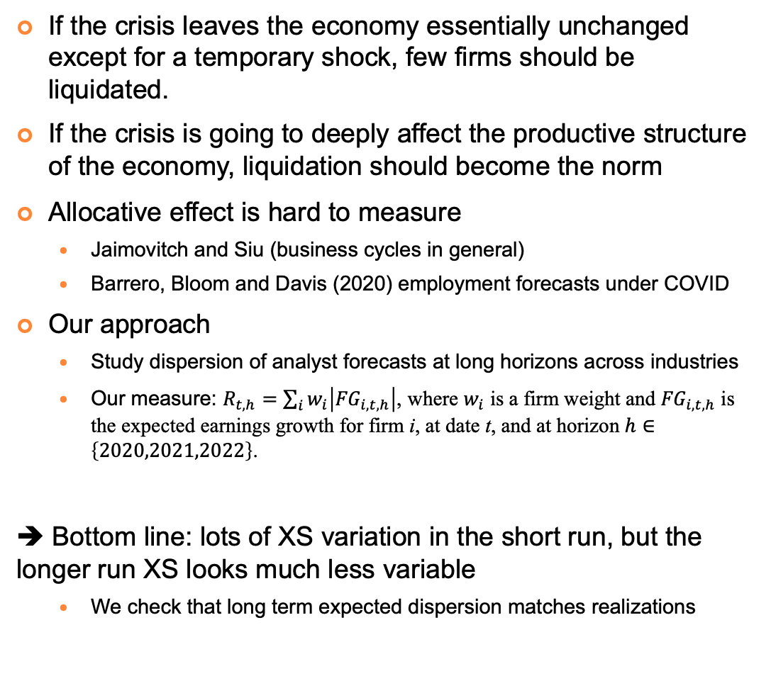
How much reallocation?
Forecast dispersion for 2022
has come down!
If the crisis leaves the economy essentially unchanged except for a temporary shock, few firms should be liquidated.
If the crisis is going to deeply affect the productive structure of the economy, liquidation should become the norm
Allocative effect is hard to measure
Jaimovitch and Siu (business cycles in general)
Barrero, Bloom and Davis (2020) employment forecasts under COVID
Our approach
Study dispersion of analyst forecasts at long horizons across industries
Our measure: $R_{t,h}=\sum_{i}{w_{i}\left|{FG}_{i,t,h}\right|}$, where $w_{i}$ is a firm weight and ${FG}_{i,t,h}$ is the expected earnings growth for firm i, at date t, and at horizon $h∈\left\{2020,2021,2022\right\}$.
➔ Bottom line: lots of XS variation in the short run, but the longer run XS looks much less variable
We check that long term expected dispersion matches realizations

Slide 20
Liquidation vs Reorganization and Firm size
For < $100M firms, bankruptcy → liquidation

Slide 21
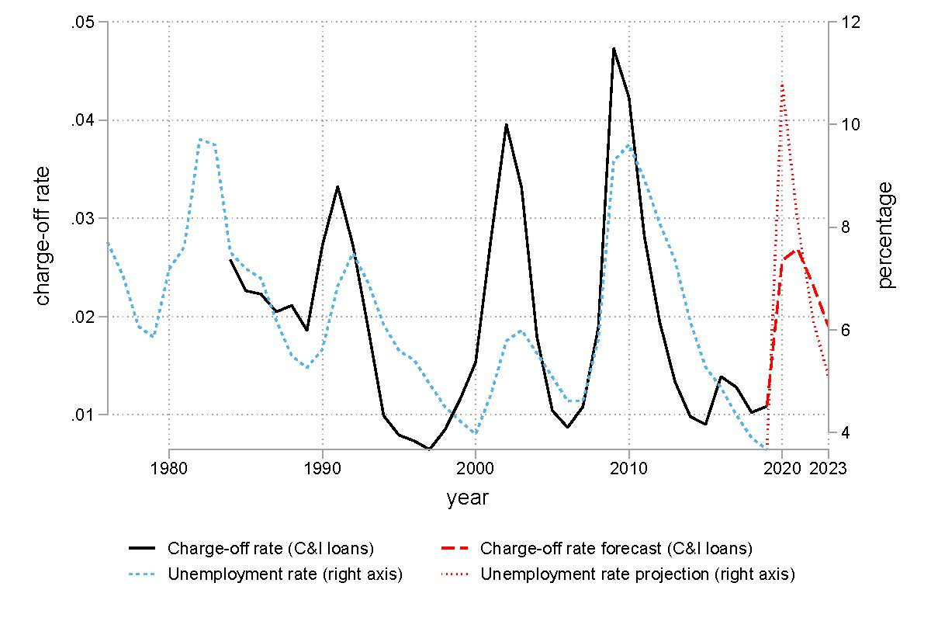
How strong are the banks?
C&I chargeoff rates are strongly correlated with unemployment
Can use current unemployment to forecast what might happen to bank balance sheets
Lots of caveats to this analysis
Table 3: Reasonable forecasts of chargeoffs of SME loans~0.2% of equity for large banks, larger effect for small banks
➔ SME defaults will not impact banks very much

Slide 22
Part III: Policy

Slide 23
Policy 1: Keep firms Alive?
Policy | Friction Addressed | Instruments
Hanson, Stein, Sunderam and Zwick (2020) | Financial constraints Input reallocation frictions | Grants to cover fixed obligations only (rents, utility bills)
Saez and Zucman (2020) | All reallocation frictions | Grants to cover all firm expenses

Slide 24
Policy 2: Avoid bankruptcy
Policy | Friction Addressed | Instruments
Payment deferral schemes | Financing constraints, Credit supply shock | Moratoria/Forbearance (no accrued interest) Payment deferrals (accrued interest) State guarantees of payment deferrals by banks Voluntary vs mandatory participation SME targeting
Brunnermeier and Krishnamurthy (2020) | Financing constraints Credit Supply shock | Fed to set up a SME loan refinancing facility at subsidized rates Regulators to actively encourage evergreening loans
Greenwood and Thesmar (2020) | Debt overhang Lack of out-of-court negotiation | Tax credit to haircut-consenting claimants

Slide 25
Moratoria & Payment deferrals
Many historical examples: French landlords did not receive rent from occupants by decree during WWI
Recently, eviction moratoria in many US states and cities
In mid-April, G20 suspended debt payments for many developing countries
Currently payment deferral programs implemented in Australia, Hong-Kong, Italy, Singapore and South Africa.
Cost of the program is that they inflict pain on lenders, primarily banks
But also taxpayers who sometimes offer government guarantees (Italy)
But our earlier evidence suggests not much to be worried about regarding US banks
SME loans ≈ 38% of banks equity → a 50% haircut across the board = 19% of equity

Slide 26
Greenwood-Thesmar (2020)
One-size fits all approach for small business, (slightly) subsidized by the government
Suppose you have a restaurant who owes a landlord $10,000
Voluntary agreement signed by both landlord and debtor
Landlord gives up claim to rent: $10,000 debt relief
Debtor continues to operate:
Landlord receives a tax credit for (a fraction of) the forgiven rent (say, $2,000)
Shares the costs of restructuring between taxpayers and lenders or landlords
Recognizes the unique position of the government to implement a form of debt-for-equity type swap
Government is a shareholder in all taxed businesses
Tax relief (“haircut”) vs greater corporate taxes from reduction in costs of financial distress (“equity”)

Slide 27
Policy 3: Improve Bankruptcy Process
Policy | Friction Addressed | Instruments
Iverson, Ellias, and Roe (2020) | Bankruptcy court congestion | Recall retired judges Create new temporary posts
Skeel (2020) | Fixed cost of restructuring | Create a standard “prepacked” restructuring process
Subchapter V of Chapter 11 (already enacted as part of SBRA) | Fixed cost of restructuring | Expedited procedure to restructure small firms No need for a creditor vote, easy to cram down
Blanchard, Philippon and Pisani (2020) | Wedge between private and social value of restructuring in bankruptcy | Government takes higher haircut than other creditors
DeMarzo, Krishnamurthy and Rauh (2020) | Undersupply of DIP funding | Government to set up a DIP funding SPV, with equity from the treasury and Fed backing, to lend senior at Fed discount rate (0%).
Bankruptcy and COVID-19 Working Group | Uncertainty of viability of bankrupt firms | Extend deadlines for all small businesses that enter Chapter 11 by six months.

Slide 28
Judges
Iverson, Ellias, and Roe (2020)
349 bankruptcy judges in the US
only 50-246 temporary judges could be needed to ensure that workload per judge does not increase beyond where it was in 2010
Bankruptcy caseloads are expected to vary substantially across districts, so some reshuffling might make sense
Subchapter V
All businesses with less than $7.5m of liabilities can file under the new Subchapter V
Intuition: wiping out owner’s equity destroys value: entrepreneur is critical to going concern value of the firm
De facto, inside equity should be senior to debt to preserve incentive compatibility
Not widely used yet (only 576 filings in the spring), so much TBD

Slide 29
Thank you!
We look forward to the discussion

Slide 30
Extra slides

Slide 31
Policy
Policy | Friction Addressed | Instruments
Hanson, Stein, Sunderam and Zwick (2020) | Financial constraints Input reallocation frictions | Grants to cover fixed obligations only (rents, utility bills)
Saez and Zucman (2020) | All reallocation frictions | Grants to cover all firm expenses
Payment deferral schemes | Financing constraints, Credit supply shock | Moratoria/Forbearance (no accrued interest) Payment deferrals (accrued interest) State guarantees of payment deferrals by banks Voluntary vs mandatory participation SME targeting
Brunnermeier and Krishnamurthy (2020) | Financing constraints Credit Supply shock | Fed to set up a SME loan refinancing facility at subsidized rates Regulators to actively encourage evergreening loans
Greenwood and Thesmar (2020) | Debt overhang Lack of out-of-court negotiation | Tax credit to haircut-consenting claimants
Iverson, Ellias, and Roe (2020) | Bankruptcy court congestion | Recall retired judges Create new temporary posts
Skeel (2020) | Fixed cost of restructuring | Create a standard “prepacked” restructuring process
Subchapter V of Chapter 11 (already enacted as part of SBRA) | Fixed cost of restructuring | Expedited procedure to restructure small firms No need for a creditor vote, easy to cram down
Blanchard, Philippon and Pisani (2020) | Wedge between private and social value of restructuring in bankruptcy | Government takes higher haircut than other creditors
DeMarzo, Krishnamurthy and Rauh (2020) | Undersupply of DIP funding | Government to set up a DIP funding SPV, with equity from the treasury and Fed backing, to lend senior at Fed discount rate (0%).
Bankruptcy and COVID-19 Working Group | Uncertainty of viability of bankrupt firms | Extend deadlines for all small businesses that enter Chapter 11 by six months.
Keep firms alive
Avoid bankruptcy
Improve bankruptcy process

Slide 32
Bankruptcies by firm size
Size Bucket | Coefficient on Unemployment Rate | Forecasted bankruptcies @ 9.2% unemployment
$0 - $50K | 23.863*** | 3,155
$50K - $100K | 23.948*** | 2,898
$100K - $500K | 205.341*** | 21,166
$500K - $1M | 196.739*** | 17,326
$1M - $10M | 460.237*** | 37,780
$10M - $50M | 77.112*** | 6,283
$50M - $100M | 10.267*** | 1,027
$100M - $500M | 6.929 | 1,120
$500M - $1B | -2.754 | 189
$1B+ | 2.401 | 310

