Slide 1
Has the Paycheck PROGRAM SUCCEEDED?
Glenn Hubbard
Columbia University
and NBER
Michael Strain
American Enterprise Institute and IZA
Presentation
Brookings Panel on Economic Activity
September 24, 2020

Slide 2
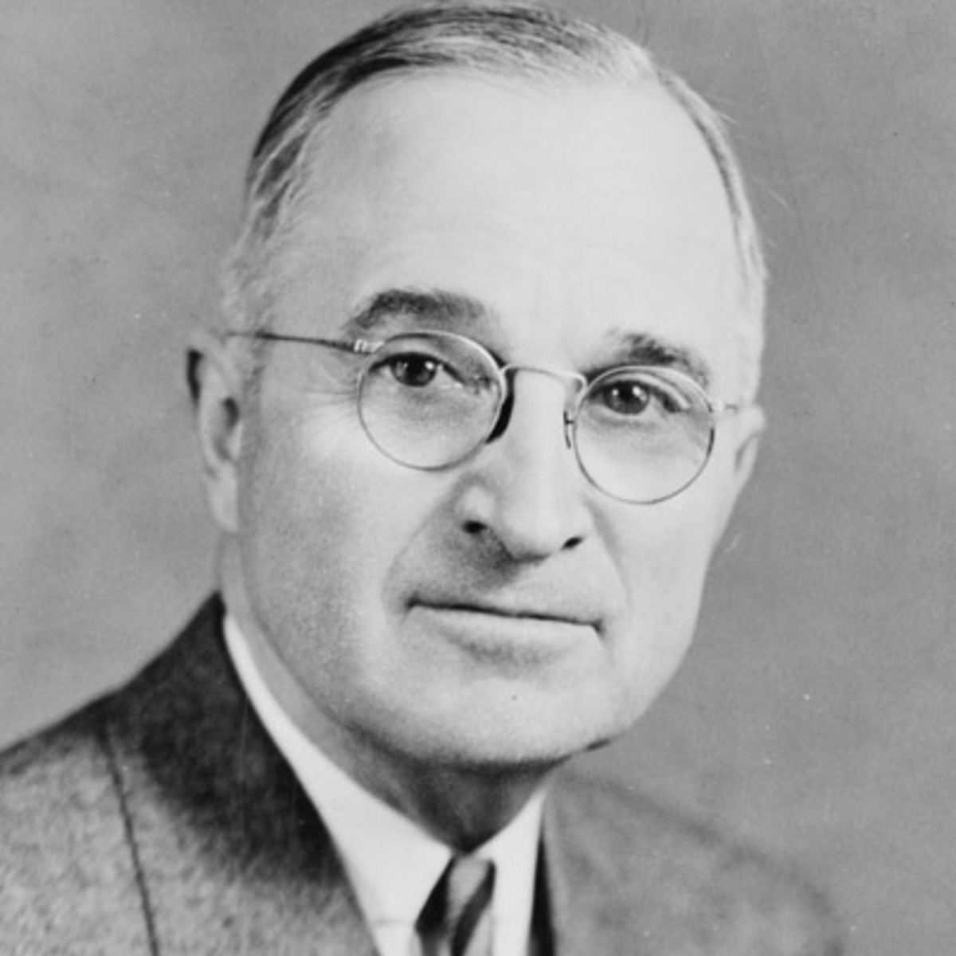
PPP — Bold to Consider
Severe downturn with destructive characteristics
Heightened vulnerability of small and mid-size firms
Large investment for evaluation
Has the PPP Succeeded?
We find success, but can’t judge definitively.

Slide 3
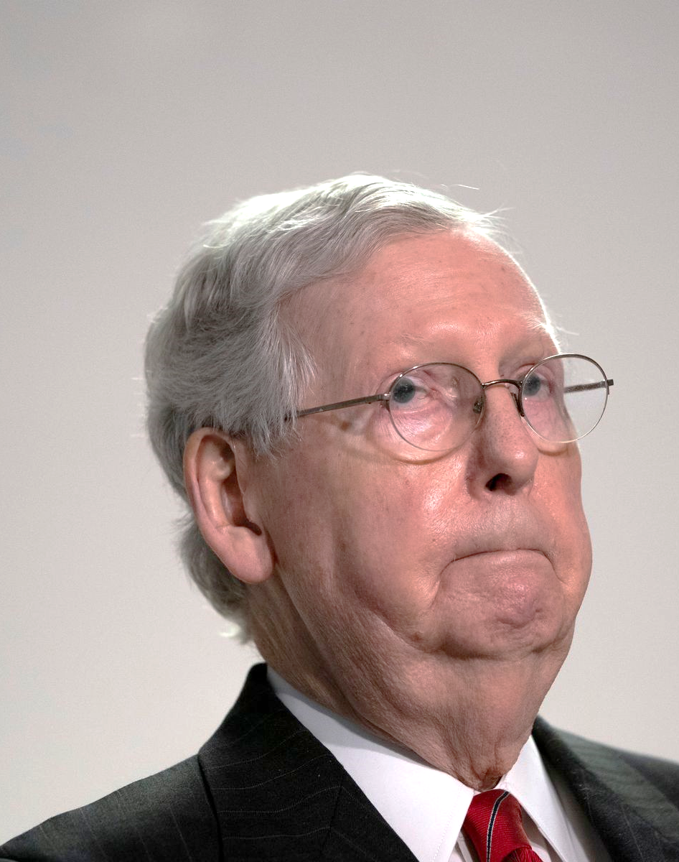
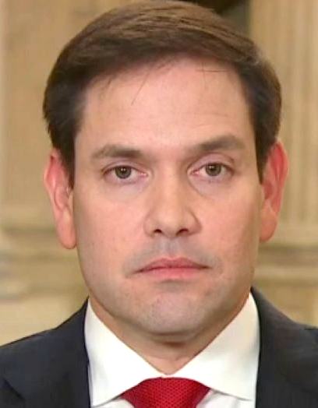
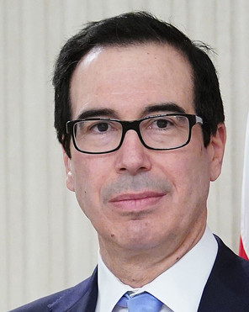
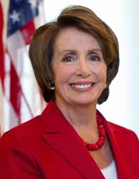
PPP — Difficult to Evaluate
Goals and tensions?
Design challenges and measurement?
Implementation challenges?
We’ve got this.
Definition of ‘success’?

Slide 4

Empirical Approach
Evaluate effects of PPP on employment, financial health (Paydex), and continuity of small businesses
Identify business in D&B data (matched with loan applications from SBA) that applied for PPP loans > $150,000
Estimate difference-in-difference models of effect of PPP application/eligibility based on size (using several treatment-control groups)
U.S. Grant, Abraham Lincoln, and
our RA used the data.
Away we go…

Slide 5
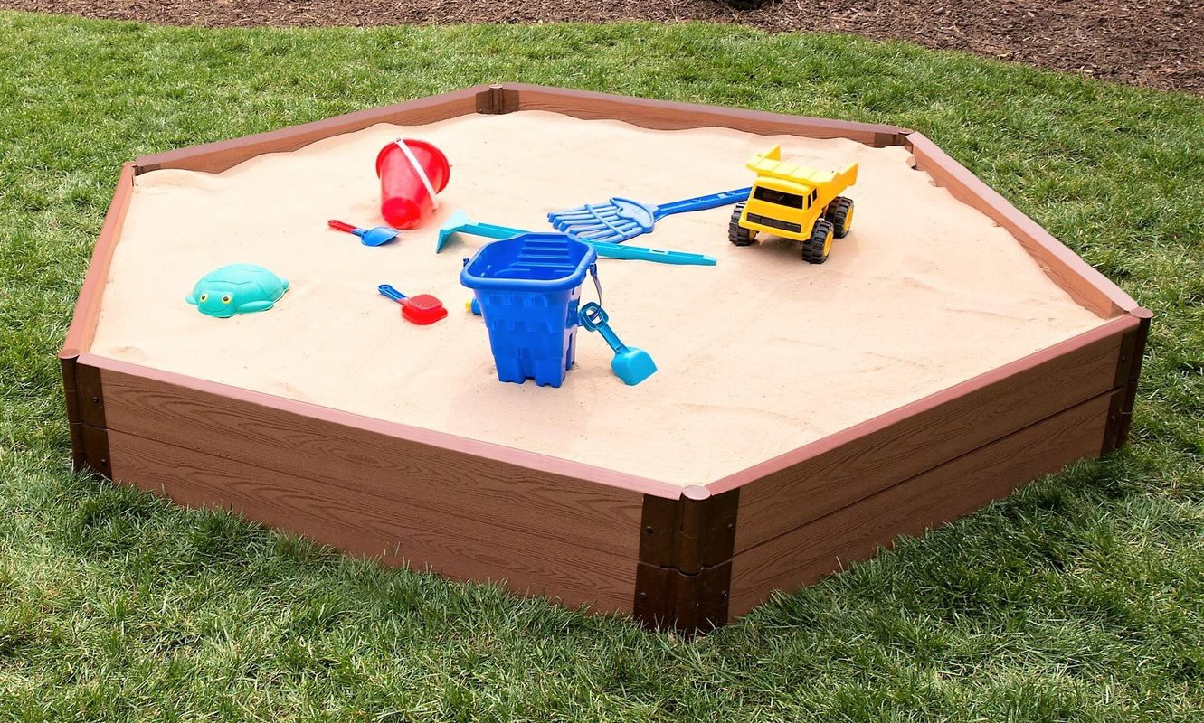
Estimation Strategy
${Outcome}_{im}$= $α$ + $β {(PPP}_{ia}$ X ${Post}_{im}$) + $∂{PPP}_{ia}$ + $δ_{sm }\text{+} δ_{jm }$ + $∈_{im }$
Applied for
loan > $150,000 in Q2
Applied
for
loan > $150,000
State-by-month
Industry-by-month
?
Observations!

Slide 6
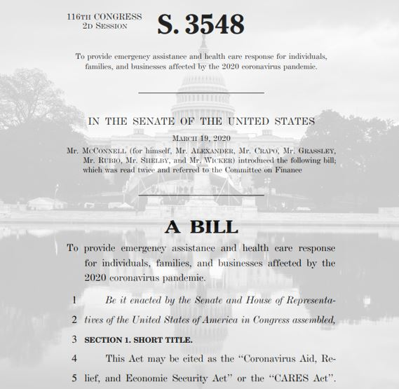
Separating ‘Demand for PPP’ from ‘PPP Itself,’ and Accounting for Firms that Received Loans Smaller Than $150K
${Outcome}_{im}$= $α$ + $β {(PPP}_{ie}$ X ${Post}_{im}$) + $∂{PPP}_{ie}$ + $δ_{sm }\text{+} δ_{jm }$ + $∈_{im }$
Eligible
based
on
size
Intent to treat

Slide 7

Results
Employment (Table 4). Treatment-on-treated (Column 4) : + 1.07%. Intent-to-treat (Column 6): + 0.51%
Average establishment employment fell by 0.6% between Jan. and June for firms with 1 to 1,000 employees. The effect is stronger in June than in March or April (see next slide).
Significant effects on Paydex (Table 5) and business continuity (Table 6)
Where to look?
Results point to significant role of PPP
in health/viability of small firms.

Slide 8
Dynamics

Slide 9
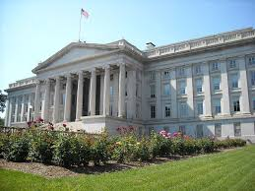
Lessons in General
Alternatives of UI or standard loans unlikely to be successful
More consideration of STC? Business interruption insurance?
Design of PPP and links to a better designed MSLF?
Where’s my thinking cap?
Thinking through alternatives in advance is useful…

Slide 10
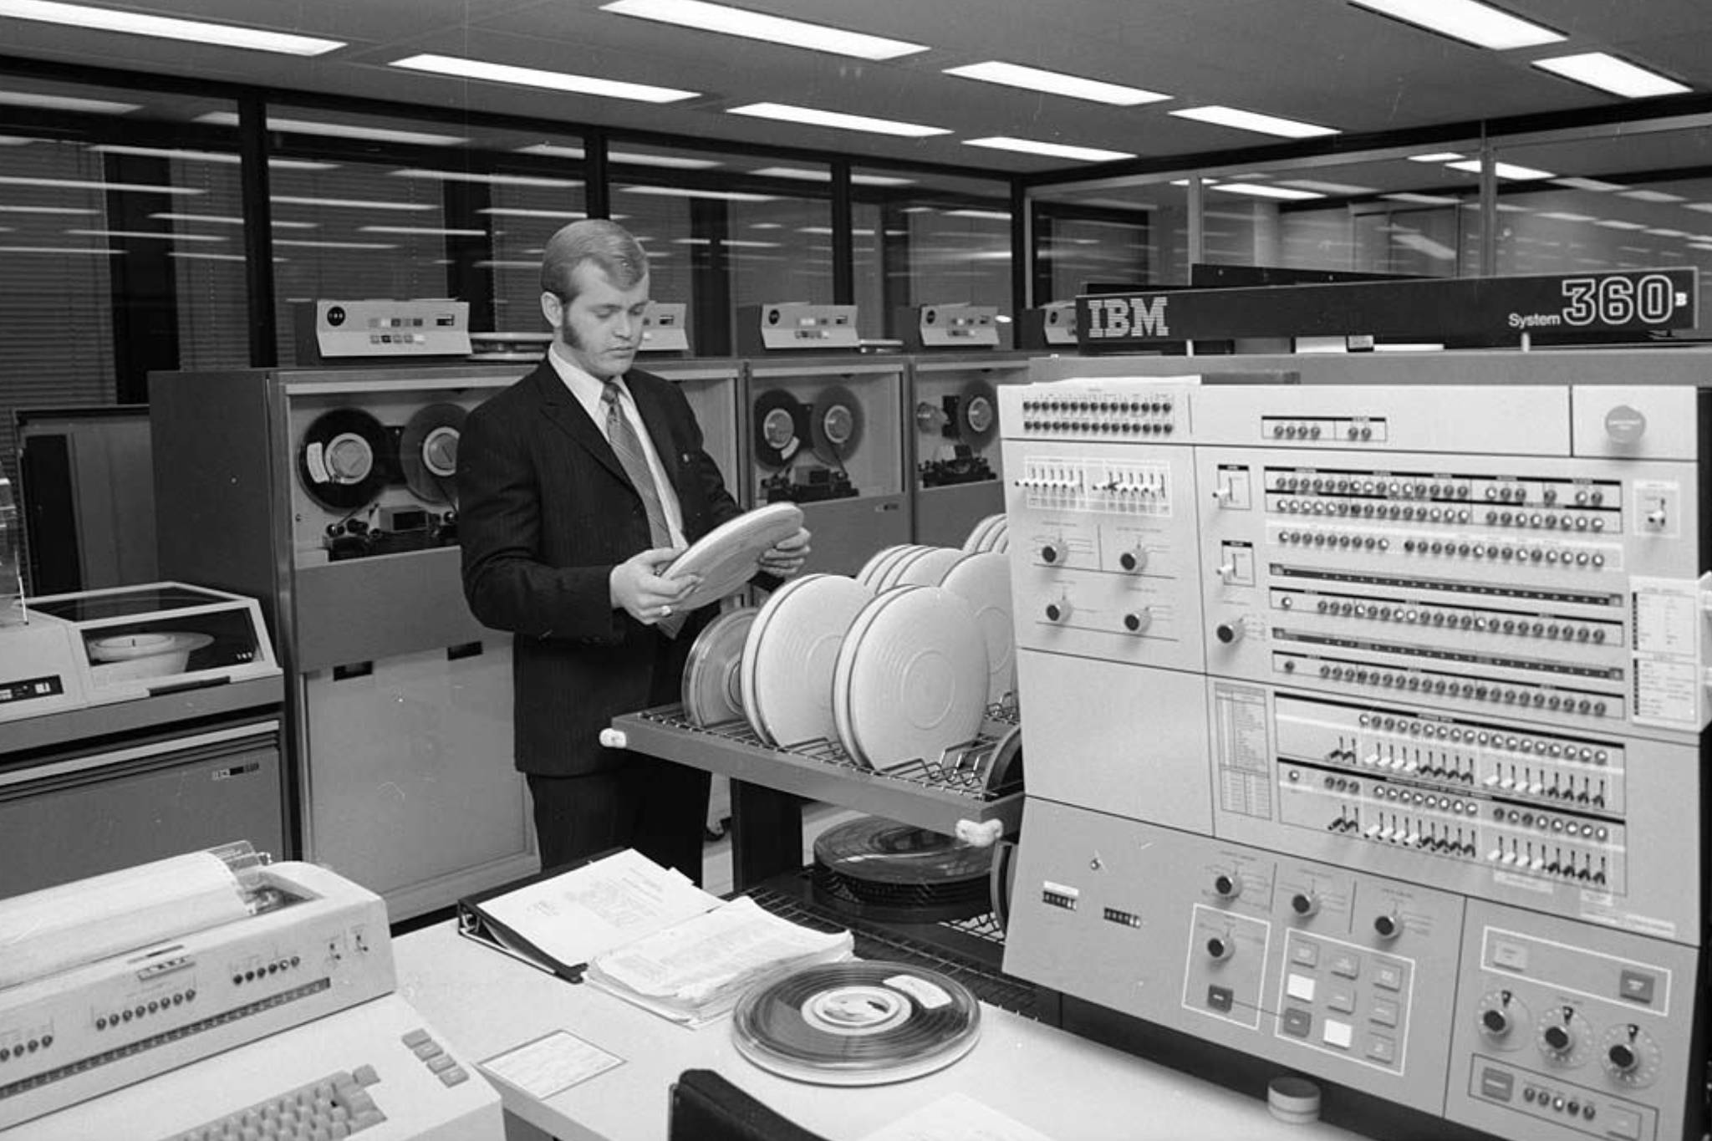
Lessons for Practice
Treasury and agency coordination!
Computer systems!
More research needed as economic situation evolves and more data become available!
Where do we put the
punch cards?
Same time next year…?

Slide 11
Has the PPP Succeeded?
Hubbard - Strain
“✓?”
Zhou Enlai
“Too early to say.”

