Slide 1
Fiscal Effects of COVID-19
Alan J. Auerbach, William Gale, Byron Lutz, Louise Sheiner
The views expressed here are solely those of the authors and should not be attributed to any other person or any organization, including the Board of Governors of the Federal Reserve.

Slide 2
Outline
What has COVID-19 shock done to the federal budget outlook over the next 10 and 30 years?
What is the short- and medium-term impact of the fiscal condition of state and local governments, in the aggregate and across states?

Slide 3
Federal Outlook: Basic Approach
Consider three “baselines” for fiscal policy
Pre-COVID “current law” baseline
Post-COVID “current law” baseline
Post-COVID “current policy” baseline
Comparing 2 to 1 gives an estimate of the impact of the COVID shock, including both direct effects and policy responses
Use CBO (January) vs. CBO (September) as starting points for for estimating these two baselines
For longer-term projections (2030-2050), make a series of small adjustments

Slide 4
Federal Outlook: Basic Approach
Consider three “baselines” for fiscal policy
Pre-COVID “current law” baseline
Post-COVID “current law” baseline
Post-COVID “current policy” baseline
Third baseline intended as a more realistic measure of where we actually are
Adjusts several assumptions where “current law” deviates from likely path (e.g., “temporary” provisions intended to be permanent)

Slide 5
Key Results
Short-run COVID fiscal shock is enormous, virtually all on the spending side
Non-interest spending up 11% of GDP in FY2020
Revenues down 0.5% of GDP in FY2020
Primary deficit >14% of GDP

Slide 6
Key Results
Short-run COVID fiscal shock is enormous, virtually all on the spending side
Non-interest spending up 11% of GDP in FY2020
Revenues down 0.5% of GDP in FY2020
Primary deficit >14% of GDP
Impact on primary deficits projected to dissipate quickly
By FY2022, an increase of only 2% of GDP

Slide 7
Key Results
Short-run COVID fiscal shock is enormous, virtually all on the spending side
Non-interest spending up 11% of GDP in FY2020
Revenues down 0.5% of GDP in FY2020
Primary deficit >14% of GDP
Impact on primary deficits projected to dissipate quickly
By FY2022, an increase of only 2% of GDP
Even so, debt-GDP ratio at all-time high (106%) by end of FY 2022 (vs. 84% pre-COVID estimate)

Slide 8
Key Results
Projected interest rates sharply lower for a time

Slide 10
Key Results
Projected interest rates sharply lower for a time
Over longer term, this mutes impact of higher primary deficits arising from structural imbalances
Debt-GDP ratio under current law now 190% in 2050, vs. 180% pre-COVID

Slide 11
Key Results
Projected interest rates sharply lower for a time
Over longer term, this mutes impact of higher primary deficits arising from structural imbalances
Debt-GDP ratio under current law now 190% in 2050, vs. 180% pre-COVID
Under current policy, debt accumulation is higher

Slide 14
Key Results
Projected interest rates sharply lower for a time
Over longer term, this mutes impact of higher primary deficits, arising from structural imbalances
Debt-GDP ratio under current law now 190% in 2050, vs. 180% pre-COVID
Under current policy, debt accumulation is higher
Projections may be pessimistic in some respects (e.g., don’t incorporate faster 2020 recovery), but also don’t include possibility of slower short-term growth (as in GFC) or upcoming policy changes, for which pressure is largely in one direction

Slide 15
Fiscal Outlook of the State and Local Sector
S&L balanced budget requirements → revenue losses offset by spending cuts or tax increases
These are a drag on the economy and also make it hard to provide essential services
Wide range of projected S&L revenue losses over next 2 years: from $130 b - $875 b
Estimates mostly from historical relationships between macro variables and tax collections.
However this recession very unusual:
Unemployment unusually concentrated among low-income workers
Taxable UI expansions and PPP
Very different consumption patterns
No stock market downturn

Slide 16
Our Approach
“Bottom up” approach for each category of taxes and fees.
We use data from Opportunity Insights (among other sources), which track, by state, consumption by category and employment by wage group (low, middle, high)
We extend data using CBO economic projections for degree of social distancing, unemployment, wages, and consumption.
For income taxes: we “shock” CPS data with unemployment and lower wages and capital income and feed through NBER’s Taxsim to calculate state tax liabilities.
For sales taxes and other taxes and fees, we use data on consumption declines to calculate revenue effects.
We also account for federal aid to state and local governments enacted to date.

Slide 17
Summary of Our Results for Nation as a Whole
Notes:
Income taxes small. Transportation $45.

Slide 18
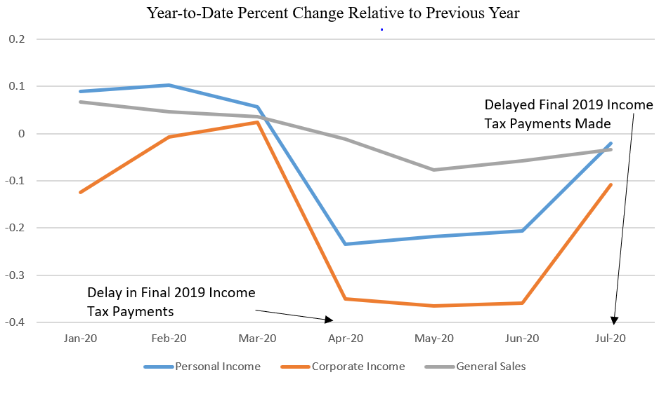
Recent Data on State Tax Collections this Year
Tax collections reflect data for 41 states accounting for 87 percent of national personal income tax and national sales tax collections and 83 percent of national corporate income tax collections.
Source:
Analysis is based on data provided by the Urban Institute available at: https://www.urban.org/policy-centers/cross-center-initiatives/state-and-local-finance-initiative/projects/state-tax-and-economic-review/data-subscriptions

Slide 19
Overall Revenue Losses Vary Across the States

Slide 20
As does Federal Aid

Slide 21
Measuring Fiscal Stress
Federal aid enacted to date covers revenue losses this year, but not next year or thereafter. Knowing this, states will likely cut back on spending.
Furthermore, aid much more generous relative to needs in smaller states, leaving some states facing shortfalls even without accounting for future years or spending needs.
From macroeconomic perspective, maintaining spending means sector not a drag on the economy.
But from a public service perspective, ability to maintain pre-COVID spending not the right metric for measuring fiscal stress.
If spending needs go up significantly—for public health, virtual schooling, etc., then states will still be under stress and have to cut necessary services.
State and local governments seeing fiscal stress in coming years without additional aid may not be willing to spend adequately. So can’t really measure spending needs by actual spending.

