Slide 1
Workshop on the Mining Sector Presentation to The Office of the Principal Accountant General (Audit), Bihar Part 2 Optimising Mineral Development in Bihar Brookings Institution India Center, New Delhi June 25, 2020
BROOKINGS INDIA
QUALITY. INDEPENDENCE. IMPACT

Slide 2
Contents
Mineral potential and opportunities in Bihar
Mineral value chain and entrepreneurial ecosystem
Prudent mineral exploration policy for India

Slide 3
Mineral Potential and Opportunities in Bihar

Slide 4
Geology of Bihar
About 10% of Bihar consists of hard rocks ranging from Archean to Mesozoic Age
About 30% area consists of hard rocks with shallow Gangetic Basin alluvial cover (max 500 m thickness)
About 60% area consists of thick Gangetic Basin alluvial cover (more than 500 m thickness)
Map by GSI

Slide 5
Mineral Potential of Bihar
Geology
Minerals
Chota Nagpur Gneissic Complex
Copper
Uranium
Gold - Silver
Platinum group (PGE)
REE – Hard rock
Lithium
Nb-Ta
Nickel chrome
Iron ore (magnetite)
Coloured gemstones
Graphite
Vanadium - Titanium
Lead Zinc
Mica
Feldspar
Talc – steatite
Granite
Marble
Vindhyans
Pyrite
Limestone
Phosphate
Dolomite
Gondwana
Coal
Tertiary
Potash
Salt
Bauxite
REE – Tertiary clay
Quaternary
Construction sand
Silica Sand
Tertiary / Quaternary
Heavy mineral sand
Construction Aggregates
China clay
Fire clay

Slide 6
Mineral Inventory of Bihar (IBM Data)
Source: Indian Bureau of Mines

Slide 7
Coal Resource of Bihar (IBM Data)

Slide 8
Mineral Resource in Bihar (GoB)
Mineral | Minerals Availability in India* | Minerals availability in Bihar*
Limestone | 75678.89 | 210.85
Pyrites | 98.79 | 53.41
Quartz | 2402.18 | 10.83
Silica sand | - | 5.25
Feldspar | 31.28 | 4.84
Quartzite | 305.07 | 3.02
Bauxite | 2462.43 | 1.5
China clay | 1042.46 | 1.2
Magnetite stone | 3407.82 | 0.59
Decorative stone | 1047.42mcub | 67.91mcub
Slate/Phylite | - | 4.07mcub
Gold ore | 1778.79 | 128.88 Gold mineral 0.1-0.6 gm / ton gold ore
* Figures in million metric tons, unless otherwise indicated
Source: Administrative report 2018-19 of the Department of Mines and Geology, GOB

Slide 9
Mineral Revenue in Bihar
Revenue Collection from the Mining Sector
figure in Lakh
 | 2017-18 | 2018-19 | 2019-20
Major Mineral
Lime Stone | 152.85 | 588.59 | 1004.11
Minor Mineral
Sand | 41066.77 | 76740.68 | 87431.42
Work division | 41893.12 | 43687.67 | 52396.58
Stone/Crusher | 12784.91 | 16283.65 | 9104.26
Bricks | 3934.47 | 4154.60 | 6218.30
Ordinary earth | 485.42 | 702.41 | 417.16
Transit Pass | 1039.12 | 0.00 | 0.00
Penalty/Others | 1636.48 | 6382.73 | 4355.64
Arrears
Certificate Case | 174.31 | 220.03 | 182.91
Bihar State Mining Corporation | 5100.00 | 6917.00 | NA
Source: Administrative report 2018-19 of the Department of Mines and Geology, GOB

Slide 10
Yearwise Revenue Target and Collection from the Mining Sector - Bihar
Yearwise Revenue target and collection from the Mining Sector
figure in Crore
Year | Target | Collection | percentage
2015-16 | 1000.00 | 971.00 | 97.10
2016-17 | 1100.00 | 994.10 | 90.37
2017-18 | 1350.00 | 1082.67 | 80.20
2018-19 | 1600.00 | 1556.77 | 97.30
2019-20 | 2000.00 | 1611.52 | 80.57
Source: Administrative report 2018-19 of the Department of Mines and Geology, GOB

Slide 11
Mineral Exploration in Bihar (By GSI)
Year | Number of Projects | Commodities | Location (Districts)
20-21 | 8 | Gold, REE, RM, Li, Potash, Fe | Jamui, Banka, West Champaran, Gaya, Munger, Rohtas
19-20 | 14 | REE, RM, Al, potash, gold, limestone, Fe, Li, Ti, V, Ga, PGE, Cr, Ni, Ti | Jamui, Banka, West Champaran, Gaya, Rohtas, Munger, Nawada, Bhagalpur
18-19 | 7 | Cr, Ni, PGE, REE, RM, limestone, Fe, potash, Ti, V, Ga | Gaya, Banka, Rohtas, Jamui,
17-18 | 6 | REE, RM, Ti, V, Ga, Fe, potash | Jamui, Rohtas, Gaya
16-17 | 6 | Fe, Ti, Au, Cr, Ni, PGE, REE, RM, potash | Gaya, West Champaran, Jamui, Kaimur
15-16 | 6 | Fe, Au, REE, RM, potash | Gaya, West Champaran, Jamui, Kaimur
14–15 | 1 | Au | Gaya
13-14 | 1 | Au | Jamui
12-13 | 2 | Au | Jamui, Gaya
10-11 | 2 | Au | Jamui, Gaya
None of the exploration carried out by GSI has led to establishment of a Geological Resource or discovery of any economic deposit

Slide 12
Baseline Data Generation: By GSI
GSI’s geological map (1:50k scale) is completed. Specialised thematic mapping is being carried out
GSI is collecting extensive geochemical data through its National Geochemical Mapping (NGCM) Program
GSI’s National Aero-geophysical Survey Program has covered about 5% of Bihar
This is one of the best baseline geological information in terms of quality.
Bihar would require a more extensive coverage of National Aero-geophysical Survey Program data covering the entire region south of Ganga and the foothills of Himalayas

Slide 13
Mineral Value Chain and Entrepreneurial Ecosystem

Slide 14
Mineral Value Chain and Entrepreneurial Ecosystem
Geological Survey
Junior and Major Exploration and Mining Companies
Mills and Metallurgists
Mills and Metallurgists
Obvious Geological Potential
Mineral Targeting
Mineral Deposit Discovery
Recycle and Reuse
Metal Extraction
Mining
And
Beneficiation
Product Development
Mining Companies
Product Developers

Slide 15
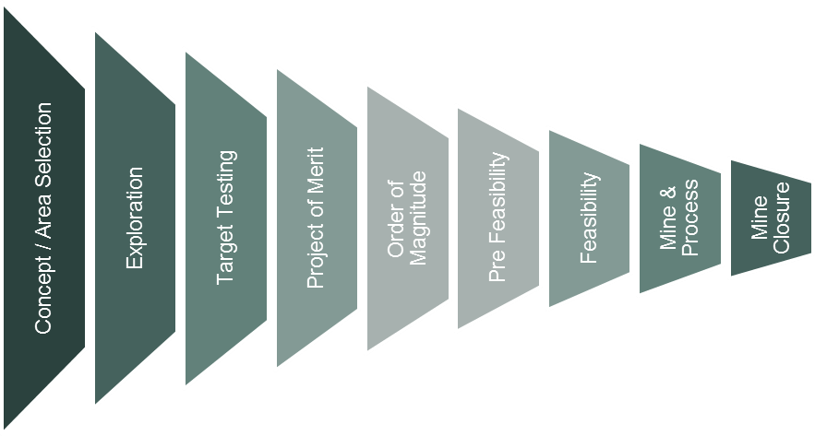
Projects through the Exploration to Mining Value Chain
Discovering and establishing a mineable deposit may cost between INR 1000 and 2000 crores
DISCOVERY
Progression of number of projects
(100 – 500)
20
5
3
2
1
Indicative cumulative cost per project (Varies from project to project) – INR Crores
5
10
15
20
50
100

Slide 16
Exploration Success is Rare
Over 200 kimberlitic rocks discovered in India; only one economic cluster
~ 2/3rd of the discoveries were in the previous MMDR regime by mining companies
~ 3/4th of diamond bearing kimberlites discovered by mining companies

Slide 17
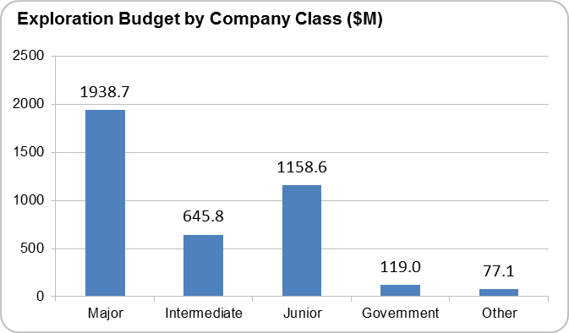
India’s Exploration Potential: India is Under-Explored
Global Exploration Expenditure (2011 – 2015)
India attracted < 0.5% of global exploration expenditure between 2000 - 2015

Slide 18
Mineral Exploration Tools
Geological Mapping: Compass, microscope, toposheet
Geochemical Mapping: Sampler (manual or machine), analytical tools (XRD, XRF, AAS, ICP, MS, Proton Probe, Portable Probes), etc.
Geophysical Survey: Magnetometer, gravimeter, electrical survey tools, electromagnetic survey, reflection seismic survey, magneto- tellurics, down hole loggers, etc.
Remote Sensing: Multispectral data, hyperspectral data, LIDAR and other active sensor data, etc.
Drilling: Diamond core, Reverse Circulation, Rotary Air Blast, Sonic, Air Core, Coiled Tube, Auger, etc., etc.
The above tools are continuously improving in efficacy. Experienced mineral explorers use these tools appropriately to dynamically assess and manage investment risks, while progressing towards the discovery

Slide 19
Exploration Specialists and Consultants
Based on:
Commodity
Mineralization style
Exploration tool applications
Terrain
Soil type / regolith
Geographies
Stage of exploration
CRIRSCO (JORC / SAMREC / NI 43-101 / NACRI) recognizes the specialisations and only allows Qualified Persons with demonstrated specific experience to sign off on specific exploration report for a specific stage
Exploration is a highly specialized activity. There are no “know all” exploration companies or exploration consultants available

Slide 20
Prudent Mineral Exploration Policy for India

Slide 21
India’s Mineral Security Needs in the 21st Century
Usage | Raw Materials
Infrastructure | Fe, Al, Mn, V, Cr, Ni, Cu, Pb, Zn, limestone, aggregates
Energy | Coal, hydrocarbons, U, Th
Energy supply | Cu, Al
Energy storage devices | REE, Nb, Ta, Graphite, Li, Ni, Co, Mn
Electric cars | REE, PGE, Sc, Al, Mg, Ti
Water desalination | PGE, Cr, Ti
Telecommunication infrastructure | Cu, Al, Ge
Cellphones | Ta, Nb, Sb
Transport systems | Al, Mg, Ti, Sc, Th, Re, Nb, Ni, Mo, Co, Sm
Paints | Ti, Cr
Moulds | Zr
Fertilizers | Potash, phosphate, boron
World is going through a revolutionary phase of development of new metallurgical process and metal product development phase for utilisation in future technologies
Most of the new age commodities occur as non-bulk mineralization in nature
India’s exploration for technology commodities would get a boost, if India starts investing in metallurgy and product development research
Elements in RED are no production; Elements in GREEN are short supply

Slide 22
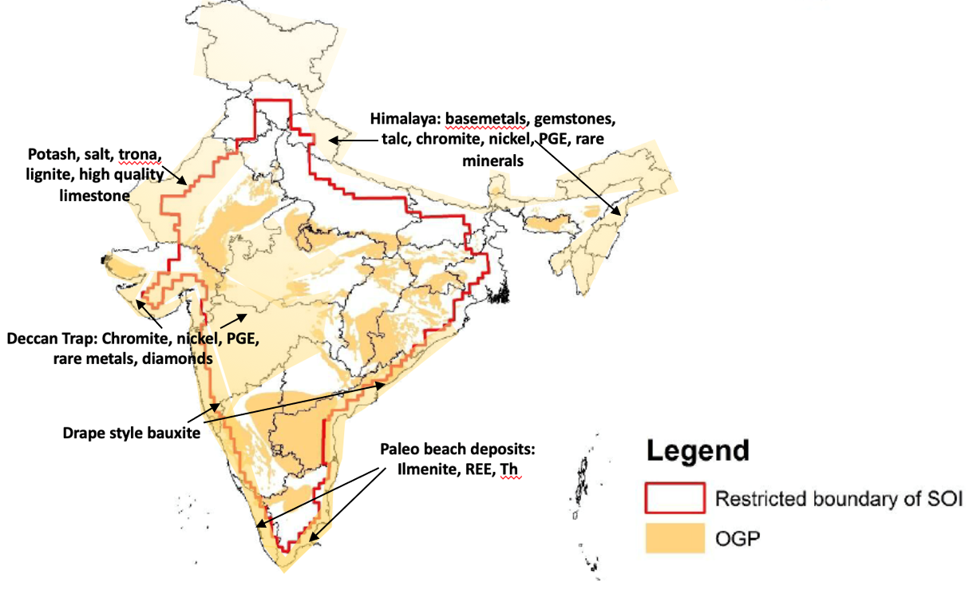
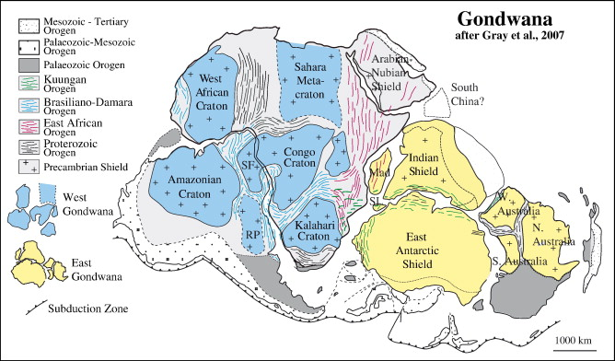
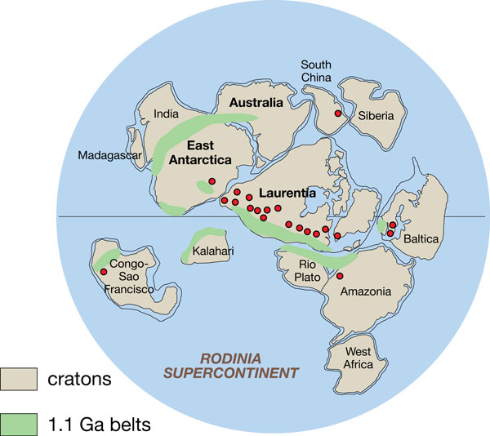
India’s Exploration Potential is Never in Doubt
India’s Obvious Geological Potential Map (GSI)
Continental Reconstructions : Gondwanaland and Rodinia
While GSI’s OGP is only 0.5 million km², India’s real OGP is about 2 million km² , Only about 15,000 sq kms area explored in detail

Slide 23
MMDR 2015 and Impact of Auction Process Rigidity
Current Auction Process Eliminates This Phase
Brownfield Mining
Brownfield Exploration
VALUE
Mining (Through Auctions)
Auctions have been designed to be transparent for investor and provide revenue maximization to the government
The Evidence of Mineral Content (EMC) Rule has been created to define auctionable blocks
EMC Rule eliminates Brownfield Opportunities in the asset
Development
Feasibility
DISCOVERY
GSI and Contractual Exploration Only and Refusal by Private Explorers to Participate
Concept (GSI / NMET)
TIME

Slide 24
Exploration in India – Post-MMDR 2015 (Amendment)
Exploration carried out by GSI and NMET funding. Some state DMGs have carried out additional exploration
Approximately 500 exploration programs since 2015. Over 2000 Crores spent (including wages and direct exploration expenditures on ground)
Bulk infrastructural commodities 50% of the programs by number and +75% by expenditure – coal, iron ore, bauxite, limestone, manganese
Non bulk tech commodity exploration programs include REE, base metals, precious metals, potash
Approximately 40 non-bulk exploration programs have moved to Geological Resource estimation stage. Approximately 100 exploration programs for bulk commodities have moved to resource estimation.
1 or 2 non-bulk deposits and about 20 bulk deposits may be declared economic by 2025.Mining if ever, would not start before 2030.
India needs significantly larger risky exploration investments from private sector and international explorers and miners to meet with India’s mineral development goals

Slide 25
Mineral Exploration: What would attract Investors!
Sl | Requirements for a Competitive Exploration Investment Destination | Current Status in India
1 | Geological attractiveness | Y
2 | Explorability (terrain, soil cover, vegetation) | Y
3 | Freedom to select exploration target | N
4 | Security of Title – from exploration to mining | N
5 | Security of Tenure – at all stages | N
6 | Transparent and structured permitting process | Y / N
7 | Freedom to trade the exploration asset for profit | Y/N
8 | Availability of high quality digital survey data | Y
9 | Capital market support | N
10 | Fiscal incentives | N
To Create a Competitive Investment Regime
Non Negotiable

Slide 26
Thank You
BROOKINGS INDIA
QUALITY. INDEPENDENCE. IMPACT

