Slide 1
Corporate Debt Overhang and Credit Policy: Discussion
Ben S. Bernanke
Brookings Institution
June 25, 2020

Slide 2
Fed interventions: Beyond Bagehot with new doctrines and new tools
Market maker of last resort
Classic LOLR to financial institutions (Bagehot)
Backstopping credit markets

Slide 3
Market maker of last resort
Buyer of last resort when limits on capital or risk tolerance inhibit normal market-making or arbitrage by private actors
Examples:
Repo market (September 2019)
Treasury market (March 2020)

Slide 4
Classic lender of last resort (Bagehot)
Lending freely against collateral to financial institutions suffering liquidity pressures
Examples:
Discount window (but no TAF this time!)
Primary dealer credit facility (13(3))
Money market liquidity facility (13(3), Treasury)
Currency swaps (global LOLR of dollars)

Slide 5
Backstopping credit markets
Standing ready to lend directly to ultimate borrowers
Backstop cuts off left tail/bad equilibria, makes private lenders comfortable about re-entering; or, if necessary, provides credit directly. Not QE, can work without actual lending (Draghi, OMT)
Why not have Treasury lend directly?
Fed expertise, connection to banks and markets, non-partisan standing
Examples
Facilities for corporate loans/bonds/commercial paper
Main Street lending facility
Municipal lending facility

Slide 6
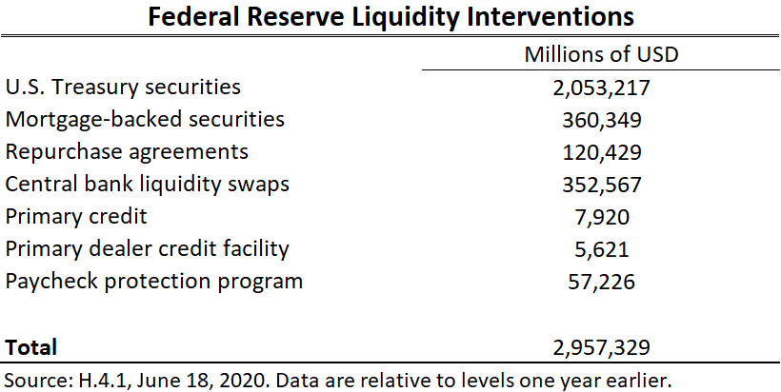

Slide 7
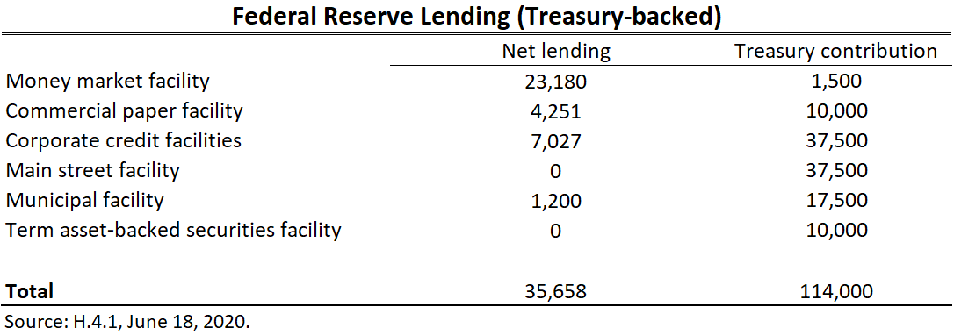

Slide 8
Assessment: Market maker of last resort
Successfully calmed market breakdown of March
Treasury, MBS purchases will ultimately be part of QE program

Slide 9
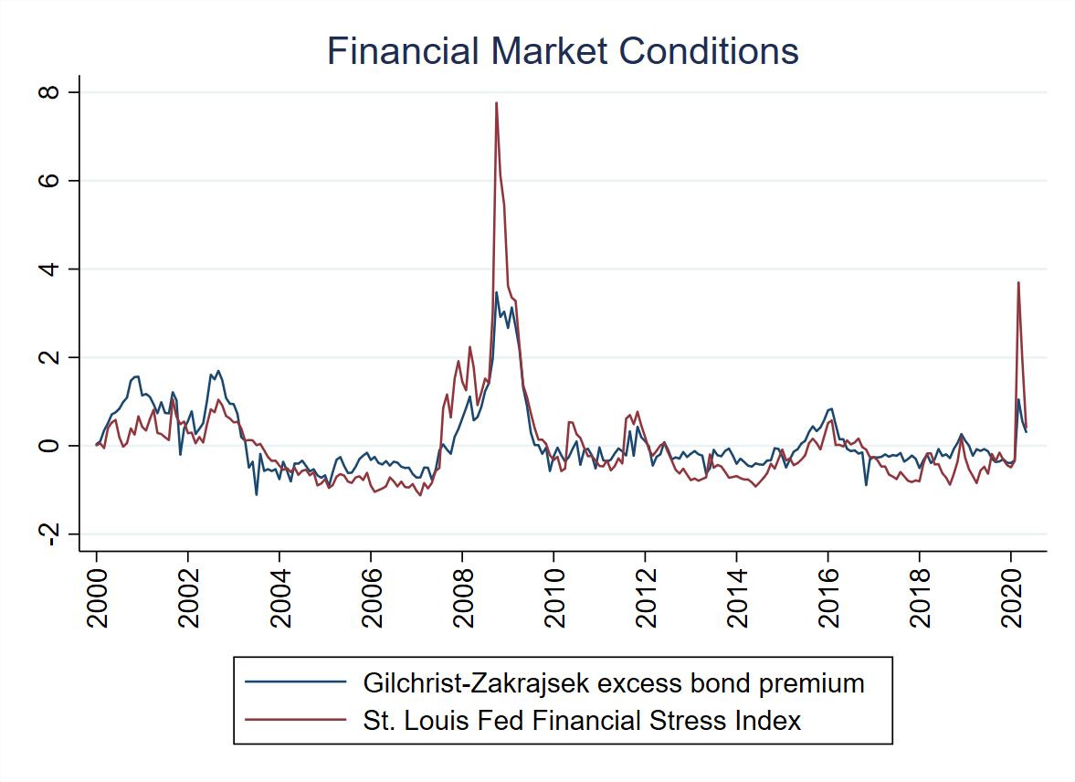

Slide 10
Assessment: Classic LOLR
Relieved some stress for money market mutual funds
Provided dollars globally
But runs not a big issue in this episode

Slide 11
Assessment: Credit backstops for public markets (large firms)
Announcement effects have restored IG corporate bond market
Is it enough to get good results? I see bankruptcy costs as relatively high:
Overloaded courts, possible DIP shortage, delays/admin costs
Breaking implicit contracts (workers, customer, suppliers); intangibles
The duration of the pandemic and its economic implications are highly uncertain
Forcing bankruptcies prematurely, before there is greater clarity, seems likely to be inefficient

Slide 12
Alternative strategies
Stein et al.: Government should take subordinated position, e.g., preferred plus warrants. Gives company more time to determine viability, in exchange for some taxpayer upside
Metrick: Staple subsidized business interruption insurance to loans, invoked in shutdown or based on biomedical indicators. Separates ordinary business risk from undiversifiable pandemic risk

Slide 13
Assessment: Credit backstops for SMEs
Bankruptcy costs high/potential for scarring and AD externalities
Need to assist short-term survival while allowing longer-term redeployment of resources
Not clear Main Street program will help enough borrowers with significant option value

Slide 14
Alternative models for lending to SMEs
Subsidized funding for lending (ECB)
Make Main Street more generous to banks and borrowers (English and Liang)
PPP/tax credits/grants

Slide 15
Conclusions
Fed has gone well beyond Bagehot. Justified by circumstances but will require new doctrines and new thinking about role of central bank.
Fed has so far succeeded as market maker and financial lender of last resort
Fed/Treasury backstop of credit markets has normalized IG markets
Forcing large-firm bankruptcies is still likely to be inefficient until there is greater clarity
SMEs are likely to need more grants or concessional finance for a time to protect option value

Slide 16
Appendix

Slide 17
References
English, William and J. Nellie Liang (2020). "Designing the Main Street Lending Program: Challenges and Options," Hutchins Center Working Paper #64. https://www.brookings.edu/wp-content/uploads/2020/06/WP64_Liang-English_FINAL.pdf
Metrick, Andrew (2020). “Proposal for Dual-Trigger Insurance + Loan (DTIL) Program,” mimeo, Yale University, June 9, 2020.
Stein, Jeremy, Sam Hanson, Adi Sunderam, and Eric Zwick (2020). “An Evaluation of the Fed-Treasury Credit Programs,” Bendheim Center webinar. https://bcf.princeton.edu/event-directory/covid19_15/

