Slide 1
Brookings Papers on Economic Activity Special Edition: COVID-19 and the Economy
Policies for a Second Wave
David Baqaee (UCLA Economics), Emmanuel Farhi (Harvard Economics),
Michael Mina (Chan School), Jim Stock (Harvard Economics)
with Veronica De Falco, Michael Droste, Adriano Fernandes, Kathryn Holston, Stephanie Kestelman, Edward Kong, Danila Maroz, Chika Okafor, Lingdi Xu
June 25, 2020

Slide 2
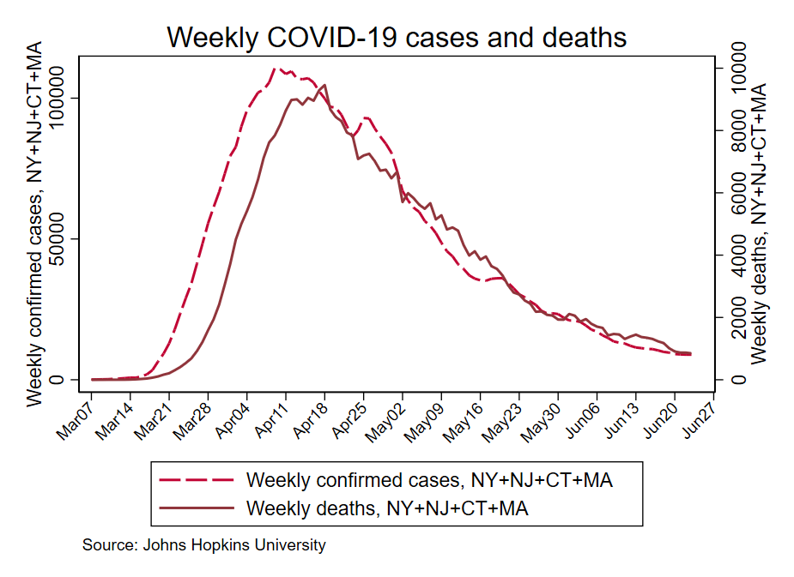
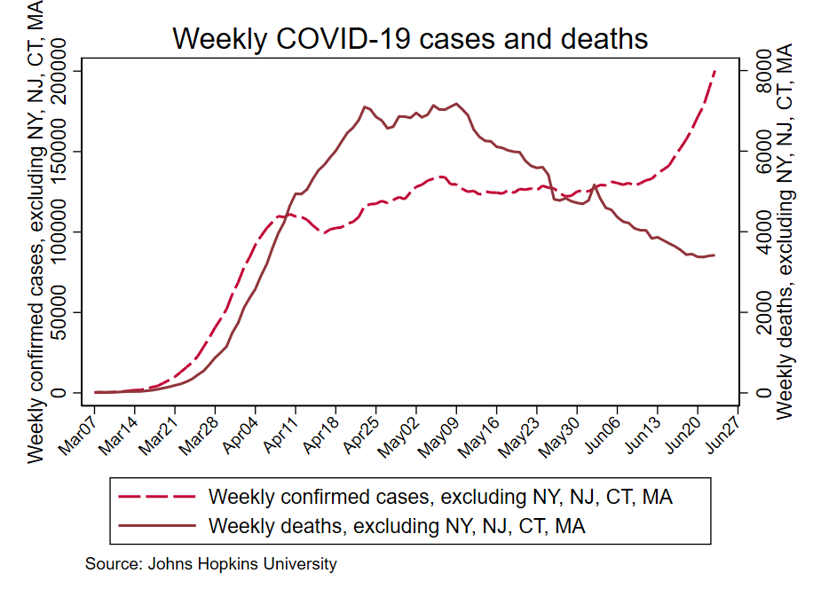
Cases and deaths through June 24
New York, New Jersey, Connecticut, Massachusetts
Rest of U.S.

Slide 3
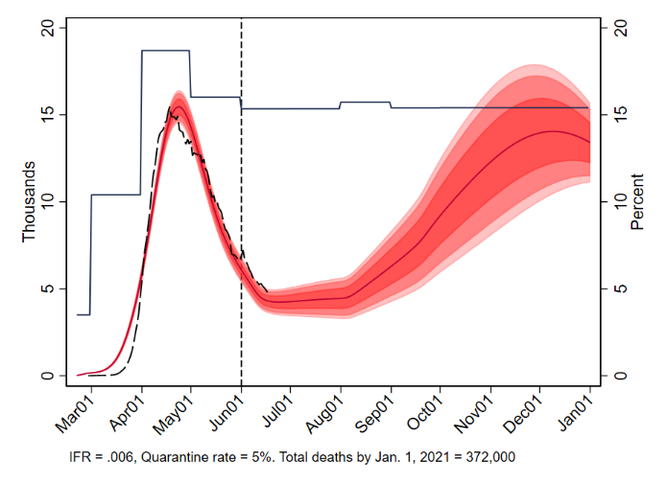
Model simulation: Second wave
Weekly deaths and slack hours (calibrated to unemployment rate)
Unemployment rate
Weekly deaths
Second wave appears as economic and on-economic activity opens up, students return to school, and personal protections relax…

Slide 4
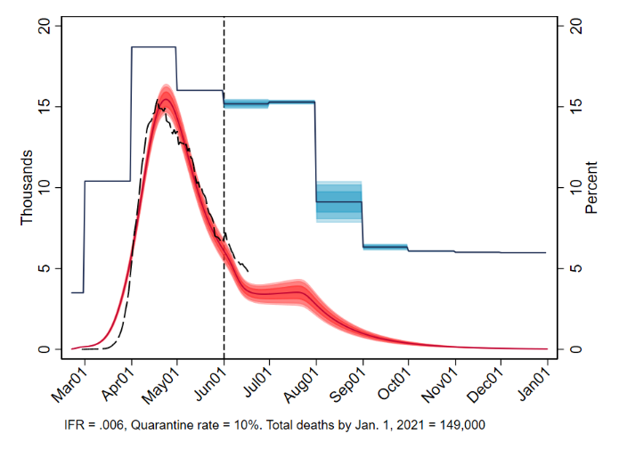
Model simulation: Second wave
Weekly deaths and slack hours (calibrated to unemployment rate)
Unemployment rate
Weekly deaths
Second wave appears as economic and on-economic activity opens up, students return to school, and personal protections relax…
So, in mid-July, governors require masks in public, personal distancing, testing & quarantine, enhanced protections for the elderly – but leave businesses (largely) open and reopens school in the fall.

Slide 5
Overview
This paper
66 sector economic model
5-age SEIQRD epidemiological model, calibrated + estimated
= SIR model with incubation period (exposed), quarantine, and deaths
Time-varying specifications of non-pharmaceutical interventions (NPIs)
Economic NPIs: shutdowns, industry prioritization,…
Non-economic NPIs: testing & isolation, masks,…
Control rules (decision maker = governor or individual, following CDC guidelines/gating criteria)
Recent related papers (economics + SIR)
Acemoglu, Chernozhukov, Werning & Whinston (2020), Alvarez, Argente, and Lippi (2020), Aum, Lee, and Shin (2020), Atkeson (2020a, b), Baqaee and Farhi (2020a, b), Berger, Herkenhoff & Mongey (2020), Bodenstein, Crosetti & Guerrieri (2020), Budish (2020), Eichenbaum, Rebelo & Trabant (2020a, b), Farboodi, Jarosch, and Shimer (2020), Glover, Heathcoate, Krueger & Rios-Rull (2020), Guerrieri, Lorenzoni, Straub & Werning (2020), Jones, Philippon, and Venkateswaran (2020), Krueger, Uhlig, and Xie (2020), Lin and Meissner (2020), Ludvigson, Ma, and Ng (2020), Morris et. al. (2020), Moser and Yared (2020), Mulligan (2020), Rampini (2020), Rio-Chanona, Mealy, Pichler, Lafond & Farmer (2020), Stock (2020),…

Slide 6
Model: Age-based SEIQRD
Contact matrices 75+
64-75
C_{ab}: age a meets age b 45-64
20-44
0-19
Contact matrix construction – estimation period
Total contacts = contacts at work + contacts at home + contacts at other activities
Baseline contact matrices: European (Polymod), reweighted for US demographics (Mossong et al (2017)) + age distribution of workers by sector (ACS) + Mongey-Pilossoph-Weinberg (2020) personal proximity index by sector
Measurable time variation: capacity to work from home (Dingel and Neiman (2020)), estimates of working from home (Bick, Blandin, Mertens (2020)), Google mobility indexes, sectoral hours shocks
Unobservable reduction in transmission given contacts: estimated φ_{t} factor (flexible functional form)

Slide 7
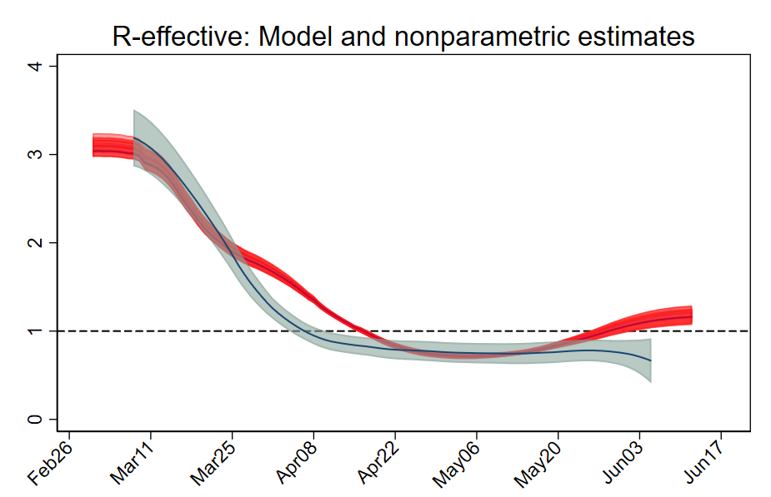
Model: Estimation
Other model parameters from the epidemiological literature:
Latency, infectious rates
Transmission rates involving children
Age-dependent infection-fatality rate (IFR) profile
Estimation
Fit to 7-day MA of US deaths, March 15 – June 12
Specify population IFR
0.6% for base case
Estimate initial infections and adult transmission rate (β)
in effect this estimates path of R0
SEIQRD model estimate
Nonparametric estimate

Slide 8
Simulations
Control
Decision-maker decides to go back to work, or not, based on unemployment rate, daily deaths, and 14-day decline in daily death rate (CDC guidelines + aversion to unemployment)
Two “governors”: fast and slow
NPIs
Economic
Economic shutdown
Sectoral reopening prioritizing certain sectors by GDP-to-Risk index:
Everyone who can, works from home
Bick, Blandin, Mertens (2020): 35% of workforce worked from home in mid-May
Workers age 65+ either work from home, or don’t work
Non-economic
Open school in the fall, or not
Masks & social distancing
Additional protections for the elderly (CMS guidelines+)
Quarantine (testing and self-isolation)
Baseline: 5% quarantine rate
Alternative: 10% quarantine rate
Output (GDP)
Business sector output computed from labor by sector and income shares (Hulten’s theorem)

Slide 9
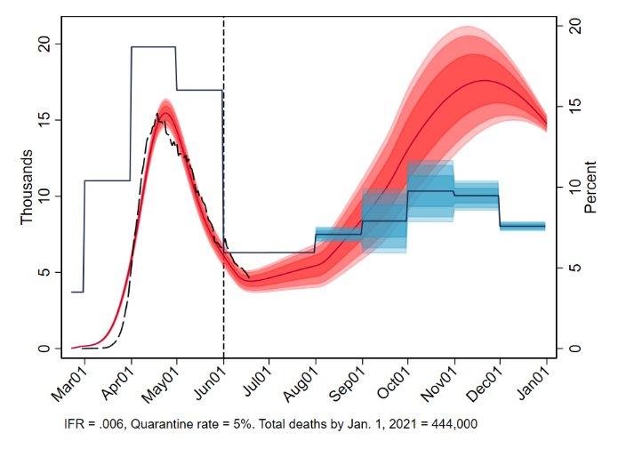
Model simulation: Second wave
Economic NPIs
Baseline + limited business shutdowns

Slide 10
Model simulation: Second wave
Economic NPIs
Baseline + limited business shutdowns
Broad economic shutdown

Slide 11
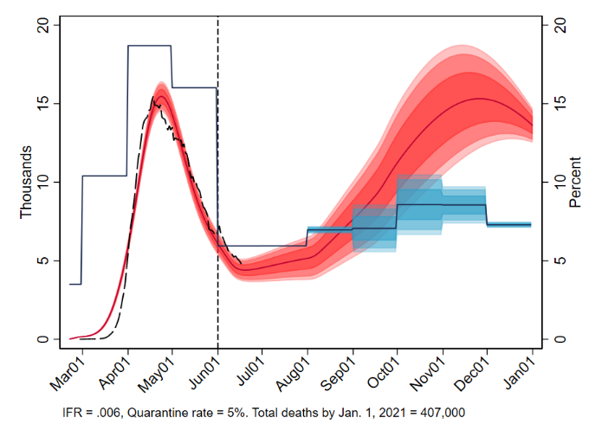
Model simulation: Second wave
Economic NPIs
Baseline + limited business shutdowns
Require working from home if able

Slide 12

Model simulation: Second wave
Economic NPIs
Baseline + limited business shutdowns
Prioritize sectors with highest marginal GDP-to-Risk
But: our sectoral detail doesn’t go to the level of bars, pro sports, night clubs

Slide 13
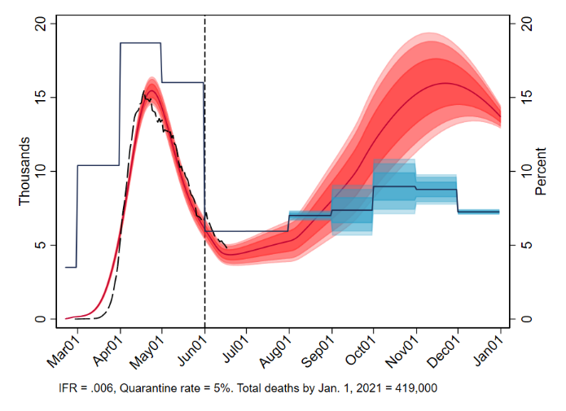
Model simulation: Second wave
Economic NPIs
Baseline + limited business shutdowns
No on-site workers age 65+

Slide 14
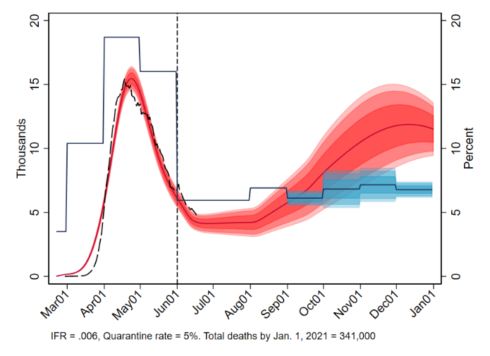
Model simulation: Second wave
Economic NPIs
Baseline + limited business shutdowns
All 3 economic NPIs (sectoral, WFH, no age 65+ on site)

Slide 15
Model simulation: Second wave
Non-Economic NPIs
Baseline + limited business shutdowns

Slide 16
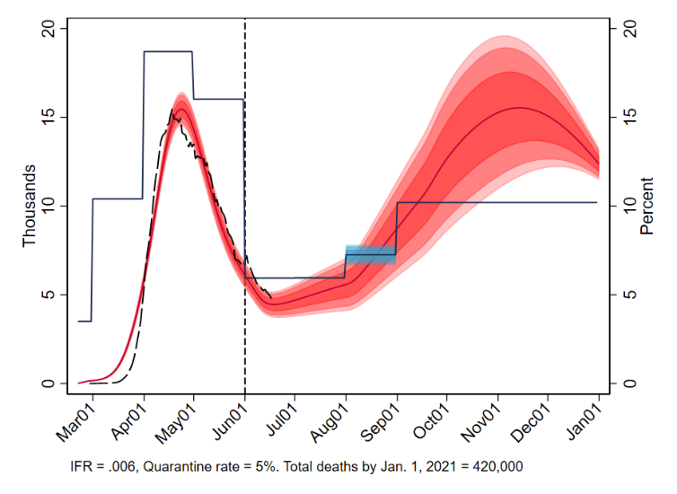
Model simulation: Second wave
Non-Economic NPIs
Baseline + limited business shutdowns
No school

Slide 17
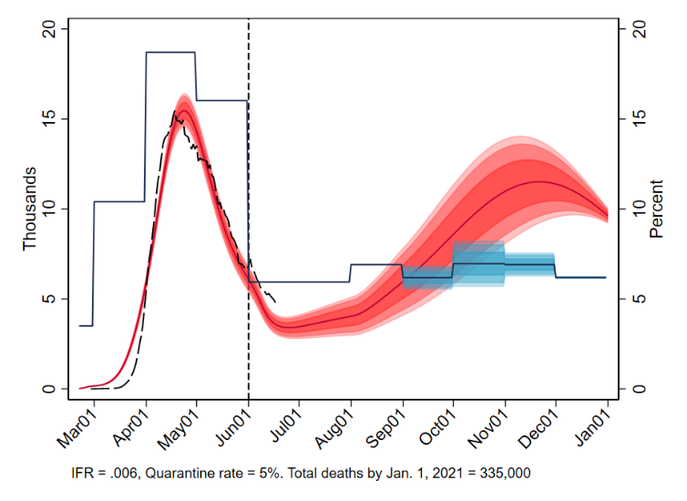
Model simulation: Second wave
Non-Economic NPIs
Baseline + limited business shutdowns
Enhanced protections for age 75+

Slide 18
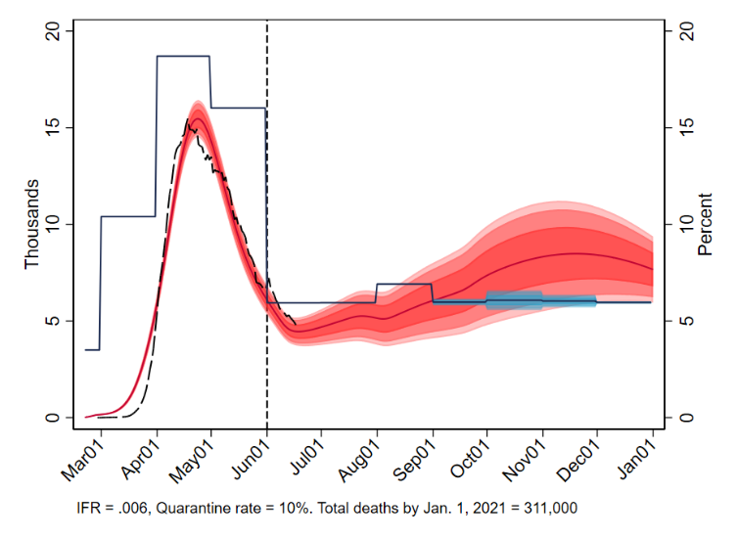
Model simulation: Second wave
Non-Economic NPIs
Baseline + limited business shutdowns
10% Quarantine rate

Slide 19
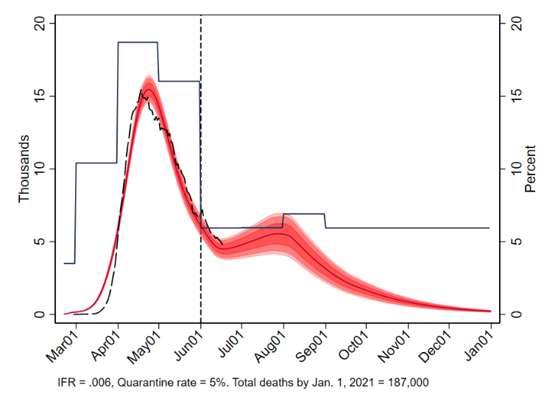
Model simulation: Second wave
Non-Economic NPIs
Baseline + limited business shutdowns
Stricter personal protections

Slide 20
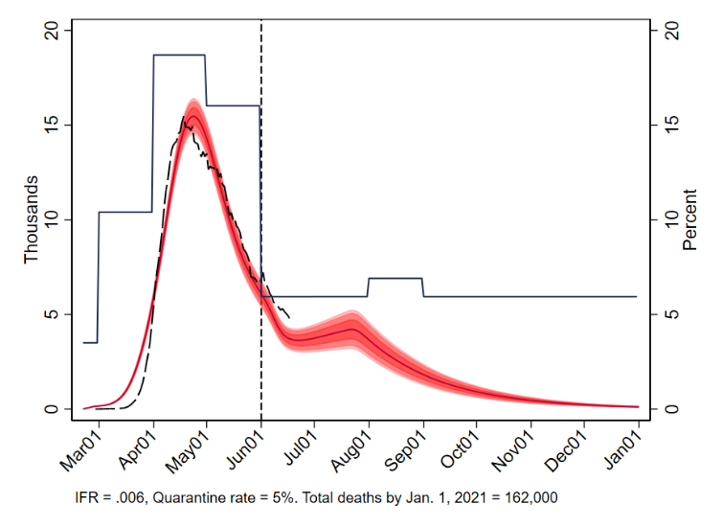
Model simulation: Second wave
Non-Economic NPIs
Baseline + limited business shutdowns
All three, fast economic reopening

Slide 21
Discussion
Output loss depends on sectoral shocks; nonlinearities and Keynesian spillovers can exacerbate output losses (Baqaee and Farhi (2020a, b)
Cost-benefit analysis?
Economic shutdowns are neither necessary nor sufficient to control deaths
If you work, ~half of contacts are made at work
Transmission and contacts in the workplace are the easiest to regulate/control
But, our modeling isn’t granular enough to address the highest-contact economic activities (bars, nightclubs, pro sports,…)

