Slide 1
The Social Safety Net in the Wake of COVID-19
Marianne Bitler, UC-Davis
Hilary Hoynes, UC-Berkeley
Diane Schanzenbach, Northwestern

Slide 2
Congress has greatly increased spending during the COVID-19 crisis
Relief payments (47% of total)
Unemployment insurance (UI) expansions (51% of total)
Regular UI
$600 weekly top-up
Expanded eligibility under PUA
Self-employed
Little work history
USDA payments (2%)
Increase SNAP benefits to maximum benefit for ~60% not already there (Emergency Assistance) ~$160/month
Increase in SNAP participation
Pandemic-EBT providing $ to families that lost access to school meals ~$120/month
Notes: Authors' tabulations of Daily Treasury Statements through June 19. The 2020 weekly payments are differenced from the same week one year prior.

Slide 3
Food insecurity has spiked
Food insecurity (FI): survey measure assessing whether households have enough $ for adequate food consumption
Companion work assessing comparability of measures in COVID-era surveys to previously collected data
Different specific Q’s asked, time period covered (last week during COVID; last month or year previously)
Last available December 2018
FI varies with the UR, project likely FI to February 2020
Compare to Census Household Pulse
FI doubled overall (blue line, dot)
FI tripled in HH’s w/children (orange line, dot)

Slide 4
Other measures of distress dramatically elevated
Emergency food use spiked
Doubling in reported mental health problems

Slide 5
Why do we see so much need despite so much spending?
Timing of payments delayed
UI systems overloaded; PUA payments slow
P-EBT school meal benefits slow (new program), some coming in July
Low-income families have little savings, access to credit
Outside of UI, magnitude of benefit increases are modest
SNAP increases ~$40/week, only for advantaged subset of cases
P-EBT school meal benefits ~$30/week, slow payout
Despite expansions, still lack of coverage in Unemployment Insurance
Data incomplete, requires ongoing monitoring

Slide 6
Payments came with delays
Pandemic Unemployment Assistance
(self-employed, fail work history test)
Increased SNAP-line spending
(payments for missed school meals)

Slide 7
Despite strong, fast SNAP increases, benefits are modest
Response of SNAP strong
Enrolled newly eligible quickly (+ administrative flexibility)
Increased all caseload to maximum benefit level (EA provision)
Increase of ~$40/week, to 60% of participating HH’s not already receiving maximum benefits
Offsets lost earnings, food vouchers so limited fungibility
No additional benefits to those already at maximum
Can’t do everything through SNAP Room to do more
Some sunsets soon (max ben only through health emergency; P-EBT through school year)
Those at max ben get no more

Slide 8
Worker eligibility for UI, pre-CARES Act
Ganong et al. UI eligibility calculator, 2019 CPS-ASEC
Fewer low-income workers eligible: 77% of <=200% FPL; 63% <=100% FPL
Some b/c undocumented (no change): 14% of income <=100%
Some groups expanded eligibility under PUA (orange box)
Self-employed: 7% poor
Fail work history: 17% poor
PUA: 9% overall; 24% poor

Slide 9
There is usually a gradient in UI receipt
UI receipt among short-term unemployed at trough of Great Recession from SIPP
< 1/3 of unemployed workers with low education rec’d UI
~half of BA+ unemployed workers

Slide 10
Survey evidence: fewer low-ed furloughed rec’d UI
COVID Impact Survey
To be sure, data not perfect:
Modest sample size
UI “received in past 7 days” (some paid out biweekly)
Low response rate
(true for all survey results during COVID-19 era)

Slide 11
Other aspects of COVID Impact data line up w/priors
Receipt of UI increases across survey waves (as backlogs clear)
Unemployed workers receiving UI have lower rates of food insecurity

Slide 12
Admin Data: Fewer Low Ed. Initial Claims Paid
California UI administrative records (Hedin, Schnorr & von Wachter, CPL)
Initial claims, not people
Initial claims paid at lower rate among low-education group
Includes regular UI + PUA
No info on likelihood of filing initial claims by education

Slide 13
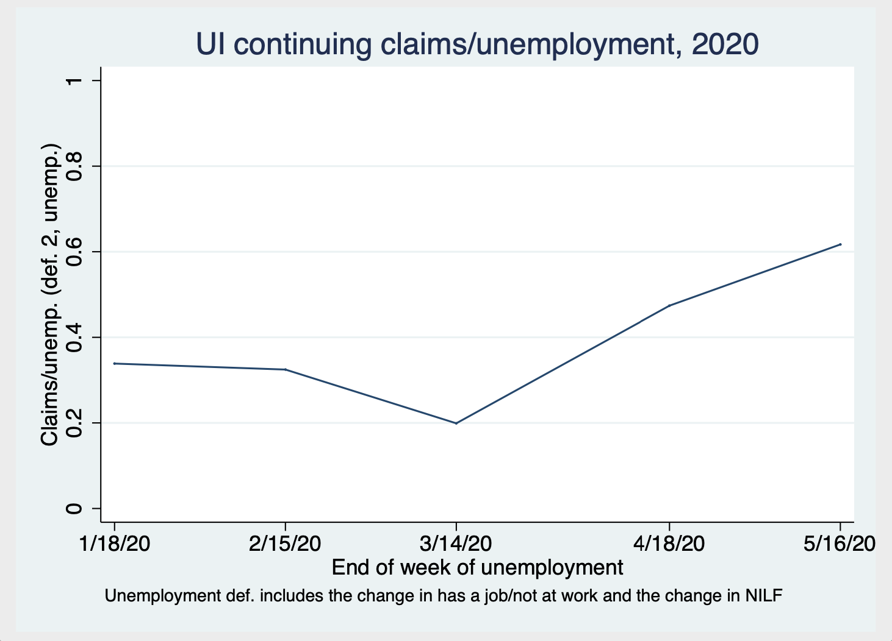
Admin Data: UI continuing claims ~60% level of Unemployed
Continuing claims – historically closer to % receiving UI
Denominator from CPS (adjust for misclassification):
Unemployed
Y/Y change in Emp not at work
Y/Y change in NILF
No covariates available
Sum: cause for concern that UI not reaching low income/education

Slide 14
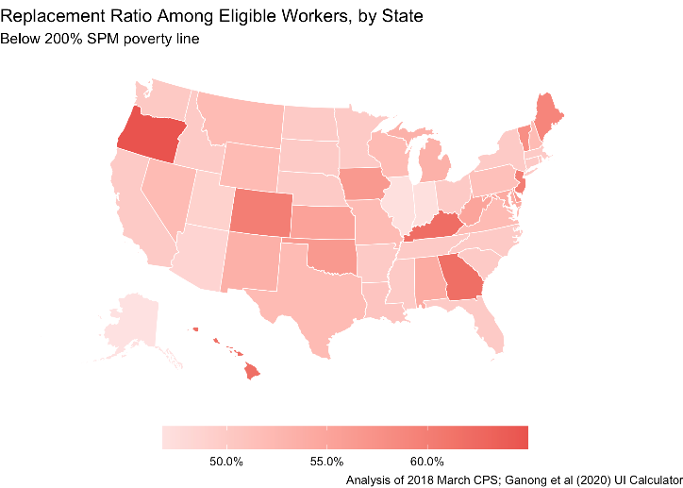
Broader Point: Safety net currently not designed for economic downturns
Shift over 25 years to work-based safety net
Boosts low earnings (EITC)
Little out-of-work payments (TANF)
These are not counter-cyclical
UI coverage rates, insurance value low, differs across states
Responds less automatically than should; need Congressional action to start

Slide 15
Next steps: Recommendations for Next Relief Package
Great need persists despite heroic increases in UI, relief payments
Evidence imperfect
Given what we know about long-term impacts on children exposed to economic shocks, over-reacting less costly than under-reacting
Will be worse if let policy changes expire, revert to regular safety net (inadequate during recessions)

Slide 16
SNAP & P-EBT
Extend Emergency Allotments (everyone gets maximum benefits)
End of health emergency is going to turn off EA programs; we need to keep them until the economy improves
Increase benefits by 15% across the board
Worst-off SNAP participants receive no extra from EA
Automatically trigger during downturns, persist until the economy gets better
Keep paying P-EBT to families w/kids on free school meals
Protection over the summer
Ready for fall if/when more closures
Broader group than served by SNAP alone

Slide 17
Unemployment Insurance
Regular payment levels not enough in many states: continue federal top-up
$200/week as suggested in Furman, Geithner, Hubbard & Kearney (2020)
Monitor coverage in real time: how much will PUA changes improve coverage among low-income unemployed?
Consider more relief payments, targeted to low-income
Mechanisms: recent EITC recipients; SNAP participants; P-EBT recipients
When data allow us to carefully assess: structural reform to UI system so provides better insurance to low-income workers
Necessary to sustain a work-based safety net

