Slide 1
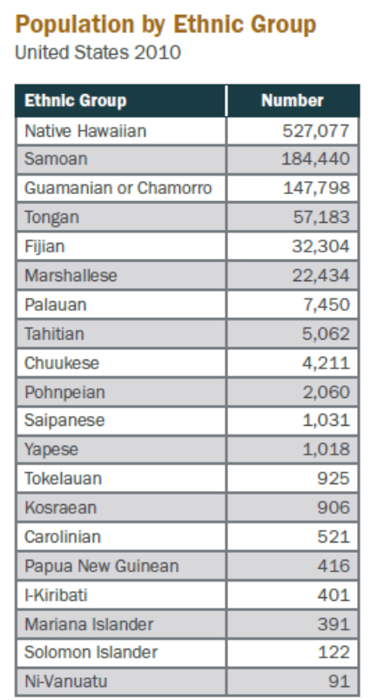
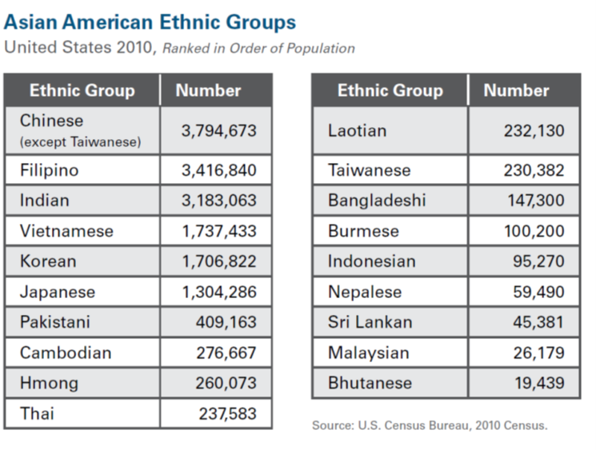
Disaggregated data shows the diversity of our community
Notes:
Data disaggregation is important because it shows our diversity.
Often viewed as a monolithic group, Asian Americans are exceedingly diverse with different needs.
The country’s fastest growing Asian American ethnic groups were South Asian. Bangladeshi and Pakistani American populations doubled in size between 2000 and 2010.
Chinese Americans continue to be the largest Asian American ethnic group, numbering nearly 3.8 million nationwide. They are followed in size by Filipino, Indian, Vietnamese,
and Korean Americans.

Slide 2
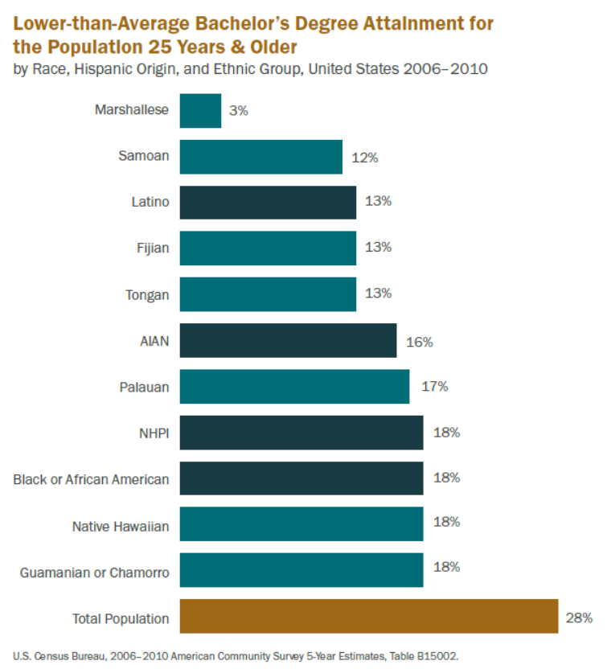
Disaggregated data dispels stereotypes and identifies potentially overlooked community needs
Notes:
The disaggregation of available data on educational attainment even further disputes the model minority myth. Census data reveal large disparities between Asian American ethnic groups, with the educational profiles of some communities similar to Latinos and African Americans.
For example, the educational attainment of Hmong, Cambodian, Laotian, and Vietnamese Americans is lowest among Asian American ethnic groups and similar to those of Latinos and African Americans. Only 61% of Hmong Americans hold a high school diploma, while only 12% of Laotian Americans have graduated from college.
This suggests that many Asian Americans lack the credentials necessary to access secure and living wage jobs, employer-provided healthcare, and opportunities to build assets.

