Slide 1
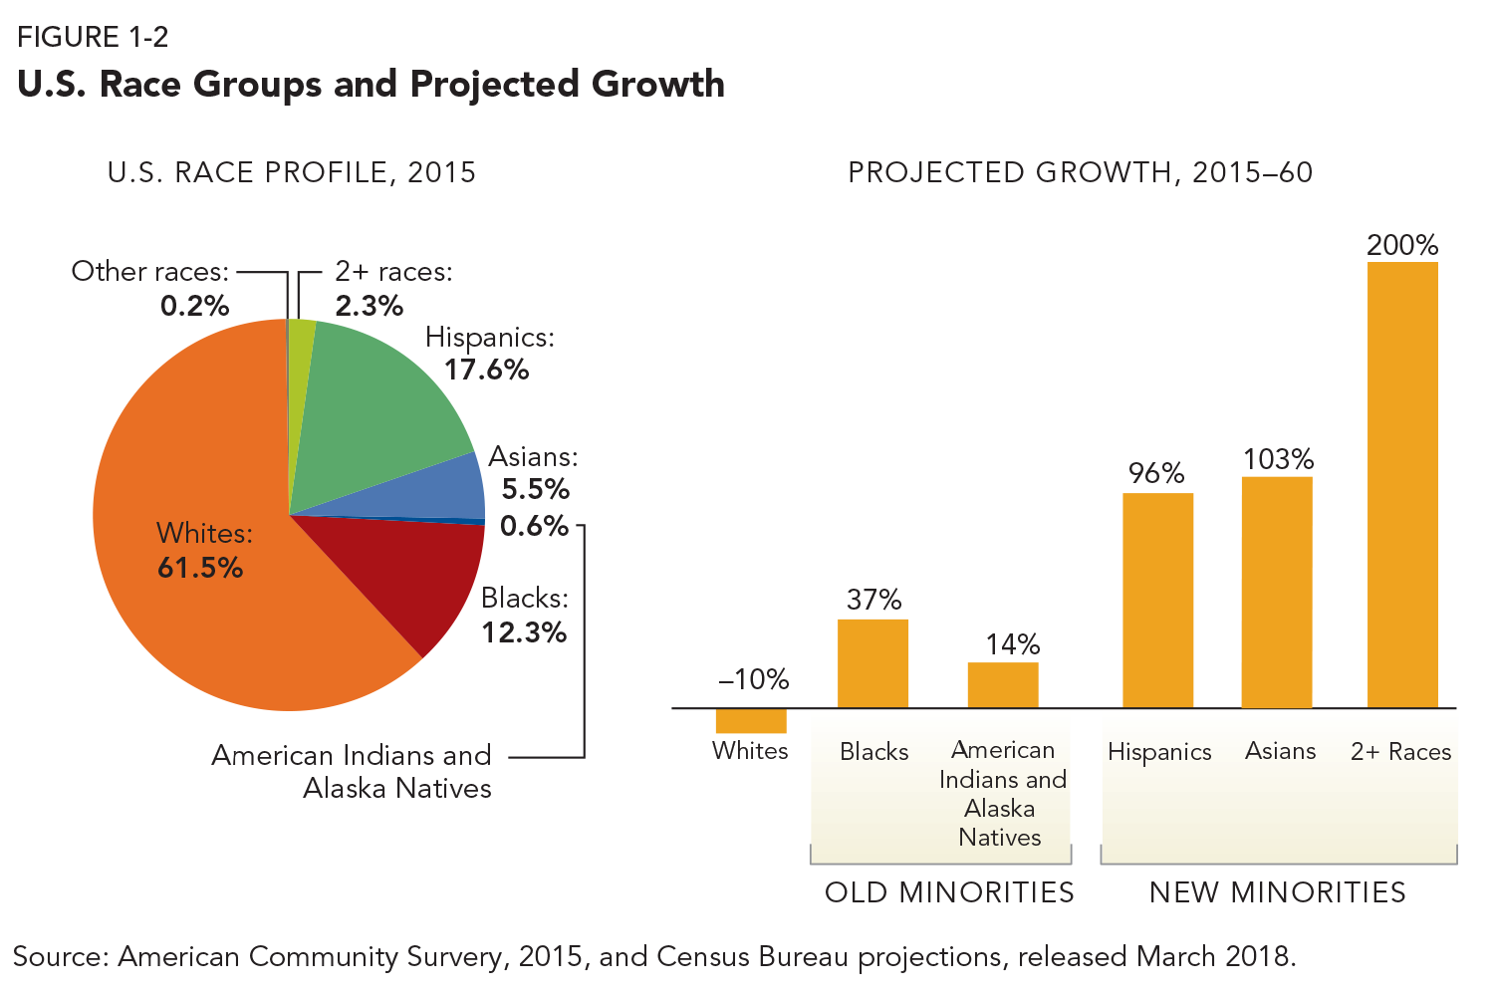
Projected growth for race-ethnic groups
2015 – 2060
200%
96%
103%
37%
14%
-10%
Blacks
American Indians and Alaska Natives
Hispanics
Asians
2+ Races
Whites
3
Source: American Community Survey, 2015, and Census Bureau Projections, released March 2018

Slide 2
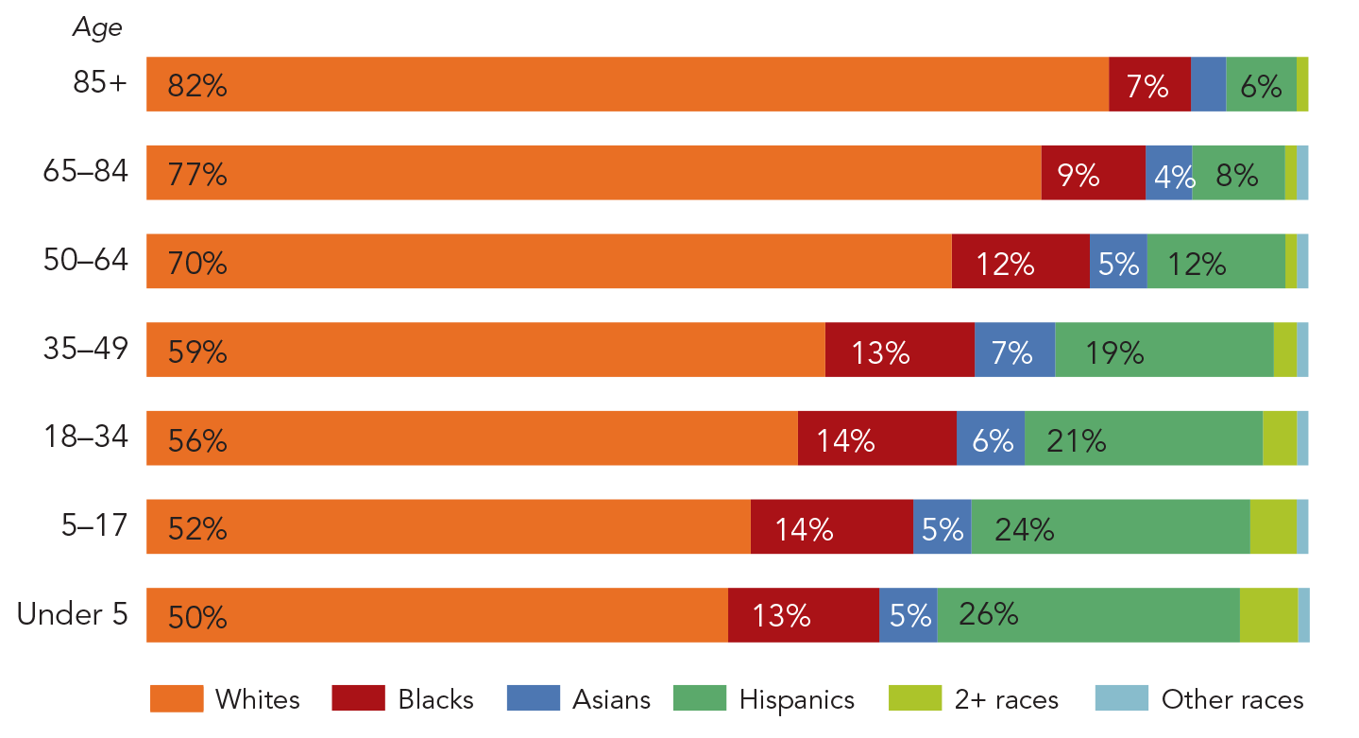
U.S. race-ethnic profiles by age, 2015
Age
85+
65 – 84
50 - 64
35 - 49
18 - 34
5 - 17
Under 5
Whites
Blacks
Asians
Hispanics
2+ races
Other races
Source: American Community Survey, 2015

Slide 3
U.S. race-ethnic profiles by age: 2020
Age cohort
Source: Author’s calculations

Slide 4
U.S. race-ethnic profiles by age: 2035
Age cohort
Source: Author’s calculations

Slide 5
Counties where groups are overrepresented
Blacks
Hispanics
Asians
Other Nonwhite
Two or more groups
None
Source: 2010 U.S. Census

Slide 6
Hispanic concentration areas and New Hispanic Destinations
Hispanic Concentration – modest growth
Hispanics comprise at least 16% of 2010 population and population increased by less than 43% between 2000 & 2010
Hispanic Concentration – fast growth
Hispanics comprise at least 16% of 2010 population and population increased by at least 43% between 2000 & 2010
New Hispanic destinations
Hispanics comprise less than 16% of 2010 population and population increased by at least 86% between 2000 & 2010
Source: 2010 U.S. Census

