Slide 1
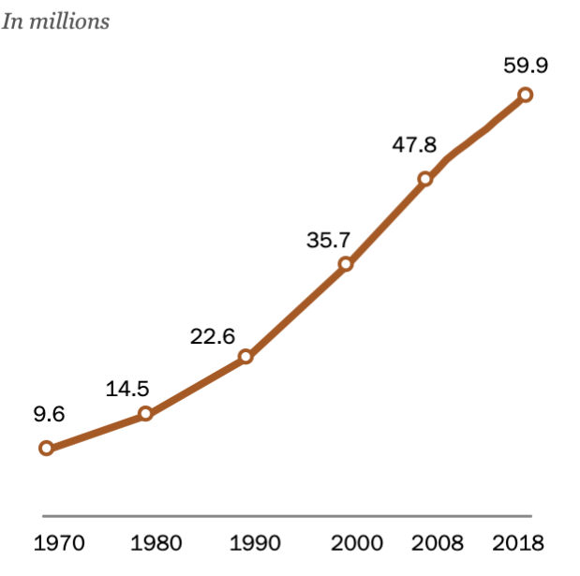
U.S. Hispanic population reached nearly 60 million in 2018
Note: Population estimates for 1990-2018 are as of July 1 for each year. Hispanics are of any race.
Source: Pew Research Center analysis of 1970-1980 estimates based on decennial censuses (see 2008 report “U.S. Population Projections: 2005-2050”), U.S. Intercensal population estimates for 1990-1999 and 2000-2009, and U.S. Census Bureau Vintage 2018 estimates for 2010-2018.

Slide 2
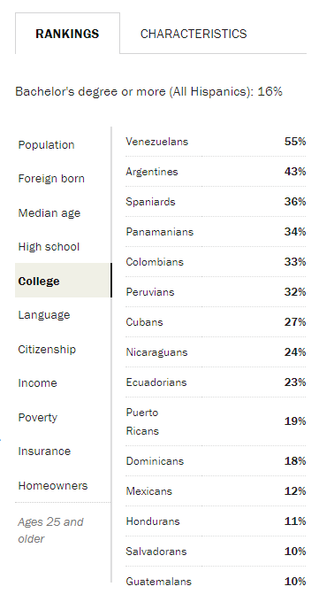
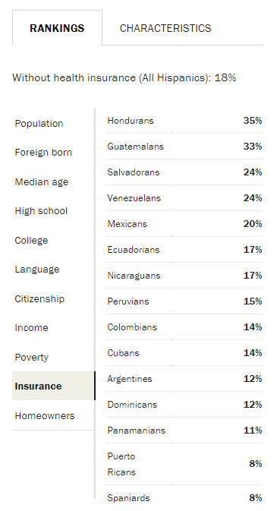
Demographic differences by Hispanic origin, 2017
Source: Pew Research Center tabulations of the 2017 American Community Survey (1% IPUMS)

