Slide 1

Creating Moves to Opportunity: Experimental Evidence on Neighborhood Choice Among Housing Voucher Recipients
Peter Bergman, Columbia Raj Chetty, Harvard and NBER
Stefanie DeLuca, Johns Hopkins
Nathaniel Hendren, Harvard and NBER
Lawrence Katz, Harvard and NBER
Christopher Palmer, MIT and NBER
September, 2019
With special thanks to our partners who implemented this experiment: Seattle and King County Housing Authorities, MDRC, and J-PAL North America

Slide 2
Motivation: Four Facts on Neighborhoods and Economic Opportunity
Children’s prospects for upward income mobility vary substantially across neighborhoods (and even nearby neighborhoods)

Slide 3
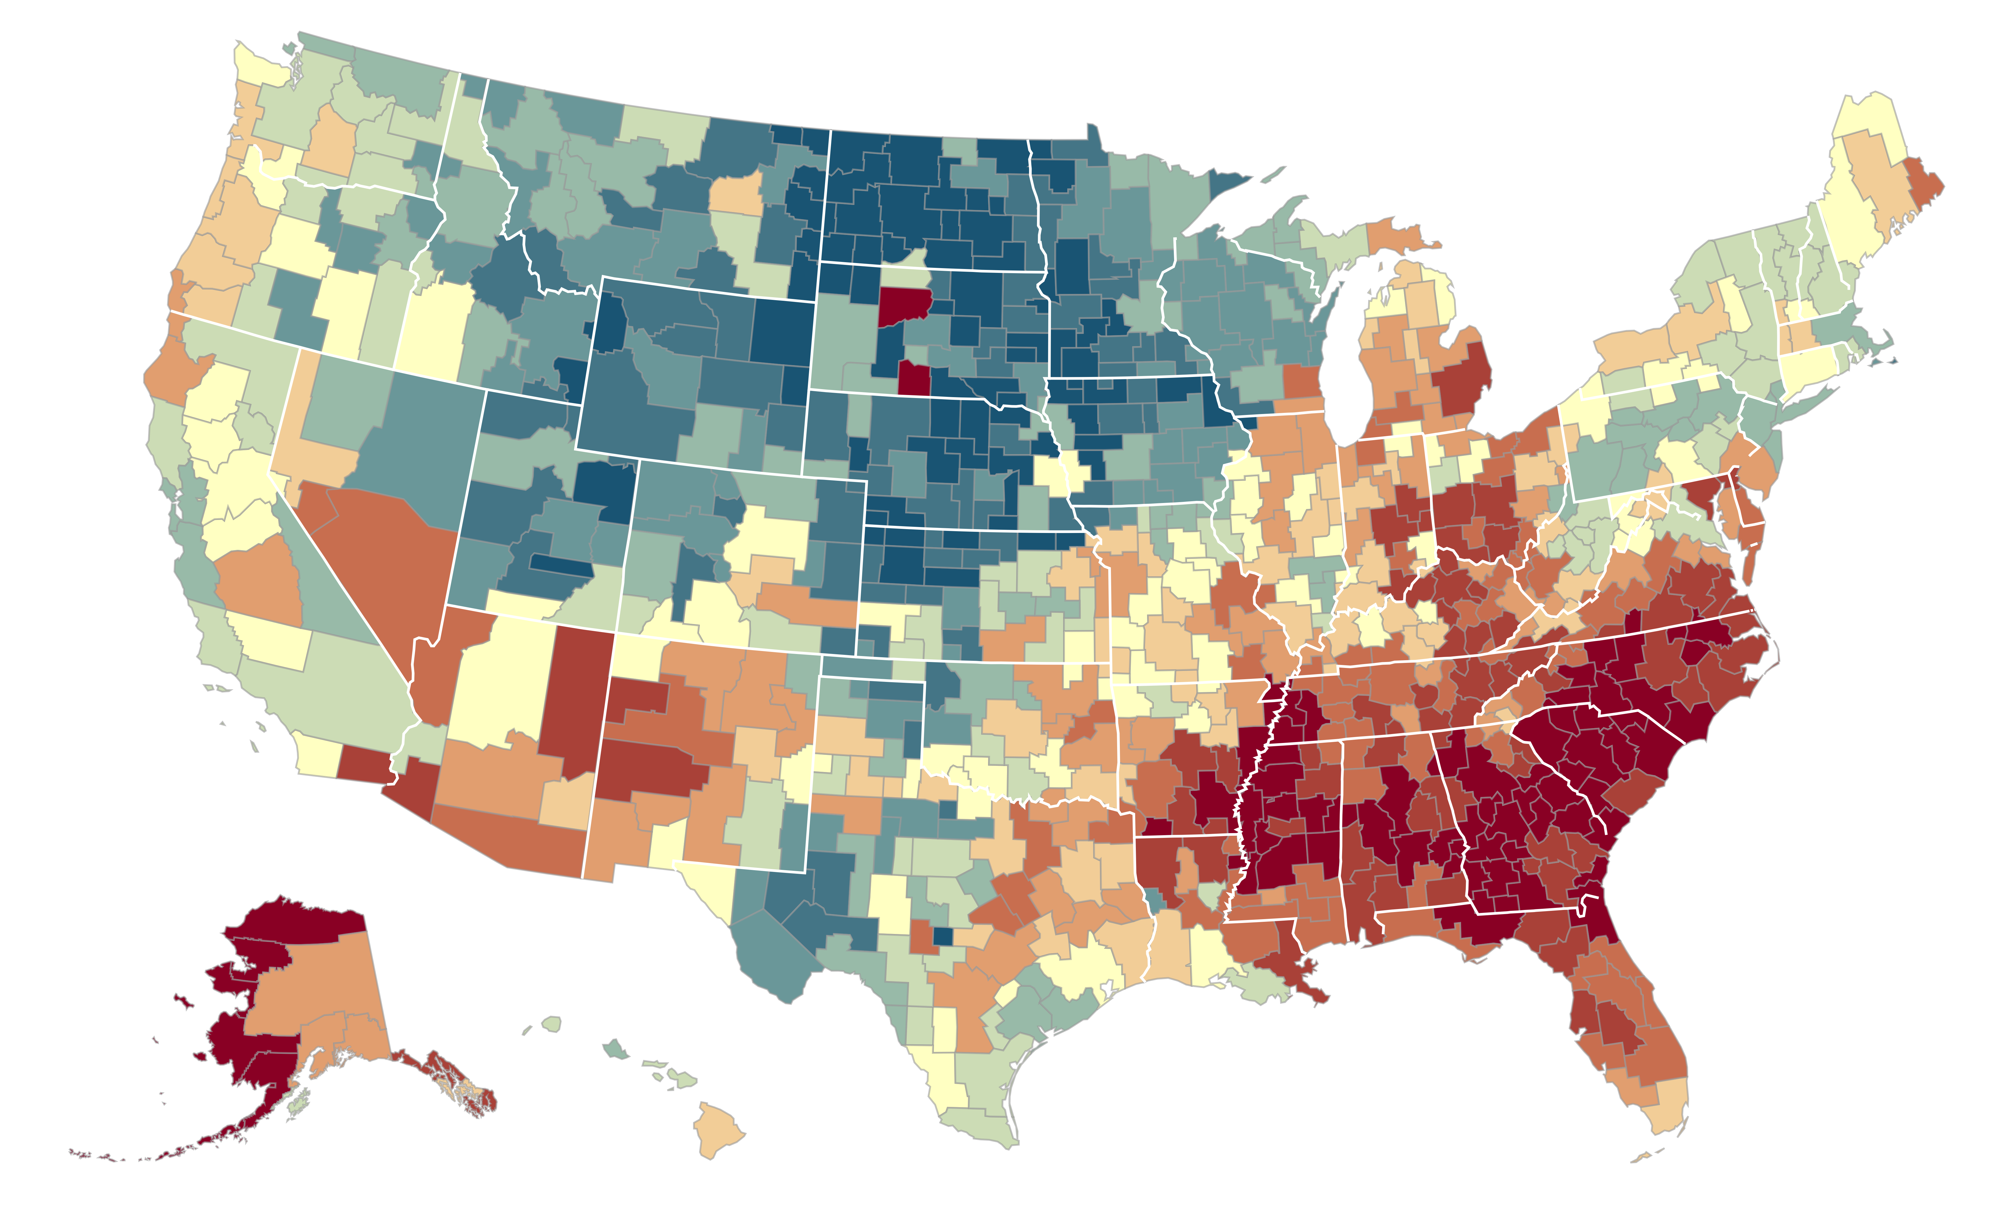

The Geography of Upward Mobility in the United States
Average Household Income for Children with Parents Earning $27,000 (25th percentile)
Seattle $35.2k
Salt Lake City $37.2k
Chicago $30.7k
Cleveland $29.4k
Boston $36.8k
San Francisco
Bay Area
$37.2k
Baltimore $28.2k
Washington DC $33.9k
> $44.8k
Los Angeles $34.3k
Atlanta $26.6k
$33.7k
Note: Blue = More Upward Mobility, Red = Less Upward Mobility
< $26.8k
Notes:
-720 metro and rural areas
-tremendous range of outcomes across the US. E.g. Baltimore and Seattle.

Slide 4
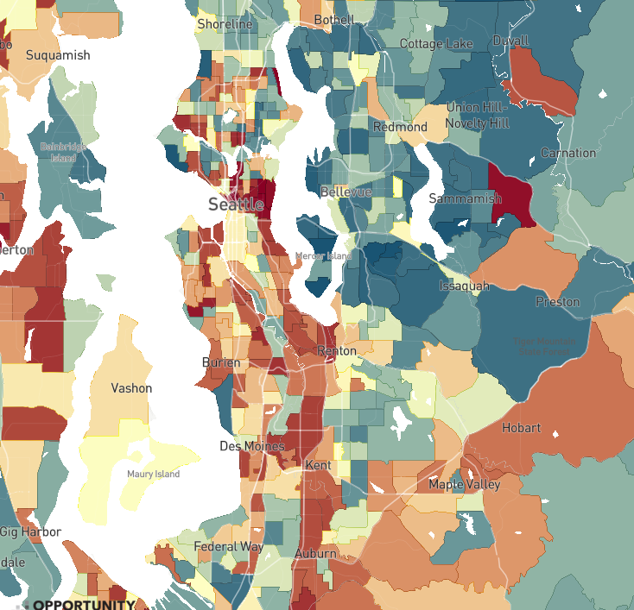
The Geography of Upward Mobility in Seattle
Average Income at Age 35 for Children with Parents Earning $27,000 (25th percentile)
North Queen Anne
$44k
Percentile Rank in Adulthood
> 60 ($55k)
Eastgate
$43k
Central District
$26K
48 ($39k)
< 30 ($20k)
Source: Chetty, Friedman, Hendren,
Jones, Porter (2018)
Notes:
--So I’ll just highlight the local variation. This is a map of Seattle, which is the site of our study. And you can see areas in red where kids from low-income families grow up to have relatively low earnings, such as here in Central District. But there are areas nearby, shaded in blue, where kids grow up to have higher incomes, such as North Queen Anne.
Notes: ~5 miles between each other

Slide 5
Motivation: Four Facts on Neighborhoods and Economic Opportunity
Children’s prospects for upward income mobility vary substantially across neighborhoods
Moving to better neighborhoods improves children’s (economic) outcomes in adulthood significantly in proportion to exposure and improves the health and well-being of adult movers

Slide 6
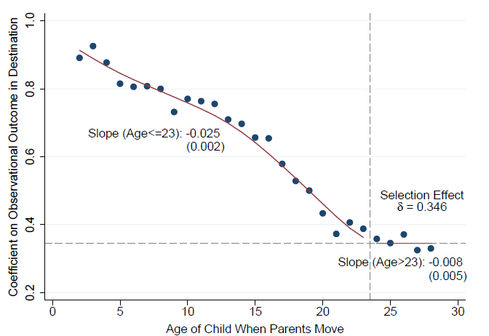
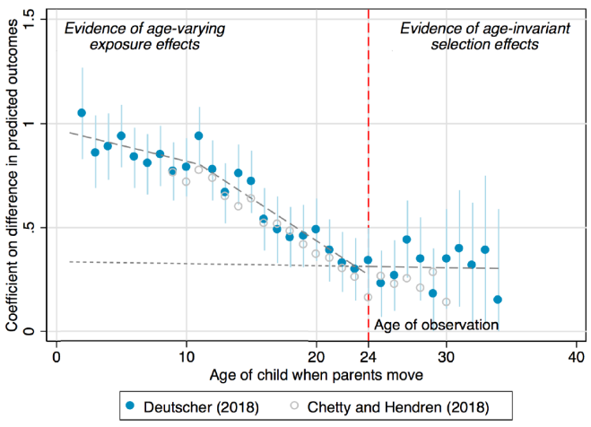
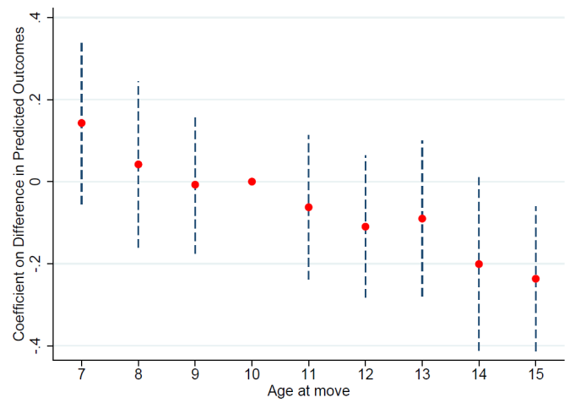
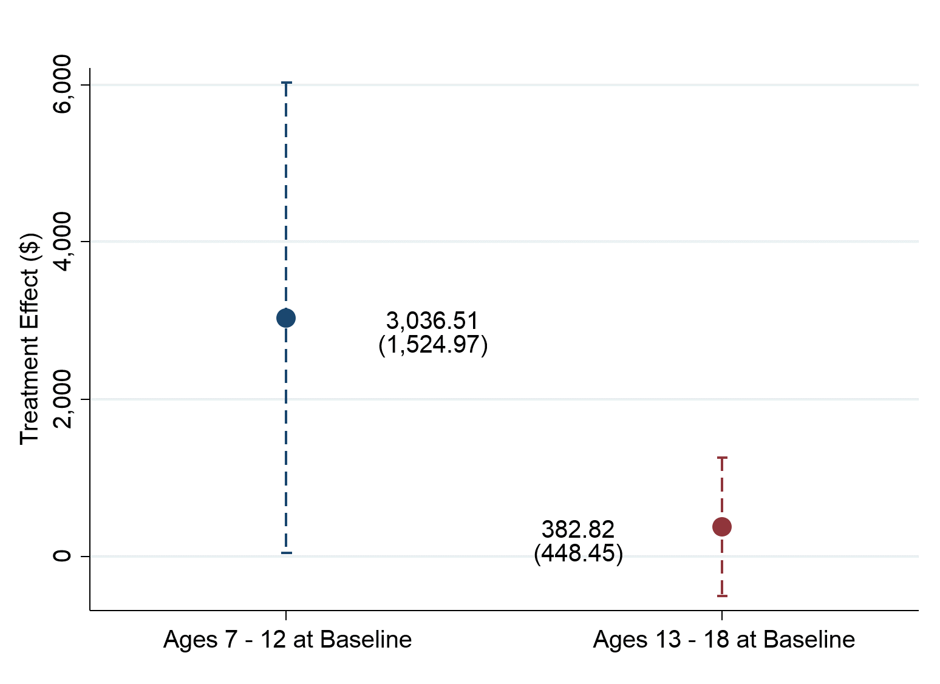
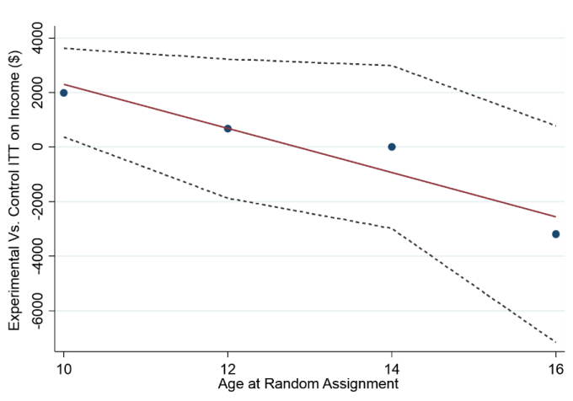
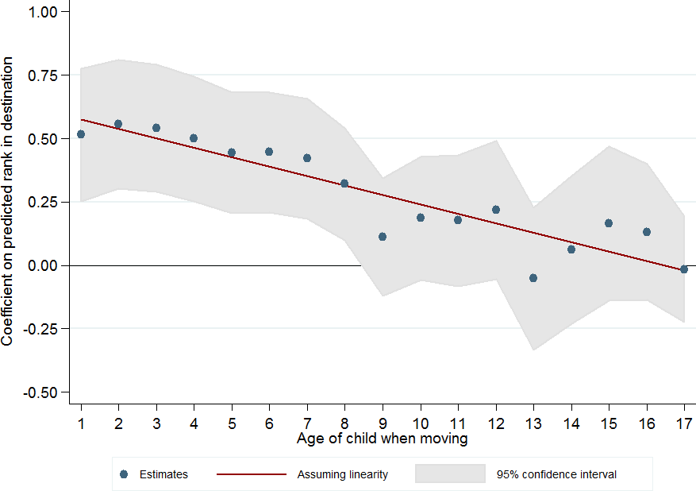
Estimates of Childhood Exposure Effects
United States
Australia
Montreal, Canada
Source: Chetty, Friedman, Hendren, Jones, Porter (2018)
Source: Deutscher (2018)
Source: Laliberté (2018)
MTO: Baltimore, Boston, Chicago, LA, NYC
Chicago Public Housing Demolitions
Denmark
Source: Faurschou (2018)
Source: Chetty, Hendren, Katz (AER 2016)
Source: Chyn (AER 2018)

Slide 7
Motivation: Four Facts on Neighborhoods and Economic Opportunity
Children’s prospects for upward income mobility vary substantially across neighborhoods
Moving to better neighborhoods earlier in childhood improves children’s outcomes in adulthood significantly
Low-income families who receive housing vouchers predominantly live in low-opportunity neighborhoods
Notes:
-Lastly, low-income families, and voucher recipients in particular, predominantly live in low-opportunity neighborhoods.
-The government spends 20 bill a year on the housing choice voucher program, formally known as section 8. The program has the explicit goal to use housing as a platform for economic mobility and it does so by helping families pay for their rent. The average voucher payment is 1500 per month in Seattle,

Slide 8
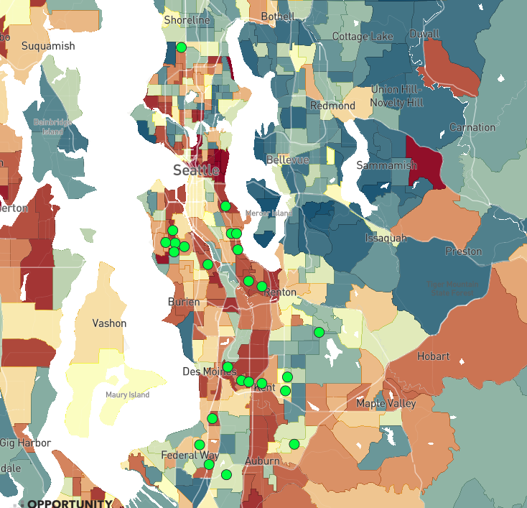
Most Common Locations of Families Receiving Housing Vouchers
25 most common tracts where voucher holders lived before the CMTO experiment
Percentile Rank in Adulthood
> 60 ($55k)
48 ($39k)
< 30 ($20k)
Notes:
-Despite this goal, you can see here that most families cluster in low-opportunity areas. Each of these dots marks one of the 25 most common areas voucher recipients live. 76% of voucher families live in below median upward mobility neighborhoods.
-So this raises the question of why do we see this segregation of low-income families into low-opportunity neighborhoods?

Slide 9
Motivation: Four Facts on Neighborhoods and Economic Opportunity
Children’s prospects for upward income mobility vary substantially across neighborhoods
Moving to better neighborhoods earlier in childhood improves children’s outcomes in adulthood significantly
Low-income families who receive housing vouchers currently live predominantly in low-opportunity neighborhoods
Differences in rent only partially explain why low-income families live in low-opportunity areas

Slide 10
The Price of Opportunity in Seattle and King County
Upward Mobility versus Median Rent by Neighborhood
60
50
with Low-Income Parents ($1000)
Average Incomes of Children
40
30
20
500
1000
1500
2000
2500
Median 2-Bedroom Rent in 2015
Notes:
Correlation of rents and upward mobility only 0.25 in King County

Slide 11
The Price of Opportunity in Seattle and King County
Upward Mobility versus Median Rent by Neighborhood
60
Opportunity Bargains
50
North Queen Anne
with Low-Income Parents ($1000)
Average Incomes of Children
40
30
Central District
20
500
1000
1500
2000
2500
Median 2-Bedroom Rent in 2015
Notes:
Here we see the two neighborhoods I showed you earlier, and we can see the median rent is the same, despite their drastic difference in economic mobility.

Slide 12
Question: Why Don’t Low-Income Families Move to Opportunity?
Two classes of explanations:
Preferences: families may prefer to stay in current neighborhoods because of other amenities (e.g., commute time, proximity to family)
Barriers: families may be unable to find housing in high-opportunity areas because of lack of information, search frictions, or landlords’ tastes
If barriers are what is driving segregation, can we reduce them through changes in affordable housing policy?
Notes:
-- To test between these two explanations, we worked with the Seattle and King County Housing Authorities to design Creating Moves to Opportunity, or CMTO, which aims to reduce the constraints and frictions that prevent families from moving to opportunity areas

Slide 13


Creating Moves
to Opportunity in Seattle and King County
Randomized trial to develop and test policy-scalable strategies to reduce barriers housing choice voucher recipients face in moving to high-opportunity areas in Seattle and King County

Slide 14
Definition of Opportunity Areas
Intervention focuses on families with young children (1+ child below age 15)
Therefore, use Opportunity Atlas to define “opportunity areas” as places where historically children from low income families have had the highest upward mobility
Starting point: Census tracts in top third of distribution within Seattle (SHA) and King County (KCHA)
Adjust definitions in collaboration with housing authorities to account for two issues:
Neighborhood change (using test score data to assess stability)
Creating contiguous areas

Slide 15
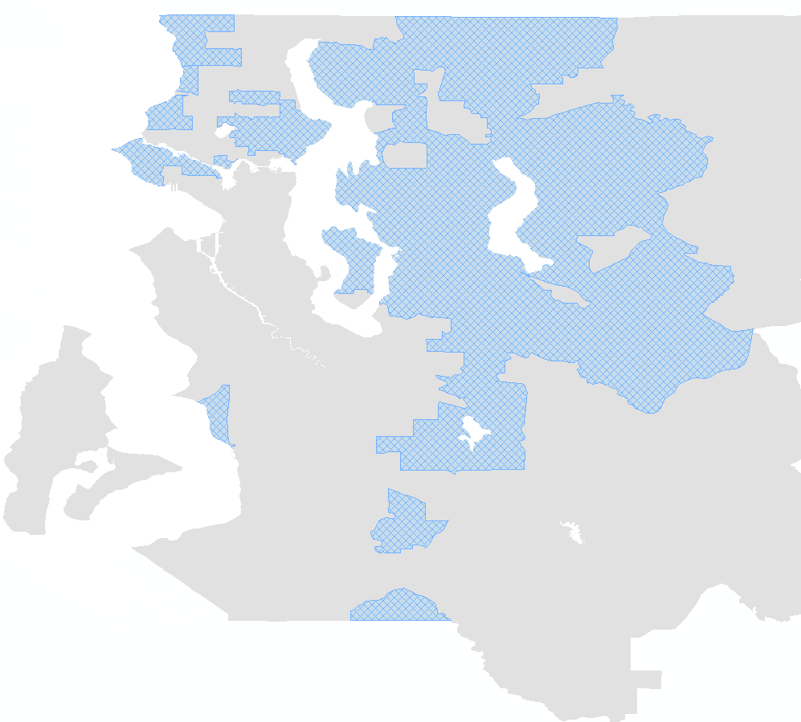
Designation of High-Opportunity Neighborhods
Shoreline
Cottage Lake
Lake City
Inglewood
High-Opportunity
Area
Seattle City Boundary
Northeast Seattle
Redmond
Magnolia
Central District
Bellevue
West Seattle
Rainier
Valley
Newport
Cougar
Mountain
Issaquah
Burien
Tukwila
East Hill
Des Moines
Kent
Lea Hill, Auburn

Slide 16
Treatment Interventions
CUSTOMIZED
SEARCH
ASSISTANCE
DIRECT
LANDLORD
ENGAGEMENT
SHORT-TERM FINANCIAL ASSISTANCE
On average, non-profit staff spend 6.3 hours with each household
52% of rentals in high-opportunity areas made through links via non-profit staff
Average financial assistance of $1,100 for security deposits, application fees, etc.
Program Cost: $2,600 per family issued a voucher (2.2% of average voucher payments over 7 years)
Note: Families not required to move to high-opportunity areas

Slide 17
Fraction of Families Who Leased Units in High Opportunity Areas
60
50
40
30
to High Opportunity Areas
Share of Households Who Have Moved
20
10
0
Control
Treatment

Slide 18
Fraction of Families Who Leased Units in High Opportunity Areas
60
50
40
30
to High Opportunity Areas
Share of Households Who Have Moved
20
Historical mean
rate: 11.6%
10
0
Control
Treatment

Slide 19
Fraction of Families Who Leased Units in High Opportunity Areas
60
50
40
30
to High Opportunity Areas
Share of Households Who Have Moved
20
14.3%
Historical mean
rate: 11.6%
10
0
Control
Treatment

Slide 20
Fraction of Families Who Leased Units in High Opportunity Areas
60
54.3%
50
40
30
to High Opportunity Areas
Share of Households Who Have Moved
20
14.3%
Historical mean
rate: 11.6%
10
0
Control
Treatment
Difference:
40.0 pp
SE: (5.2)

Slide 21
Fraction Who Has Leased Any Unit within Six Months of Voucher Issuance
Notes:
Contrast to MTO mandatory program where Experimental group had much lower lease-up rate (47%) than Section 8 group (62%) --- voluntary program with assistance hugely increases opportunity moves without reducing lease-up rate

Slide 22
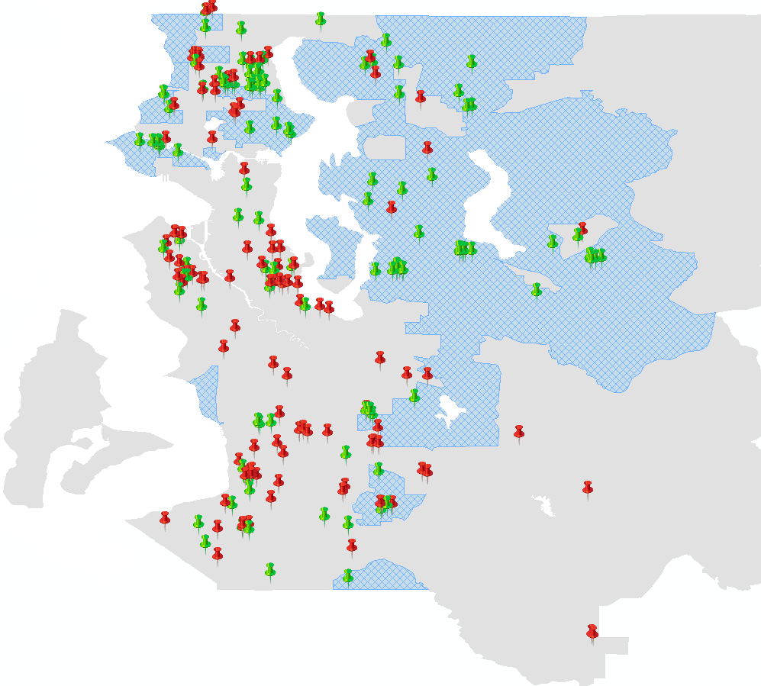


Destination Locations for Families that Leased Units Using Housing Vouchers
Lake City
Inglewood
High-Opportunity
Area
Northeast Seattle
Magnolia
Central District
Control
Bellevue
CMTO
Treatment
West Seattle
Cougar
Mountain
Issaquah
Rainier
Valley
Newport
Burien
Tukwila
East Hill
Des Moines
Kent
Lea Hill, Auburn
Notes:
CMTO treatment families not bunched at cut-off or in same neighborhoods spread out in high opportunity areas 77 treatment movers in 35 distinct Census tracts

Slide 23
Treatment Effects By Race and Ethnicity
80
65.9%
60
60.5%
46.2%
to High Opportunity Areas
40
Percent of Households Who Moved
Diff. = 37.0
Diff. = 55.6
(10.8)
(10.2)
Diff. = 33.9
23.5%
(7.3)
20
12.3%
10.3%
0
Control
Treatment
Control
Treatment
Control
Treatment
Black Non-Hispanic
White Non-Hispanic
Other Race/Ethnicity

Slide 24
Tradeoffs in Unit Characteristics
Are families making sacrifices on other dimensions to move to high-opportunity areas?

Slide 25
Tradeoffs in Neighborhood and Unit Quality
Treatment Effects on Distance Moved and Unit Size
Distance Moved
Unit Size
1500
1419.9
1278.8
1000
Square Footage of Unit
500
0
Control
Treatment
Difference:
141.1 sq. ft.
SE: (110.1)
Notes:
Treatment group does not end up in smaller units or need to move longer distances to lease-up in opportunity areas – end up in areas with lower poverty rates, better schools, more college graduates as well – higher payment standards in high rent areas for SHA and KCHA facilitated such moves. Rent payments to landlord up by $186 per month but out-of-pocket rent payments reduced by $37 per month for treatment relative to control.

Slide 26
Satisfaction with New Neighborhoods
Based on Surveys Six Months Post-Move
Satisfaction with
New Neighborhood
Certainty about Wanting
to Stay in New Neighborhood
Notes:
Can’t see persistence in new neighborhoods yet but follow-up survey after moves shows huge increase in neighborhood satisfaction and desire to stay in new neighborhood for treatment group

Slide 27
Conclusions
Economic residential segregation in the United States appears to be partially driven by barriers in the housing search process
Services to reduce barriers can increase moves to opportunity and thereby increase upward mobility substantially for low-income children
Program cost is about $2,600 per family issued a voucher, or $4,700 per opportunity move
CMTO is predicted to increase the lifetime household income of each child who moves at age 1 by $210,000 (10.4%)
Also predicted to increase college attendance rates, reduce teen birth rates, and reduce incarceration rates significantly

Slide 28

Seattle and King County Housing Authorities
Andria Lazaga, Sarah Oppenheimer, Jenny Le, Jodi Speer
MDRC
James Riccio, Nandita Verma, Jonathan Bigelow, Gilda Azurdia
J-PAL North America
Jacob Binder, Graham Simpson, Kristen Watkins
Opportunity Insights
Federico Gonzalez Rodriguez, Jamie Gracie, Martin Koenen, Sarah Merchant, Max Pienkny, Peter Ruhm, James Stratton, Kai Matheson
Johns Hopkins Fieldwork Team
Paige Ackman, Christina Ambrosino, Divya Baron, Joseph Boselovic, Erin Carll, Devin Collins, Hannah Curtis, Christine Jang, Akanksha Jayathi, Nicole Kovski, Melanie Nadon, Kiara Nerenberg, Daphne Moraga, Bronte Nevins, Simon Robbennolt, Brianna So, Maria Vignau-Loria, Allison Young, MEF Associates
This research was funded by the Bill & Melinda Gates Foundation, Chan-Zuckerberg Initiative, Surgo Foundation, the William T. Grant Foundation, and Harvard University
From Jasmine, 7 years old, whose family moved to a high-opportunity area in Seattle

Slide 29
Appendix Tables and Figures

Slide 30
Key Elements in the CMTO Intervention
CUSTOMIZED
SEARCH ASSISTANCE
High-opportunity area education to increase families’ knowledge about high-opportunity areas.
Rental application coaching to increase families’ competitiveness for rental units by addressing credit history and preparing a narrative.
Housing locator services to help families identify suitable units in high-opportunity areas.
INCREASED LANDLORD ENGAGEMENT
Cultivate relationships with landlords in designated high-opportunity areas to create housing opportunities for CMTO families.
Expedite lease-up processes by completing PHA required documents and conducting housing inspections more quickly.
Insurance fund to mitigate risks of property damage.
SHORT-TERM FINANCIAL ASSISTANCE
Grants to defray move-in expenses, such as application fees and security deposits (on average $1,100).

Slide 31
Next Steps
Completion of CMTO Seattle-King County Phase I analysis with full sample of 421 with at least 6 months to lease-up and analysis of persistence in new neighborhoods
CMTO Phase 2 ongoing in Seattle-King County – does a CMTO “lite” version work and role of financial incentives alone
Going forward, we plan to partner with other cities to expand CMTO nationally
Aim to increase cost-effectiveness of program and better understand mechanisms
Of course, not all families can move to opportunity → also studying which place-based investments have the biggest impacts on upward mobility in low-opportunity areas

Slide 32

Phase 2 Design: Three Treatment Arms
PHASE 1
Apr. 2018 to Feb. 2019*
PHASE 2
July 2019 to June 2020*
1. Comprehensive Support
$
Retain phase 1 program
Comprehensive Support
Financial Assistance
Navigator
Services
$
2. Financial Incentives Only
$
Provide only financial incentives
Financial Assistance
Navigator
Services
Financial Assistance
3. Cost-Optimized Comprehensive Support
$
Reduce financial incentives and increase navigator caseloads
Financial Assistance
Navigator
Services
* Enrollment timeframes (interventions continue beyond enrollment)

Slide 33
Creating Moves to Opportunity Program Costs
 | Average Cost
A. Total Costs
Cost of CMTO services per family issued | $2,573
Cost of CMTO services per family leased | $2,926
Cost of CMTO services per opportunity move | $4,712
Cost of CMTO services per family issued / 7-year HAP costs per family | 2.2%
B. Costs by Service Category
Cost of CMTO financial assistance per issuance | $1,070
Cost of CMTO program services per issuance | $1,500
Cost of PHA CMTO administration per issuance | $392
Cost savings of PHA services paid by CMTO | ($389)
C. Housing Assistance Payment (HAP) Costs
Incremental HAP cost per lease per year | $2,804
Incremental HAP / average HAP costs per family | 17.0%

Slide 34
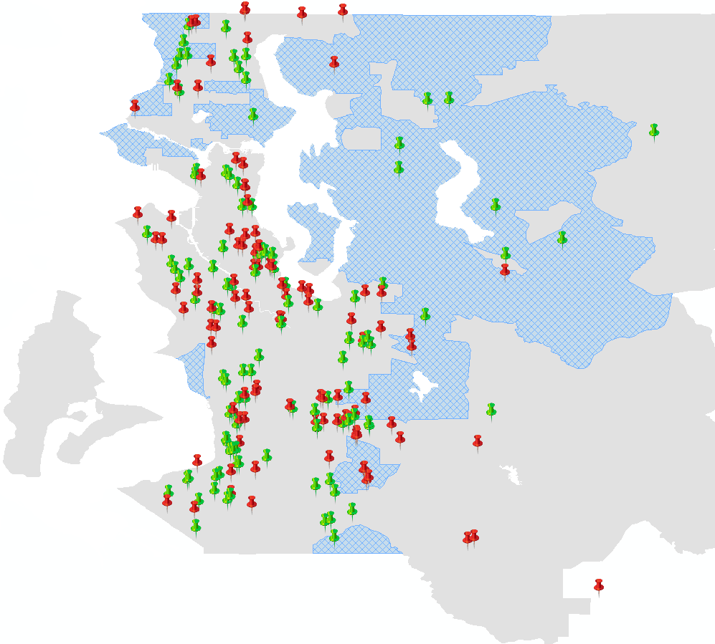
Map of Origin Tracts for Voucher Recipients
Lake City
High-Opportunity
Area
Inglewood
Northeast Seattle
Control
Magnolia
Central District
Bellevue
CMTO
Treatment
West Seattle
Cougar
Mountain
Issaquah
Newport
Burien
Tukwila
East Hill
Des Moines
Kent
Lea Hill, Auburn

Slide 35
Distribution of Upward Mobility in Destination Tracts Families Issued Vouchers by King County Housing Authority

Slide 36
Distribution of Upward Mobility in Destination Tracts Families Issued Vouchers by Seattle Housing Authority

Slide 37
Total Rent Paid to Owner

Slide 38
Post-Move Treatment Effects on Neighborhood Satisfaction
Certainty about Wanting to Stay
in New Neighborhood
Satisfaction with New Neighborhood
60
Control
60.0%
n = 45
60
Control
Treatment
Treatment
47.4%
40
40
n = 36
Neighborhood Satisfaction
33.3%
35.0%
28.6%
Certainty About Wanting to Stay or Leave
n = 7
28.6%
n = 7
n = 6
n = 6
20
17.3%
20
20.0%
18.4%
20.0%
12.0%
15.0%
15.8%
n = 4
n = 14
n = 4
n = 13
n = 3
11.8%
10.0%
n = 12
4.8%
4.8%
8.0%
n = 9
6.6%
n = 9
2.7%
n = 6
n = 5
n = 2
0
n = 1
n = 2
n = 1
0
Very
Somewhat
Neither
Somewhat
Very
Very Sure
Somewhat
In the Middle
Somewhat
Very Sure
Dissatisfied
Dissatisfied
Satisfied nor
Satisfied
Satisfied
Wants to
Sure
Sure
Wants to
Unsatisfied
Move
Wants to
Wants to
Stay
Move
Stay
Difference in % Very Satisfied:
33.6pp
Difference in % Very Sure Want to Stay:
29.5pp
SE: (11.6)
SE: (10.7)

Slide 39
Comparison Between MTO and CMTO Treatment Effects
Upward Mobility in Destinations
Conditional on Lease-up
Lease-up Rates by Group
Upward Mobility in Destinations
Unconditional on Lease-up

Slide 40
Effects of Voucher Payment Standard Changes on Moves to
Neighborhoods with Higher Upward Mobility
Effect of KCHA 5-Tier Reform
5 Tier Reform
50
in KCHA
48
2.6 ranks
In New Neighborhood (Forecast)
Mean Household Income Rank (p=25)
46
KCHA
44
SHA
42
Aug/Sep
Oct/Nov
Dec/Jan
Feb/Mar
Apr/May
Jun/Jul
Aug/Sep
Oct/Nov
2015
2015
2015/16
2016
2016
2016
2016
2016
Date of Voucher Issuance
Effect of 5-Tier Reform: 0.38 ranks
(0.65)

Slide 41
Effects of Voucher Payment Standard Changes on Moves to
Neighborhoods with Higher Upward Mobility
Effect of SHA Family Access Supplement
48
47
Supplement Introduced
46
45
In New Neighborhood (Forecast)
Mean Household Income Rank (p=25)
HHs w/ Kids
CMTO Pilot
44
43
HHs w/out Kids
42
Aug/Sep
Oct/Nov
Dec/Jan
Feb/Mar/Apr
May/Jun
Jul/Aug
Sep/Oct
2017
2017
2017/18
2018
2018
2018
2018
Date of Voucher Issuance
Effect of Family Access Supplement: 1.20 ranks
(0.64)

Slide 42
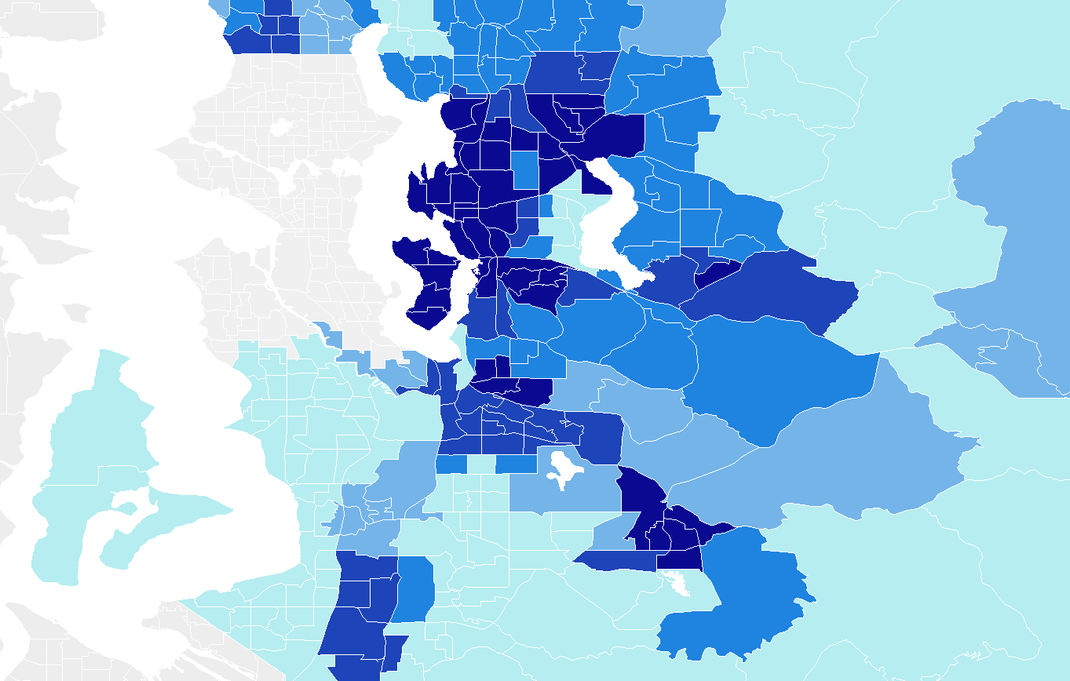

Changes to King County Housing Authority Payment Standards in March 2016
Increase in Max Rent
for 2BR Apt.
> $400
$250
< $150

Slide 43
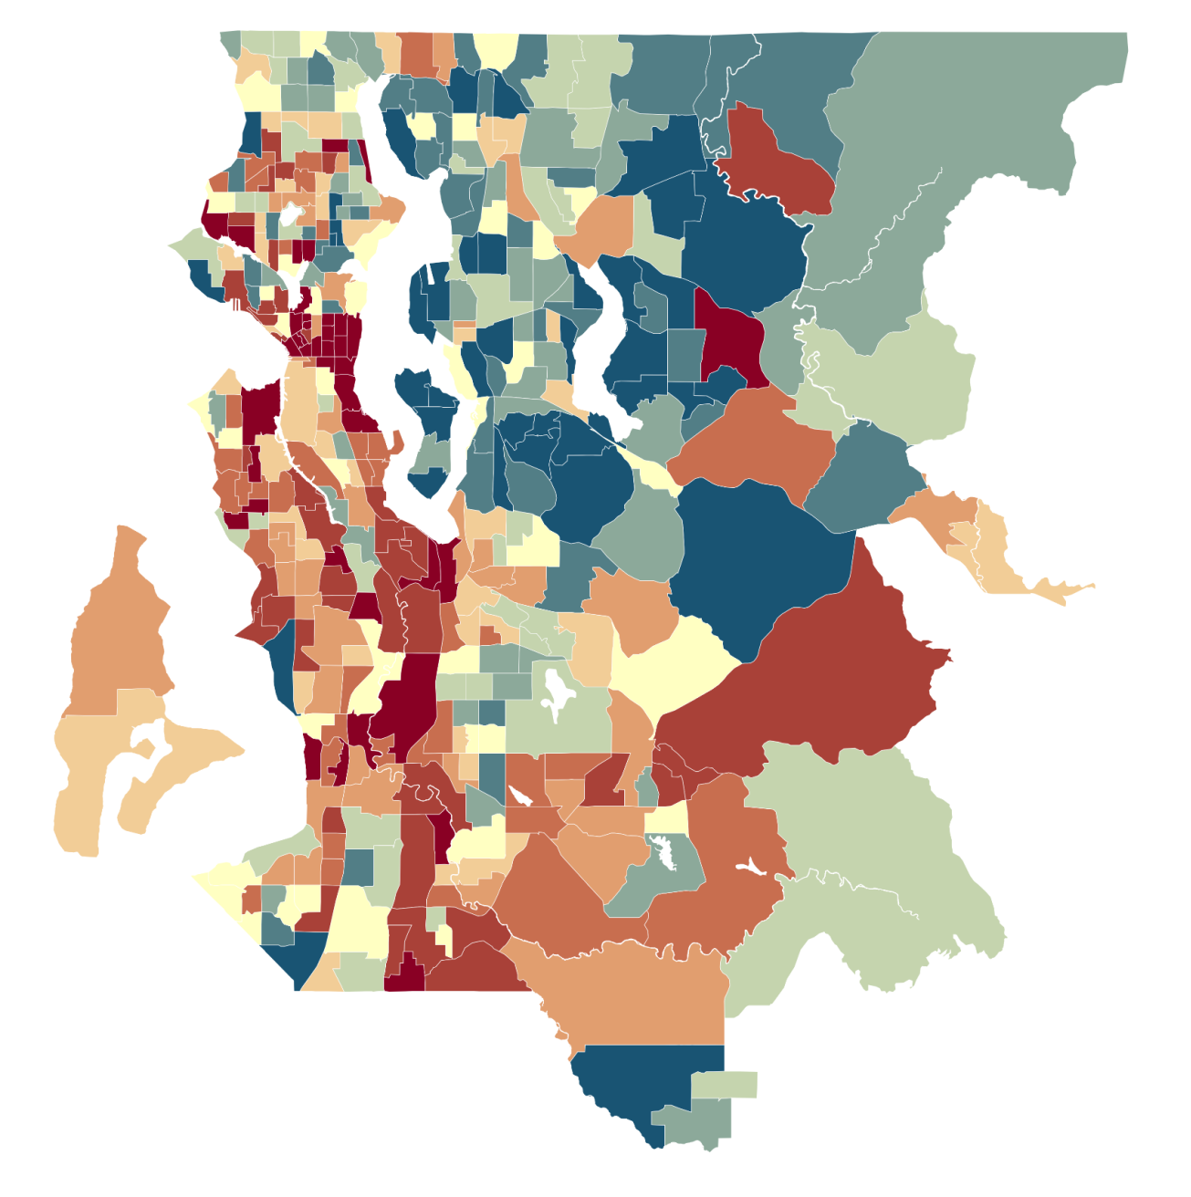
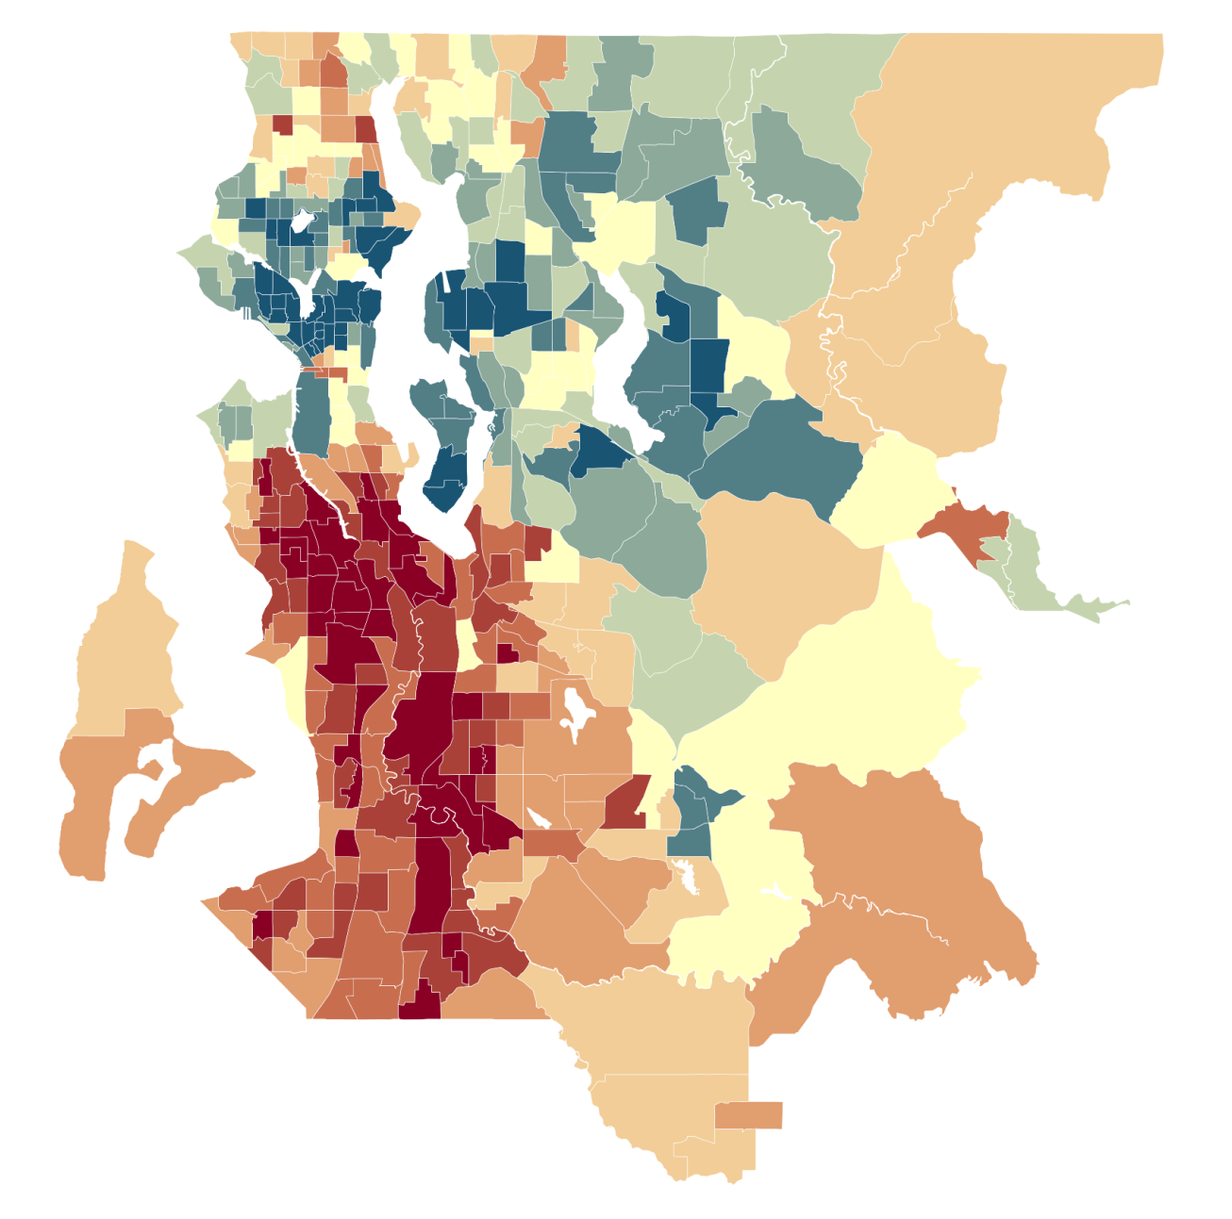

Opportunity Atlas vs. Other Measures of Economic Opportunity
Upward Mobility (Opportunity Atlas)
Kirwan Child Opportunity Index
Shoreline
Shoreline
Inglewood
Inglewood
> 53 ($46k)
> 0.68 SD
Central District
Bellevue
Central District
Bellevue
West Seattle
West Seattle
Cougar Mountain
Cougar Mountain
47 ($38k)
0.23 SD
Tukwila
Tukwila
East Hill
Kent
East Hill
Kent
< 40 ($31k)
< -0.44 SD
Population-Weighted Correlation Across Tracts: 0.30

Slide 44
Creating Moves to Opportunity Experiment
Sample frame: families with at least one child below age 15 who were issued vouchers in either Seattle or King County between April 2018 to April 2019
421 eligible families in the experiment, split randomly into control (standard services) and treatment
Here we use data on 274 families issued vouchers up to December 31, 2018, followed through June 24, 2019
141 treatment families and 133 control families

Slide 45
Intervention Process Timeline
Family Contacted
Notified of selection from waitlist
Voucher Issued
Unit Selected
Family approved by landlord for unit
Lease Signed
Intake Appointment
Consent
Randomization
Baseline survey
Nonprofit Staff Meet with Families and Landlords
Lease Up
Receive paperwork and financial assistance
(e.g. assistance for deposit)
Rental application coaching
Opportunity area education
Visiting locations
Search assistance
Landlord recruitment
Linking families to units
PHA
Nonprofit
Family Milestone

Slide 46
Summary Statistics for Experimental Sample
 | Pooled | Control | Treatment
Head of Household Characteristics | Mean | Mean | Mean
Household Income | $19,639 | $19,932 | $19,362
% Black | 50.2 | 50.8 | 49.6
% High School Grad or more | 80.8 | 75.4 | 85.8
Head of Household's Age | 34.2 | 34.2 | 34.2
Children’s Mean Age | 6.5 | 6.4 | 6.6
% Homeless | 13.6 | 15.2 | 12.1
% Currently Working | 56.4 | 63.6 | 49.6
% Satisfied with Current Neighborhood | 54.2 | 50.0 | 58.1
% Poverty in Census Tract | 16.1 | 16.2 | 15.9
Number of Observations | 274 | 133 | 141
F-Test for Treat-Control Balance: | F-Statistic | P-Value
 | 1.053 | 0.394
Notes:
70% indicate willing to move to specific high-opportunity areas in Seattle and King County -- primary motivations to move to new neighborhoods are better schools (44%), safer neighborhood (20%) and housing quality/space (17%) as compared to MTO where vast majority listed safety/gangs/crime as primary reason to move – much lower poverty rates in neighborhoods than MTO in mid-1990 where 50 percent mean nghd poverty vs. 16 percent in CMTO

Slide 47
Outline
Program Description and Experimental Design
1
Treatment Effect Estimates
2
Mechanisms
3
Conclusion
4

