Slide 1
Moving to Opportunity: What’s Next?
Jens Ludwig
University of Chicago, NBER & Brookings Institution
Summarizing work by the larger MTO research team: Lawrence Katz, Lisa Sanbonmatsu, Jeffrey Kling, Greg Duncan, Lisa Gennetian, Ronald Kessler, Emma Adam, Tom McDade, Stacy Tessler Lindau, Robert Whitaker, Raj Chetty, and Nathan Hendren

Slide 2
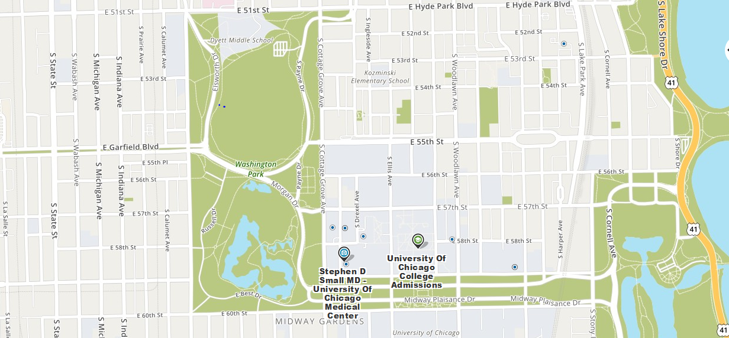
Notes:
One of the most striking features of poverty and disadvantage in modern America is how spatially patterned it is – in cities like Chicago, where I live on the south side, people’s life outcomes are dramatically different even across neighborhoods that are very close to one another.
For example in the 1940s the city of Chicago began to build high rise public housing projects all along the state street corridor leading south from downtown (in what had been the city’s racially segregated so-called “black belt”), one of the best known nationally was the Robert Taylor Homes located in the Washington Park neighborhood
Literally on the other side of the street (Cottage Grove) is the economically and racially integrated neighborhood of Hyde Park where the U of C is located and I live
U of c sociologists noticed these massive disparities in people’s life outcomes 100 years ago
Depending on what exact year you looked at the data, the child poverty rate was 5+ times as high in Washington Park as hyde park, homicide rate was up to 7 times as high in Washington Park, rate at which people died of heart disease was 3 times as high, high school dropout rate X times as high
Raised the natural question of whether something about the neighborhood environments themselves are influencing how people’s lives turn out?
Differential access to resources like high-quality schools or job opportunities
Differential exposure to middle-class families that might serve as role models or job referrals or sources of informal support
But there’s also an alternative possibility, which is that these differences across neighborhoods just reflect the fact that different types of people whose outcomes would have been different anyway wind up living in different places?

Slide 3
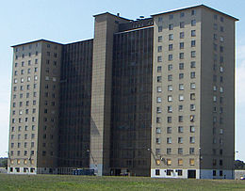
Notes:
One of the most striking features of poverty and disadvantage in modern America is how spatially patterned it is – in cities like Chicago, where I live on the south side, people’s life outcomes are dramatically different even across neighborhoods that are very close to one another.
For example in the 1940s the city of Chicago began to build high rise public housing projects all along the state street corridor leading south from downtown (in what had been the city’s racially segregated so-called “black belt”), one of the best known nationally was the Robert Taylor Homes located in the Washington Park neighborhood
Literally on the other side of the street (Cottage Grove) is the economically and racially integrated neighborhood of Hyde Park where the U of C is located and I live
U of c sociologists noticed these massive disparities in people’s life outcomes 100 years ago
Depending on what exact year you looked at the data, the child poverty rate was 5+ times as high in Washington Park as hyde park, homicide rate was up to 7 times as high in Washington Park, rate at which people died of heart disease was 3 times as high, high school dropout rate X times as high
Raised the natural question of whether something about the neighborhood environments themselves are influencing how people’s lives turn out?
Differential access to resources like high-quality schools or job opportunities
Differential exposure to middle-class families that might serve as role models or job referrals or sources of informal support
But there’s also an alternative possibility, which is that these differences across neighborhoods just reflect the fact that different types of people whose outcomes would have been different anyway wind up living in different places?

Slide 4
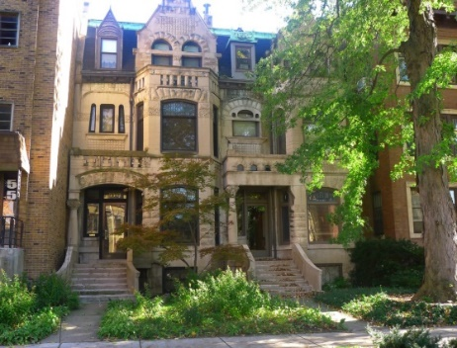
Notes:
One of the most striking features of poverty and disadvantage in modern America is how spatially patterned it is – in cities like Chicago, where I live on the south side, people’s life outcomes are dramatically different even across neighborhoods that are very close to one another.
For example in the 1940s the city of Chicago began to build high rise public housing projects all along the state street corridor leading south from downtown (in what had been the city’s racially segregated so-called “black belt”), one of the best known nationally was the Robert Taylor Homes located in the Washington Park neighborhood
Literally on the other side of the street (Cottage Grove) is the economically and racially integrated neighborhood of Hyde Park where the U of C is located and I live
U of c sociologists noticed these massive disparities in people’s life outcomes 100 years ago
Depending on what exact year you looked at the data, the child poverty rate was 5+ times as high in Washington Park as hyde park, homicide rate was up to 7 times as high in Washington Park, rate at which people died of heart disease was 3 times as high, high school dropout rate X times as high
Raised the natural question of whether something about the neighborhood environments themselves are influencing how people’s lives turn out?
Differential access to resources like high-quality schools or job opportunities
Differential exposure to middle-class families that might serve as role models or job referrals or sources of informal support
But there’s also an alternative possibility, which is that these differences across neighborhoods just reflect the fact that different types of people whose outcomes would have been different anyway wind up living in different places?

Slide 5
The MTO Experiment
MTO demonstration authorized by U.S. Congress
-- Housing and Community Development Act of 1992
-- A randomized social experiment
Open to families with children living in:
-- public housing or in project-based assisted housing
-- high-poverty neighborhoods (poverty rate >= 40%)
5 Sites: Baltimore, Boston, Chicago, Los Angeles, and New York
-- 4600 families enrolled from 1994 to 1998

Slide 6
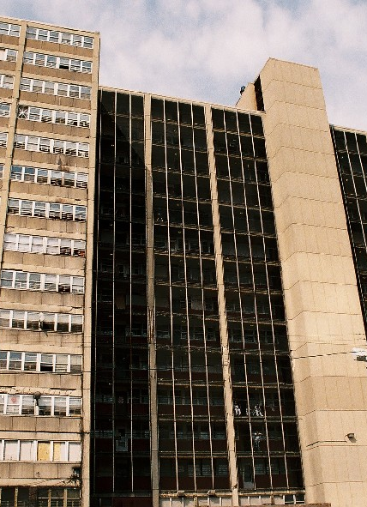
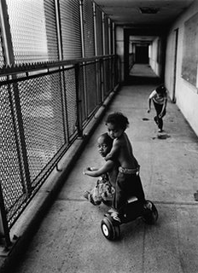
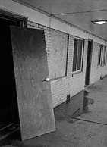
MTO Families Resided in Public Housing and Project-Based Housing at Baseline
Notes:
The racial segregation and disadvantage of these housing developments is reflected in the background characteristics of the MTO participants:
60% African American
30% Hispanic
most of these MTO households are headed by a female in her early 30s
A quarter were working and just over a third had a high school diploma

Slide 7
Random Assignment to 3 Groups
Control No vouchers – remain eligible for current
project-based housing assistance
Low poverty voucher (LPV) Restricted Section 8 voucher
(<10% Poverty Census Tract)
+
Mobility Counseling
Traditional voucher (TRV) Conventional Section 8 vouchers
Notes:
Given random assignment we wind up with three groups of families that are very similar on average in almost every way EXCEPT for the fact that two of these groups get some assistance to move out of the initial housing developments,
we can then follow up to track their life outcomes, that let’s us attribute any difference in average outcomes to differences in where families live rather than to differences in the characteristics of the families themselves

Slide 8
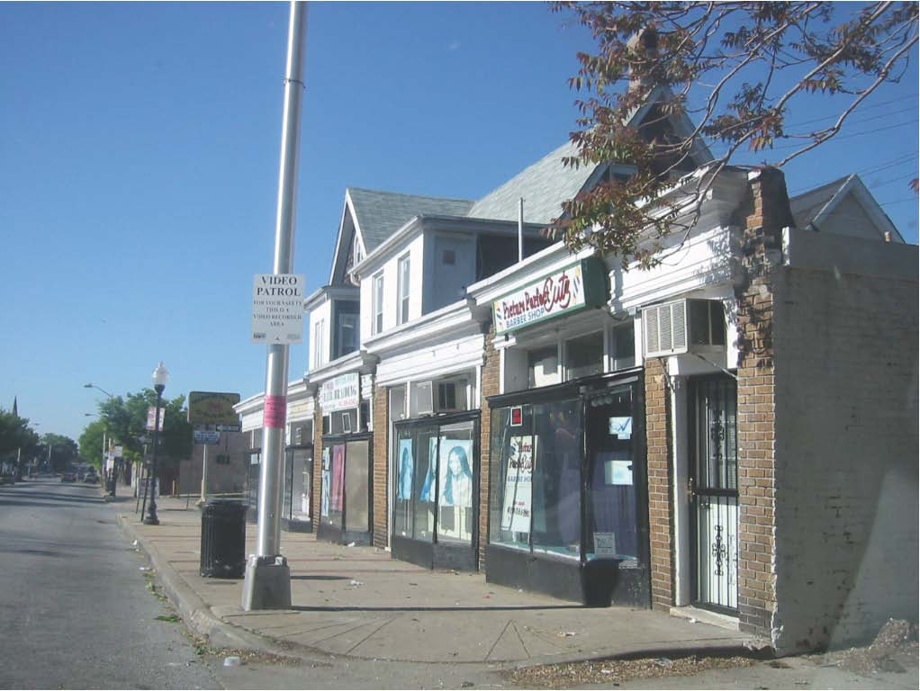
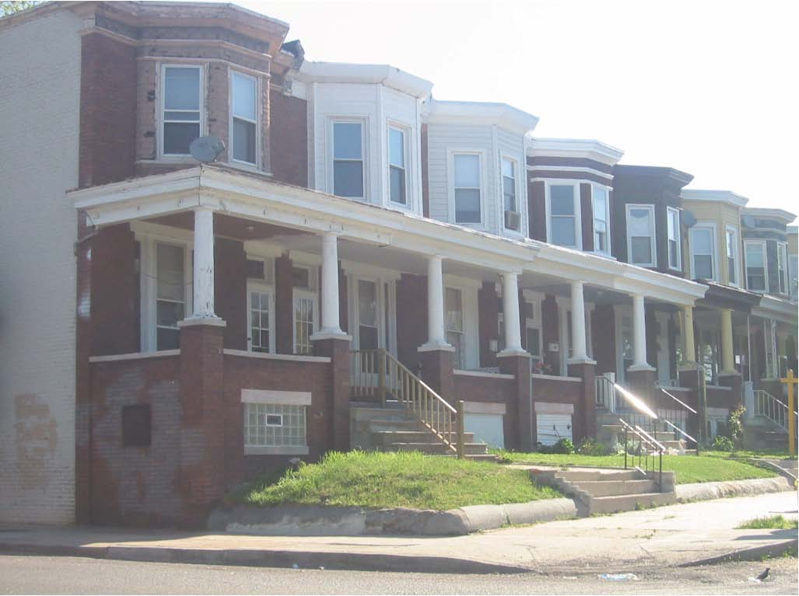
Types of Neighborhoods to which MTO Experimental Families Moved

Slide 9
Neighborhood Poverty Distribution (Weighted by time spent in each neighborhood during study period)
Notes:
Lots more families with low-poverty vouchers winding up in low-poverty neighborhoods
(but notice some control group families do as well, that’s partly b/c some of the housing developments got torn down over time and families relocated b/c of that and partly b/c some control group families just moved on their own)

Slide 10
Neighborhood Poverty Distribution (Weighted by time spent in each neighborhood during study period)
Notes:
We see smaller changes in neighborhood poverty rates for the families who got a standard housing voucher that DIDN’T require them to move to a low-poverty neighborhood and include extra mobility assistance
** For both voucher groups we also saw much smaller changes in neighborhood racial segregation than economic segregation

Slide 11
Impacts on MTO adults

Slide 12
Source: Sanbonmatsu et al. 2011, Ludwig et al. 2011, 2012

Slide 13
No Detectable Impacts on Adult Employment or Other Economic Outcomes

Slide 14
How do we reconcile lack of economic gains for MTO adults with previous research?
We think we can rule out:
Possibility that MTO families systematically different from other families
Possibility that MTO neighborhood changes “too small” wrt either time in low-poverty areas or racial integration
More likely explanation:
Adults who chose on their own to live in low-poverty areas different from other adults (selection bias)
Source: David Harding et al., 2019 UC-Berkeley working paper

Slide 15
Results for MTO children

Slide 16
Impacts on MTO children through 10-15 years after baseline
Remarkably limited through 10-15 years
Some improvements in health & behavior for girls
No signs of improved academic outcomes
For either boys or girls
Regardless of age at baseline

Slide 17
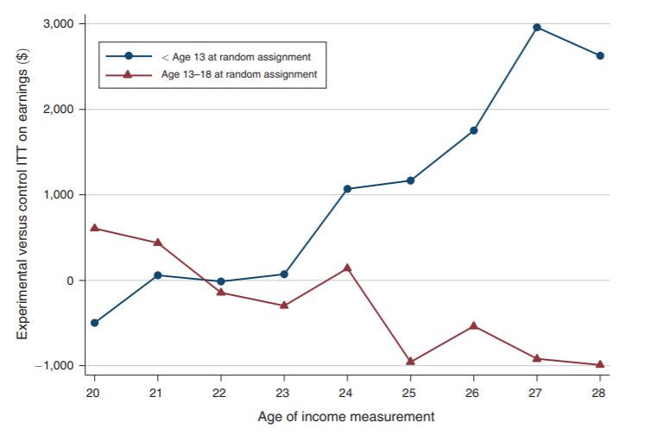
Longer-term follow up: Increased earnings for youngest kids at baseline
Source: Chetty, Hendren and Katz 2016 AER

Slide 18
What does this all mean?
Seem to be long-term benefits to having very young children in lower-poverty areas
For adults it depends on what we care about
Not likely to be earnings gains for adults from moving (need other economic supports for adults)
Impacts are on health

Slide 19
Catalog of Policy Options
How do we make mobility programs more helpful?
Target families with young children
More / better housing counseling and search assistance for families with young children.
Allowing higher voucher rents in lower-poverty areas
Expanding legal protections for voucher tenants.
Making vouchers more attractive to landlords.
Mobility incentives for housing authorities.
Collison and Ludwig, forthcoming

Slide 20
Catalog of Policy Options, continued
Additional supports beyond mobility needed to improve adult earnings
JobsPlus
Cash incentives
Improve neighborhoods directly
Key priority for families to participate in MTO was safety
Affects mental health, child schooling outcomes, job opportunities
Do more to make distressed neighborhoods safer
Collison and Ludwig, forthcoming

