Slide 1
Policy opportunities
for
handling juvenile records
Brookings Race, Prosperity & Inclusion Initiative
The Brookings Institution
March 20th, 2019

Slide 2
Key Facts on Justice-Involved Youth
48,043 juveniles were incarcerated as of 2015
Roughly 1 – 2 million youth are arrested each year
African American juveniles are 5x as likely to be arrested and committed than their white counterparts
Juvenile offenders often encounter employment challenges, even years after reentry into society
Source: Office of Juvenile Justice & Delinquency Prevention

Slide 3
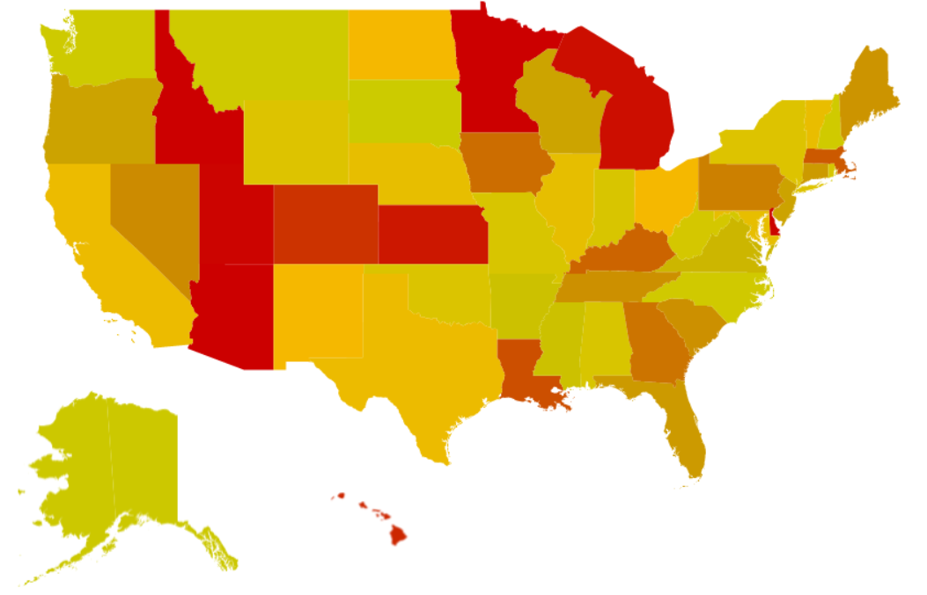
Policies on protecting and removing juvenile criminal records vary across the country
National Scorecard on Juvenile Records (2014)
Strong to Weak Laws on Protecting Criminal Records (Sealing, Expungement & Confidentiality)
Source: Juvenile Law Center

