Slide 1
From Saving to Spending:
Annuities and Nontraditional Retirement Payouts from Retirement Plans
David C. John, William G. Gale, J. Mark Iwry, Aaron Krupkin
Can DC Plans Provide Safe Income?
The Brookings Institution/The Retirement Security Project
April 18, 2019

Slide 2
73 percent of Americans said they do not have the financial skills to manage their money in retirement.
79 percent said that retirees don’t have the investment skills to ensure their retirement savings last throughout retirement.
Retirement Insecurity 2019: Americans’ Views of the Retirement Crisis

Slide 3
“Research has shown that even the most financially capable individuals can make irrational and sub-optimal choices when it comes to financial matters, or defer making those choices out of regret aversion.”
UK’s National Employment Savings Trust (NEST)

Slide 4
Needed:
An automatic retirement income solution that helps consumers as much as existing automatic retirement saving mechanisms.

Slide 5
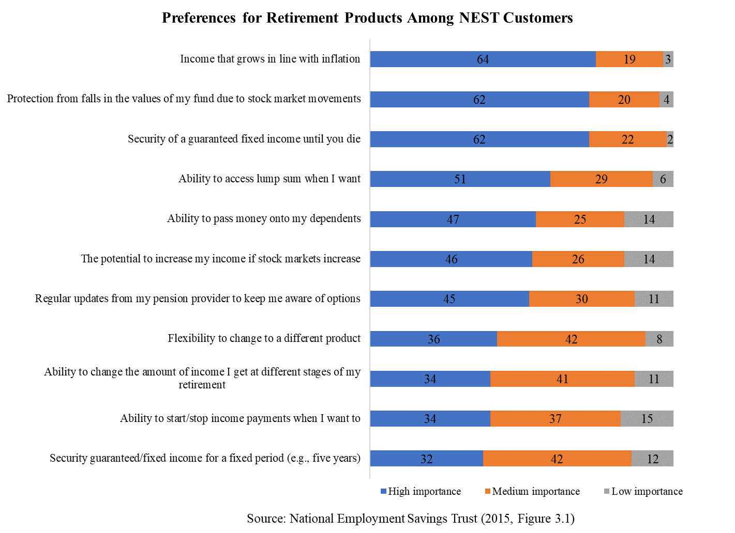

Slide 6
Annuities?
Offer many features consumers want
BUT:
Unpopular
Expensive
Not flexible if circumstances change
STILL:
A solution for some.

Slide 7
The Search for Another Solution
Australia: Government implementing Comprehensive Income Products for Retirement (CIPR).
United Kingdom: House of Commons Committee urges government to require plan sponsors to provide a default drawdown strategy.
Canada: Seven major pension stakeholders call for government to remove barriers to longevity risk pooling.
New Zealand: University of Auckland expert urges defaulting savers into a generic annuity.

Slide 8
Common Elements
Pooled managed payout fund
Additional amount available for emergencies or other purposes.
Longevity annuity or self-annuitizing feature.

Slide 9
Pooled Managed Payout Fund
Actively traded fund with a fairly high proportion of equities to produce consistent income plus countercyclical alternative investments or strategies intended to reduce losses when the markets are down
Example portfolio: 55% stocks, 6% bonds, 21% commodities, & 18% alternatives such as hedge funds, private equity, etc.
Payments Vary. Fund sets a target level of income every year, and then pays out a consistent amount every month.

Slide 10
“…meaning the amount of money you get is much higher than you could likely achieve on your own. Pension plan members pay significantly reduced fees for asset management and administration compared with what is available on the retail market, and they generally achieve higher investments returns (owing to economies of scale, better asset purchasing power and better capacity to diversify investments, across asset classes and over time).”
Bonnie-Jeanne MacDonald (2019) “Here’s a Way DC Pension Plans Could Give Canadians a More Secure Retirement.” The Globe and Mail: January 14, 2019.

Slide 11
Retirement Income Philosophies
Issue | Probability-Based | Safety-First
How are goals prioritized? | Particular lifestyle goal in mind. Not meeting this overall goal indicates failure. Goals are not prioritized between essentials and discretionary. | Prioritized goals. Example: (1) basic needs, (2) contingency fund, (3) discretionary expenses, (4) legacy goals.
Investment approach? | Diversified portfolio similar to pre-retirement plan. The focus is wealth management for the financial portfolio. | Assets are matched to goals. Focus on lifetime spending potential over an uncertain horizon, not maximizing wealth. There is a wider role for annuities, etc.
Role of an account-based pension? | Investment account is all that is needed for an outcome that will probably work & flexible enough for whatever adjustments are required. | Investment account limited to lesser goals.
Source: Pfau and Cooper (2014)

Slide 12
Tontines
An asset pool that pays its investors a regular income. As others die, the survivors receive increased income as the pool’s earnings are divided among fewer people and perhaps a share of the deceased members’ assets.
By the early 20th century, tontines accounted for roughly two-thirds of the life insurance market in the United States, representing more than 7 percent of national wealth. There were nine million policyholders, half the households in the country at that time.

Slide 13
Modern Retirement Tontines
Proposals by Moshe Milevsky, Jon Forman and others recreate the model for today’s savers & retirees.
A traditional tontine would pay out its highest amounts after many years when retirees are very old.
Milevsky, Forman, etc. use formulas to smooth payouts over time rather than backloading them. They are more suitable for todays’ consumers.

Slide 14
An Automatic Retirement Income Solution
Three parts: Managed payout fund, emergency fund, longevity annuity or other form of protection. This is a package, not separate elements.
Managed payout fund is not part of a Target Date Fund. It is a separate fund that an individual saver is automatically enrolled into as of a certain date. Transfer either over a number of years, or all at once when the individual reaches retirement.
The fund can (and should) include employees of many firms to build optimal size. Regulated to ensure that fees are low & investments are appropriate.

Slide 15
Automatic Mechanism – Slide 2
The transfer is not irreversible. If the employee changes jobs during the transition, the money could be rolled into the new employer’s plan. Similarly, the participant could change his or her mind and decide on a different retirement income strategy either before retirement or even after payments begin.
As a separate fund serving many employers, it could receive IRAs in addition to money from 401(k)-like plans.

Slide 16
Automatic Mechanism – Slide 3
Retirees receive a monthly check. Payments structured to meet RMD rules. Fund could handle both Roth and traditional tax treatments.
Purchase of longevity annuity could be immediate or delayed until a certain age. If purchase is delayed, funds to pay for it would be set aside, but could be released if circumstances change.
Same package could be available at a higher price for retail customers with an IRA, etc.

