Slide 1
Using “Big Data” to Track Consumer Spending in Real Time
Overview of new research with Aditya Aladangady, Shifrah Aron-Dine,
Wendy Dunn, Laura Feiveson, and Paul Lengermann for CRIW
Claudia Sahm
Federal Reserve Board
March 14, 2019
The views expressed here are those of the authors and not necessarily those of other members of the Federal Reserve System. Thanks especially to Dan Moulton, Aaron Jaffe, Felix Galbis-Reig, and Kelsey O’Flaherty, as well as to Zak Kirstein, Tommy Peeples, Gal Wachtel, Chris Pozzi, and Dan Williams in developing the new spending indexes.

Slide 2
Can “Big Data” improve macro policy making?
Promise
Challenge
Huge amount of detailed data already created in business operations
Address gaps in official statistics: geographic, high frequency, timely
Not constructed with same statistical rigor and theory as official statistics
Short time series, often not comparable to prior economic events
Slide 2 of 10

Slide 3
“Big Data” is a big TEAM effort
Important public good when private companies share data created in doing business and support economic statistics
Partnering here with First Data, a global payment technology company, that processes $2 trillion in card transactions annually
New anonymized indexes: a multi-disciplinary effort: economists at the Fed working with engineers and programmers at Palantir
Confidence in new indexes required comparisons to official statistics from Census Bureau and Bureau of Economic Analysis
Slide 3 of 10

Slide 4
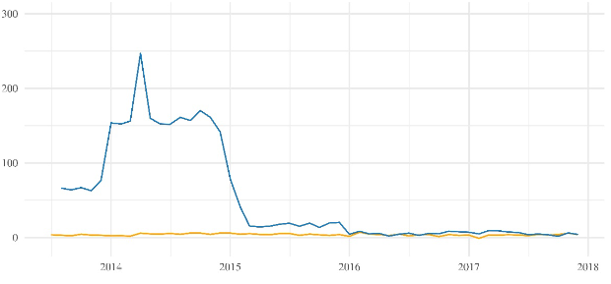
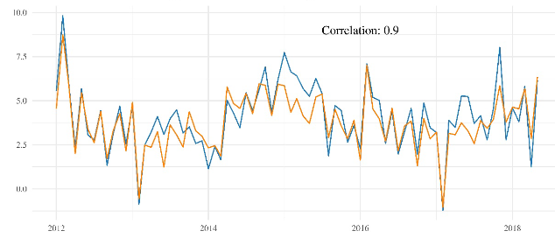
Filter and combine card transactions on retail activity
12-month percent change, spending at retail stores and restaurants
BEFORE
300
10
AFTER
200
First Data
Census
5
100
Census
0
First Data
0
2014
2015
2016
2017
2018
2012
2014
2016
2018
Before: changes in business operations swamp changes in economy-wide spending, not useful for macro policy
Slide 4 of 10

Slide 5
Filter and combine transactions on retail activity
12-month percent change, spending at retail stores and restaurants
BEFORE
AFTER
300
10
Correlation 0.9
200
First Data
Census
5
100
Census
0
First Data
0
2014
2015
2016
2017
2018
2012
2014
2016
2018
After: changes in new index in national monthly sales similar to Census Bureau, transactions do capture economic activity
Slide 5 of 10

Slide 6
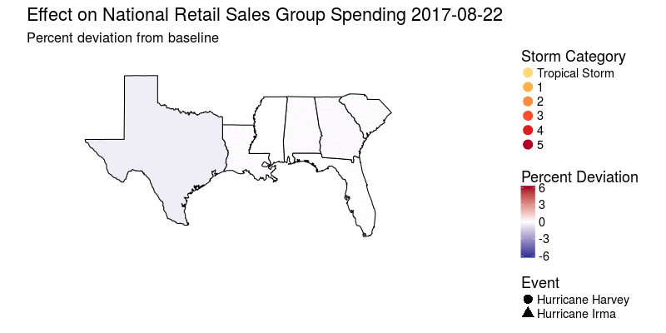
Tracking Hurricanes Harvey and Irma in real time
Tracked and reported on spending disruption within three days
Slide 6 of 10

Slide 7
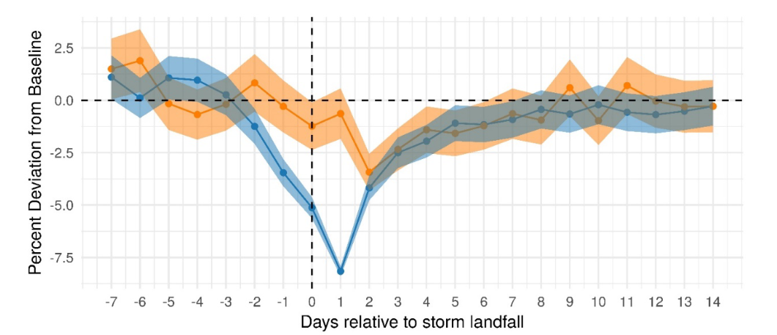
Sharp decline in spending with hurricanes
Effect on national, daily spending at retail stores and restaurants
Source: First Data Merchant Services, Board estimates.
Within week spending back to normal, no rapid make up spending
Slide 7 of 10

Slide 8
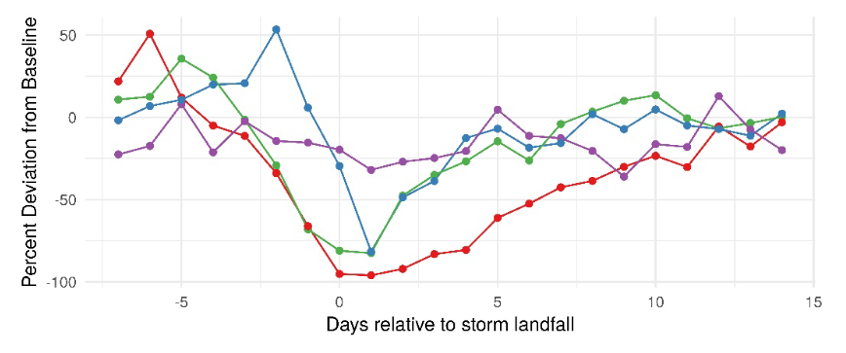
Spending in direct path of hurricanes nearly halted
Effect of Irma on local, daily spending at retail stores and restaurants
Jacksonville
Pensacola
Miami
Fort Myers
Geographic detail shows spending in metro areas in direct path declined by 75 to 100 percent with Irma, similar with Harvey
Slide 8 of 10

Slide 9
Translating daily disruptions to quarterly GDP
Effect of hurricane or other severe weather on national GDP depends on severity of weather event and population affected
Geographic, daily data allows us to isolate economic effects of short-lived, localized weather events with more confidence than is possible with national, monthly data
Our tracking of local daily spending at retailers and restaurant suggest almost ½ percentage point less GDP growth in third quarter of 2017 from Hurricanes Irma and Harvey
Slide 9 of 10

Slide 10
Concluding remarks
At early stages of harnessing “Big Data” for macro policy analysis, requires new techniques and scrutinizing data quality
New spending indexes used to study high-frequency, localized events in real time (other examples: delay in EITC, state sales tax holidays) can fill gaps from official national statistics
New, independent data sources when combined with existing official statistics can also improve real-time assessments of economic conditions, important for supporting policy decisions
Slide 10 of 10

