Slide 1
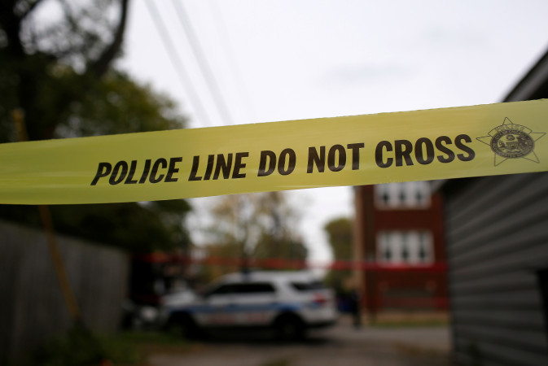
Deadly Force:
The legal basis for police shootings of unarmed black males
Brookings Race, Prosperity & Inclusion Initiative
The Brookings Institution
October 26th, 2018

Slide 2
Agenda
National fatal shootings by police officers
National fatal police shootings of all victims (by race)
National fatal police shootings of unarmed victims (by race)
Criminal case dispositions

Slide 3
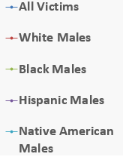
National fatal shootings by police officers
Fatal Shootings by Police, 2015-2018
Number of fatal shootings
Source: Fatal Encounters, 2018

Slide 4
National fatal shootings of all victims by race

Slide 5
National fatal shootings of unarmed victims by race

Slide 6
High profile cases of 17 unarmed black male victims
Stephon Clark, March 18, 2018
Botham Jean, September 6, 2018
Terence Crutcher, September 16, 2016
Philando Castile, July 6, 2016
Keith Lamont Scott, September 20, 2016
Paul O’Neal, July 28, 2016
Alton B. Sterling, July 5, 2016
Samuel DuBose, July 19, 2015
*Freddie Gray, April 19, 2015
Walter L. Scott, April 4, 2015
Christian Taylor, August 7, 2015
Akai Gurley, November 20, 2014
Laquan McDonald, October 20, 2014
Tamir Rice, November 22, 2014
Michael Brown, August 9, 2014
*Eric Garner, July 17, 2014
Dakota Bright, November 8, 2012
*Death as a result of physical violence/bodily injury by police officers

Slide 7
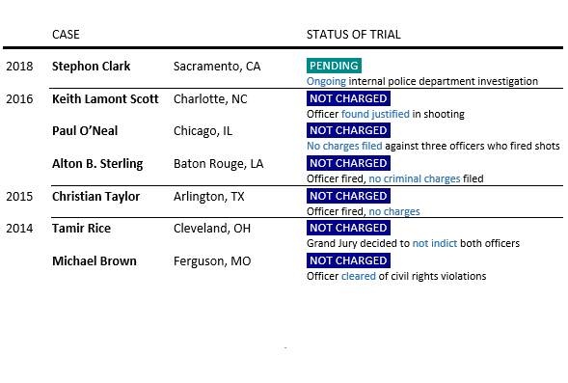
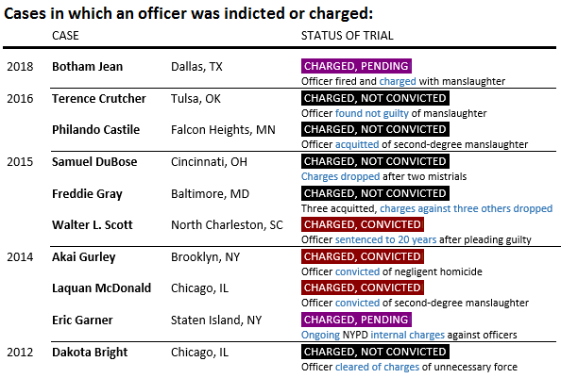
Criminal case dispositions of the 17 black male victims
Source: New York Times

Slide 8
Criminal charges and convictions against officers are rare nationally

Slide 9
“Reasonable threat” - police officer perspectives
Officer Guyger…said that she mistook Jean’s apartment…for her own…and shot him thinking he was an intruder.
Source: Dallas News, September 18, 2018
Police had said officers fired at Clark believing he was pointing a gun at them. Source: Washington Post, March 30, 2018
Officer Loehmann told the grand jury that he fired out of fear for his safety after Tamir…grabbed the pellet gun, which he believed to be real. Source: NYT, December 28, 2015
Officer Shelby…calmly assert(ed) that she had a reasonable fear that Mr. Crutcher was reaching for a gun and that she simply followed her training. Source: NYT, May 17, 2017
Vinson felt Scott was “an imminent threat” to him and the other officers…he fired because Scott was looking at the officers like he was “trying to decide who to shoot first.” Source: Washington Post, November 30, 2016

