Slide 1
Discussion of “Unconventional Monetary Policies in the Euro Area, Japan and the United Kingdom”
Ben Broadbent
Deputy Governor for Monetary Policy
Brookings, Washington DC
17 October 2018

Slide 2
Three main conclusions
QE more powerful in periods of heightened financial distress. Yes. When markets operating smoothly liquidity & portfolio balance channels relatively less important, signalling effect more so. Some more evidence on this point.
Unconventional policy requires central bank is credible. Yes. True (in some sense) of all monetary policy! Particularly true of QE precisely because signalling channel matters. ∃ limits to our ability to commit.
Less effective when long rates already low. Yes. Related to limits to commitment.

Slide 3
Some other points
We need to be modest about QE estimates. Evidence is limited, effects almost certainly vary, use in the crisis was not exogenous policy. “x $bn of QE = y bp off short rate” unlikely to be valid.
Equally, we should push back hard against the more extreme (and often demonstrably false) criticisms. Important if we’re to use it again.
Operationally and politically more complicated to achieve in a currency union with a non-unitary fiscal authority... but thankfully not impossible.

Slide 4
QE’s critics
Newfangled and dangerous policy
Didn’t help the wider economy - served only to subsidise profligate governments (Europe) and/or push up prices of financial assets (US/UK/Europe), risking instability and benefiting only the well-off
[Can’t be reversed]

Slide 5
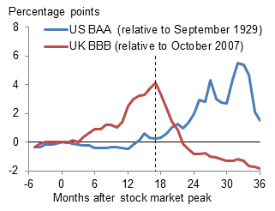
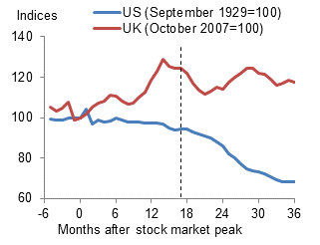
Things might have been worse
Corporate bond yields Deposits
Sources: Bank of England; ICE BoAML; National Bureau of Economic Research, retrieved from FRED, Federal Reserve Bank of St Louis; and Bank calculations.

Slide 6
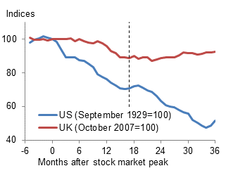
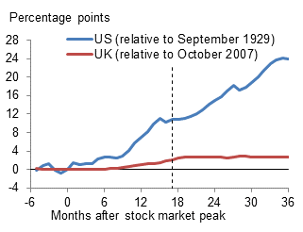
Things might have been worse
Industrial production Unemployment
Sources: National Bureau of Economic Research and Board of Governors of the Federal Reserve System, retrieved from FRED, Federal Reserve Bank of St Louis; ONS; and Bank calculations.

Slide 7
The impact on GDP
Weale and Wieladek (2016): Bayesian VAR, direct estimates, variety of identification schemes including sign restrictions and reaction of equity prices. QE of 1% of GDP leads to a 0.25% rise in real GDP for the UK.
Churm et al (2015): Assumes bond yields a sufficient statistic for GDP effect. QE2 (about 11% of GDP) added 0.6% to GDP.
Andrade et al (2016): Assesses asset valuation and reanchoring channels, then incorporates these into stylised macro model. Finds APP increased output by around 1.1%.

Slide 8
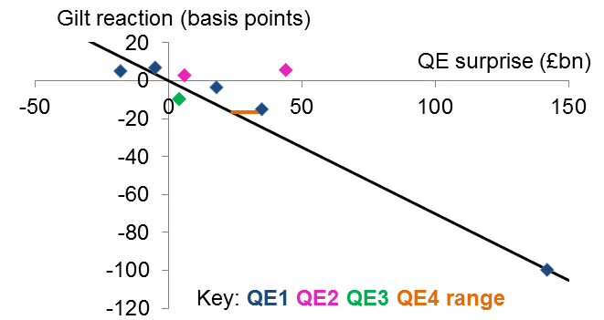
QE1 had the largest impact on bond yields
Sources: Bloomberg Finance L.P., TradeWeb, Reuters Poll, and Bank calculations. The chart is based on Figure 10 in Haldane et al (2016).

Slide 9
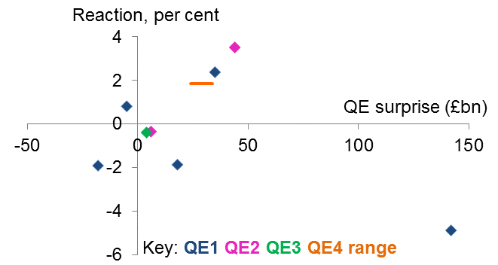
The impact on share prices is harder to detect
Sources: Refinativ, Reuters Poll, and Bank calculations. The share price reaction is for UK-focused equities.

Slide 10
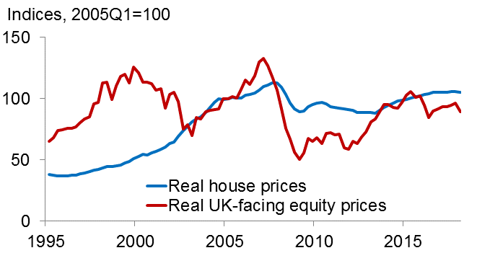
Real prices of equity, housing below pre-crisis levels
Sources: Nationwide, ONS, Refinativ, and Bank calculations.

Slide 11
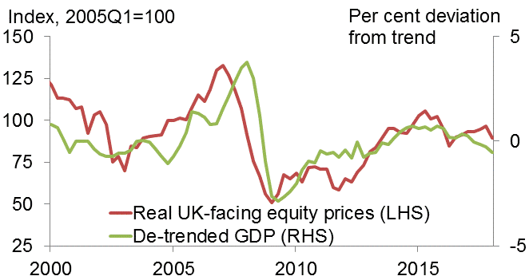
Real equity prices and de-trended GDP
Sources: ONS, Refinativ, and Bank calculations. Output de-trended using a HP filter.

Slide 12
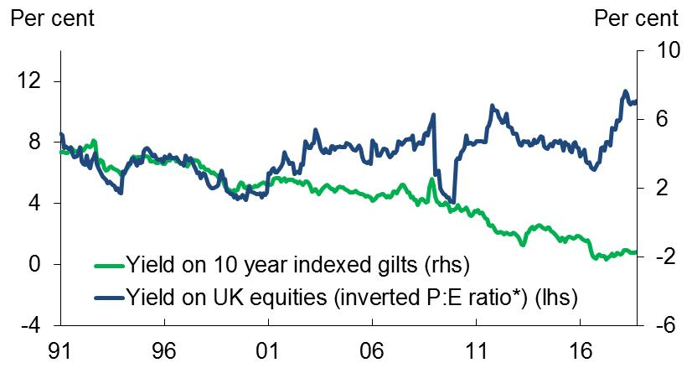
Most news has driven equities, bonds in opposite directions, before and since QE
Sources: Bank of England, Refinativ, TradeWeb, Bloomberg Finance L.P and Bank calculations. * Adjusted for changes in leverage.

Slide 13
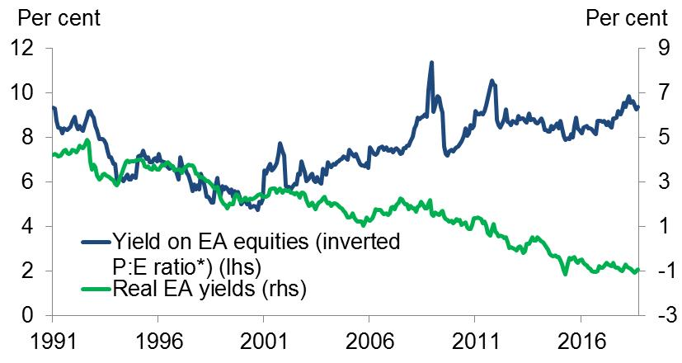
Similar divergence in Europe…
Sources: Bank of England, Refinativ, Bloomberg Finance L.P and Bank calculations. Real EA yields implied from swaps, extrapolated using UK data prior to April 2004. * Adjusted for changes in leverage.

Slide 14
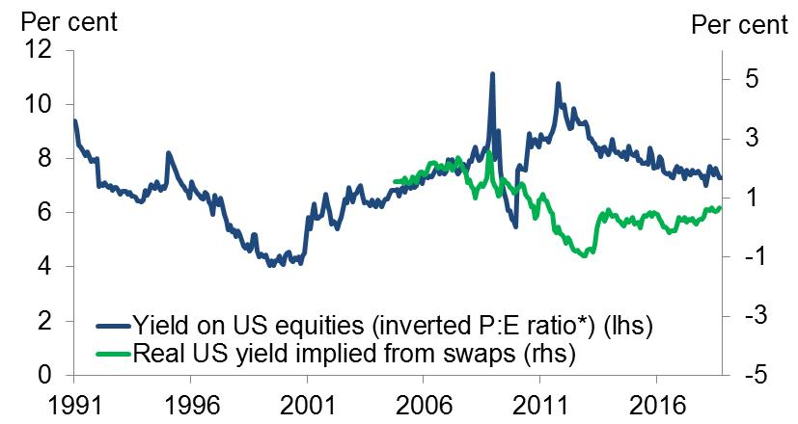
… and in the US
Sources: Bank of England, Refinativ, Bloomberg Finance L.P and Bank calculations. * Adjusted for changes in leverage.

Slide 15
How does it work?
Modigliani and Miller/ Wallace: Open market operations are neutral.
But if markets are imperfect – investors have “preferred habitats” – substituting short-term for long-term liabilities can have “portfolio balance” effects on their relative price (and so long-term rates).
If central bank money has special features (even relative to short-term government debt) there may be additional “liquidity effects”.
QE may signal something about monetary policy in future.

Slide 16
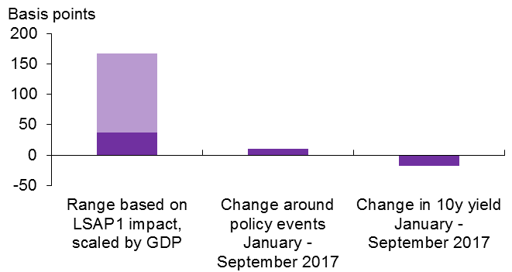
US QT has done little to US bond yields
Sources: Bloomberg Finance L.P, BEA, Federal Reserve Bank of New York (2017), academic studies and Bank calculations.

Slide 17
Taper tantrum
Ben Bernanke, 22 May 2013: “If we see continued improvement [in the economy] and we have confidence that that is going to be sustained then we could, in the next few meetings, take a step down in our pace of [asset] purchases.”
FOMC minutes later that day: “a number of [FOMC] participants expressed willingness to adjust the flow of purchases downward as early as the June meeting.”

Slide 18
QT
Yellen, January 2017:
“The downward pressure on longer-term interest rates that the Fed’s asset holdings exert is expected to diminish over time -- a development that amounts to a “passive” removal of monetary policy accommodation. Other things being equal, this factor argues for a more gradual approach to raising short-term rates.”

Slide 19
QE and the signalling channel
QE1: Balance sheet and future short rates complements: easing on one front implied more on the other as well.
QT: Balance sheet and future short rates substitutes: tightening from one implies less from the other.

Slide 20
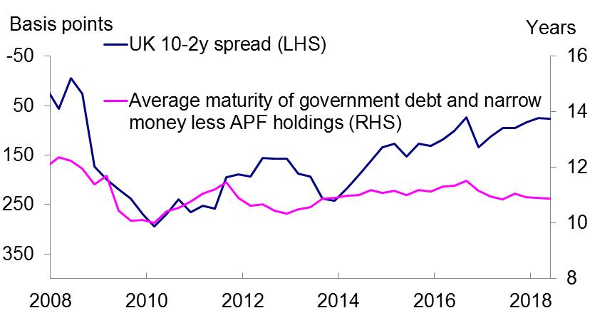
UK: despite QE average maturity of claims on state has not declined
Sources: United Kingdom Debt Management Office, Bank of England, TradeWeb, Bloomberg Finance L.P and Bank calculations.

Slide 21
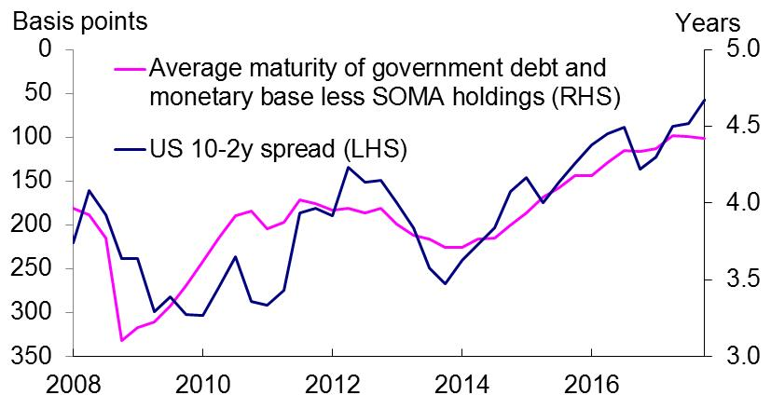
In the US it has risen
Sources: U.S. Department of the Treasury, Dallas Fed, New York Fed, St. Louis Fed, Bloomberg Finance L.P and Bank calculations

Slide 22
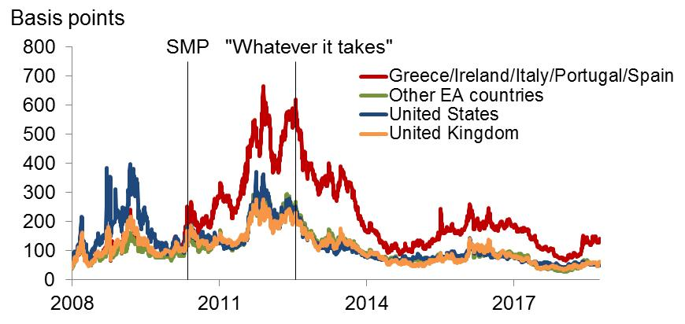
Most powerful intervention by the ECB was verbal
Sources: Markit Group Limited, SNL Financial, Refinativ and Bank calculations. Asset-weighted five-year CDS premia for selected banking systems.

