Slide 3
Unleashing Africa’s inner strengths: Institutions, policies, and champions
Sustainable financing for economic development: Mobilizing Africa’s resources
Broadening the benefits of growth: No one left behind
Rethinking Africa’s structural transformation: The rise of new industries
Harnessing Africa’s digital potential: New tools for a new age
Reassessing Africa’s global partnerships: Approaches for engaging the new world order

Slide 4
Chapter 2
Sustainable financing for economic development: Mobilizing Africa’s resources

Slide 5
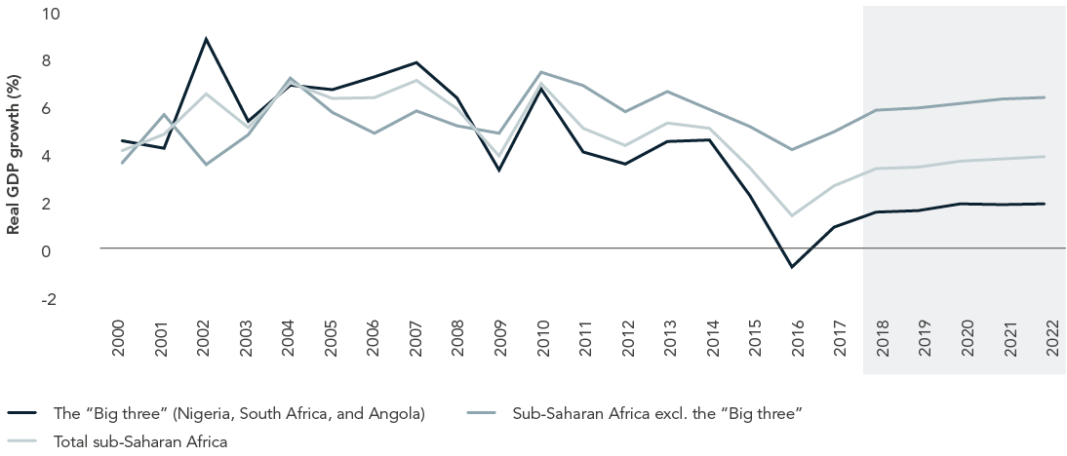
Economic Outlook Sub-Sahara Africa

Slide 6
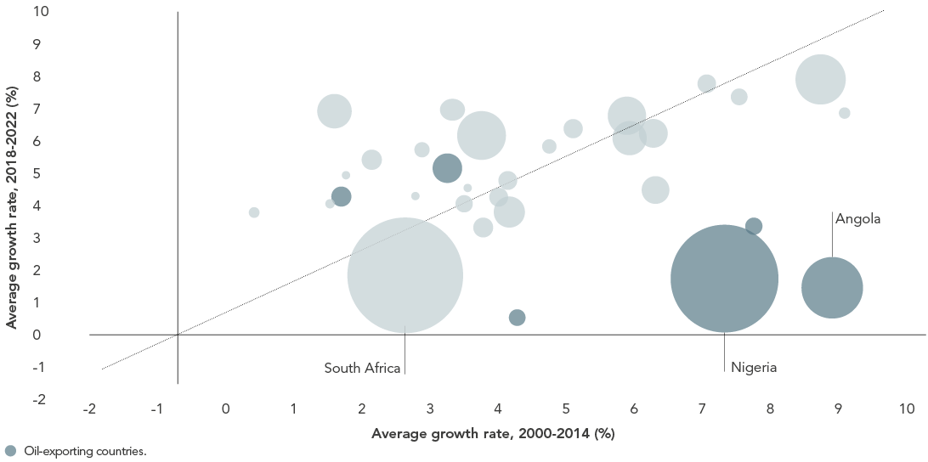
Real GDP Growth sub-Saharan Africa

Slide 7
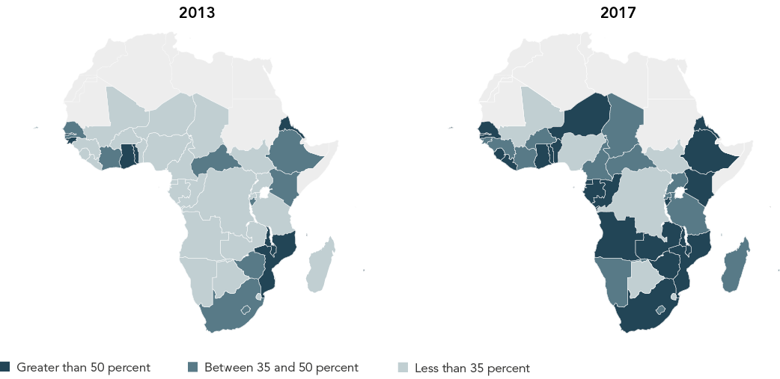
…but debt levels are rising

Slide 8
Possibly more difficult external funding conditions…DRM is Imperative
Less commodity revenues
Outlook for ODA uncertain
Sovereign downgrades
Rising global interest rates / weaker local currencies

Slide 9
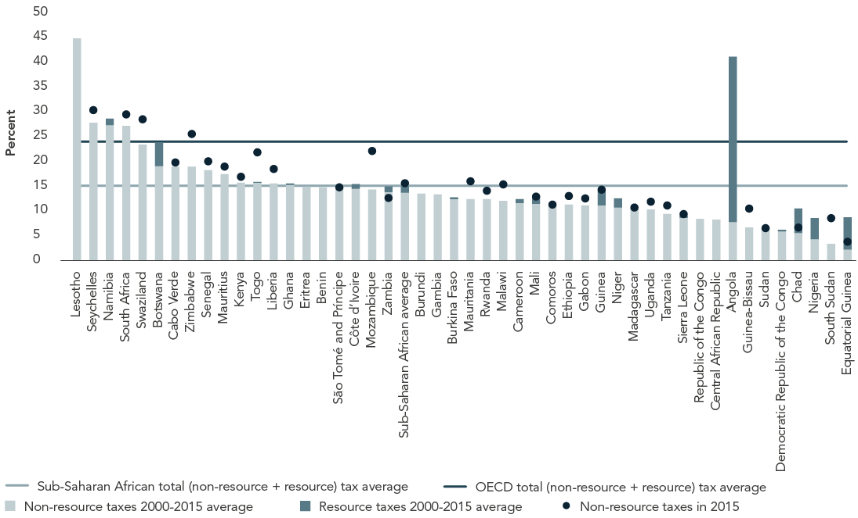
Tax Revenues as a percent of GDP Avg. 2000-2015

Slide 10
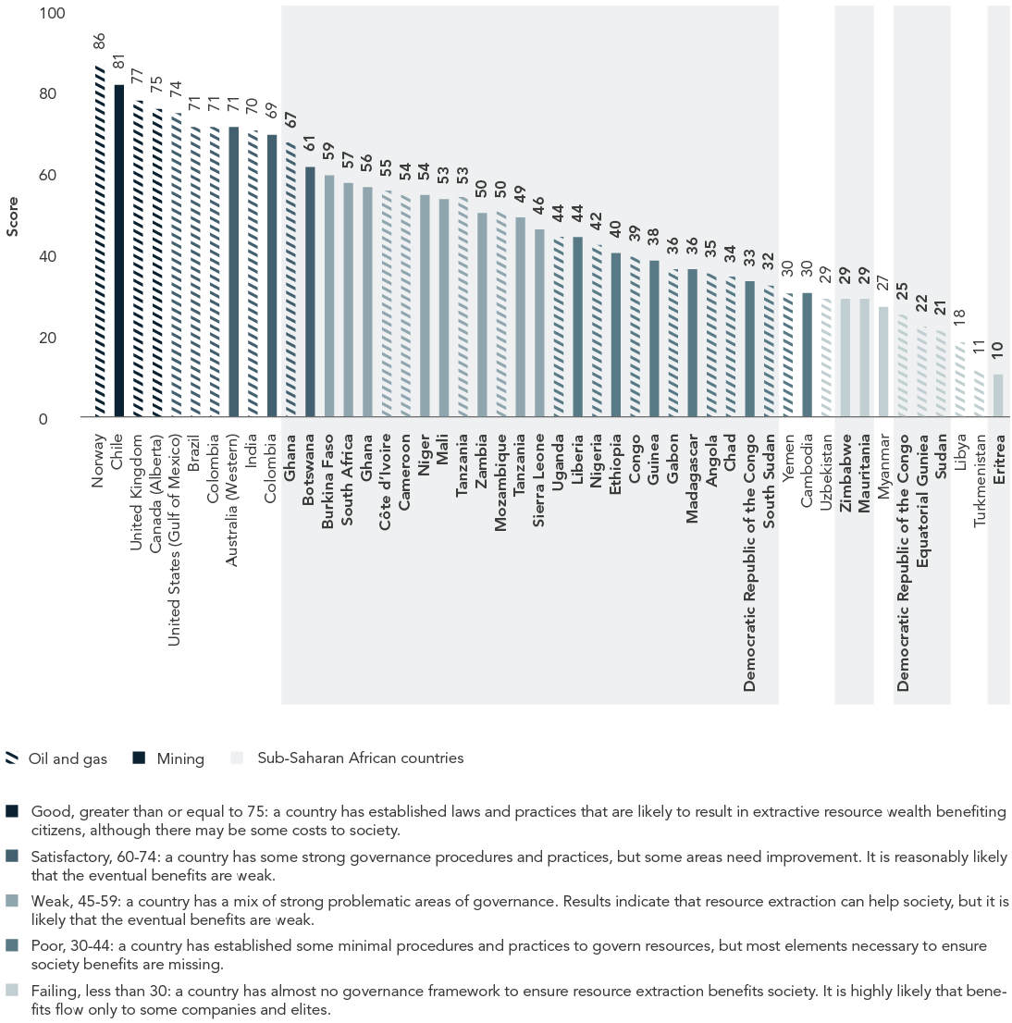
Natural Resource Wealth Management

Slide 11
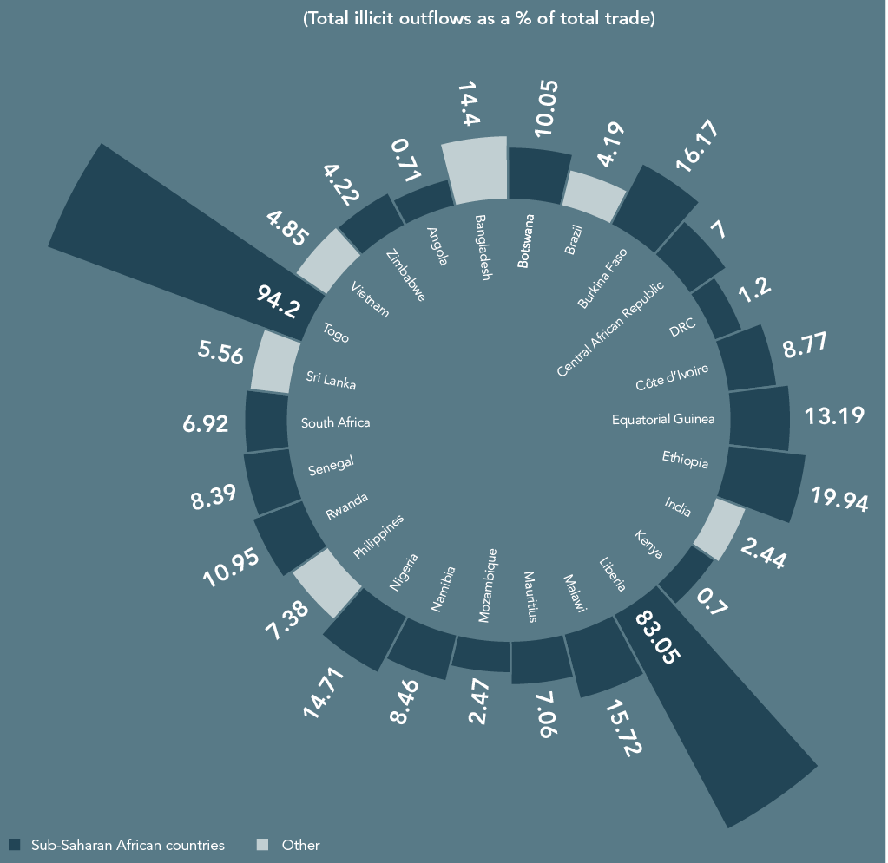
Illicit Capital Flows

Slide 12
Innovative Financing for Development
Blended Finance
The “Big Bond” proposal
Diaspora bonds
Notes:
We don’t eat growth… Adesina

Slide 13
Chapter 3
Broadening the benefits of growth:
No one left behind

Slide 14
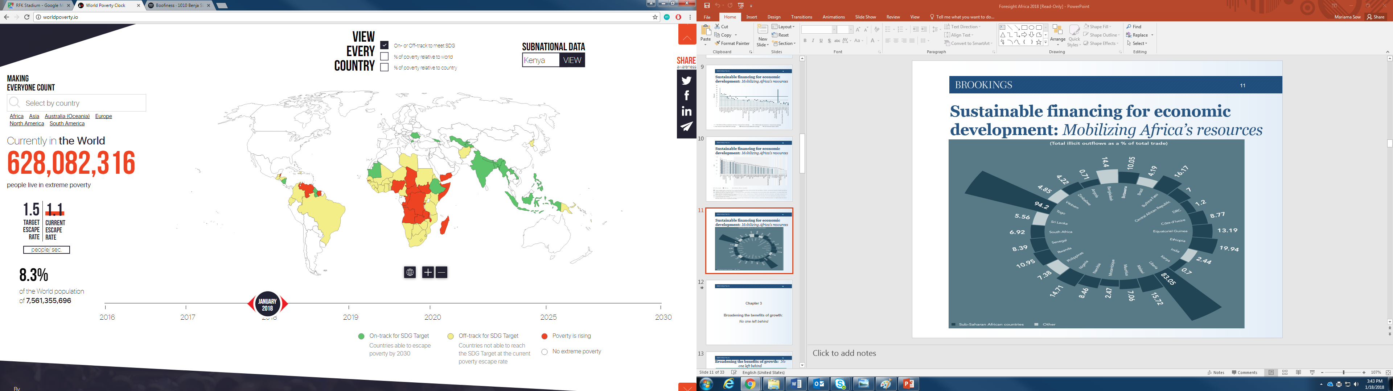
World Poverty Clock
As of 1/18/2018 3:43pm EST

Slide 15
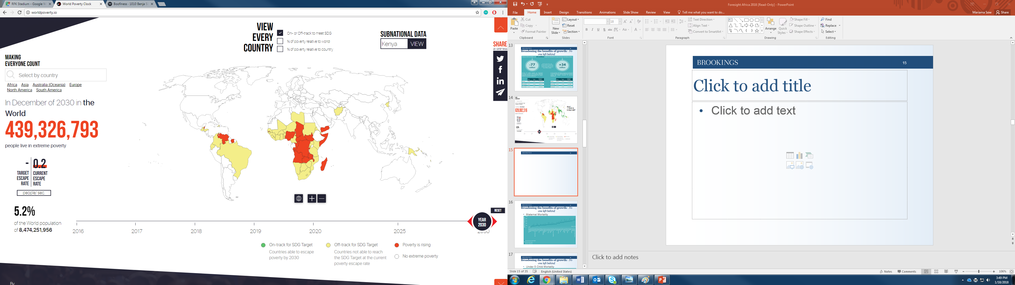
World Poverty Clock in 2030
As of 1/18/2018 3:48pm EST

Slide 16
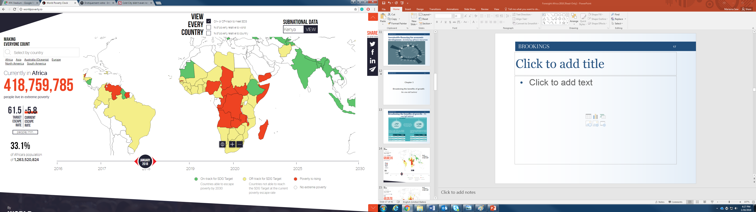
Africa Poverty Clock
As of 1/18/2018 3:48pm EST
Notes:
Currently Africa makes up two-third of world’s poor

Slide 17
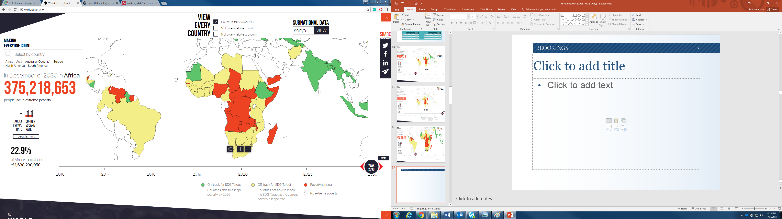
Africa Poverty Clock in 2030
Notes:
Currently Africa makes up two-third of world’s poor

Slide 18
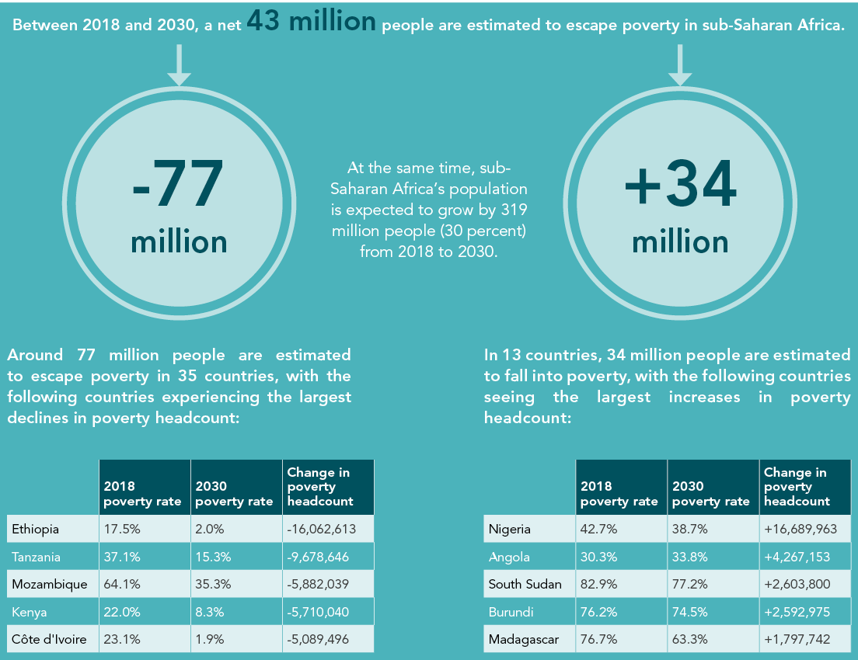
Poverty: Lower Rates; Higher Headcount
Notes:
What is the methodology?
Also, lack of progress on” Goal 3.1. Reducing Global Maternal Mortality; Reducing mortality for children under 5; safe and affordable drinking water for all;
Consequences of progress: Migration. Big deal. But statistics suggest that Africa is not leading the world when it comes to migration

Slide 19
Growth-poverty disconnect
Deeply seated poverty and rapid population growth
Limited or ineffective pro-poor policy interventions
(Quality) jobless growth
Notes:
We don’t eat growth… Adesina

Slide 20
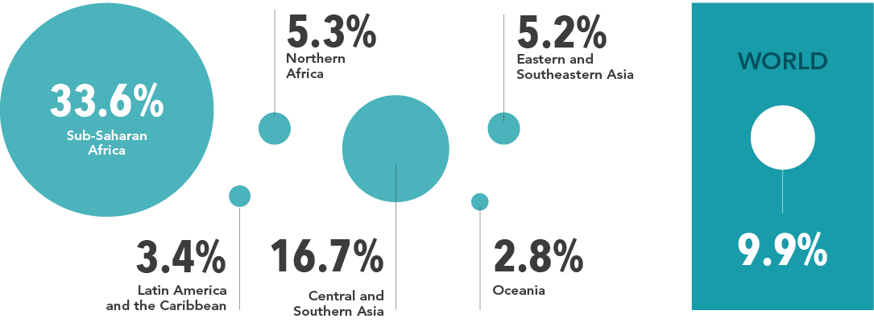
Share of African Workers Below the Poverty Line
Notes:
What is the methodology?
Also, lack of progress on” Goal 3.1. Reducing Global Maternal Mortality; Reducing mortality for children under 5; safe and affordable drinking water for all;
Consequences of progress: Migration. Big deal. But statistics suggest that Africa is not leading the world when it comes to migration

Slide 21
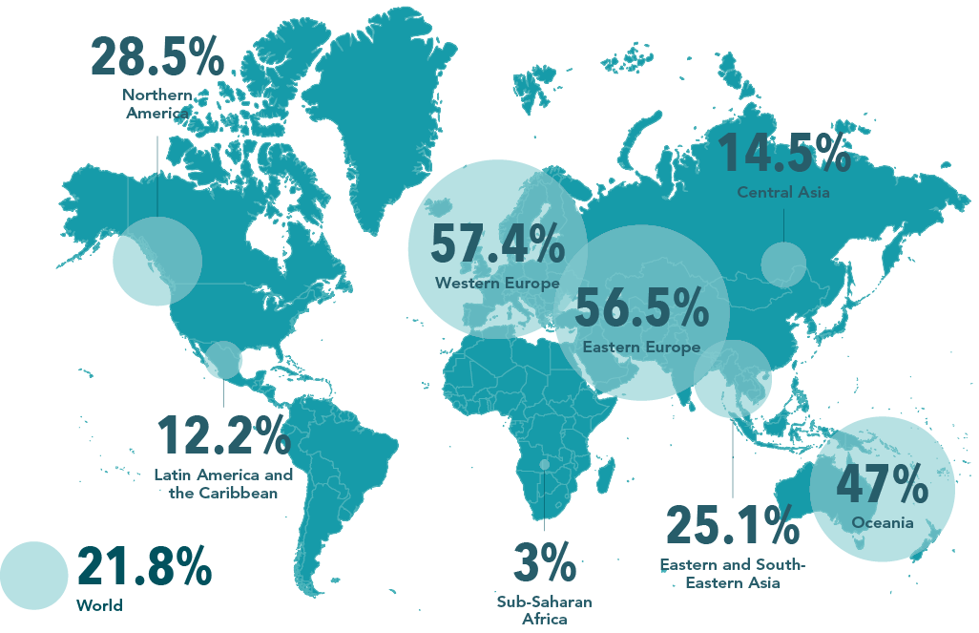
Share of Unemployed with Unemp. Benefits
Notes:
Note that similar picture emerges with % of population with Social Protection. SSA=13%; World 45%; West Europe: 99%
Also, lack of progress on” Goal 3.1. Reducing Global Maternal Mortality; Reducing mortality for children under 5; safe and affordable drinking water for all;
Consequences of progress: Migration. Big deal. But statistics suggest that Africa is not leading the world when it comes to migration

Slide 22
Chapter 4
Rethinking Africa’s structural transformation:
The rise of new industries

Slide 23
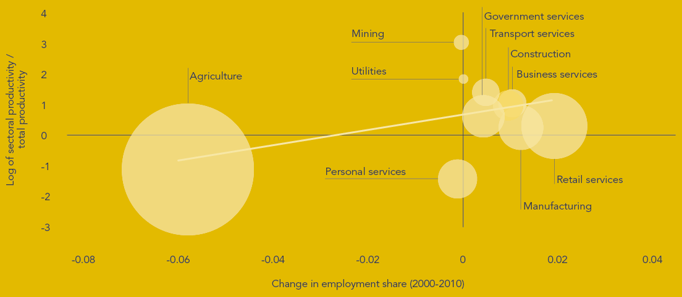
Sectoral productivity and employment chg. in sub-Saharan Africa, 2000-2010

Slide 24
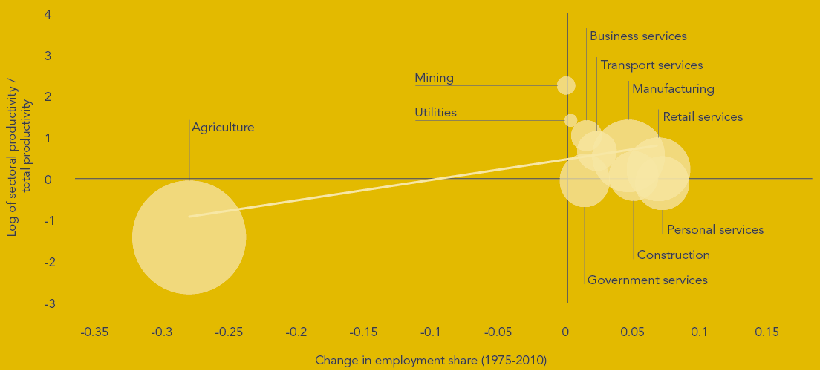
Sectoral productivity and employment chg. in Asia, 1975-2010

Slide 25
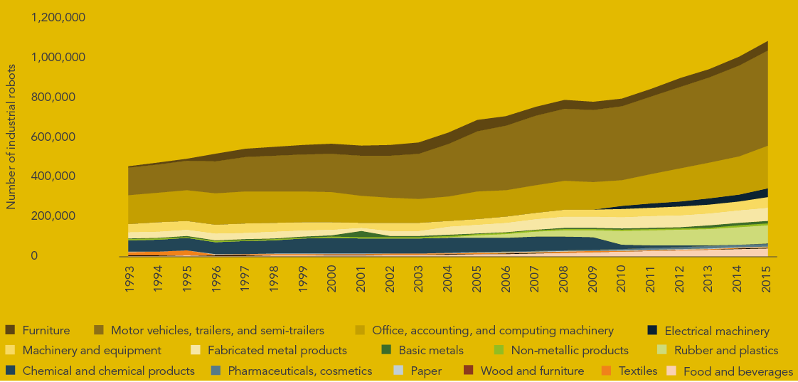
Global Industrial Robots by Manufacturing Subsector
Notes:
Feasible entry points into GVC:
-Commodity-based (food & beverage)
-Manuf. e.g. basic metals, non-mineral products
-Wood products
-Paper products
-Food processing
-Food & beverages
NOT motor vehicles

Slide 26
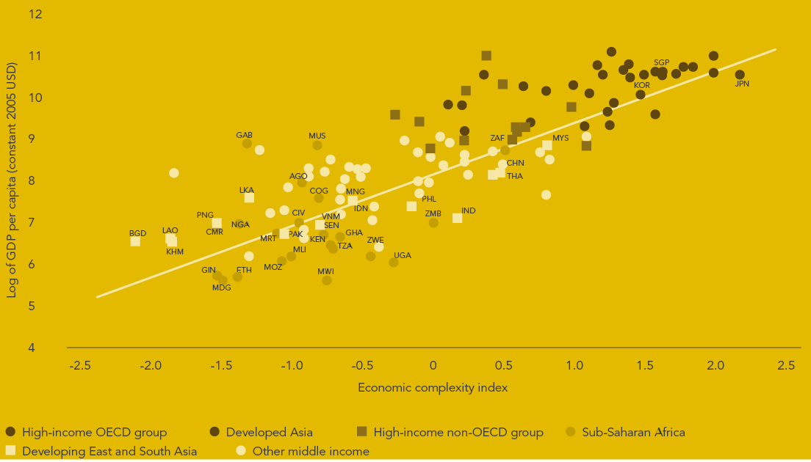
Complexity and GDP per Capita

Slide 27
Some practical issues…
How does one build complexity?
Capital / Labor intensity of high complexity sectors?

Slide 28
‘Industries without Smokestacks’
ICT-based services
Tourism
Horticulture (fruit, flower, tea…)
Agro-industry

Slide 29
…but with features similar to manufacturing
Tradable
High value-added per worker
Absorb large numbers of moderately skilled workers
Benefit from tech. change, scale, and agglomeration economies
Unconditional convergence?

Slide 30
Thank You

Slide 31
Unleashing Africa’s inner strengths: Institutions, policies, and champions
Role of the three continental institutions:
AfDB
African Union
UNECA
Managing African economies post-conflict: The case of Côte d’Ivoire

