Slide 1
Discussion of: The Rise, the Fall, and the Resurrection of Iceland by Benediksdottir, Eggertsson, Þorarinsson
Jón Steinsson
Columbia University

Slide 2
Policy Failure 1: Banking Supervision
Paper covers this very well!
Regulators completely captured / incompetent
Related party lending (lack of diversification)
Massive lending to owners of banks (conflicts of interest)
Weak equity (financed by bank itself or other Icelandic banks without collateral)
Love letters
This is what it is like to have a completely unregulated banking system
Particularly dangerous when a “Nordic country” behaves so badly

Slide 3
Policy Failure 2: Housing
Recession made much worse due to collapse of housing bubble
Fall in employment 2008-9:
Total: 11,100
Banking: 1,000
Construction: 6,600
Retail/Wholesale: 2,100
Government: 2,400
For most normal people, housing shock was big part of the shock
Government policy in 2004 contributed to bubble
Little done to slow this down

Slide 4
Policy Failure 3: Monetary Policy
Followed conventional wisdom of the time:
One instrument: Very high interest rates
No management of exchange rate
Consequences:
Rapidly appreciating exchange rate
Large amounts of carry trade
FX car loans, mortgages
FX financing for non-exporting companies
Contrast with policy after the crisis
Heavy exchange rate intervention
Capital controls / Restrictions on carry trade / Restrictions on FX lending

Slide 5
Policy Failure 4: Not Making Insured Deposits Super-Priority Claims
Emergency law made deposits priority claims in the banks
As they are in the U.S. but not in Europe
We failed however to make insured deposits super-priority claims
As they are in the U.S.
This would have avoided the infamous Icesave dispute
Why wasn’t this done?
No one thought of it.

Slide 6
Policy Success 1: Emergency Law
Two key elements:
Ex-post reordering of priority of bank liabilities (deposits moved up)
Resolution authority
Consequences:
Sovereign did not assume liabilities of banks / Owners-credits bore losses
Banks remained open for business throughout
Minimal disruption for real economy (given enormity of shock)
No lines at ATMs, no stockpiling of food, everyone got wages paid on time, etc.
Very successful restructuring of corporate sector
Most major companies were bankrupt after crisis (e.g., major airline, major shipping company, major super market chain, etc.)
This was handled well (many things were not)

Slide 7
Policy Success 2: Fiscal Room
Iceland‘s experience highlights the values of fiscal room
Very little debt going into crisis
Could run massive deficits to smooth out the shock
2008 deficit: 13% of GDP
2009 deficit: 10% of GDP
2010 deficit: 10% of GDP
2011 deficit: 6% of GDP

Slide 8
Policy Success 3: Capital Controls
Iceland imposed capital controls after crisis (with strong prodding from IMF)
I opposed this at the time
We had already defaulted on most foreign liabilities
Why not let scared foreigners exit at fire-sale prices?
I have changed my mind
Lowered government financing costs
Massive deficits perhaps not possible without this
A way of taxing the wealthy
Controlling inflation without capital controls could have been difficult politically

Slide 9
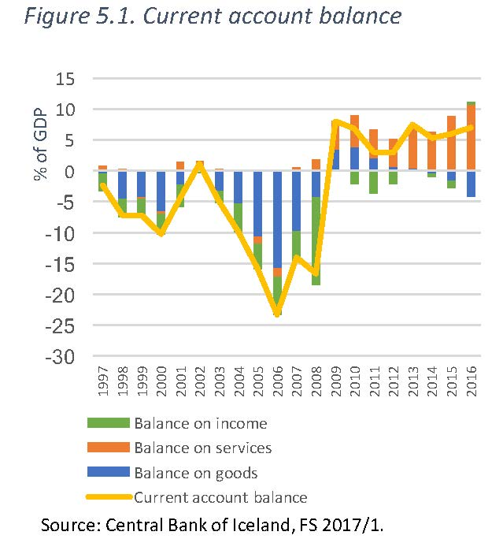
Policy Success 4: Devaluation
Icelandic krona depreciated by over 50%
Allowed for inflation and reductions in real wages “without bloodshed”
Important for government budget
Allowed for expenditure switching towards Icelandic goods
Short term adjustment mostly on durable goods imports
Exports mostly capacity constrained (fish and aluminum (electricity))
Longer term, tourism has been important

Slide 10
Policy Success 4: Devaluation

Slide 11
Policy Success 4: Devaluation
Does this mean Iceland is an “optimal currency area”?
Exchange rate flexibility is like insurance
Valuable in bad times
But you pay a premium in good times
Very high interest rates (low demand for currency)
Massive fluctuations in the exchange rate
Is the premium in good times worth the benefit in bad?
Hard to say

Slide 12
Policy Failures Policy Successes
Banking Supervision
Housing Policy
Monetary Policy
Insured deposits
Emergency Law
Fiscal Room
Capital Controls
Devaluation

