Slide 1

Where Have All the Workers Gone?
An Inquiry into the Decline of the U.S. Labor Force Participation Rate
Alan B. Krueger
Princeton University & NBER
September 7, 2017

Slide 2
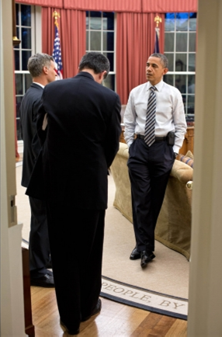
Outline:
Where Have All the Workers Gone?
LFPR = (E + U) / Pop’n
Overview of Secular Trends and Aging → Explain All of Post-1997 Decline
Focus on Understanding Secular Trends for Younger Workers, Prime Age Men, and Women
Depressed Labor Force Participation has Run Into the Opioid Crisis

Slide 3
U.S. Labor Force Participation Rate Peaked in 2000
And Has Declined by 4 Percentage Points

Slide 4
U.S. Labor Force Participation Rates by Age and Gender
Note: Shading denotes recession.
Source: Bureau of Labor Statistics; National Bureau of Economic Research.

Slide 5
Men Ages 35+

Slide 6
Women 35+

Slide 7
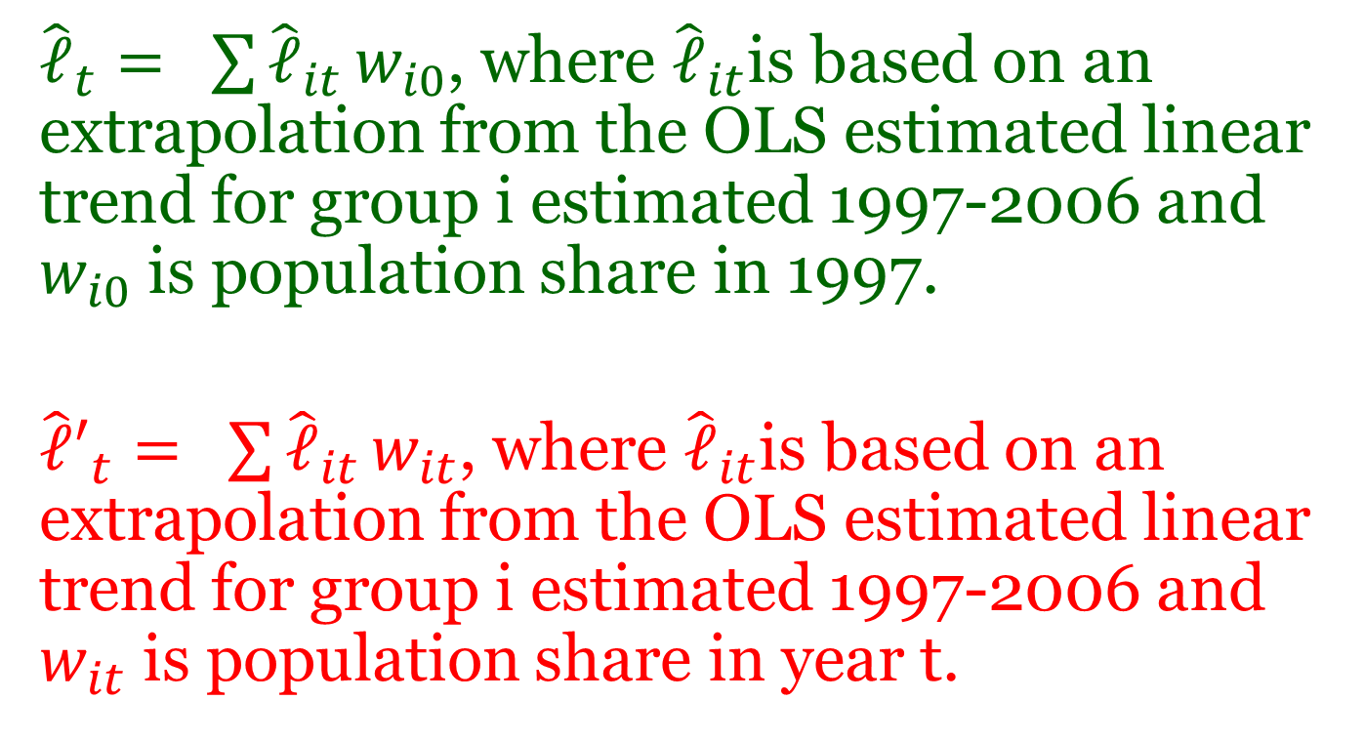
Most of the Decline in U.S. LFPR since 1997 is Accounted for by Aging of the Population and Pre-Recession Trends
${\hat{𝓁}}_{t}= \sum{{\hat{𝓁}}_{it}}w_{i0}$, where ${\hat{𝓁}}_{it}$is based on an extrapolation from the OLS estimated linear trend for group i estimated 1997-2006 and $w_{i0}$ is population share in 1997.
${\hat{𝓁}′}_{t}= \sum{{\hat{𝓁}}_{it}}w_{it}$, where ${\hat{𝓁}}_{it}$is based on an extrapolation from the OLS estimated linear trend for group i estimated 1997-2006 and $w_{it}$ is population share in year t.

Slide 8


Actual
$${\hat{𝓁}}_{t}$$
$${\hat{𝓁}′}_{t}$$
Notes:
Gap is the cycle.

Slide 9
Understanding Longer Term Trends for Subgroups
Young Workers
Prime Age Men
Women
Connection Between Opioid Crisis and Labor Force Participation

Slide 10
Rise in School Enrollment Offset Most of Decline in LFPR for Young Men, and All of it for Young Women

Slide 12

Subjective Well-Being – ATUS-WB 2010, 2012-13
Experienced Well-Being (ATUS-WB)
Overall Evaluation
Cantril Ladder: “Please imagine a ladder with steps numbered from zero at the bottom to ten at the top. The top of the ladder represents the best possible life for you and the bottom of the ladder represents the worst possible life for you.
If the top step is 10 and the bottom step is 0, on which step of the ladder do you feel you personally stand at the present time?”

Slide 14
NLF Young People Overall are Content
Figure 12(b): Cantril Ladder by Gender for Ages 16-24
Note: Sample is Well-Being Module pooled over 2012 and 2013.
Source: Bureau of Labor Statistics (American Time Use Survey); author's calculations.

Slide 15

Prime Working-Age Men

Slide 16
LFPR has been Falling for Prime-Age Men for Decades
Note: Shading denotes recession.
Source: Bureau of Labor Statistics; National Bureau of Economic Research.
Notes:
YoY 1.6% core in march ; 0.8% pce – core cpi up 2.1% over last 12 months.

Slide 17
LFPR Prime Men, by Education
Annual Averages

Slide 18
Many NLF Prime Age Men Report Poor Health
(and Look Different from the Unemployed)

Slide 19
More than 1/3rd of NLF Men Report a Severe Disability

Slide 20
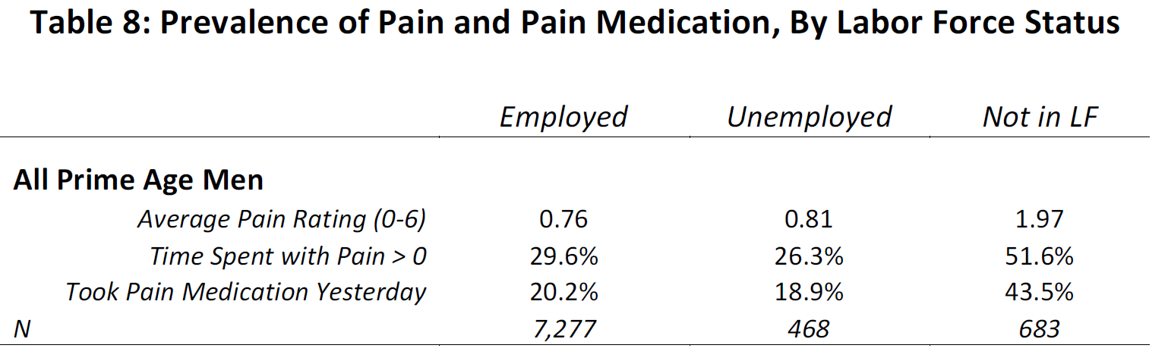
NLF Men Report High Incidence of Pain and Pain Medication – Esp. White <BA NLF Prime Age Men
White
<BA
NLF
3.15
57.0%
50.3%
374
Prime age NLF men spend 30% of their time alone, compared with 18% for employed prime age men and 19% for NLF young men.
Deaton & Kahneman (2010) – Alone time negatively correlated with daily emotional well-being

Slide 21
Longitudinal Princeton Pain Survey (PPS)
Sept. 30-Oct 2, 2016 and July 7-14, 2017
Survey of 571 NLF prime-working-age men using an internet panel provided by Survey Sampling Inc. Weights developed to match CPS in terms of age, race and Hispanic ethnicity.
47% of NLF prime-age men took pain medication on the previous day, similar to ATUS-WB
65% of those who took pain medication reported that they took prescription pain medication (in 36 percent of these cases they took both over-the-counter and prescription pain medication).
66% reported a disability. Higher disability rate than in CPS partly resulted because 16% wrote in “Other” in addition to the BLS’s six conditions. Also possible that men participate in Internet surveys are more likely to suffer a disability, or that the CPS understates the number of prime age men with a disability.
35% reported receiving SSDI

Slide 23
Second Wave of PPS
Follow-up survey conducted July 7-14, 2017. Attempted to interview the 376 respondents who continued in the SSI panel 9 months after initial survey. A total of 156 (41%) prime age men responded; 6 had a steady full-time job and are dropped. N=150.
Asked additional questions on how pay for prescription pain medication, source of pain, and program participation
30% of those not on SSDI have applied for it – thus around half of NLF prime age men are on or have applied to SSDI.
High degree of persistence in use of prescription pain medication – 77% who took prescription pain med in Wave 1 took it in Wave 2.
Mostly use Medicaid (38%) and Medicare (29%) to pay for prescription pain medication.
Only 12% said that work injury was source of pain.
Widespread use of prescription pain medication likely related to opioid epidemic.

Slide 24
Subjective Well-Being – ATUS-WB 2010, 2012-13
Experienced Well-Being (ATUS-WB)
Overall Evaluation
Cantril Ladder: “Please imagine a ladder with steps numbered from zero at the bottom to ten at the top. The top of the ladder represents the best possible life for you and the bottom of the ladder represents the worst possible life for you.
If the top step is 10 and the bottom step is 0, on which step of the ladder do you feel you personally stand at the present time?”

Slide 25
Subjective Well-Being of Prime Age Men,
By Labor Force Status

Slide 26

Women

Slide 27
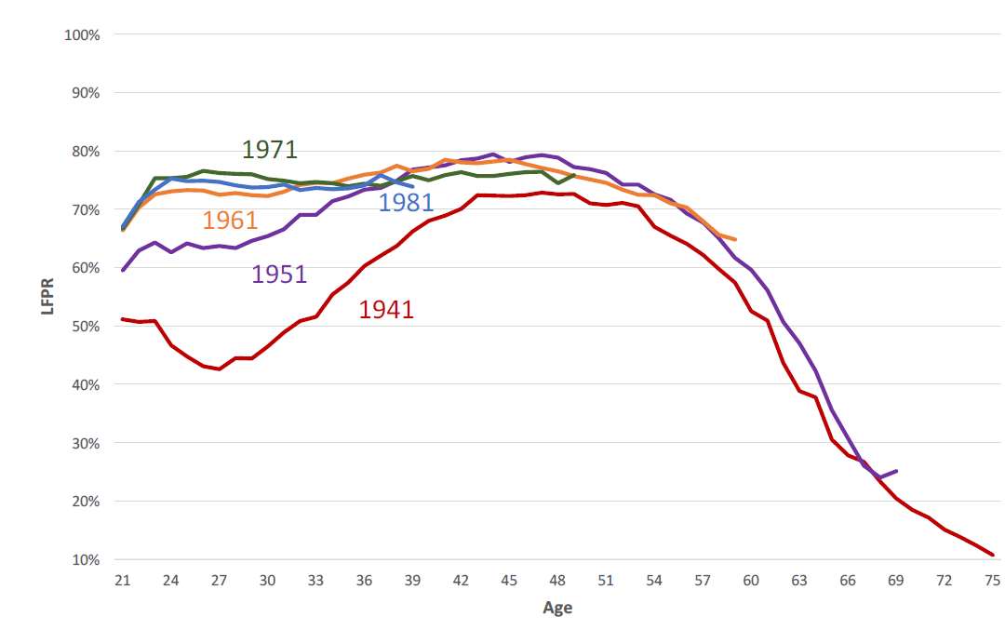
Labor Force Participation Rate for Women, by Age and Birth Cohort
Labor Force Participation Rate
Age

Slide 28
Subjective Well-Being of Prime-Age Women,
NLF Group as a Whole is Happier

Slide 29
But NLF Women who are Not Keeping House
Are Almost as Miserable as Male Counterparts
Prime-Working-Age Women, NLF
 | Not in LF - only "keeping house" | Not in LF - excluding "keeping house"
Happy | 4.63 | 4.17
Tired | 2.36 | 2.82
Stressed | 1.35 | 1.78
Sad | 0.44 | 1.11
Pain | 0.71 | 2.13
Meaningful | 4.68 | 4.30
U-Index | 0.09 | 0.19
Cantril Ladder | 7.62 | 6.40
N | 3,709 | 3,027
Notes: ATUS well being module, pooling years 2010, 2012, and 2013. Affects and U-index weighted using the well being final activity weights. Cantril ladder question was asked in 2012 and 2013, and was weighted using well being final person weights. N is total number of activities (3 per respondent) for each group. p-value is from an F-test that the means between the three labor force statuses are the same.

Slide 30
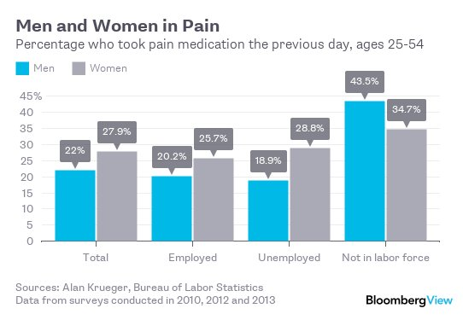
Pain Medication by Gender and Labor Force Status

Slide 31
NLF Prime Age Women Who are Not Keeping House are Even More Likely that NLF Men to Take Pain Meds
Table 8a - Prevalence of Pain and Pain Medication, By Activity of NLF Women
 | Not in LF - Only Keeping House | Not in LF - Excluding Keeping House
All Prime Age Women
Average Pain Rating (0-6) | 0.71 | 2.13
Time Spent with Pain > 0 | 24.4% | 52.1%
Took Pain Medication Yesterday | 21.3% | 49.4%
N | 1,242 | 1,023

Slide 32
Prime-Age NLF Women who Aren’t Taking Care of Home are Growing as Fast as NLF Men

Slide 33


Slide 34
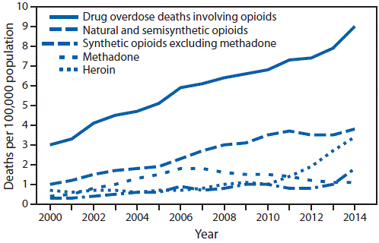
Since 2000 the Rate of Deaths from Opioid Overdoses in the U.S. has Increased >300%
Source: Vital Statistics.
Notes:
In 2015, more than 33,000 Americans died from opioid overdose, more than double the number murdered in homicides

Slide 35
No Evidence that Pain Has Declined Despite Opioid Use

Slide 36
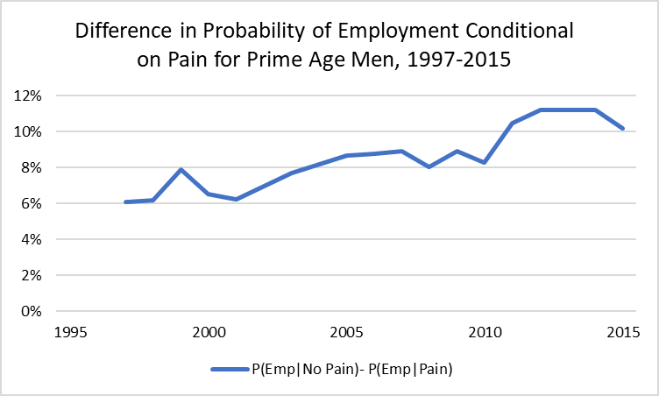
Consequence of Pain for Employment Has Increased CDC’s National Health Interview Survey

Slide 37
Link Opioids Prescribed Per Capita, 2015 to ATUS and CPS
Morphine Milligram Equivalent (MME) Prescribed Per Capita
Avg. in top 10% of counties is
31X the avg. in bottom 10%
Notes:
http://www.businessinsider.com/lost-decade-us-manufacturing-employment-2012-12

Slide 38
Local Opioid Prescription Rate Predicts Use of Pain Medication, Controlling for Health, Etc.

Slide 39
Labor Force Participation Rate Fell More for Prime Age Men in Areas Where More Opioids are Prescribed
Robust to linear MME
Robust to including ADH China import exposure variables
Similar effect in ASEC, controlling for self-reported health
Magnitude:
MME rose 3.5x 1999-2015
Log(3.5) x .011 = 0.6 pp
0.6 / 3.2 ≈ 20 percent

Slide 40
Labor Force Participation Rate Fell More for Prime Age Women in Areas Where More Opioids are Prescribed

Slide 41
Conclusions
Physical, mental & emotional health conditions as well as pain are a barrier to work for many prime age NLF men.
Don’t know direction of causality, but it is a barrier to participation regardless, and has run into opioid crisis.
Opioid addiction is a major social and economic problem. Focus on interventions such as pain management, preventative health care, physical therapy & mental health services. Could raise LFPR and improve subjective well-being.
Women’s plateau in LFPR is unexpected and possibly related to lack of maternity and family leave time in U.S. Should think of two distinct groups of women.

Slide 42
Thank You

Slide 43
Bonus Slides

Slide 44
Some Recovery in LFPR for Prime Age Women Since 2015

Slide 45
Retirement Rate Has Risen By Same Amount that LFPR Has Declined Since 2009

