Slide 1
The Debt Limit: Past, Present, and Future
David Wessel
Hutchins Center on Fiscal & Monetary Policy
Brookings Institution
dwessel@brookings.edu
March 7, 2019 Senate Staff Briefing

Slide 2
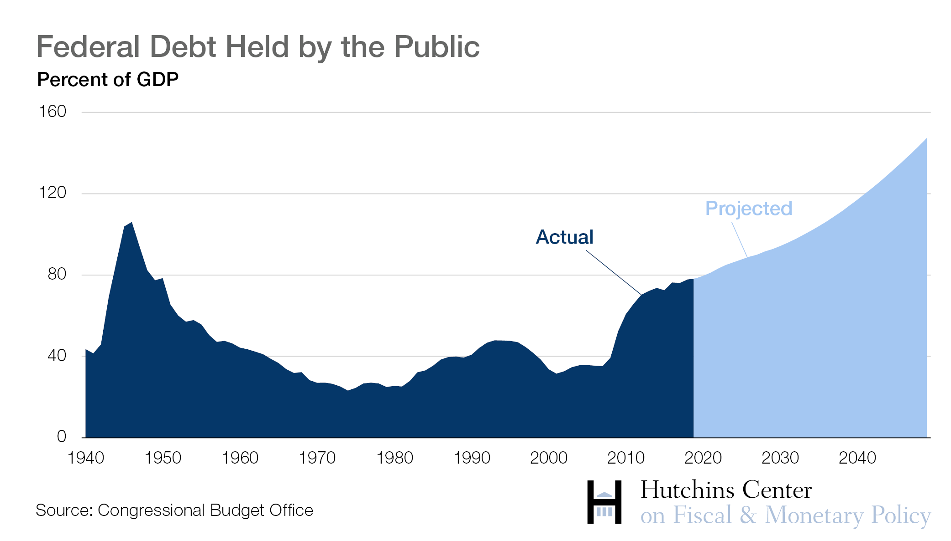
The Problem is the Problem

Slide 3
Why does Congress have to raise the debt ceiling?
1. Congress voted to levy taxes and spend money.
2. Congress approved spending that exceeds revenue from the taxes Congress imposed.
3. Congress put the deficit on the national credit card.
4. The credit card bill has arrived.
5. Not paying the bill will not do anything to change #2.

Slide 4
How Congress has done this in the past
Congress has enacted 97 separate debt limit modifications between the end of World War II and the present to accommodate the changes in federal debt levels….16 separate changes to the debt limit since 2001.
- Congressional Research Service, 2019

Slide 5
How Congress has done this in the past
Option A
Bite the bullet and raise the debt limit, sometimes attaching as a provision in a bigger tax and spending bill.
2008: Bush stimulus
2009: Obama stimulus
Option B
Raise the debt limit and create a mechanism to address the deficit.
1985: Gramm Rudman Hollings Balance Budget & Emergency Deficit Control Act. Set deficit targets, sequesters.
1990: Six temporary debt-ceiling increases while Omnibus Budget Reconciliation Act of 1990 is negotiated. Paygo, set first caps.
Option C
Create a commission
2011: Budget Control Act. Gave president authority to increase debt limit subject to Congressional motion of disapproval, created “supercommittee” (Joint Committee on Deficit Reduction) which failed; sequester imposed.
Option D (House)
Gephardt Rule: When House passes a budget resolution, debt ceiling is suspended till end of fiscal year.
Option E
“Suspend” the debt limit.
2015: Bipartisan Budget Act of 2015. Raised spending caps, “suspended” debt ceiling until March 2017.
2018: Bipartisan Budget Act of 2018. Raised spending caps, “suspended” debt ceiling until March 2019.

Slide 6
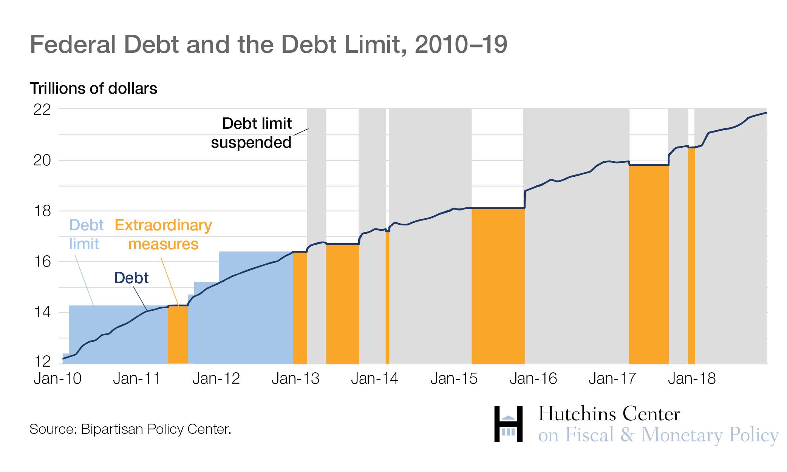
Recent history 2010-2018

Slide 7
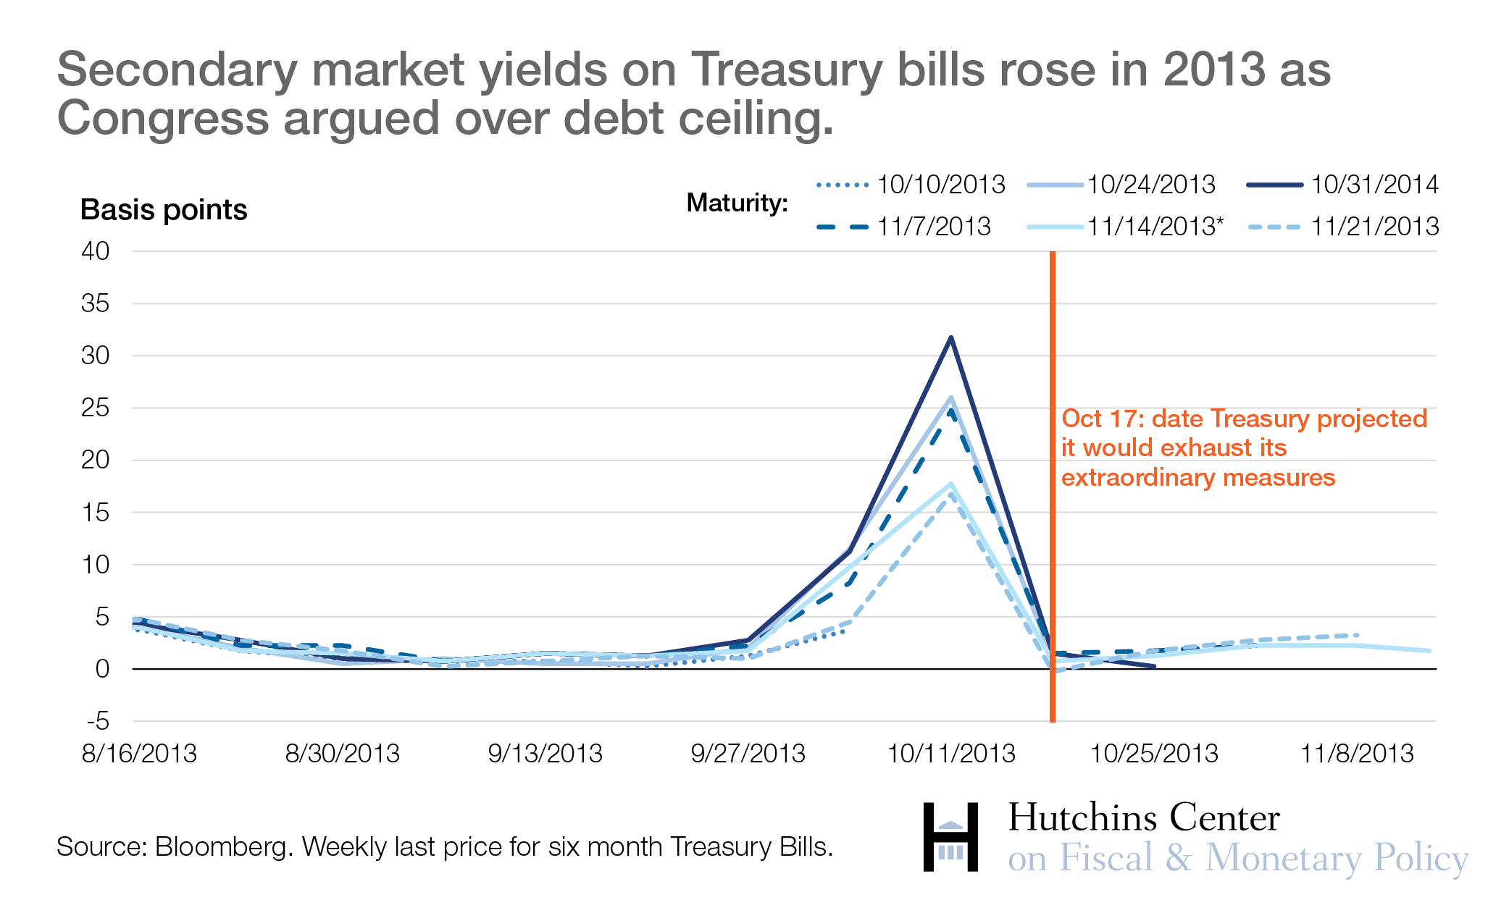
What happens when Congress takes the debt limit vote down to the wire?

Slide 8
What happens when Congress takes the debt limit vote down to the wire?
GAO (2012) “Delays in raising the debt limit can create uncertainty in the Treasury market and lead to higher Treasury borrowing costs. GAO estimated that delays in raising the debt limit in 2011 led to an increase in Treasury’s borrowing costs of about $1.3 billion in fiscal year 2011.”
GAO (2015): “GAO estimated the total increased borrowing costs incurred through September 30, 2014, on securities issued by Treasury during the 2013 debt limit impasse. These estimates ranged from roughly $38 million to more than $70 million, depending on the specifications used.”

Slide 9
What happens when Congress takes the debt limit vote down to the wire?
Fed staff: “We find that yields across all maturities were 0.04 to 0.08 percentage points higher than they otherwise would have been just prior to the projected breach dates during the 2011 and 2013 debt limit episodes, but fell precipitously upon resolution of the episode. As a result, Treasury borrowing costs were roughly $250 million higher than they would have been.”
$250 million = Annual Medicare tab for 21,000 individuals

Slide 10
Can’t Treasury ‘prioritize’ payments?
If the debt limit were not raised, and assuming Treasury had sufficient cash on hand, the New York Fed's systems would be technologically capable of continuing to make principal and interest payments while Treasury was not making other kinds of payments. This approach would be entirely experimental and create unacceptable risk to both domestic and global financial markets. As we have repeatedly stated, this would mean that the United States would default on its obligations, including to senior citizens, veterans, and members of the military."
—Alastair Fitzpayne, assistant Treasury secretary
letter to House Financial Services Committee, May 7, 2014

Slide 11
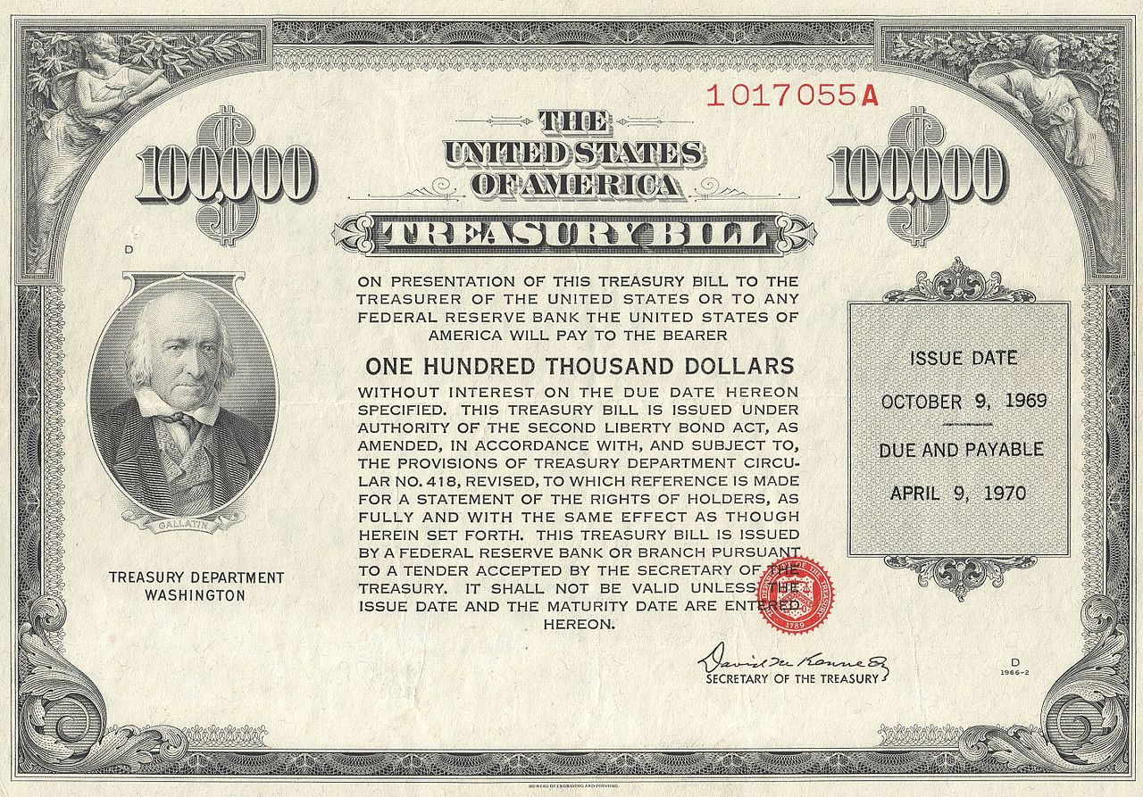
What does Congress get for raising the debt ceiling?
It gets to keep borrowing.
It preserves benefits (to taxpayers) of the U.S. government issuing the world’s safest asset: U.S. Treasury debt.

Slide 12
What are today’s political realities?
President’s party usually provides votes to raise debt ceiling.
Democrats control the House. House can raise debt ceiling with majority vote. (Gephardt Rule)
Senate needs 60 votes. With a Republican president, onus is on Republicans to avert default.
Democrats have leverage to extract concessions to get to 60 votes.
Noteworthy: X date will be close to Oct. 1, when discretionary spending caps will bind unless lifted.

Slide 13
Reading list
Bipartisan Policy Center debt limit page
https://bipartisanpolicy.org/bpc-debt-limit-analysis/
“Hutchins Center Explains: The debt limit”
https://www.brookings.edu/blog/up-front/2017/08/03/the-hutchins-center-explains-the-debt-limit/
“Q&A: Everything you should know about the debt ceiling,” Committee for a Responsible Federal Budget
http://www.crfb.org/papers/qa-everything-you-should-know-about-debt-ceiling
“The Debt Limit,” Congressional Research Service, 2019.
https://fas.org/sgp/crs/misc/IF10292.pdf
“Take it to the limit: The debt ceiling and Treasury yields,” Federal Reserve Board staff discussion paper, 2017.
https://www.federalreserve.gov/econres/feds/files/2017052pap.pdf
Debt limit: Market response to recent impasses underscores need to consider alternative approaches,” Government Accountability Office, 2015.
https://www.gao.gov/products/GAO-15-476
“Analysis of 2011-2012 Actions Taken and Effect of Delayed Increase on Borrowing Costs,” GAO, 2012.
https://www.gao.gov/assets/600/592834.pdf
“Frequently Asked Questions about the Public Debt,” U.S. Treasury.
https://www.treasurydirect.gov/govt/resources/faq/faq_publicdebt.htm
Sen. Everett Dirksen (R, Ill.) on increasing the debt limit, 1965. Two-minute video.
https://www.youtube.com/watch?v=7Au2-J-3on0

