Slide 2
Expansion of global value chains (GVCs) complicates reality and analysis
GVC = production crosses at least one border
Two-thirds of trade now within GVCs
Gross value of trade often misleading
New data on value added of trade 1995-2014

Slide 3
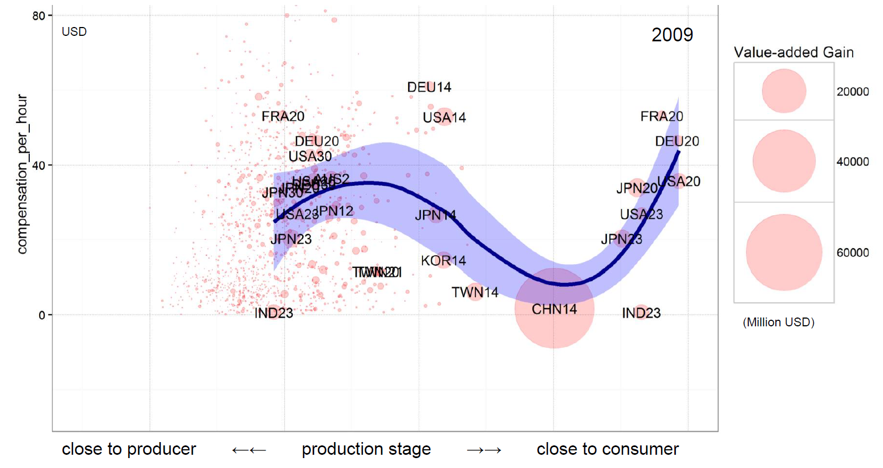
“Smile curve” for China’s exports of electrical and optical equipment, 2009

Slide 4
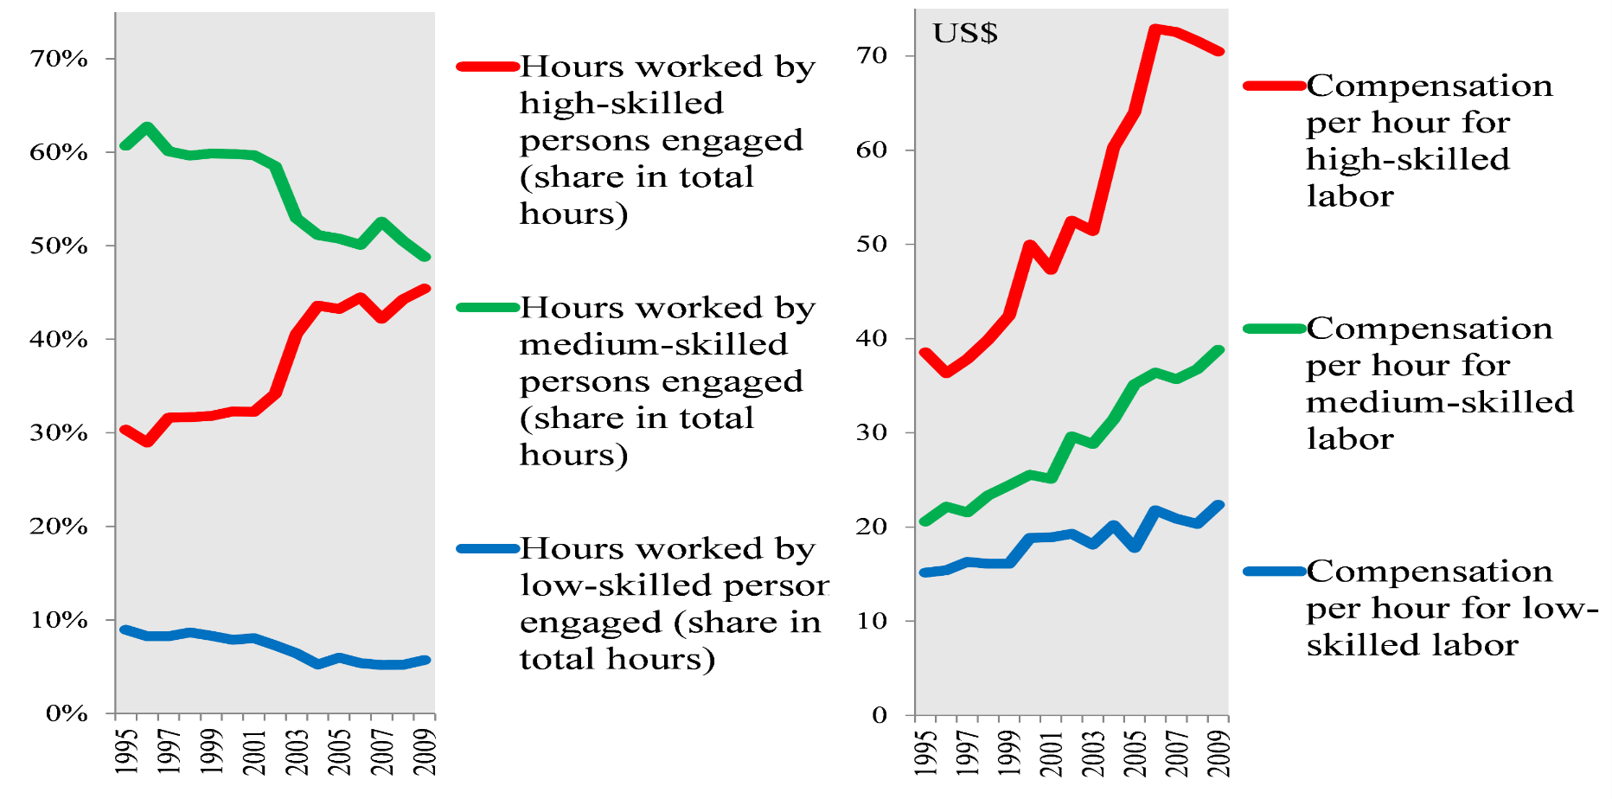
U.S. IT manufacturing: hours and compensation, 1995-2009

Slide 5
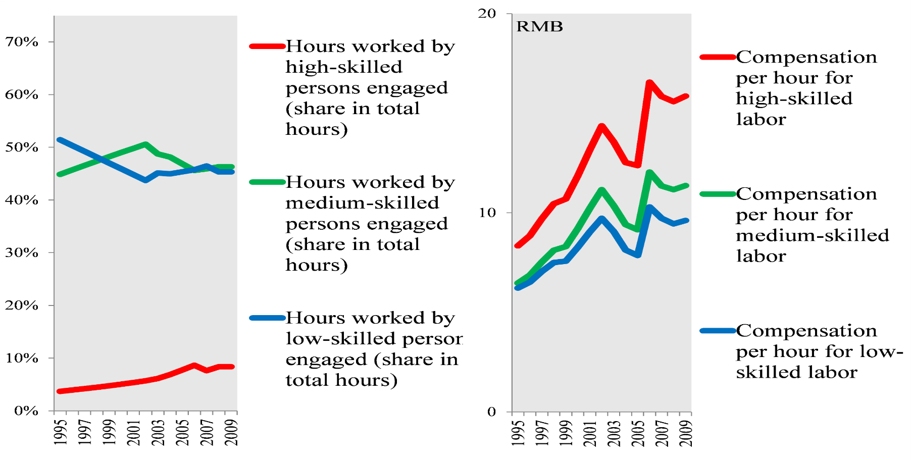
Chinese IT manufacturing: hours and compensation, 1995-2009

Slide 6
Developing country participation
Trade costs -- via poor infrastructure, tariffs, bureaucracy -- cascade
Institutions, and neighbors’ institutions matter
“Deep” trade agreements facilitate GVC participation

Slide 7
Most trade is in goods, not services

Slide 8
In value added terms, however, nearly half of trade now is in services

Slide 9
Some take-aways for developing countries
Reduce trade costs via infrastructure, tariff reduction, deregulation
Open up foreign trade and investment in services
Deep trade agreements with more advanced economies

Slide 10
Some take-aways for developed countries
Expansion of GVCs put downward pressure on jobs and wages for low-skilled
Multinational companies and skilled workers are the winners
Adjustment assistance and retraining of workers
Distributional policies

Slide 11
Download the Report
WTO Link: http://bit.ly/2uzoo2I
World Bank Link: http://bit.ly/2tfim3l

