Slide 1
Modelling the Economic Impact of Korean Unification
Warwick J. McKibbin
CAMA, Crawford School of Public Policy, ANU
& The Brookings Institution, Washington DC
Jong Wha Lee
Korea University
Weifeng Liu
CAMA, Crawford School of Public Policy, ANU
Cheol Jong Song
Korea University
Prepared for Conference on “Korean Unification: Prospect and Global Implications”
held at The Brookings Institution Feb 27-28, 2017

Slide 2
Summary
Overview of the new North Korean database
The Model (G-cubed)
Results for 4 scenarios
Status Quo
Gradual Reform and Convergence of PRK
Managed Chaos in PRK
Chaos and Crisis in PRK and KOR
Future Research

Slide 3
Project Overview
Joint 3 Year research project between ANU (team directed by Warwick McKibbin) and Korea University( team directed by Professor Jong Wha Lee)

Slide 4
Goal
Build a new database for North Korea
Incorporate North and South Korea into a global economic model and to simulate various scenarios on Korean Unification
To explore the impact of different scenarios on economic activity, trade and capital flows on the Korean Peninsula and in the Asia Pacific

Slide 5
Literature on Modeling North Korea
Dynamic General Equilibrium (DGE) models
Bradford and Phillips (2005), Bradford et al. (2011), St. Brown et al. (2012), Funke and Stulik (2005), Song (2014), Mun and Yoo (2012)
Static General Equilibrium (CGE) models
Noland et al. (1997), Noland et al. (1999, 2000)
Cross-country Comparison approaches
Lee (1999), Jeong (2013), Lee and Pyun (2016), Haggard and Noland (2010), Noland et al. (2011)
Other studies: descriptive or statistical , comprehensive coverage:
Noland (2000), Haggard and Noland (2010), Noland et al. (2011), Wolf and Akramov (2005), Ruiz and Park (2008)

Slide 6
The G-Cubed Model
McKibbin W. and P. Wilcoxen (2013), “A Global Approach to Energy and the Environment: The G-cubed Model” Handbook of CGE Modeling, Chapter 17, North Holland.
McKibbin W. and P. Wilcoxen (1999) “The Theoretical and Empirical Structure of the G-Cubed Model” Economic Modelling , 16.

Slide 7
G-Cubed Model
Developed in 1991 by McKibbin and Wilcoxen drawing on Mckibbin & Sachs and Jorgenson & Wilcoxen models.
Hybrid of macro models (dynamic stochastic general equilibrium model) and a computable general equilibrium models
Annual frequency with detailed macroeconomic and sectoral dynamics

Slide 8
G-Cubed Model
Allows for inter-industry input-output linkages, capital movements, and consumption and investment dynamics.
Extensive econometric estimation of key consumption and production substitution elasticities

Slide 9
Steps to Building the New South and North Korean Models
Develop a 6 sector social accounting matrix for North Korea based on our own data collection and other researchers work
Create a synthetic macroeconomic, sectoral, trade database on North Korea based on our own data collection and other authors works

Slide 10
Countries and Sectors (G-cubed, v. 137K)
Countries
1 United States
2 Japan
3 Australia
4 Europe
5 rest of OECD
6 South Korea (KOR)
7 North Korea (PRK)
8 China
9 India
10 Eastern Europe and the former Soviet Union
11 Oil Exporting Developing Countries
12 Rest of World
Sectors
1. Energy 2. Mining
3. Agriculture 4.Durable Manufacturing
5. Non-Durable Manufacturing 6. Services
*Capital producing sector

Slide 11
North Korea Data Sources
Macro data (1996-2016): nominal GDP, real GDP, exports, imports. Bank of Korea
Macro data (1996-2016): exchange rate, PPP conversion factor. Data for South Korea
Trade data (1996-2016): Imports by commodities of all countries from North Korea. UN Comtrade Database
Input-Output Table: new table, developed from Shin (2009) and Choi (2014)
Labor by sector (2008): Korea Statistical Office
Capital share by sector: Bradford et al. (2011)
Capital and labor share in production: Bradford et al. (2011)
Capital stock (2007): GTAP 8 (North Korea and Macao), Bradford and Phillips(2005)

Slide 12
North Korean Economy and Estimates of Initial Conditions

Slide 13
Macro Data North Korea relative to South Korea
GDP (2015): 2.1%
KOR 1464.2 trillion KOR Won ( 2.6% growth)
PRK 30.1 trillion KOR Won ( -1.1% growth)
Population(2015): 50%
KOR 50.6 million (0.4% growth)
PRK 24.8 million (0.5% growth)
Per-capita GDP (2015): 4.3%
KOR 28.9 million KOR Won (2.2% growth)
PRK 1.2 million KOR Won (-1.6% growth)

Slide 14
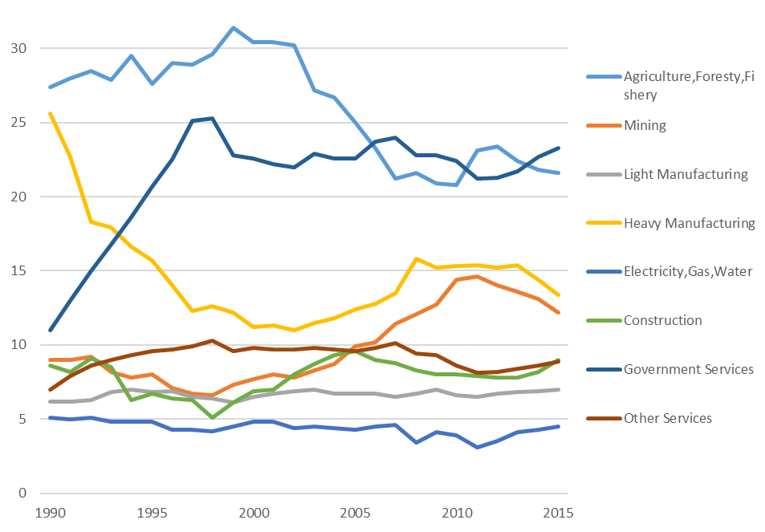
Industrial Structure of North Korea (% in GDP)

Slide 15
Employment and Labor Productivity by Industry, North Korea (2008)
 | Industrial Shares in Employment (%) | Labor Productivity (million WON) | LP Ratio (PRK/KOR, %)
Agriculture, Forestry and Fishing | 36.0 | 1.5 | 8.6
Mining and Industry | 29.6 | 3.1 | 3.9
Mining and Quarrying | 5.9 | 6.1 | 5.7
Manufacturing | 23.7 | 2.4 | 3.0
Electricity, Gas and Water Supply | 1.8 | 5.4 | 3.7
Construction | 3.0 | 6.4 | 19.6
Services | 29.6 | 2.6 | 6.3
Government | 19.7 | 2.8 | 7.0
Others | 9.9 | 2.1 | 5.2
Aggregate Economy | 100 | 2.5 | 5.5

Slide 16
Input-Output Table Basic Data
Input Output Table: Previous Studies
Choi (2014):2011 PRK IO table based on Vietnamese IO table
Shin (2009):2009 PRK IO table based on East-German IO table
Others : Kuribayashi (2005), Lee and Yoon (2004), Noland et al. (2000, 2001) etc.
Construction of New IO Table
Input-output structure of PRK is assumed to be similar to Vietnam 2011 (Choi, 2014)
Sectoral GDP, sectoral exports and imports, government budget for PRK are updated to 2014
Methodology : Cross-entropy minimization

Slide 17
G-Cubed Approach of Generating Future Projections
Make assumptions about labor augmenting technical change (LATC) for each sector in the US
Calculate economy wide gaps between LATC within each sector relative to the US sector such that the TFP gap across sectors is approximately equal to the PPP GDP per worker gap
Assume that the gap in LATC between each country and the US closes by 2% per year (i.e. the Barro rate) unless institutional rigidities

Slide 18
Results
Develop some initial illustrative scenarios to explore model properties and generate initial insights

Slide 19
Scenario 1: Status Quo
In North Korea
No reform, muddling through
No productivity growth but some growth driven by demographics
No change in any policies within PRK or against PRK

Slide 20
Key Assumptions on Status Quo
No collapse of PRK
No labor mobility between PRK and KOR but complete mobility within each country across sectors (unemployment possible)
Capital controls to slow the adjustment of the real exchange rate to the rate that would apply with risk adjusted interest parity (same as China)
Independent central banks in PRK and KOR and fiscal agencies in PRK and KOR

Slide 21
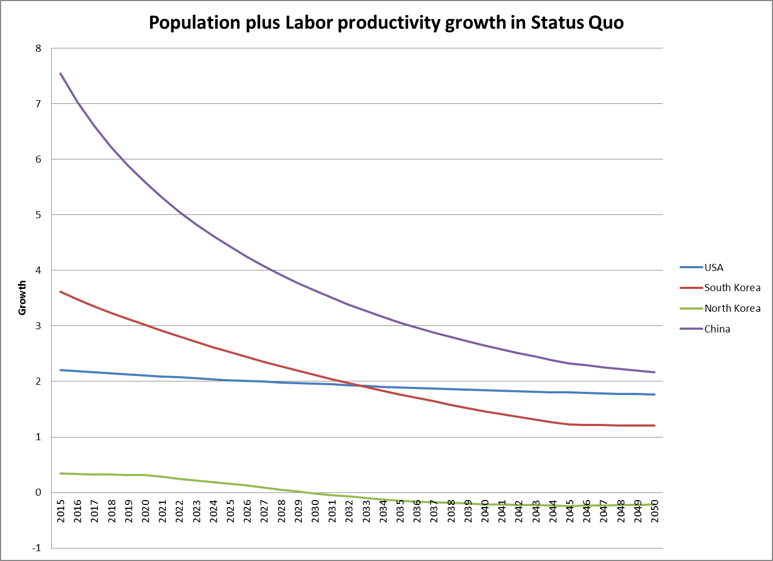

Slide 22
Results for Alternative Scenarios
All shocks begin in 2017 and show impacts up to 2040
KOR is South Korea
PRK is North Korea
Results are % or %GDP deviation from the Status Quo scenario

Slide 23
Scenario 2: Gradual Reform and Convergence in PRK
No collapse of PRK
Gradual policy reforms in PRK, allowing the economy to increase labor productivity growth rates over time.
No labor mobility between PRK and KOR but complete mobility within each country across sectors (unemployment possible)

Slide 24
Scenario 2: Gradual Reform and Convergence in PRK
Capital controls in PRK to slow the adjustment of the real exchange rate to the rate that would apply with risk adjusted interest parity.
Independent monetary and fiscal policies in
PRK and KOR
With and without fiscal transfers from KOR to PRK, amounting to 1.0% of KOR GDP.

Slide 25
Scenario 2: Gradual Reform and Convergence in PRK
Labor productivity growth depend on the initial gap in sectoral productivity to the US sector and the rate of catchup
Rate of catchup of labor productivity in PRK becomes
2016 (1%)
2017(1.1%)
2018(1.2%)……
2027(2.0%)
Rate of catchup of labor productivity in KOR is unchanged at 2% every year

Slide 26
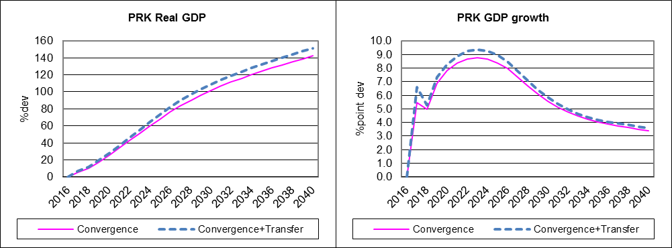
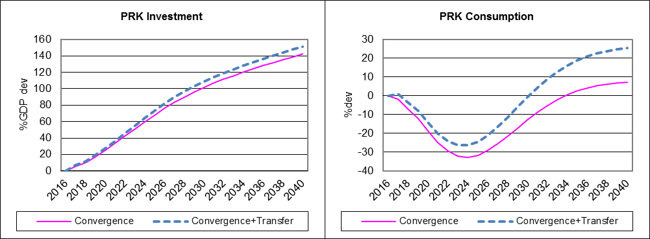
PRK Gradual Convergence
Source G-Cubed Model version 137

Slide 27
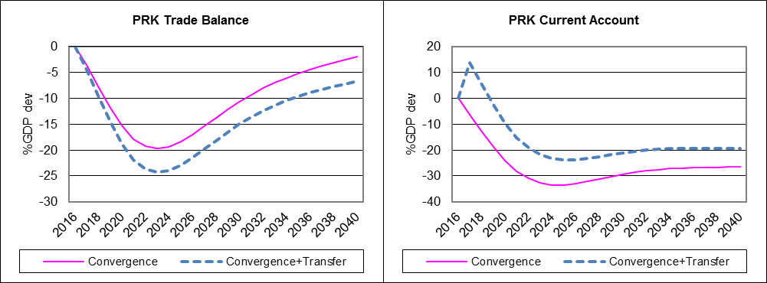
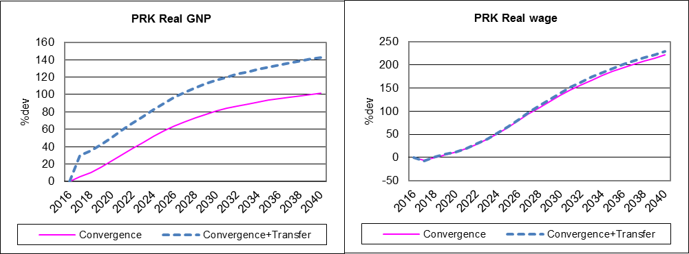
PRK Gradual Convergence
Source G-Cubed Model version 137

Slide 28
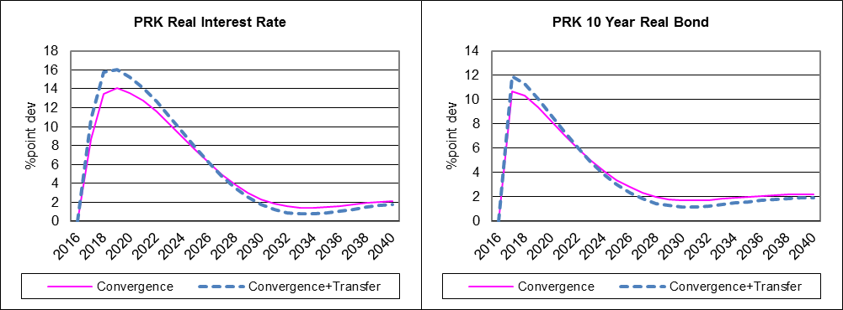
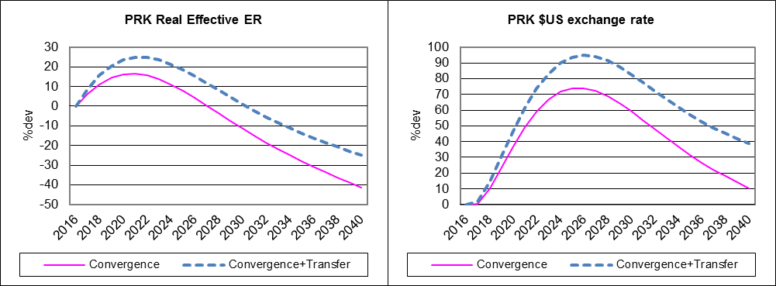
PRK Gradual Convergence
Source G-Cubed Model version 137

Slide 29
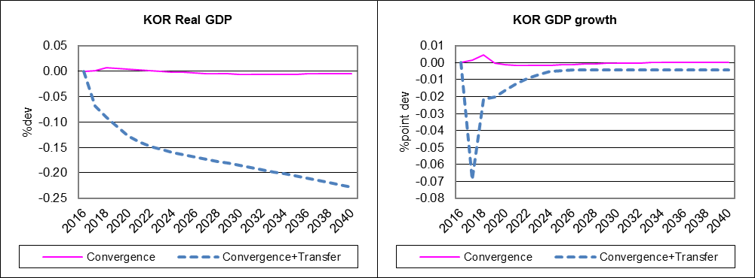
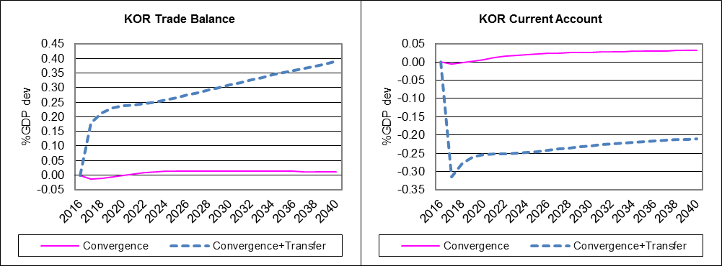
KOR Gradual Convergence
Source G-Cubed Model version 137

Slide 30
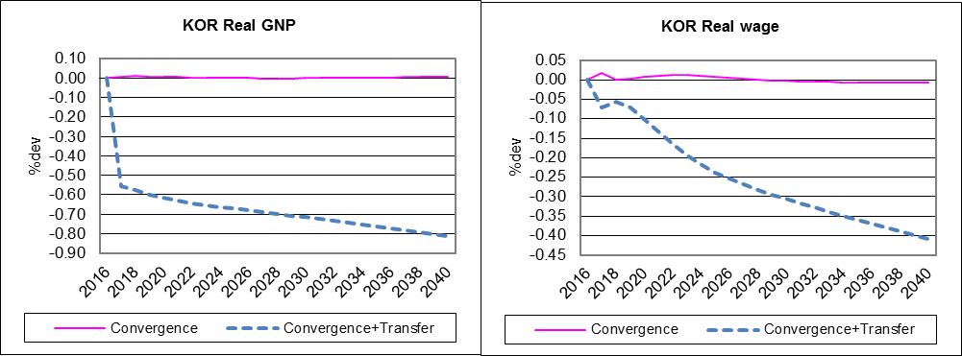
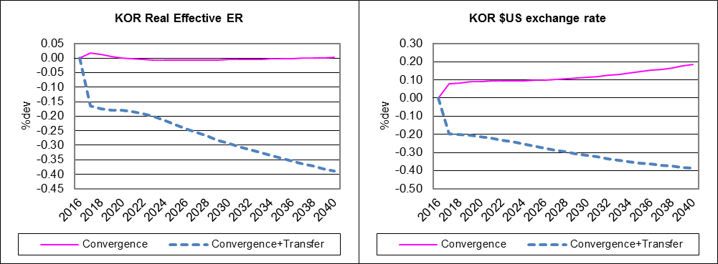
KOR Gradual Convergence
Source G-Cubed Model version 137

Slide 31
Scenario 3: Managed Chaos in PRK
North Korea collapse
Productivity falls 20%
Fiscal transfers from KOR to PRK
1% of KOR GDP
Fiscal transfers is a quarter of West German case but large for PRK(about 40% of GDP).
Refugee flows, about 0.5% of PRK population
to KOR per year (as much as in the German
unification case)

Slide 32
Scenario 3: Managed Chaos in PRK
No immediate labor market integration. We assume the country can be managed as divided for the time being with different wage policies and restrictions on labor mobility.
Capital controls to slow the adjustment of the real exchange rate to the rate that would apply with risk adjusted interest parity.

Slide 33
Scenario 3: Managed Chaos in PRK
Political crisis or military conflict increases risk premium in PRK of 10% point in 2016, declining by 2% point per year back to zero by 2022
After PRK collapse and unification, extensive market-oriented reform and economic opening will take place in PRK ramping from
2021

Slide 34
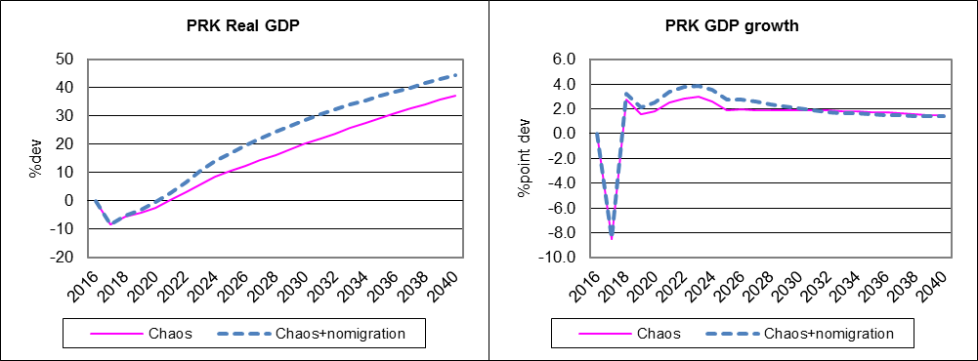
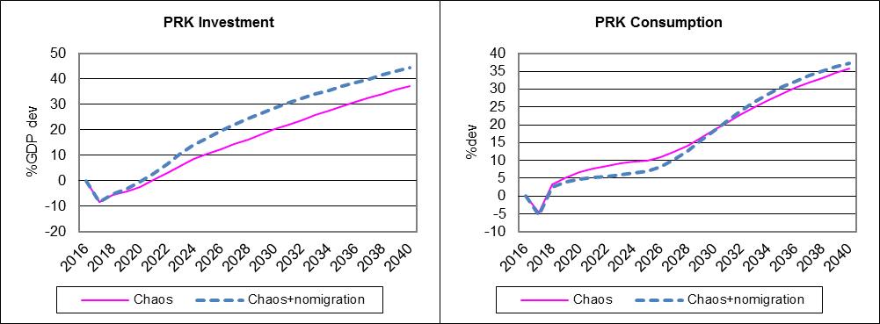
PRK Managed Chaos
Source G-Cubed Model version 137

Slide 35
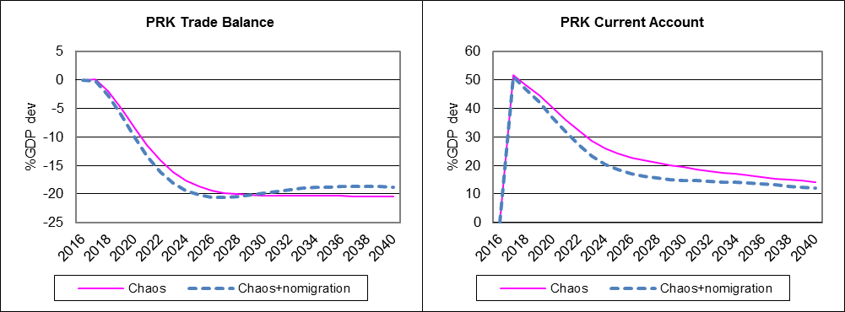
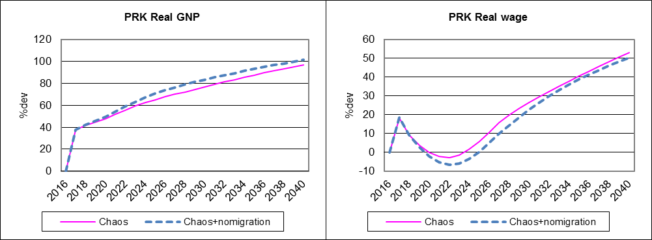
PRK Managed Chaos
Source G-Cubed Model version 137

Slide 36
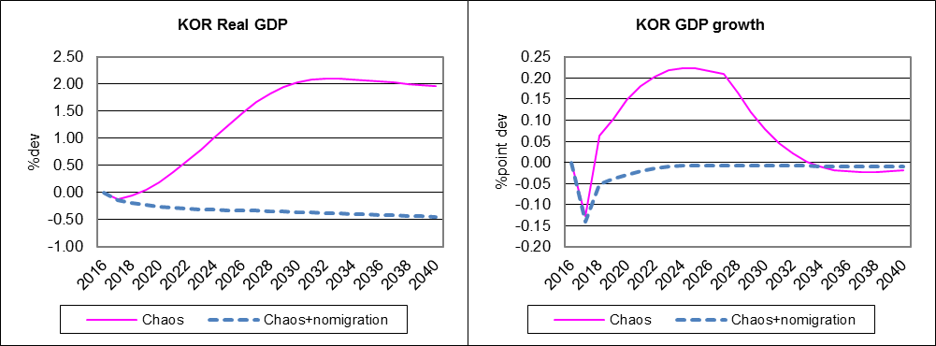
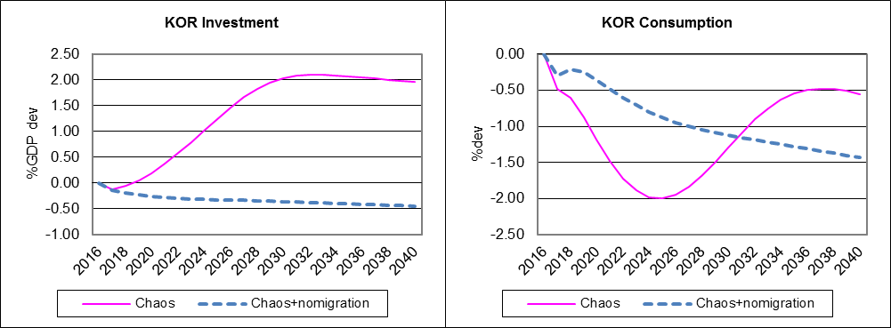
KOR Managed Chaos
Source G-Cubed Model version 137

Slide 37
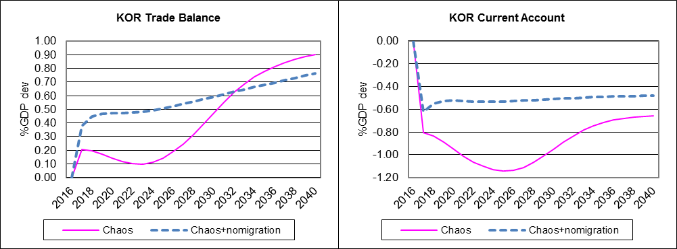
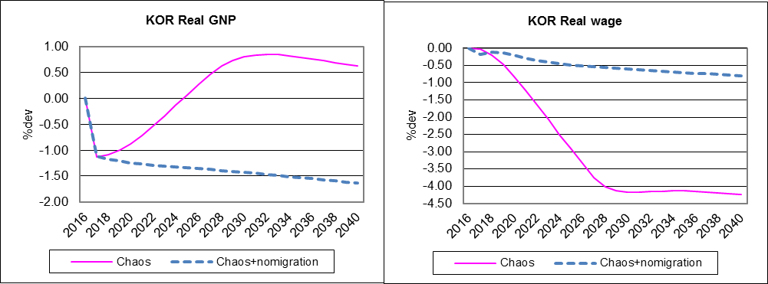
KOR Managed Chaos
Source G-Cubed Model version 137

Slide 38
Scenario 4: Chaos in PRK and Confidence Crisis in KOR
Scenario 3 plus
Reforms in PRK delayed 5 years
Risk premium in PRK rises 20% point and declines over time by 2% point per year
Political crisis or military conflict increase risk premium in KOR of 10% point in 2016, 9% point in 2017, and then back to zero by 2027

Slide 39
Scenario 4: Chaos in PRK and Confidence Crisis in KOR

Slide 40
Crisis of Confidence in KOR

Slide 41
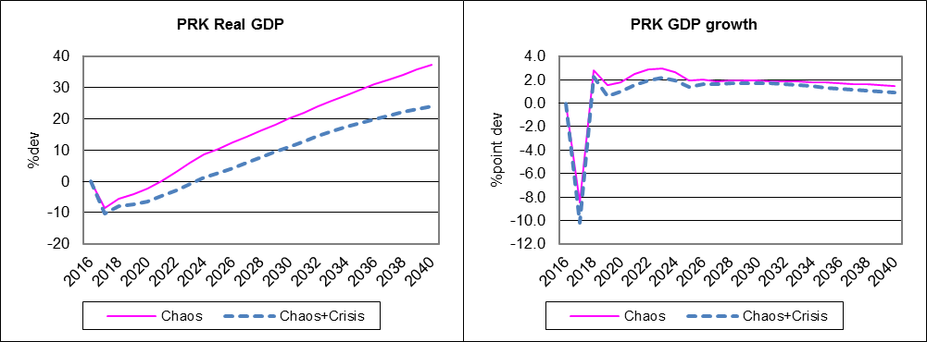
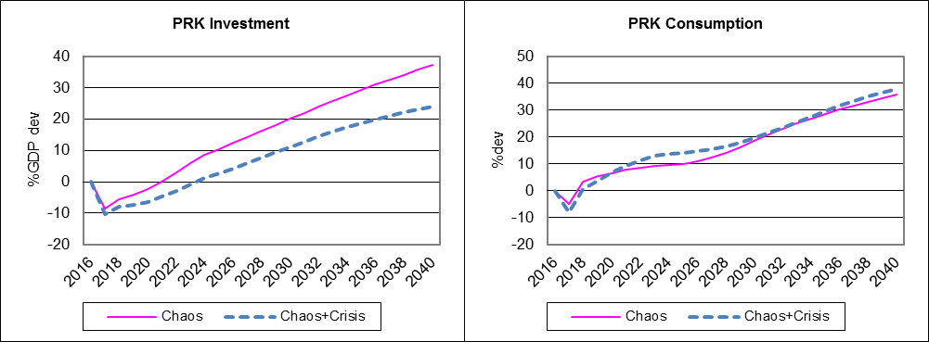
PRK Chaos and KOR Crisis
Source G-Cubed Model version 137

Slide 42
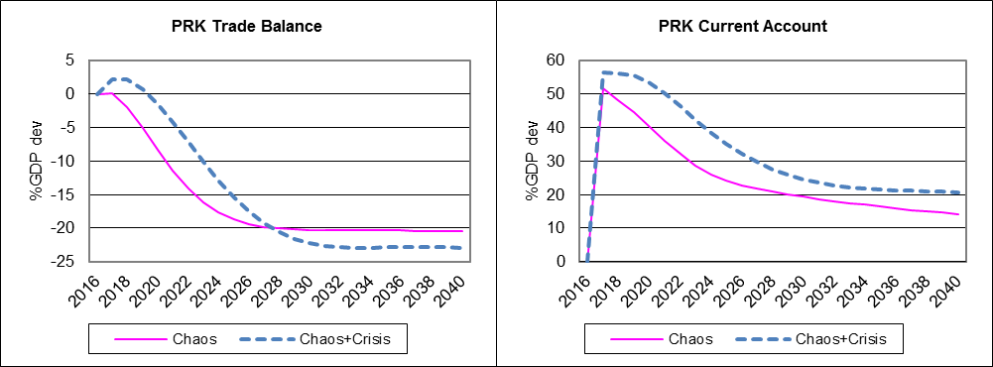
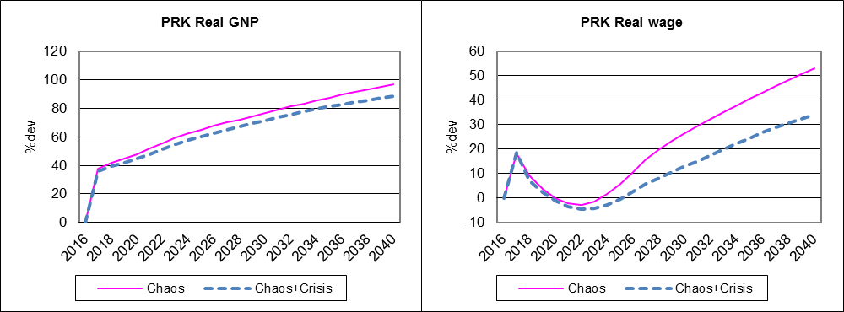
PRK Chaos and KOR Crisis
Source G-Cubed Model version 137

Slide 43
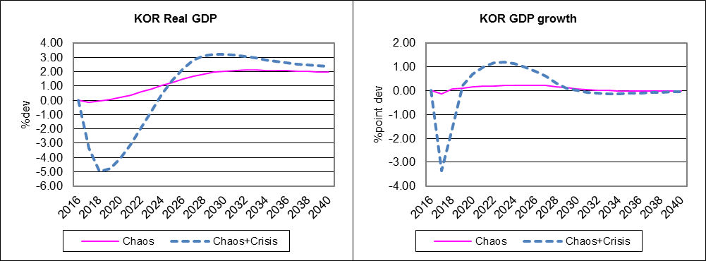
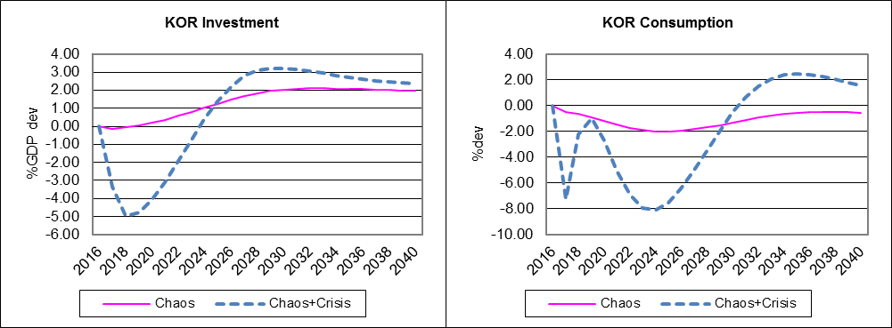
KOR Chaos and KOR Crisis
Source G-Cubed Model version 137

Slide 44
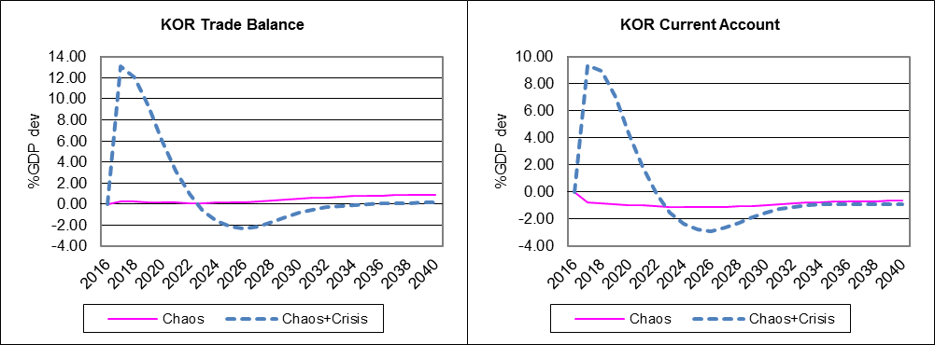
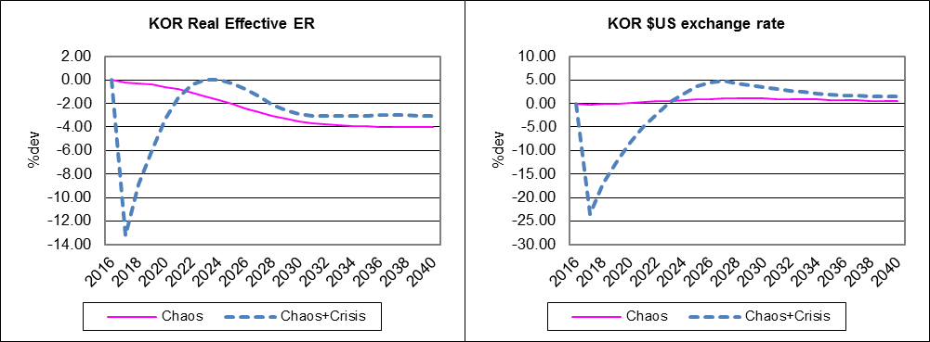
KOR Chaos and KOR Crisis
Source G-Cubed Model version 137

Slide 45
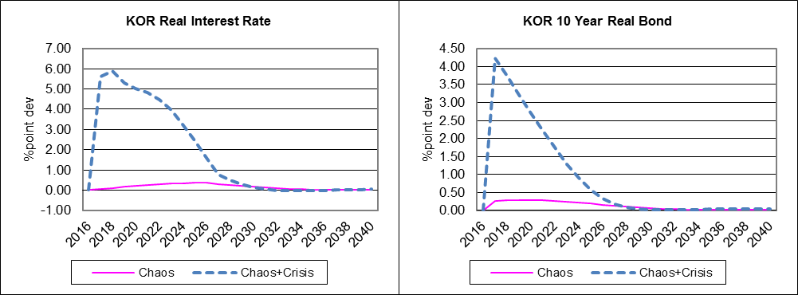
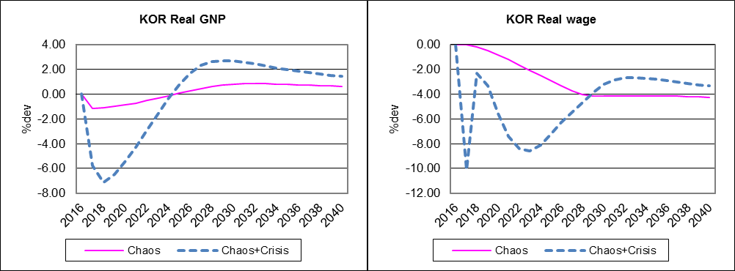
KOR Chaos and KOR Crisis
Source G-Cubed Model version 137

Slide 46
Some Insights
Reform and cooperation with KOR matters a lot for PRK’s growth.
There will occur potentially large costs if the process of unification is not handled well.
Migration flows from North to South have medium and long term implications for potential growth in both Koreas.

Slide 47
Some Insights
Someone has to pay for rebuilding PRK
PRK clearly will need a fiscal transfer during adjustment
Too much fiscal transfer can cause surge in KOR’s fiscal debt and adverse shock to export sectors in KOR and PRK.
Political crisis (or immediate collapse) can cause an economic crisis in the Korean peninsula.
Borrowing from international markets or international aid will be explored in future work

Slide 48
Directions for Future Research
Implement estimates of productivity gaps
Alternative financing and allocation of fiscal transfers
Explore debt dynamics in PRK and KOR
Consider significant expansion of inter-Korean trade and private investment
Alternative exchange rate regimes and monetary policy
Sectoral reallocation and productivity changes
Regional spillover in trade and finance

Slide 49
www.GCUBED.com

