Slide 1
Human Resources, Institutions and Policies: A Simple Model for Postwar Global Development, With Implications for Hypothetical Korean Re-unification
Nicholas Eberstadt
Henry Wendt Chair in Political Economy
American Enterprise Institute
Eberstadt@aei.org
“Korean Unification: Prospect and Global Implication”
ANU/Brookings/KIEP/Korea Unification Workshop
Brookings Institution
27-28 February 2017

Slide 2
Outline
A simple model for postwar economic development that can include DPRK
How the simple model fares for 100+ countries for 1970-2010
Illustrative Model Results for northern Korea in U+10 (ten years after unification)
Concluding observations

Slide 3
Modeling Northern Korea’s Economic Performance in U+10
Quantitative research nightmare?
DPRK data shortage is notorious
Yet we can attempt to model based on postwar international patterns of development and available estimates (of whatever quality) for DPRK
Basic model takes economic performance to be driven by human resources and institutions/polices (“business climate")
Our simple (and necessarily oversimplifying) model is surprisingly robust and powerful—even with 10 year lagged independent variables

Slide 4
Our Simple Model
Right hand side variables:
1) Human Resource Variables—
Life expectancy at birth for both sexes combined (WDI);
MYS 15+ (Barro-Lee);
Urbanization Ratio (WDI)
2) Quality of Institutions/Policies Variables—i) Fraser Institute Economic Freedom Index, or
ii) WSJ/Heritage Index of Economic Freedom
Left hand side variables:
Various measures of Economic performance—
GDP per capita (WDI, PPP 2011 dollars);
Per capita merchandise and service imports and exports (WTO and WDI, 2010 USD GDP deflated dollars);
Per capita FDI stock (UNCTAD, 2010 USD GDP deflated dollars)

Slide 5
How does our simple model do?
We use panel data for 1970-2010, over 100 countries in every regression modeled
Log-linear OLS specifications
Generally speaking: regression results generate high R-squareds, high t-statistics
This is also true when we use 10 year lagged variables
Modeled human resource variable coefficients look quite stable not only with different specifications, but also with 10-year lags

Slide 6
ln(GDP per capita) = 0.0410 (Life Expectancy) + 0.0184 (Percent Urban) + 0.117 (Mean years of schooling) + 0.130 (Fraser IEF) + 3.455
(19.72 )
(23.40) (16.42) (8.18) (31.82)
Number of Observations: 1452 Number of countries: 116
R-squared: 0.8522

Slide 7
ln(GDP per capita) = 0.0403 (Life Expectancy) + 0.0209 (Percent Urban) + 0.0820 (Mean years of schooling) + 0.0174 (Heritage/WSJ EFI) + 3.428
(21.41 )
(28.46) (13.23) (13.08) (33.82)
Number of Observations: 2030 Number of Countries :143
R-squared: 0.8184

Slide 8
ln(GDP per capita) = 0.0500 (Life Expectancy) + 0.0178 (Percent Urban) + 0.0773 (Mean years of schooling) + 0.0983 (Fraser IEF) + 3.698
(18.16)
(17.56) (8.24) (5.88) (27.78)
Number of Observations: 847 Number of Countries: 116
R-squared: 0.8587

Slide 9
ln(GDP per capita) = 0.0478 (Life Expectancy) + 0.0180 (Percent Urban) + 0.0876 (Mean years of schooling) + 0.0117 (Heritage/WSJ EFI) + 3.649
(20.36)
(19.43) (11.27) (7.82) (29.47)
Number of Observations: 1108 Number of Countries: 139
R-squared: 0.8406

Slide 10
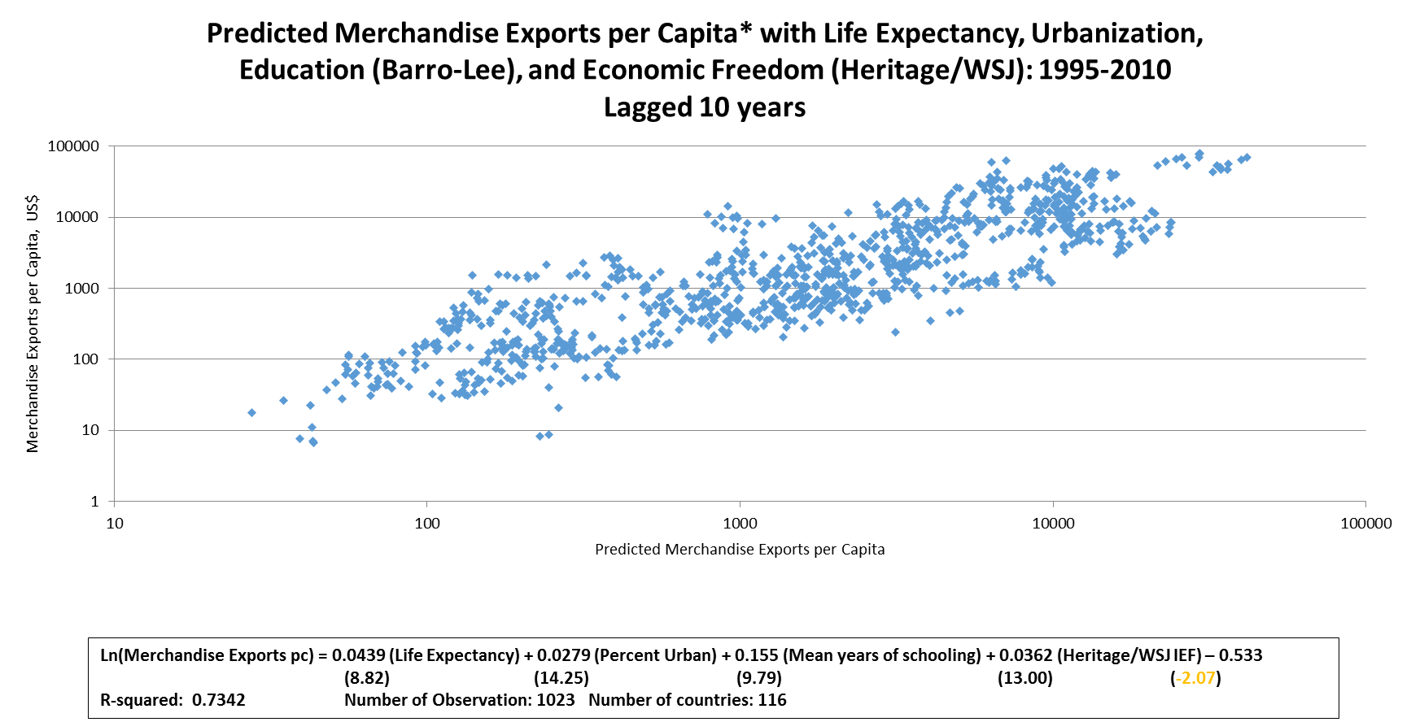

Slide 11
Ln(Merchandise Imports per capita) = 0. 0505(Life Expectancy) + 0.0142 (Percent Urban) + 0.171 (Mean years of schooling) + 0.0386 (Heritage/WSJ IEF) - 0.234 (13.59) (9.68) (14.45) (18.52) (-1.22)
R-squared: 0.7998 Number of Observation: 1023 Number of countries: 139

Slide 12
Ln(Service Exports pc) = 0.0724 (Life Expectancy) + 0.0090 (Percent Urban) + 0.225 (Mean years of schooling) + 0.0512 (Heritage/WSJ IEF) – 4.180 (13.06) (4.12) (12.90) (14.42) (-13.87)
R-squared: .7891 Number of Observation: 947 Number of countries: 139

Slide 13
Ln(Service Imports pc) = 0.0358 (Life Expectancy) + 0.0180 (Percent Urban) + 0.193 (Mean years of schooling) + 0.463 (Fraser IEF) – 1.773 (5.06) (6.63) (8.15) (9.48) (-4.75)
R-squared: 0.7701 Number of Observation: 427 Number of Countries: 116

Slide 14
Ln(UNCTAD FDI Stock pc) = 0 .027 (Life Expectancy) + 0.025 (Percent Urban) + 0. 273 (Mean years of schooling) + 0.503 (Fraser IEF) – 1.164 (4.13) (10.71) (12.63) (13.46) (-3.67)
R-squared: 0.7519 Number of Observation: 965 Number of countries: 139

Slide 15
What does our simple models suggest for northern Korea in U+10?
Begin with an illustrative example
Assume U took place in 2015
---Use 2015 variable values for DPRK human resources:
LE (UNPD)/Urbanization (UNPD)/MYS15+ 10.5 years (vs. 10.3 in 2008)
---AND 2015 variable values for Economic Freedom for low/med/high secarios (Cuba/Vietnam/ROK)
Then calculate predicted U+10 values for economic performance
(GDP in 2011 PPP dollars; trade and finance indicators in constant 2010 dollars)
Major assumptions: 1) zero “transition” costs; 2) current DPRK data accurate

Slide 16
Hypothetical results for Northern Korea for year U+10 under alternative scenarios
Values for Northern Korea for year U+10 –Heritage/WSJ Model
 | Cuba Scenario | Vietnam Scenario | ROK Scenario
Predicted GDP PPP | $ 11,955 | $ 15,586 | $ 19,766
Merchandise Exports | $ 794 | $ 1,475 | $ 2,568
Merchandise Imports | $ 1,254 | $ 2,905 | $ 6,165
Service Exports | $ 204 | $ 628 | $ 1,725
Service Imports | $ 364 | $ 738 | $ 1,391
UNCTAD Stock | $ 700 | $ 2,637 | $ 8,651
Values for Northern Korea for year U+10 – Fraser Model
 | Cuba Scenario | Vietnam Scenario | ROK Scenario
Predicted GDP PPP | n/a | $ 17,289 | $ 19,013
Merchandise Exports | n/a | $ 3,404 | $ 4,702
Merchandise Imports | n/a | $ 4,130 | $ 5,845
Service Exports | n/a | $ 1,742 | $ 2,924
Service Imports | n/a | $ 958 | $ 1,501
FDI Stock | n/a | $ 4,285 | $ 6,979

Slide 17
Hypothetical aggregate outputs in Northern Korea in year U+10 assuming population of 25 million
Heritage/WSJ Models L10 Models
Range of output for Northern Korea in year U+10 assuming population of 25 million
 | Cuba | Vietnam | ROK
Predicted GDP PPP | $ 298.9 | $ 389.6 | $ 494.1
Merchandise Exports | $ 19.9 | $ 36.9 | $ 64.2
Merchandise Imports | $ 31.4 | $ 72.6 | $ 154.1
Service Exports | $ 5.1 | $ 15.7 | $ 43.1
Service Imports | $ 9.1 | $ 18.5 | $ 34.8
FDI Stock | $ 17.5 | $ 65.9 | $ 216.3
Fraser L10 Models
Range of output for Northern Korea in year U+10 assuming population of 25 million
 | Cuba | Vietnam | ROK
Predicted GDP PPP | n/a | $ 432.2 | $ 475.3
Merchandise Exports | n/a | $ 85.1 | $ 117.6
Merchandise Imports | n/a | $ 103.3 | $ 146.1
Service Exports | n/a | $ 43.6 | $ 73.1
Service Imports | n/a | $ 23.9 | $ 37.5
FDI Stock | n/a | $ 107.1 | $ 174.5

Slide 18
But do we believe the contemporary estimates for North Korea?
If our data for DPRK are systematically biased, our U+10 modeled estimates will be as well
LE, URB, and MYS estimates for North Korea all depend on DPRK 2008 Population Census
Are DPRK 2008 Census returns reliable???

Slide 19
Does This One Pass The
Laugh-Out-Loud Test?
YEAR | DPRK MYS 25+ | ROK MYS 25+
1995 |  | 9.94
1996
1997
1998 | 10.40
1999
2000 |  | 10.59
2001
2002
2003 | 10.56
2004
2005 |  | 11.25
2006
2007
2008 | 10.68
2009
2010 |  | 11.89
Estimated Mean Years of Schooling
For the 25+ Population, 1995-2010:
ROK vs. DPRK
Sources: ROK estimates from
Barro-Lee Educational Attainment
Database; DPRK estimates derived
from DPRK 2008 Population Census
In Eberstadt (2017)

Slide 20
Sensitivity Analysis— Modeled Proportional Adjustments Assuming Overstatements of LE by 5 Years; Urbanization Ratio by 20 percentage points; and BL MYS15+ by 2 Years
Heritage/WSJ Models – Variables Lagged 10 years
 | Life Expectancy at Birth | Urbanization | Barro-Lee Mean years of schooling |  | Cumulative Effect (all three together)
Predicted GDP PPP | -0.21 | -0.30 | -0.16 |  | -0.54
Merchandise Exports | -0.20 | -0.43 | -0.27 |  | -0.66
Merchandise Imports | -0.23 | -0.24 | -0.29 |  | -0.58
Service Exports | -0.30 | -0.16 | -0.36 |  | -0.63
Service Imports | -0.19 | -0.34 | -0.31 |  | -0.63
FDI Stock | -0.19 | -0.41 | -0.34 |  | -0.68
Fraser Models – Variables Lagged 10 years
 | Life Expectancy at Birth | Urbanization | Barro-Lee Mean years of schooling |  | Cumulative Effect (all three together)
Predicted GDP PPP | -0.22 | -0.30 | -0.14 | -0.53
Merchandise Exports | -0.21 | -0.44 | -0.25 | -0.67
Merchandise Imports | -0.24 | -0.30 | -0.24 | -0.60
Service Exports | -0.28 | -0.18 | -0.38 | -0.64
Service Imports | -0.16 | -0.30 | -0.32 | -0.60
FDI Stock | -0.13 | -0.39 | -0.42 | -0.69

Slide 21
Final Observations
•Our simple model offers a promising approach to exploring international patterns of global development
•Statistical problems in model (collinearity, endogeneity)—consider further refinements?
•10-year lagged models over-predict per capita merchandise exports/imports for DPRK for 2010: data problem?
•Model suggests the “year zero” business climate in northern Korea will have a major impact on economic performance in U+10—underscoring importance of quality of institution and policies at time of unification
•Model does not deal with “transition costs”—issue require attention
•Model implicitly assumes “best of all possible worlds” unification—less happy alternatives require attention
•This exercise highlights the critical importance of accurate data on social conditions in DPRK to unification planning

