Slide 1
Mortality and Morbidity in the 21st century
Comments by Adriana Lleras-muney

Slide 2
Understanding the trends: When did things get bad?
Original (2015) paper focused on period effects: year 2000 roughly “turning point”
Suggestion: focus on cohorts “effects”
Cohorts born after 1945 (age 55 in 2000) have significantly worse mortality than comparable groups
Hard to identify, but possibly important.

Slide 3
Stalling absolute incomes, at the median and below, since 1970s
Taken from Piketty Saez and Zucman 2016.
Results are similar post-tax.
Whether incomes stalled or declined depends on deflator/CPI choice & valuation of transfers

Slide 4
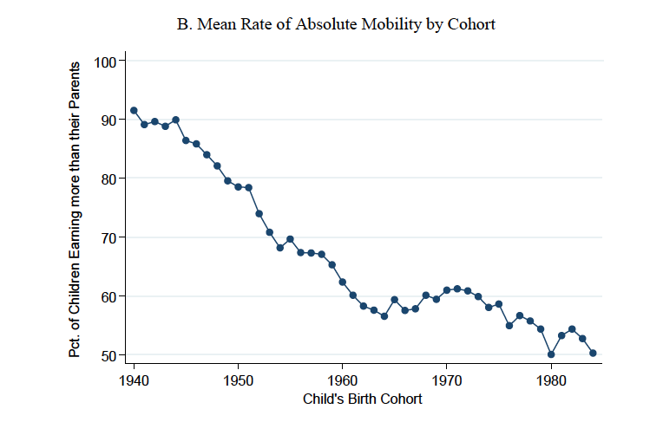
Worsening relative incomes
Chetty et al 2016
Relative incomes at median or below falling
Mobility (incomes relative to parents) also falling
Long literature in epidemiology and biology suggesting sustained stress leads to chronic conditions (Sapolsky, Marmot)

Slide 5
Case & Deaton II: Age profile of mortality by cohort
Ps: It would be nice to see figures for overall mortality

Slide 6
Case & Deaton II: Age profile of disease by cohort
Figure 1.13 Fraction reporting sciatic pain, white non-Hispanics by birth year and education class

Slide 7
Case and Deaton: A summary of their findings
“The age-outcome profiles steepen with each successive birth cohort.”
“The model has a latent negative factor that all members of the cohort experience as they enter the labor market, and that will stay with them for the rest of their lives”
“focus on cumulative disadvantage for birth cohorts that came of age in and after the mid-1970s”
“The data are consistent with long-run processes influencing outcomes, rather than contemporaneous shocks affecting health.”
“Our final figure suggests that there may be two underlying factors, not one, but they are not very different, and we do not press that conclusion.”

Slide 8
A cohort-based framework to understand the results: Lleras-Muney and Moreau (2017)

Slide 9
Log mortality of a cohort is (almost) shaped like a check mark ✔
Falls fast in
childhood
Declines rapidly
in childhood
Lines
don’t
cross
Low, flat and variable during
reproductive ages
Levels-off during
reproductive ages
Is linear on old age
(Gompertz 1825).
After ~age 45:
Lines move in parallel (as mortality falls)
Is linear in old age
(Gompertz 1825)
Human Mortality database

Slide 10
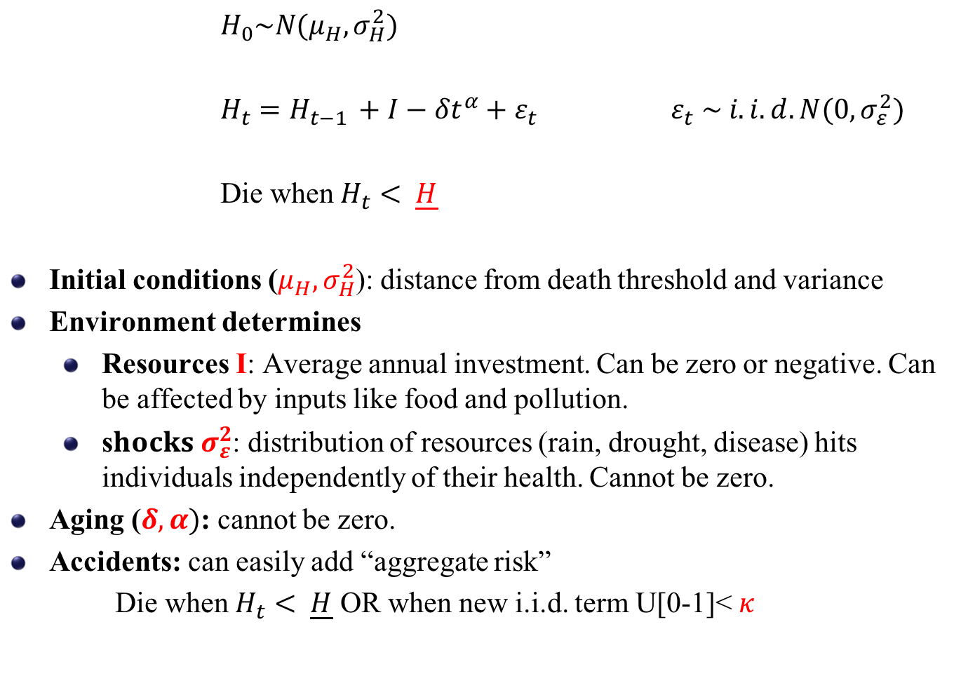
A stochastic dynamic model of health and mortality
$H_{0}\sim N(μ_{H},σ_{H}^{2})$
$H_{t}=H_{t−1 }+I−{δt}^{α}+ε_{t}$ $ε_{t} \sim i.i.d. N(0,σ_{ε}^{2})$
Die when $H_{t}< \underline{H}$
Initial conditions ($μ_{H},σ_{H}^{2}$): distance from death threshold and variance
Environment determines
Resources I: Average annual investment. Can be zero or negative. Can be affected by inputs like food and pollution.
s$hocks σ_{ε}^{2}$: distribution of resources (rain, drought, disease) hits individuals independently of their health. Cannot be zero.
Aging ($δ,α)$: cannot be zero.
Accidents: can easily add “aggregate risk”
Die when $H_{t}< \underline{H}$ OR when new i.i.d. term U[0-1]< $κ$

Slide 11

How is mortality determined?
*like Probit, scale and location are not identified
*normalize
$\underline{H}=$0, $σ_{H}^{2}$=1
*model has 5 parameters
Infant mortality:
Area under curve,
depends mostly on
initial distribution

Slide 12
Process is fundamentally stochastic
*without shocks:
no mortality after age 1!
*mortality at age t depends
on entire history of shocks
Mortality at age 2:
Area under curve,
depends a lot on
shock

Slide 13
Evolution of health stock over the ages
Distribution moves right and widens.
Then moves left but tail continues to
expand: 90-years old are on average
as frail as babies. But some are as
healthy as 40-yr olds
H close to normal in most periods.

Slide 14
Simulated evolution of mortality and average stock (for Belgium 1860)
Max health stock ~ age 40
Max sd of
health
~ age 60
Min mortality ~ age 20

Slide 15
Can changes to the parameters of the model generate the patterns documented by Case and Deaton for the US?
Simulate 5 different changes at age 20
Plot mortality and disability rates for affected and unaffected populations (imagine two successive cohorts in the Case & Deaton paper)
Can we replicate findings? YES!
lower annual (health) resources and higher depreciation rate are consistent with the data: Exactly what Case and Deaton argue!!
Other shocks are not consistent with observation
Can rule out change in accident rate, threshold and variance

Slide 16
Lower annual health resources generates pattern

Slide 17
Increases in depreciation also fit the data

Slide 18
Increases in accident rate does not affect disease rates

Slide 19
Increase in threshold lowers disease rates

Slide 20
Increase in variance generates a cross over (flatter slopes)

Slide 21
In logs, possible to distinguish: mortality example

Slide 22
Other comments
Temporary or contemporary changes in parameters DO NOT generate observed pattern
Model with optimal I* does not change conclusions (model here is purely mechanical)
What is I? health resources (not income). Is it plausible these have gone down for a majority of the population?
What would change depreciation/aging rate?
Rank and stress
Theories about pollution & exposure to other hazards

Slide 23
What does the model imply about compensation?
We prove in the paper that in this model initial conditions and investments are complements (there is dynamic complementarity).
Both shocks have a “scarring” effect
Return to baseline levels of I (or delta) will not “undo” effects
Loss of I needs to be compensated by more than I
Results are important implications for
Disability levels in future
Future health care expenditures
Debate about transfers and SS essential.

