Slide 1
mortality and morbidity in the 21st century Spring 2017 Brookings Panel on Economic Activity
Anne Case and Angus Deaton

Slide 2
Give you some facts: mortality by cause, by country, by sex, education group, race - (highlights) – these have the potential of ruling out (and not ruling out) possible drivers (5 minutes)
Contemporaneous circumstances - income (2 minutes)
A model of cumulative disadvantage (8 minutes)

Slide 3
Figure 1.3

Slide 4
Figure 1.1

Slide 5
Figure 1.2 All-cause mortality, black and white non-Hispanics with a high school degree or less education

Slide 6
Figure 1.5

Slide 7
Appendix Figure 2

Slide 8
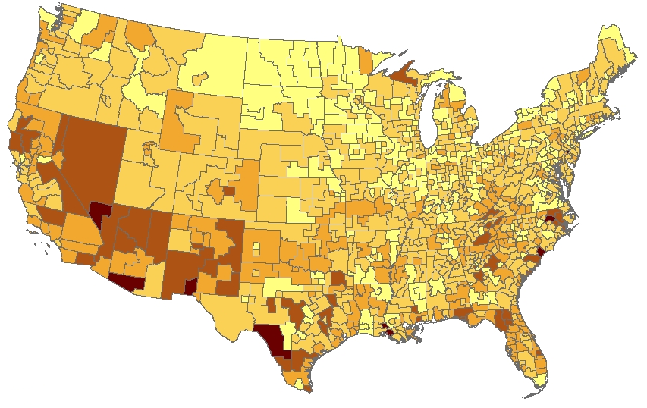
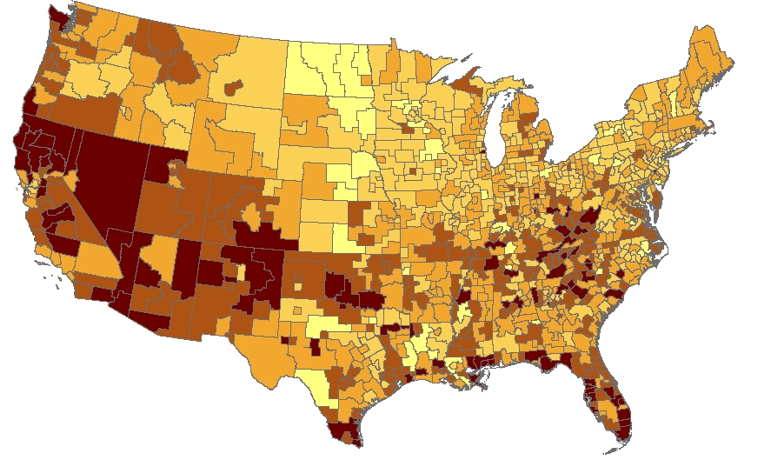
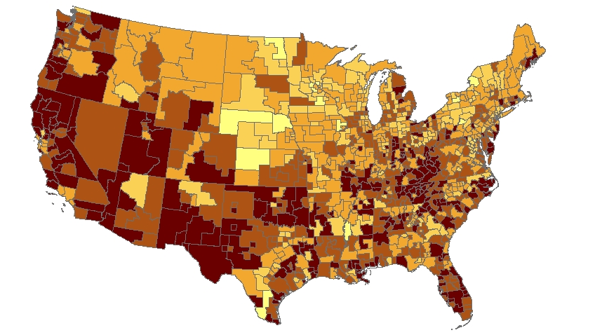
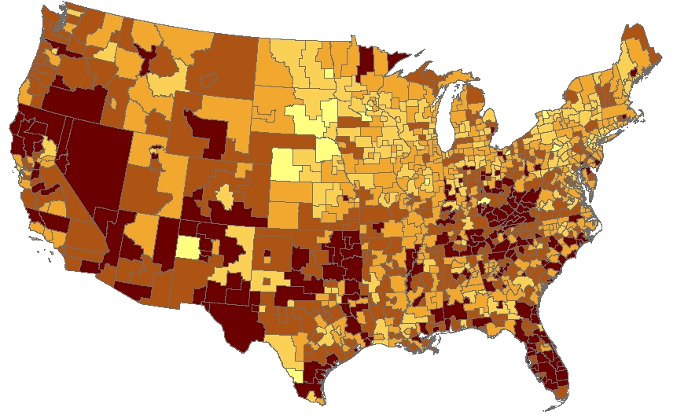
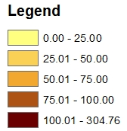
Figure 1.6 Drug, alcohol and suicide mortality, white non-Hispanics ages 45-54
2000
2007
2011
2014

Slide 9
Figure 1.11 Drug, alcohol and suicide mortality

Slide 10
Figure 1.7 Drug, alcohol and suicide mortality by birth cohort, white non-Hispanics, less than BA

Slide 11
Drug, alcohol and suicide mortality, white non-Hispanics by birth cohort
Less than BA
BA or more

Slide 12
Figure 1.8
Heart disease mortality, ages 50-54, US white non-Hispanics and comparison countries

Slide 13
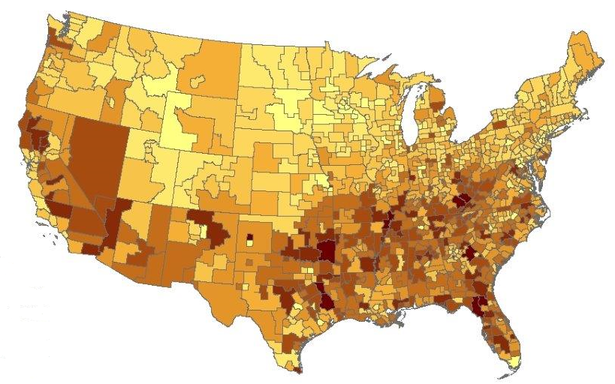
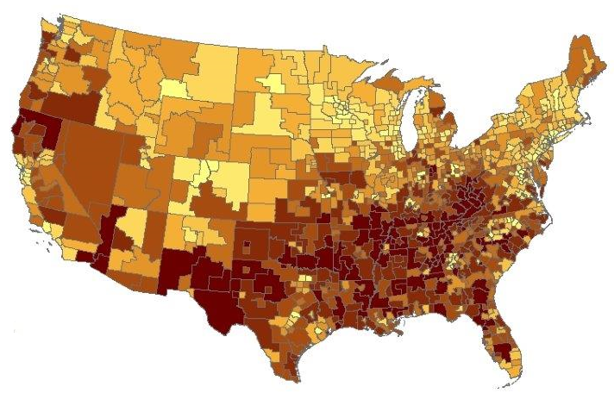
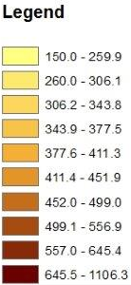
Figure 1.9 All-cause mortality, white non-Hispanics, ages 45-54
2000
2014

Slide 14
Figure 1.10 Change in mortality rates, white non-Hispanics 1998-2015

Slide 15
Mortality by cause, by country, by sex, education group, race - (highlights) – this provides us with facts we can use to rule out (and not rule out) possible drivers (5 minutes)
Contemporaneous causes - income (2 minutes)
A model of cumulative disadvantage (8 minutes)

Slide 16
Figure 2.1
Median household income per member and all-cause mortality, white non-Hispanics by age group
Median income per household member $2015
Deaths per 100,000

Slide 17
Figure 2.2

Slide 18
Figure 2.3

Slide 19
Mortality by cause, by country, by sex, education group, race - (highlights) – this provides us with facts we can use to rule out (and not rule out) possible drivers (5 minutes)
Contemporaneous causes - income (2 minutes)
A model of cumulative disadvantage (8 minutes)

Slide 20
Figure 1.7 Drug, alcohol and suicide mortality by birth cohort, white non-Hispanics, less than BA

Slide 21
Figure 1.13 Fraction reporting sciatic pain, white non-Hispanics by birth year and education class

Slide 22
Figure 3.1 Percent not in the labor force, white non-Hispanic men by birth cohort and education

Slide 23
Figure 3.2 Percent of birth cohorts never married, white non-Hispanic men and women

Slide 24
Cumulative deprivation
Long term process of decline for those without a BA
Steady deterioration in job opportunities, beginning with those leaving high school in the early 1970s
Social and economic structures weakened
High paying, secure jobs disappeared
Marriage gave way to cohabitation
Legacy religions gave way to new churches emphasizing “seeking”
The longer one lives in this environment, the worse outcomes become
To begin, we assume the factor responsible is latent -- it can change between birth cohorts, but is fixed for a birth cohort.

Slide 25
Cumulative deprivation
Health and mental health outcomes
Pain – sciatic pain, chronic joint pain
Markers of “serious mental distress” or “serious mental illness”
Social isolation – reports of difficulty socializing with friends
Body weight, obesity
Marriage – never married, not currently married
Heavy drinking
Mortality – suicide, drug overdose

Slide 26
where i indexes an outcome—suicide, obesity, pain; t is the time of observation; b is the birth year, so that a is age.
Regress each outcome on a complete set of age indicators, and birth year indicators interacted with age (the length of time the person has experienced the factor )
The coefficient on the birth cohort-age interaction term for birth cohort b
is an estimate of

Slide 27
The coefficient on the birth cohort-age interaction term for birth cohort b
is an estimate of
Plotting these estimates against b for each condition, we should see the
latent cohort factor and we should see the same pattern, up to scale,
for every outcome.

Slide 28
Figure 3.3 Estimates of cumulative deprivation, white non-Hispanics ages 25-64, less than BA

Slide 29
Figure 3.4

Slide 30
Tentative story: slow collapse of white working class
Each birth cohort entering the labor market without a BA after those born in 1945
Men start with lower real wages
Have worse subsequent careers, lower returns to experience
Lower marriage rates, higher divorce for those who get married, worse family lives
leaving the labor force, more mental distress, difficulty socializing, more pain, more drugs more alcohol, more suicide
All of these follow the same pattern over birth cohorts as do earnings
Starting off worse, and getting worse at a faster rate with age
This process was unfolding before heavy-duty prescription opioids flooded the market, but their presence has heightened its impact
These cumulative effects are unlikely to disappear at retirement
The next generation of retirees are likely to be in worse health and mental health than current retirees, and those that follow in worse health still
European countries have not suffered in the same way
Social safety nets? Better social connection? More stability in cohabiting relationships?
Black non-Hispanics have not, either
More likely to be eligible for US anti-poverty programs?

