Slide 1
Comment on: Kiley and Roberts, “Monetary Policy in a Low Interest Rate World”
Brookings Papers on Economic Activity
Ben Bernanke
March 24, 2017

Slide 2
Monetary policy at ZLB/ELB – a BPEA tradition
Krugman, “It’s Baaack: Japan’s Slump and the Return of the Liquidity Trap” (BPEA, 1998)
Eggertsson and Woodford, “The Zero Bound on Interest Rates and Optimal Monetary Policy” (BPEA, 2003)
Bernanke, Reinhart, Sack, “Monetary Policy Alternatives at the Zero Bound: An Empirical Assessment” (BPEA, 2004)
Williams, “Heeding Daedalus: Optimal Inflation and the Zero Lower Bound” (BPEA, 2009)
Campbell, Fisher, Evans, Justiniano, “Macroeconomic Effects of Federal Reserve Forward Guidance” (BPEA, 2012)
Evans, Fisher, Gourio, Krane, “Risk Management for Monetary Policy Near the Zero Lower Bound” (BPEA 2015)

Slide 3
This paper provides a valuable new look at the debate. It’s timely because as the Fed exits from ELB we are approaching the time when (as John Williams has pointed out) we should actively consider how the monetary policy framework can be improved to reduce ELB risks.
Some key issues:
How frequent, long, and severe are ELB episodes?
What is the right policy response to the ELB constraint?
Neglected in this literature: How do imperfect information, learning, and expectations formation bear on the optimal choice of policy regime and the associated central bank communication?

Slide 4
Frequency and severity of ELB episodes
K-R find greater frequency, duration, and severity than much of the earlier literature
Changes in the economic environment increase the risk of such episodes
Decline in equilibrium nominal interest rate (r* + π*) to about 3 percent is the most important factor
Changes in a) the variance of shocks and b) the structure of the economy are found to be less important

Slide 5
Frequency and severity of ELB episodes
K-R emphasize the role of the monetary policy regime:
The frequency and severity of ELB episodes is endogenous and jointly determined with the monetary (and fiscal) policy regime
Some “standard” policy rules yield bad results when equilibrium nominal interest rates are low
“Technical” assumptions in earlier literature may have led to underestimation of ELB risk (comparison to Williams 2009)

Slide 6
Some simple policy rules and the ELB
Estimated rule:
i(𝑡) = .9𝑖(𝑡 - 1) + .2𝜋₄(𝑡) + .15𝑦(𝑡) + .25Δ𝑦(𝑡)
Simple Taylor rule:
i(𝑡) = 𝑟∗ + 2 + 1.5(𝜋₄(𝑡) - 2) + 𝑦(𝑡)
i(𝑡): nominal federal funds rate
𝜋₄(𝑡): four-quarter core PCE inflation
y(𝑡): output gap (using CBO’s estimate of potential)
𝑟∗: equilibrium real interest rate
FRB/US performance under estimated and simple rules
 | ELB frequency | Mean duration of ELB | Mean(y) | Mean(π)
Estimated rule | 31.7% | 2.3 years | -1.3% | 1.2%
Simple rule | 38.3% | 2.5 years | -1.1% | 1.2%
Note: Results for steady-state nominal interest rate of 3%

Slide 7
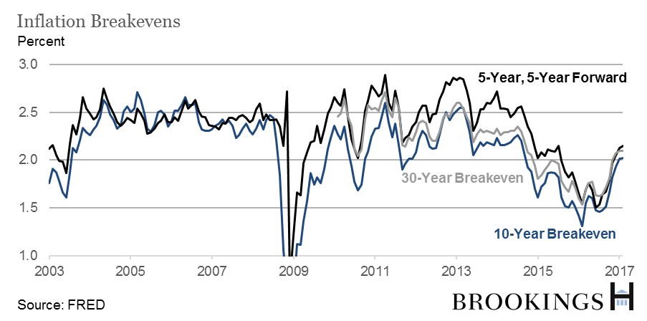
Interestingly, one indicator of ELB risk, far-forward inflation breakevens, don’t show much concern.

Slide 8
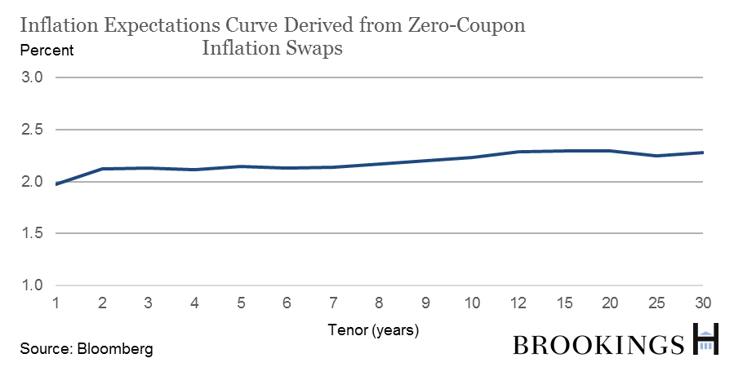
Neither do expectations based on inflation derivatives… Why?

Slide 9
Is expected inflation outside ELB episodes > 2 percent? Seems unlikely.
Are markets confident that policymakers will “do what it takes”?
K-R disagreement with Williams (2009) shows that conclusions about ELB depend heavily on market/public beliefs about how policy will react to highly unusual and/or extreme circumstances….

Slide 10
Policy response to ELB
The basic insight from literature: Credibly promising to keep rates low well beyond the ELB period solves the problem (Krugman, Eggertsson-Woodford).
Factors that improve performance:
Macro targets that imply easier policy after ELB episode (price level)
History dependence in rate setting (rate inertia; keeping rates lower for longer after ELB episode)

Slide 11
K-R focus on two general approaches:
Higher inflation target or “risk-adjusted” inflation target
“Shadow rate” approach (“making up” for lost accommodation under ELB after the ELB period is over)
They identify the inefficiencies of the higher inflation target approach:
Not sensitive to ELB duration etc.; so output remains subpar
Inefficient to have high inflation all the time when it’s only needed temporarily, after the ELB episode (Woodford)
[In addition]: Risk of destabilizing inflation expectations

Slide 12
Preferred rule:
​Change in interest rate depends on inflation and output gap (inertia)
Shadow rate allowed to be negative; actual rate rises only when shadow rate turns positive (“make-up” policy)
“In both models, [this policy] effectively eliminates any deterioration in economic performance associated with an ELB.”
Has similar characteristics to flexible price-level target but expressed very differently – does that matter?

Slide 13
Expectations, information, and communication
Key practical problem not addressed by this paper or literature: How are expectations of markets/public formed outside of steady state, and in particular how are they influenced by central bank talk? (Paper assumes MCE, steady state)
Matters a lot for thinking about implementing regime change – KR exercise analyzing hypothetical policy shift in 2013 should not be thought of as something that the FOMC could actually have done in real time

Slide 14
Matters for how policy framework is explained…perhaps higher inflation target is better than shadow rate in practice, as former is simpler and relevant at all times, while latter is relevant only after ELB episodes. Or perhaps talking in terms of interest rates is better because interest rates are under direct control of central bank so credibility for keeping promises easier to develop
Matters for debate about “Delphic” versus “Odyssean” forward guidance; if households and businesses see rates but don’t listen to central bank guidance, even Delphic statements (that lower rates but signal central bank pessimism) might be expansionary
Matters for interpretation of signaling devices like quantitative easing

Slide 15
There is a small literature on these issues:
Reifschneider-Roberts (2006) and Kiley (2017) study case in which financial participants have rational expectations but households and firms have adaptive expectations – differing results
Afrouzi et al (BPEA 2015) find that inflation targeting does not anchor inflation expectations of firms in New Zealand
Building on both these simulation and empirical studies is a promising and important direction for research

