Slide 1
Discussion of
“Safety, Liquidity, and the
Natural Rate of Interest”
John Williams
Federal Reserve Bank of San Francisco
Prepared for the Brookings Papers on Economic Activity Conference
March 23-24, 2017
The views expressed here are those of the author and do not necessarily reflect those of anyone else in the Federal Reserve System.

Slide 2
The Natural Rate of Interest: R*
The natural rate is an abstraction; like faith, it is seen by its works. One can only say that if the bank policy succeeds in stabilizing prices, the bank rate must have been brought in line with the natural rate, but if it does not, it must not have been.
John H. Williams (1931)

Slide 3
Contributions of DGGT
Estimate R* in VAR with shifting endpoints using macro, financial, and survey data
Modify standard DSGE model to incorporate:
  highly persistent financial shocks (ρ = 0.99)
  financial data (corporate bond spreads)
Use VAR and DSGE models to gauge contributions of real and financial factors (“safe assets”) to decline in R*

Slide 4
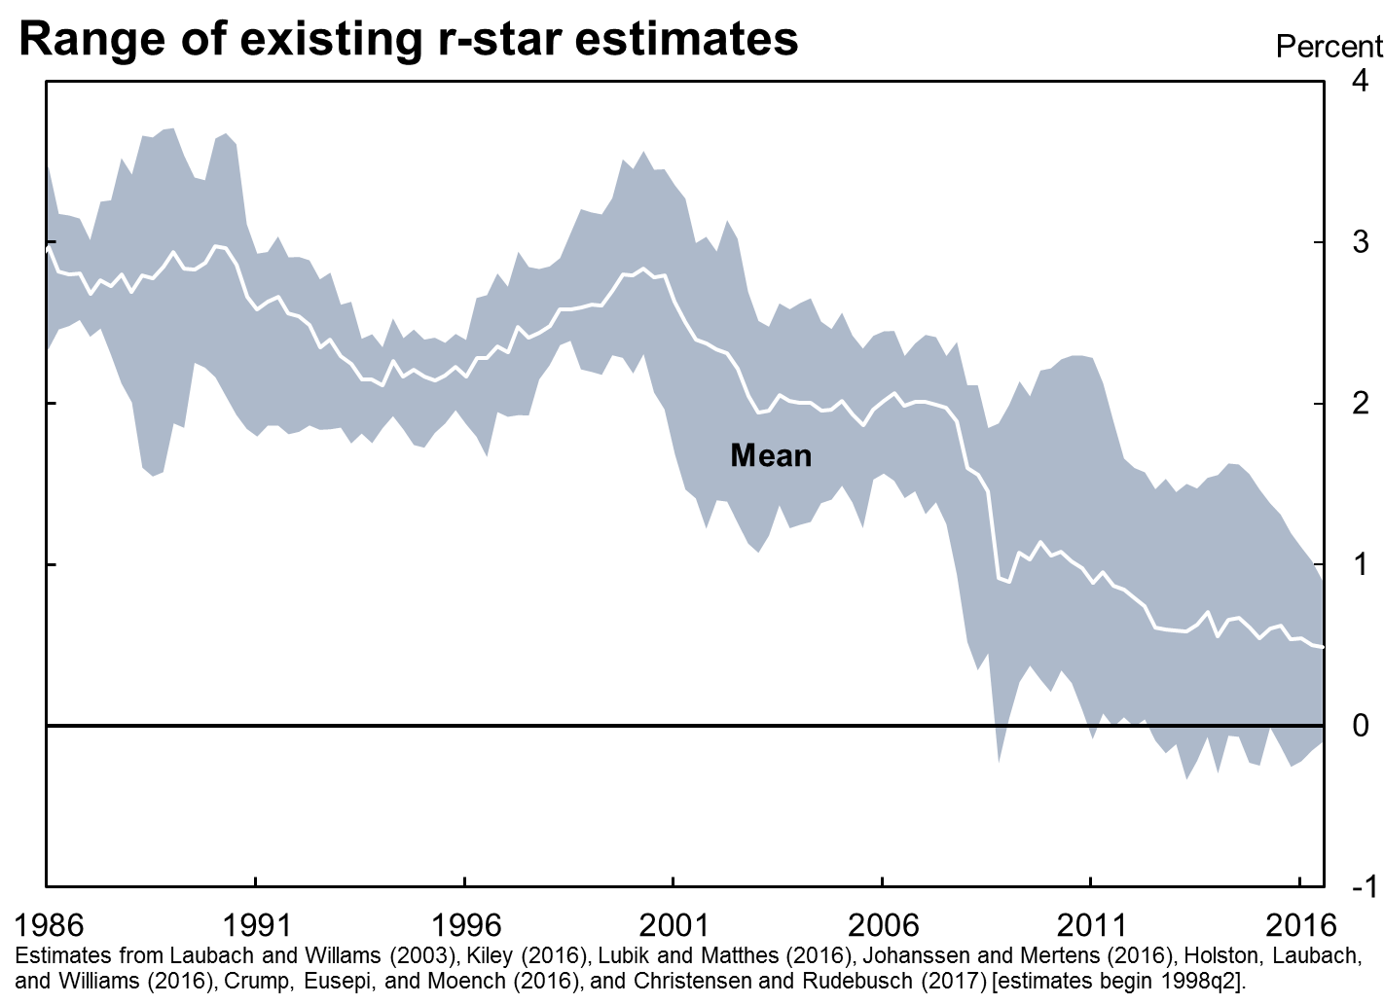
Starting Point: the Decline in R*

Slide 5
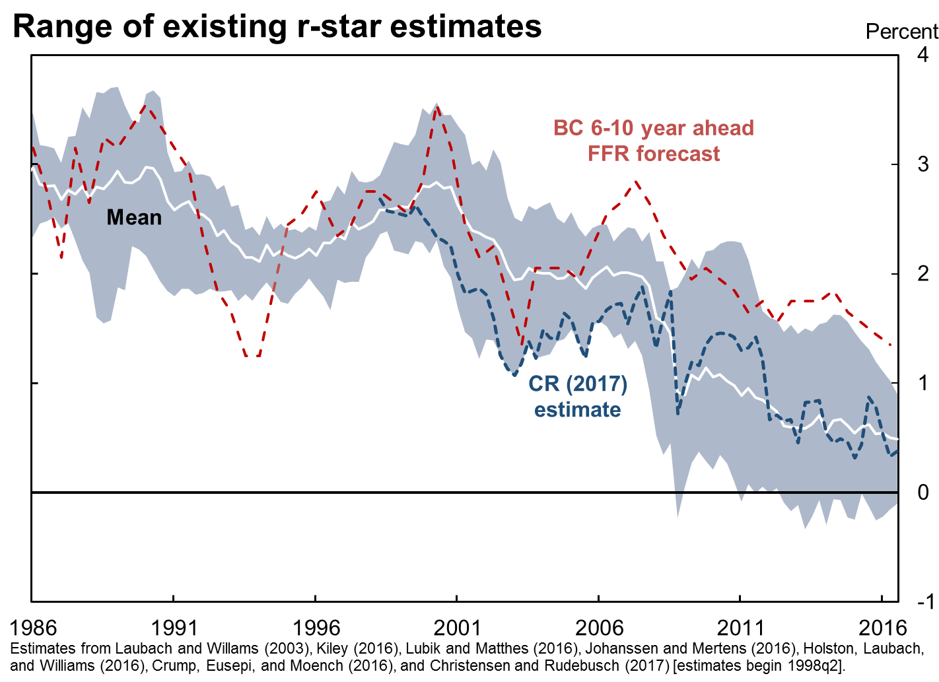
Market Expectations of R*

Slide 6
Estimates of R*
 |  |  | Change
 | 1998 | 2016 | 1998-2016
Laubach-Williams (2003) | 2.5 | 0.2 | -2.3
Holston-Laubach-Williams (2016) | 3.0 | 0.4 | -2.6
Kiley (2016) | 2.5 | 0.9 | -1.7
Lubik-Matthes (2016) | 2.4 | -0.2 | -2.6
Johanssen-Mertens (2016) | 2.5 | 0.8 | -1.7
Christensen-Rudebusch (2017) | 2.6 | 0.4 | -2.2
Crump-Eusepi-Moench (2016) | 2.4 | 1.0 | -1.4
Mean of 7 estimates | 2.6 | 0.5 | -2.1
DGGT VAR – consumption | 2.6 | 1.2 | -1.4
DGGT VAR – productivity | 2.7 | 1.1 | -1.6
DGGT- DSGE (10-year forward) | 2.7 | 0.3 | -2.4
Chistensen-Rudebusch (2017) and Crump-Eusepi-Moench (2016) estimates are adjusted
upwards by 0.35 to account for the mean difference in PCEPI and CPI inflation rates.

Slide 7
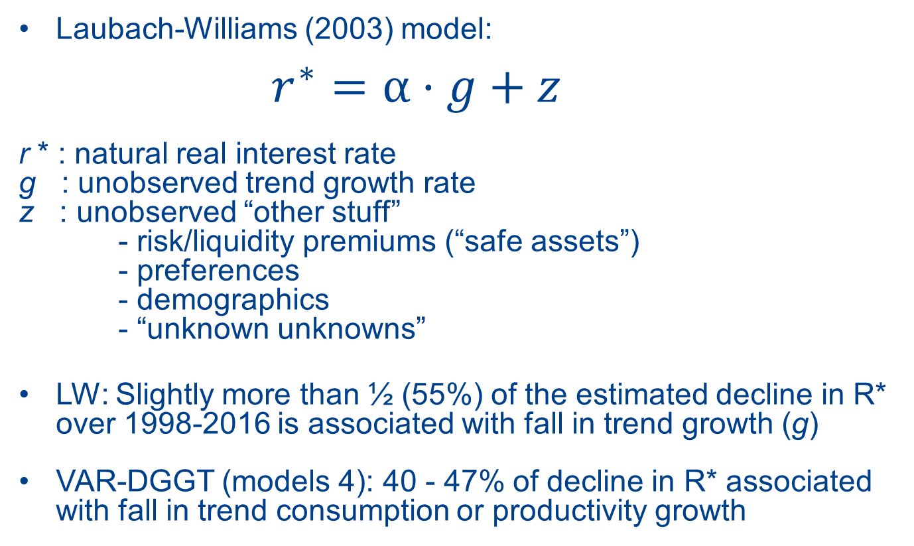
Why Has R* Declined?
Laubach-Williams (2003) model:
$r^{∗}=$ $α·g+z$
r * : natural real interest rate
g : unobserved trend growth rate
z : unobserved “other stuff”
- risk/liquidity premiums (“safe assets”)
- preferences
- demographics
- “unknown unknowns”
LW: Slightly more than ½ (55%) of the estimated decline in R* over 1998-2016 is associated with fall in trend growth (g)
VAR-DGGT (models 4): 40 - 47% of decline in R* associated with fall in trend consumption or productivity growth

Slide 8
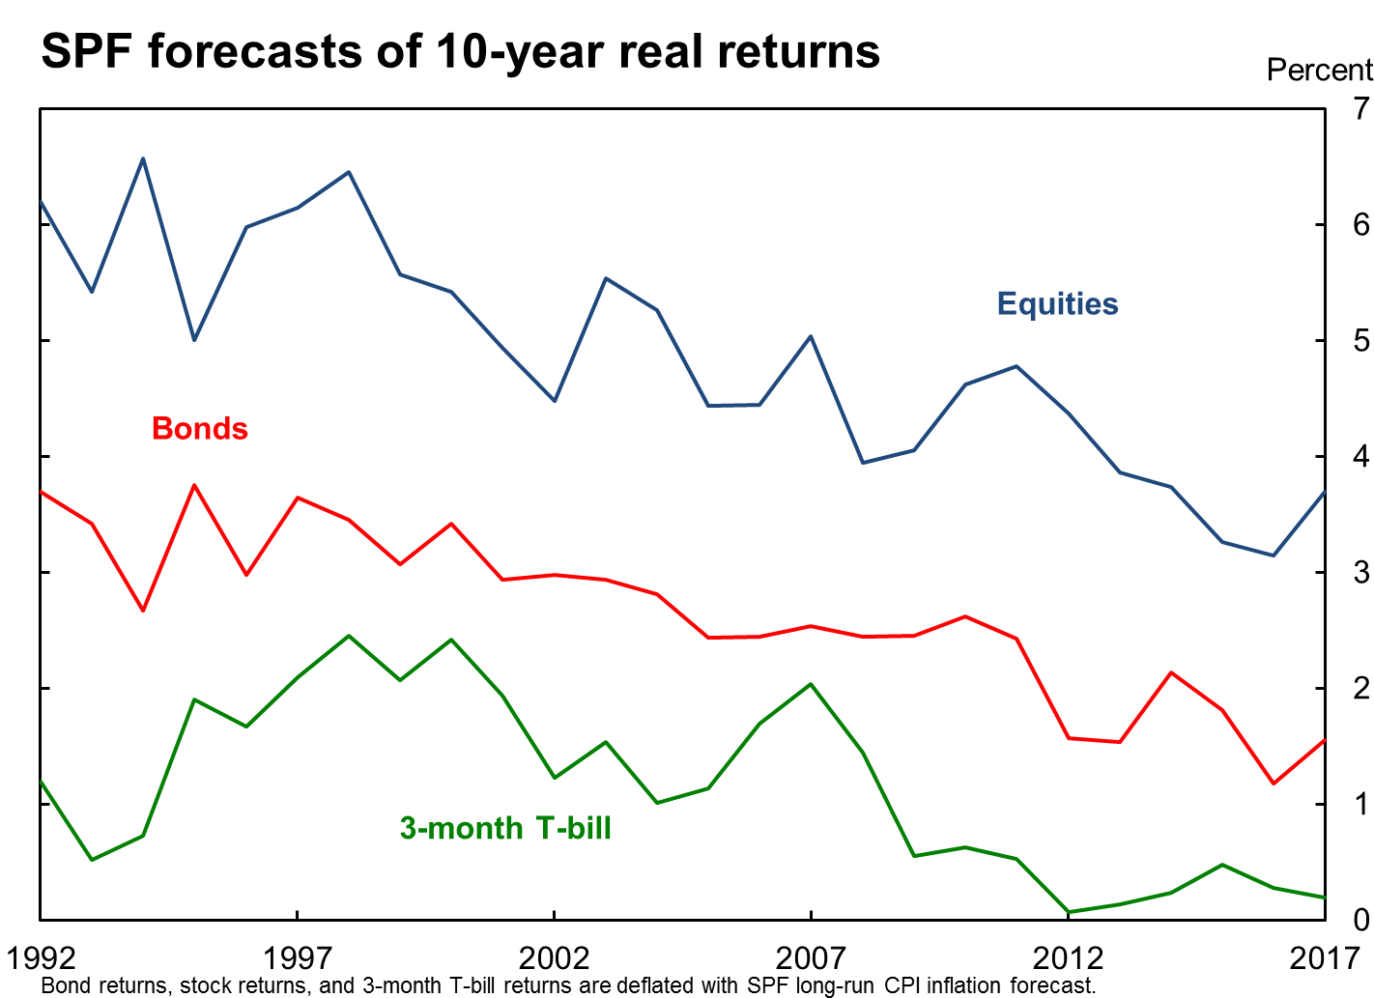
Is it Just a Safe Asset Story?
No: Expected Returns Have Fallen with R*
Change
1998-2017
Equities -2.7
Bonds -1.7
T-Bills -2.2

Slide 9
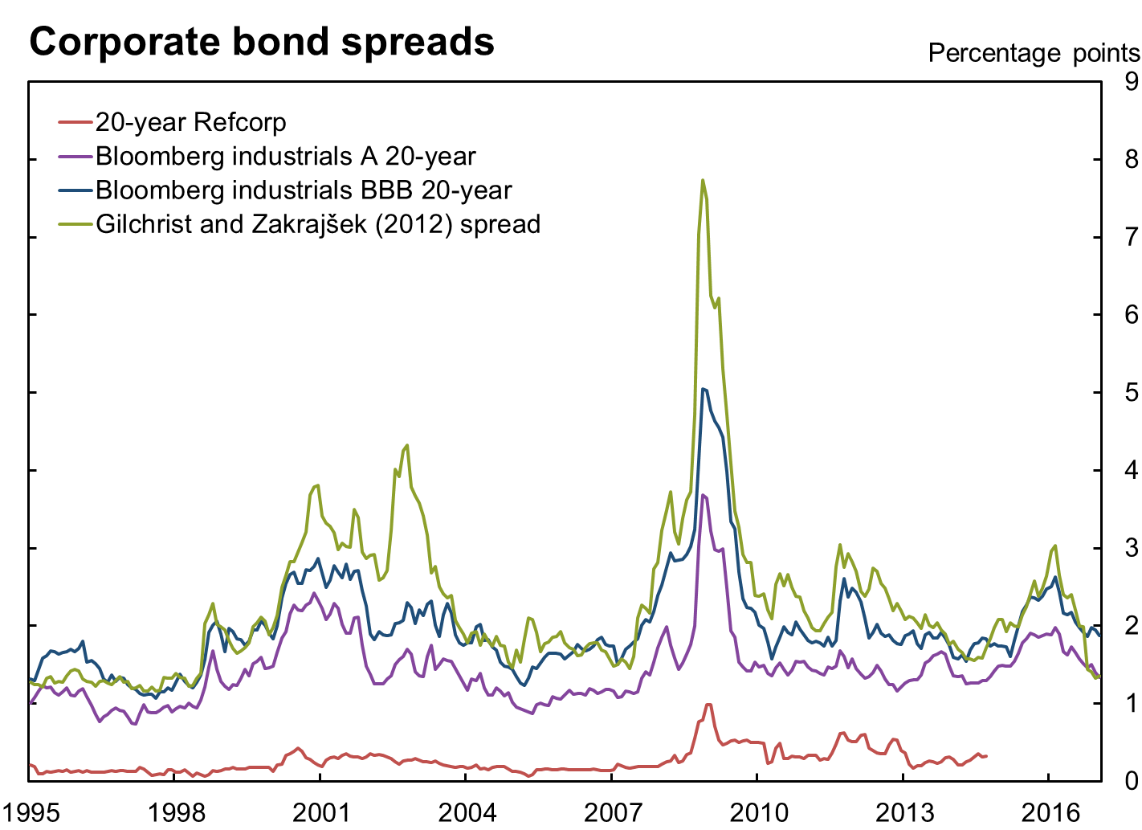
Liquidity/Risk Spreads are Not Very Elevated

Slide 10
Liquidity/Risk Spreads are Not Very Elevated
Median bond spreads to Treasuries: pre- and post-crisis
 | 1995 - 2006 | 2010 - 2017 | Difference
20-year Refcorp* | 0.16 | 0.33 | 0.17
Bloomberg industrials A 1-year | 0.57 | 0.34 | -0.23
Bloomberg industrials A 5-year | 0.75 | 0.70 | -0.05
Bloomberg industrials A 10-year | 0.82 | 1.05 | 0.23
Bloomberg industrials A 20-year | 1.20 | 1.47 | 0.27
Bloomberg industrials BBB 1-year | 0.81 | 0.79 | -0.02
Bloomberg industrials BBB 5-year | 1.13 | 1.41 | 0.28
Bloomberg industrials BBB 10-year | 1.34 | 1.71 | 0.38
Bloomberg industrials BBB 20-year | 1.75 | 1.88 | 0.13
Gilchrist and Zakrajšek (2012) spread | 1.80 | 2.14 | 0.35
GZ (2012) excess bond premium | -0.31 | -0.19 | 0.12
DGGT AAA | 0.66 | 1.11 | 0.45
DGGT BAA | 1.50 | 2.11 | 0.61
*through Sep. 2014

Slide 11
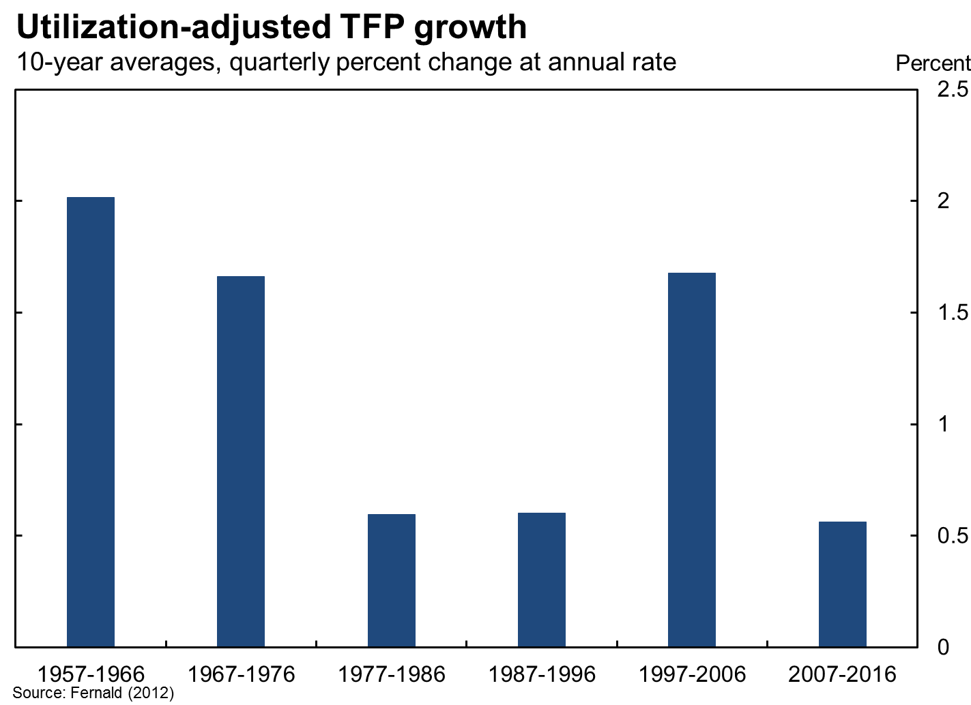
Highly Persistent Factors AWOL from DSGE Model:
TFP Growth and Demographics

Slide 12

DSGE Model with Persistent Shocks Tracks Existing R* Estimates

Slide 13
Where Does that Leave Us?
VAR evidence:
  New estimates add to consensus that R* has declined significantly
  Both real & financial factors appear to have pushed down R*
DSGE models with persistent shocks can replicate reduced-form estimates of R*:
  Clarifies relationship between lower-frequency models of R* and natural rate in DSGE models
  Allows for model-based assessment of factors affecting R*
However, DGGT DSGE model does not allow for highly persistent real factors: this is a horse race with just one horse!
  Inconsistency between VAR and DSGE models/results
  With allowance for persistent movements in TFP growth and demographics and better measurement of spreads, will convenience yield story hold up?

Slide 15

VAR Estimates of R*

