Slide 1
Along the Watchtower: The Rise and Fall of US Low-Skilled Immigration
BPEA Spring Conference 2017
Gordon Hanson, UC San Diego and NBER
Chen Liu, UC San Diego
Craig McIntosh, UC San Diego

Slide 2
Epochal Wave of Low-Skilled Immigration
Immigration surge of 1980, 1990s and 2000s
Result of extraordinary confluence of events
Relatively strong and stable growth in US income
Relatively slow growth in US domestic labor supply
Relatively weak immigration enforcement
Each of these conditions has since weakened or reversed, presaging an era of reduced low-skilled immigration

Slide 3
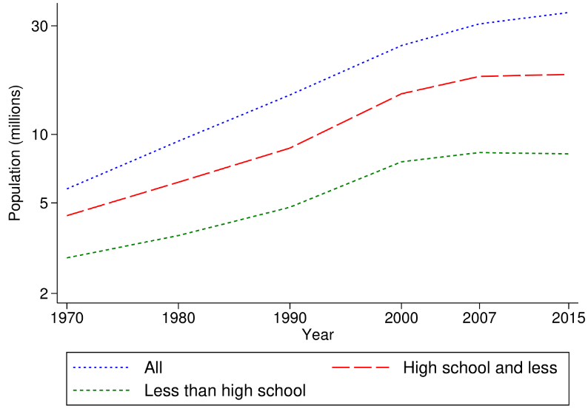
Low-skilled immigration has been flat since 2007
Foreign-born population, 18 to 64 years old (log scale)

Slide 4
Employment of the foreign-born has surged in labor-intensive industries
Share of low-skilled immigrants in total industry employment (%)

Slide 5
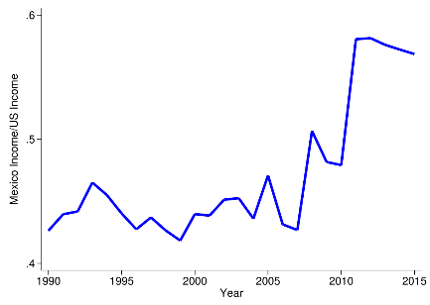
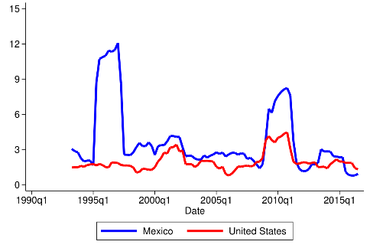
(I) US economy isn’t as attractive as it used to be
Income in Mexico at 50th percentile/
Income in US at 25th percentile
Standard deviation of GDP growth, rolling eight-quarter window
Note: Income values are in terms of PPP.

Slide 6
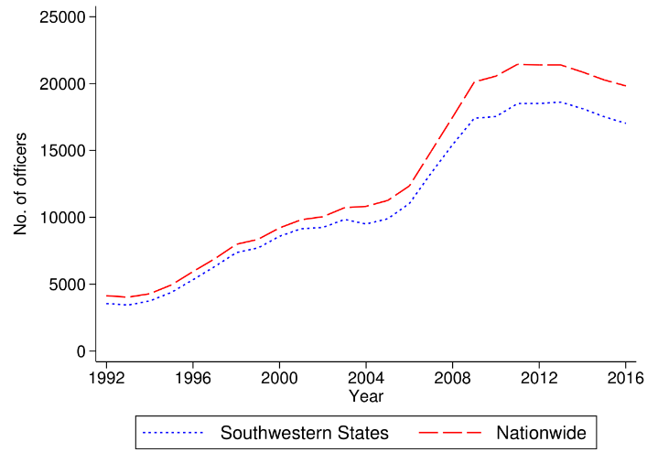
(II) US immigration enforcement has intensified
Number of US Border Patrol Agents

Slide 7
US-Mexico border security today

Slide 8
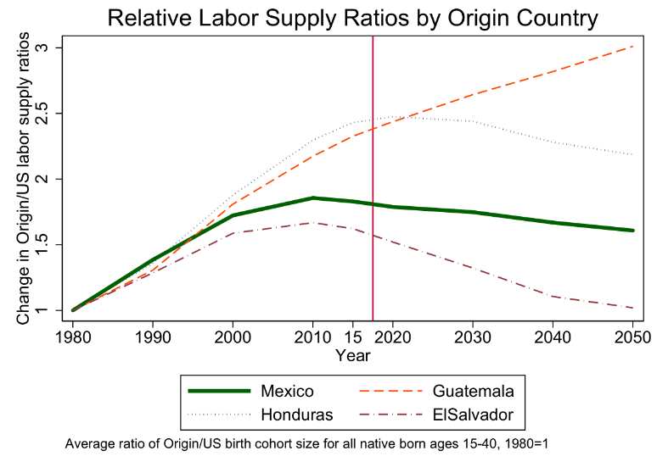
(III) Labor-supply growth (relative to the US) is now stagnating in most of Latin America

Slide 9
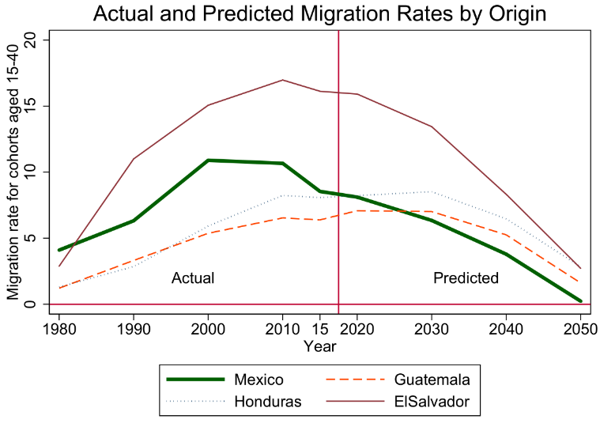
Projected immigration rates (based on a standard econometric model) are set to drop rapidly

Slide 10
Consequence will be the rapid graying of the low-skilled immigrant population

Slide 11
Discussion
Causes of immigration slowdown
Reduced fertility in Latin America (unlikely to reverse)
Macroeconomic stability in Latin America (may reverse)
Political support for strong immigration enforcement (may reverse)
Consequences of immigration slowdown
Negative labor-supply shock to immigrant-intensive industries
Ag., construction, hospitality, personal services, nondurable manuf.
Upward pressure on wages of low-skilled labor
Raises incentives for automation, changes in product mix
Shift in immigrant population from young to old
Challenge in future isn’t large inflows but growth in non-citizen elderly

Slide 12
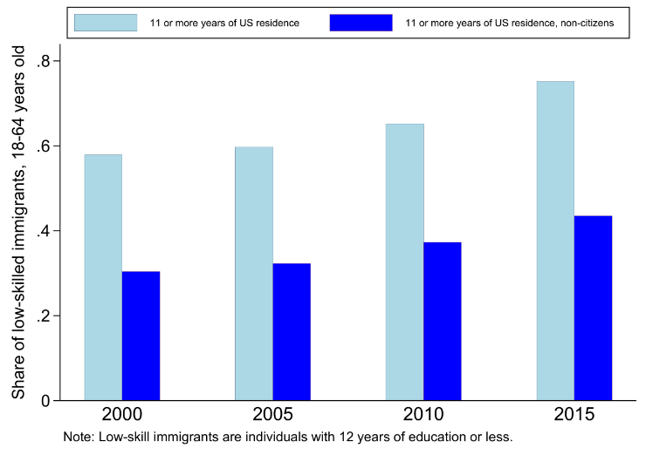
Most low-skilled immigrants are long-term US residents

