Slide 1
Climate-Related Risk: Disclosure and Financial Stability
Adele C. Morris, Ph.D. Senior Fellow
Policy Director, Climate and Energy Economics Project
The Brookings Institution
October 6, 2016

Slide 2
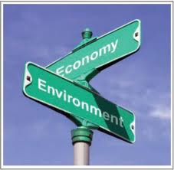
Climate Change is a Market Failure
Prices in most countries don’t reflect damage to the environment.
Damages are externalities.
E.g., sea level rise, ocean acidification, extreme weather events, shifts in vector-borne diseases, fires, ecosystem disruptions
Economists advise imposing an
economy-wide price on
greenhouse gases (GHGs) as a central
policy strategy.

Slide 3
Climate policies around the world are still under construction…
Emissions mitigation
Adaptation/resilience
Technology R&D
Support systems for abatement, adaptation, and development in poor countries
Diplomatic processes
Climate science research
Disclosure? Financial stability?

Slide 4
Risk categories
Damages from climatic disruption & ocean acidification
Litigation risks: Who’s going to sue whom for what?
Transition: When and how will countries control GHGs? What economic effects will it have?
Once policy is set, some outcomes are foreseeable.

Slide 5
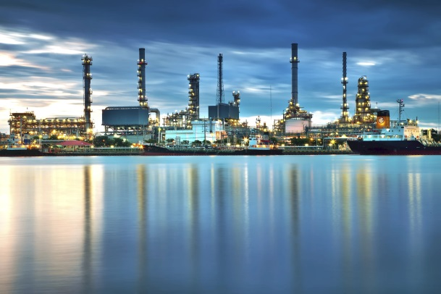
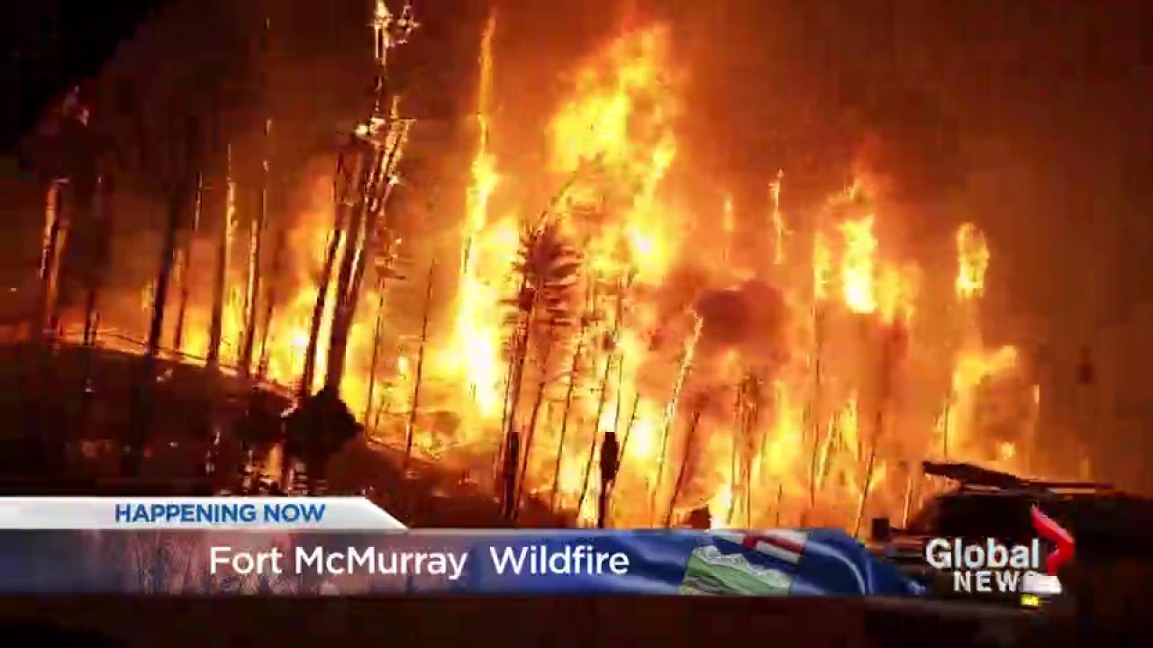
1. Risks from climatic disruption & ocean acidification
Facilities in low-lying or vulnerable areas
Operations vulnerable to droughts or floods
Disruption to resource inputs, production, and demand
Disruption to labor supply

Slide 6
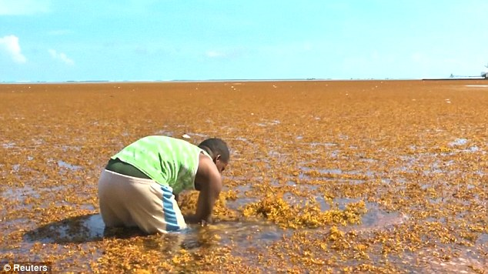
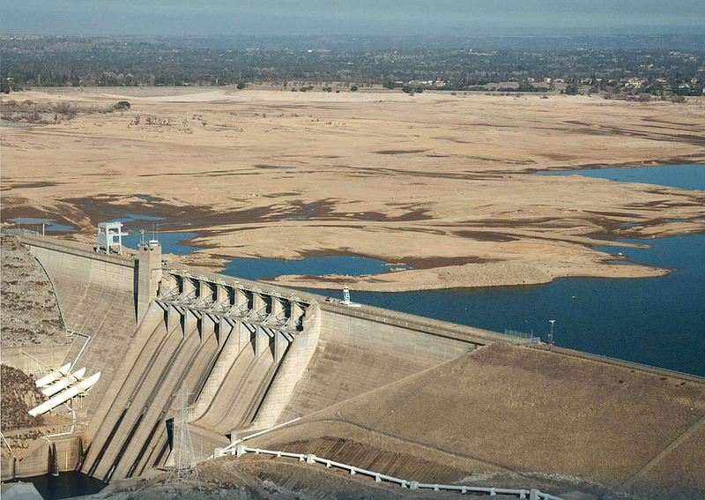
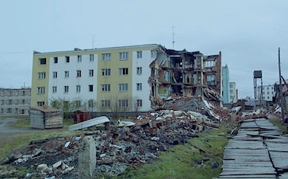
Dominican Republic coast
choked with rotting seaweed, 2015
http://www.daily
mail.co.uk/travel/travel_news/article-3264684/
Pictured-decaying-seaweed-ruining-
pristine-white-beaches-Dominican-Republic.html
Folsom Lake, California circa 2014
Permafrost thaw destroyed this apartment building in Cherski, Siberia,
only days after the appearance of the first cracks.
http://www.nunatsiaqonline.ca/stories/article/
65674world_must_pay_more_attention_to_thawing_permafrost_un_report/

Slide 7
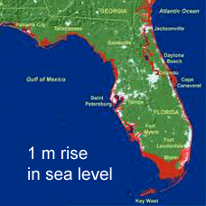
Disclosure of Risks of Climatic Disruption
Downside risks are firm- and location-specific
Probably infeasible to standardize this disclosure
Map or index risks
Outcomes depend on government and firm behavior
What if investment shifts away from vulnerable areas or activities?

Slide 8
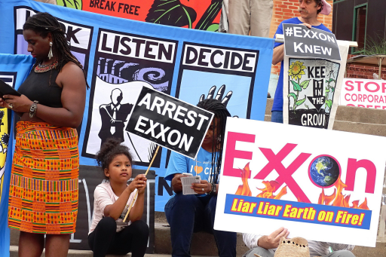
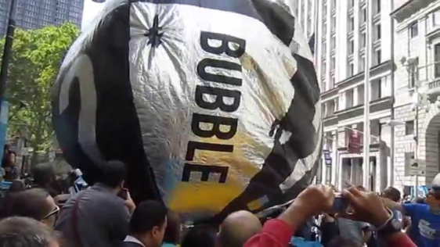
2. Litigation risk
#ExxonKnew, etc.
Did companies mislead shareholders and the public about climate change science?
Carbon bubble/unburnable carbon
Are companies overpricing their fossil fuel assets, thus misleading investors?
Damage liability
Could insurers or others successfully sue emitters to cover losses?
Failure to avoid damages, anticipate policy
In the U.S., legal risks may be different at state level than federal level.

Slide 9
3. Transition
Winners and losers depend on policy specifics, TBD. Consider the United States:
Regulatory system, e.g. under Clean Air Act
Protracted, legally uncertain
Stringency uncertain
Carbon tax alternative
More efficient than regulation.
High uncertainty about timing, price trajectory, regulatory backstop, coverage, use of revenue, border adjustments
Change of Administration reverses policy direction

Slide 10
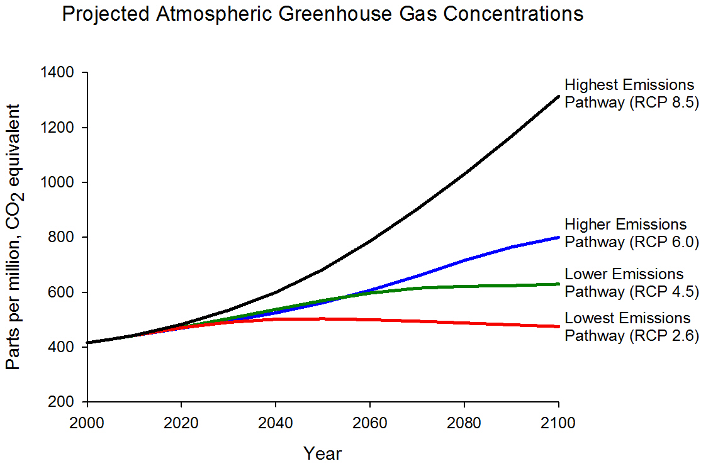
Transition
Which transition?
https://www.epa.gov/climate-change-science/future-climate-change
How should firms & oversight authorities take into account
climate commitments that haven’t been implemented?

Slide 11
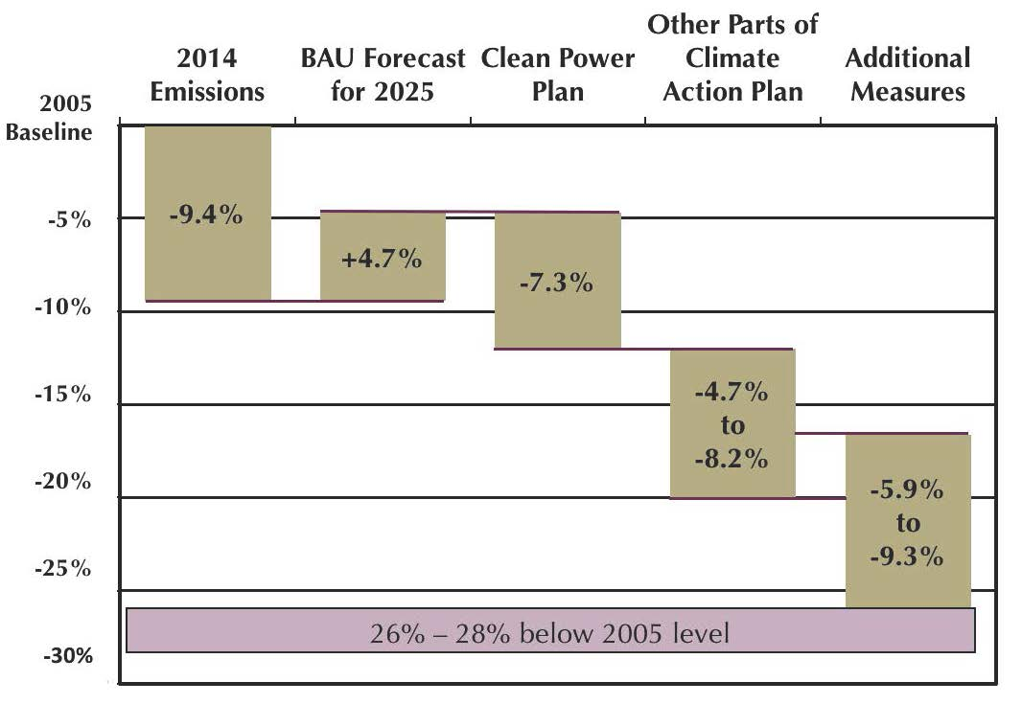
The US Emissions Pledge for 2025
?
Center for Climate and Energy Solutions: http://www.c2es.org/docUploads/us-indc-fact-sheet-8-2015.pdf

Slide 12
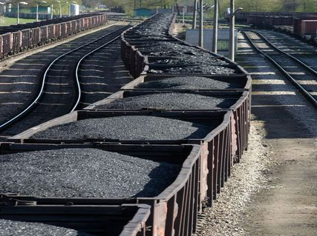
Disclosure Related to Transition
Policy scenarios
Outcomes for individual firms don’t just depend on their own carbon footprint
Policy details
Business model
Competitors
Suppliers and customers
Pricing power/trade
Policies elsewhere
Technology
Large economic literature on climate policy
For example, coal is hit hard in most scenarios

Slide 13
An illustrative $25 per metric ton CO2 fee scenario in US, 2011-2040
US Energy Information Administration AEO 2014

Slide 14
Disclosure Related to Transition
Some standardization is feasible and desirable
Helps investors compare companies, target investments.
May incentivize corporate behavior
GHG inventory methods already standardized
Could establish standard methods of shadow pricing, e.g. for new investment, acquisition, sourcing, technology; allow certification to these standards.
Stress test under standardized policy scenarios
Also disclose implications of weak policy
Clean tech may not find a market
Green finance may have its own bubble
Subsidies/mandates can be removed

Slide 15
Disclosure Questions
Who should develop standards and methods?
Voluntary or mandatory?
Does disclosure reduce liability?
Is climate policy more significant than other risks firms don’t disclose?
How much discretion is warranted?
How do we assess benefits of disclosure?
What are the costs of disclosure?
What kinds of gaming should regulators anticipate?
Mandate disclosure of upside risks and opportunities?
Firms have an interest in telling a positive story, but how reliable is it?

Slide 16
Climate-Related Financial Stability
What might threaten stability of financial markets?
Climatic disruption can exacerbate natural disasters
Insurance reprices regularly.
Abrupt policy changes (imposing or removing) strand capital.
Policymakers know this.

Slide 17
What Other Factors Could Affect Financial Stability?
Crude oil prices in the United States
(West Texas Intermediate)
Commodity price swings?
Technology?
Sudden changes in consumer sentiment or social license?

Slide 18
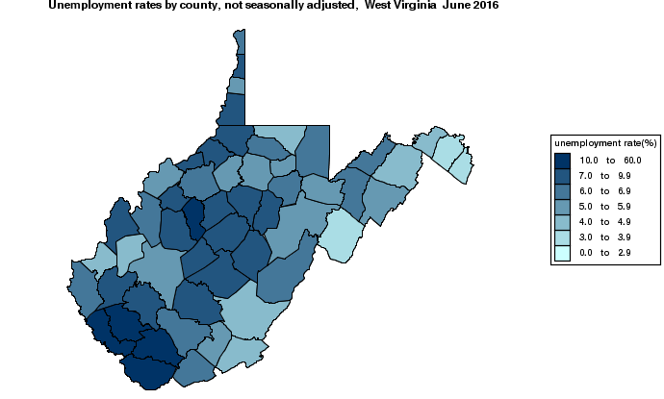
Where are the weak spots?
Coal in bankruptcy
Bonds from coal-reliant areas?
West Virginia Coal Severance Tax Paid to Counties, Quarterly
West Virginia
Unemployment Rates
by County, June 2016
Unemployment over 10 %
[

Slide 19
What can financial market regulators and central banks do?
Note that serious climate policy is economic policy.
Emphasize value in developing policy sooner rather than later.
Call for efficient, predictable, transparent policies to price carbon.
Recommend approaches that limit distortions of trade and investment across jurisdictions.
Call on leadership from finance ministers in climate policy development.

Slide 20
Options for further reading on economics of climate policy in the United States…

Slide 21
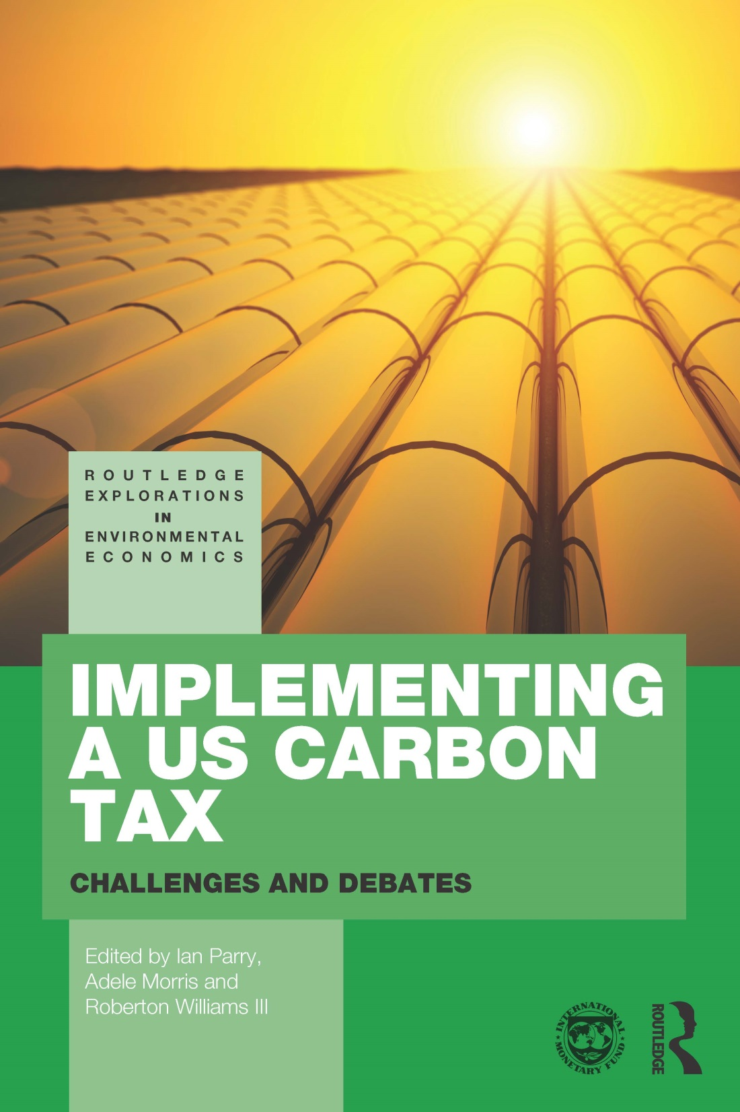
Book http://www.amazon.com/Implementing-Carbon-Tax-Explorations-Environmental/dp/1138825360/ref=sr_1_1?ie=UTF8&qid=1423668157&sr=8-1&keywords=morris+parry+williams Book launch was April 22, 2015 at AEI

Slide 22
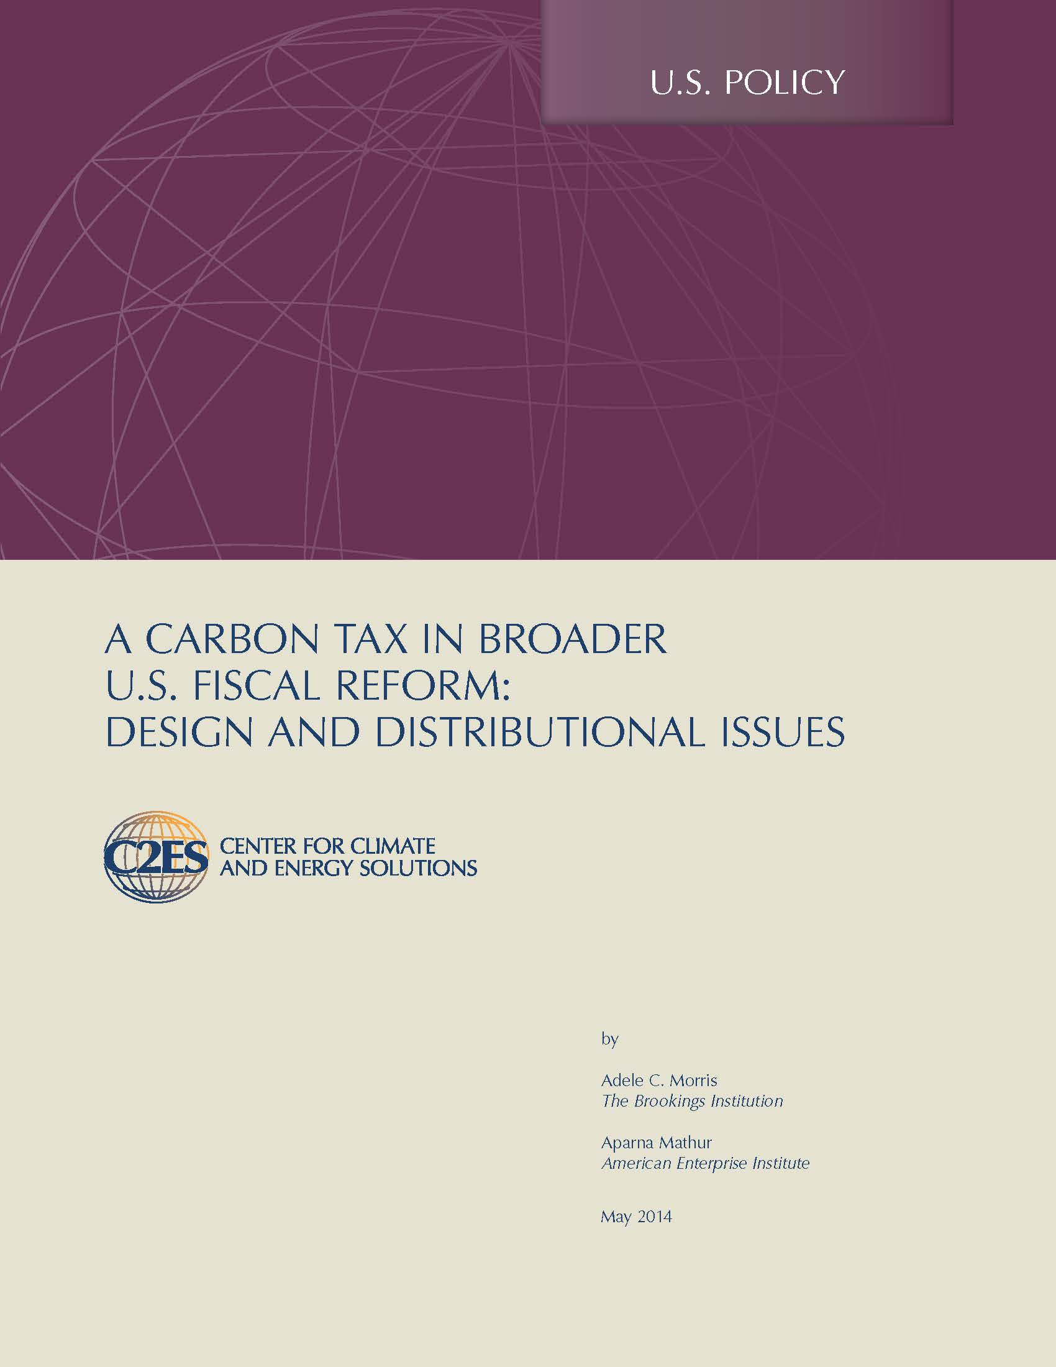
Policy Brief
http://www.c2es.org/docUploads/carbon-tax-broader-us-fiscal-reform.pdf

Slide 23
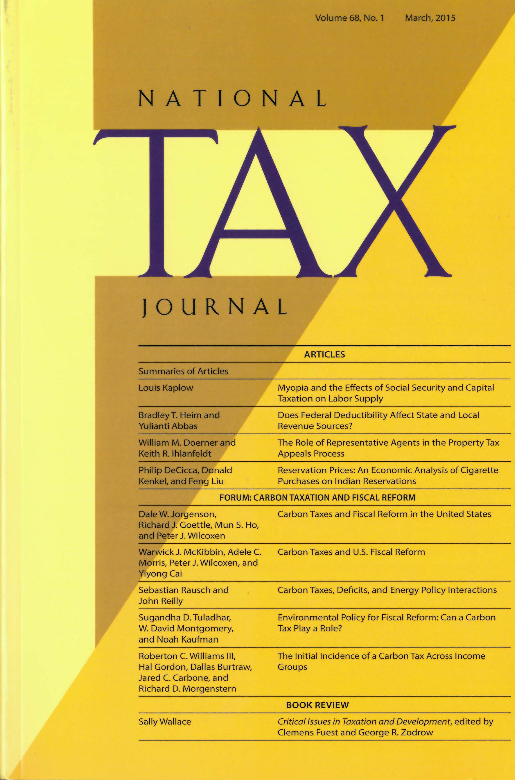
Five carbon tax swap studies: NTJ, March 2015
CARBON TAXES AND U.S. FISCAL REFORM, Warwick J. McKibbin, Adele C. Morris, Peter J. Wilcoxen, and Yiyong Cai
CARBON TAXES AND FISCAL REFORM IN THE UNITED STATES, Dale W. Jorgenson, Richard J. Goettle, Mun S. Ho, and Peter J. Wilcoxen
ENVIRONMENTAL POLICY FOR FISCAL REFORM: CAN A CARBON TAX PLAY A ROLE? Sugandha D. Tuladhar, W. David Montgomery, and Noah Kaufman
CARBON TAXES, DEFICITS, AND ENERGY POLICY INTERACTIONS, Sebastian Rausch and John Reilly
THE INITIAL INCIDENCE OF A CARBON TAX ACROSS INCOME GROUPS, Roberton C. Williams III, Hal Gordon, Dallas Burtraw, Jared C. Carbone, and Richard D. Morgenstern

