Slide 1
Christiane Baumeister and Lutz Kilian
“Lower Oil Prices and the U.S. Economy:
Is This Time Different?”
Discussion by Valerie A. Ramey
BPEA, September 2016
Notes:
Intro

Slide 2
Summary
Very interesting, in-depth analysis of the effects of the recent oil price decrease on the U.S. economy.
Informative case study analyses, comparing effects to 1986, across states, and across categories of expenditures.
One econometric equation for consumption.
Findings:
  ↑ consumption.
  ↓ investment, with oil-extraction investment plummeting.
  No evidence for other channels, such as uncertainty channel, cost channel, etc.
  net effect on GDP was near 0.

Slide 3
Background: Possible oil effect channels
Cost channel in production
Sectoral reallocation
Uncertainty effects
Complementarity/operating cost effect
Discretionary income Effect
← Baumeister-Kilian focus on this for investment.
← Baumeister-Kilian focus on this for consumption.

Slide 4
BK’s discretionary income channel logic
↓ in the real retail price of gasoline is like a tax cut from the point of view of consumers.
  Although oil producer income falls, it takes time to show up as a fall in household income.
Households have more “discretionary income,” so they raise their consumption spending.
GDP rises through multiplier effects.

Slide 5
BK back-of-the-envelope calculation
45% ↓ in real price of gas
0.37 short-run elasticity of gasoline demand.
Gasoline expenditures are 3.17 % of total consumption expenditures
Thus, the ↓ in real price of gas freed up 1.13% of income for additional purchases.

Slide 6
My assessment of the discretionary income channel
The logic makes no sense to me.
The same logic would imply that the decline in the relative price of any good would act like a tax cut and stimulate consumption and GDP.
Consider consumption services in 2015:
  - The real price of services rose 1.7%.
  - Services consumption is 67% of consumption expenditures.
  - If I use the Baumeister-Kilian calculation, I find that this change reduced “discretionary income” by 1.13 %!

Slide 7
But how do we explain the empirical consumption response?
VAR: Effect of negative oil price shock (BK measure, unit shock)

Slide 8
So why does consumption rise when gas prices fall?
Because the U.S. is a net importer of oil!
  A fall in oil prices improves the U.S. terms of trade which has general equilibrium effects on consumption.
Backus-Crucini (2000) show that oil price fluctuations have accounted for a significant part of historical terms-of-trade fluctuations:

Slide 9
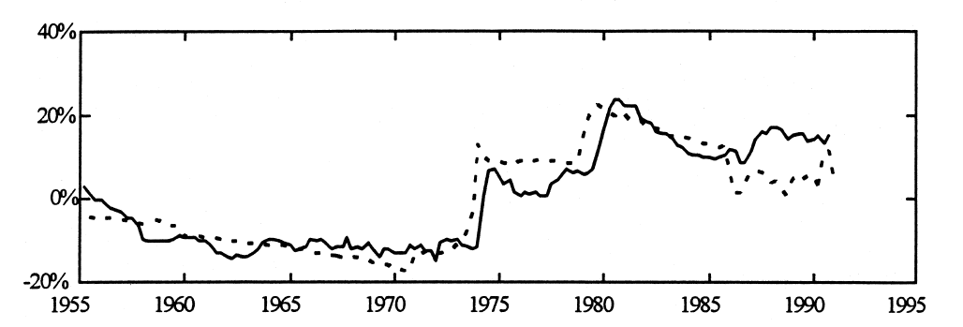
Real Oil Price and the U.S. Terms of Trade
Real oil price
Inverse of terms of trade
Graph from Backus-Crucini (2000) Figure 1

Slide 10
We should use an open economy model to analyze the effects of oil price changes.
To explore this, I extend the Arezki, Ramey, Sheng (forthcoming) model to look at the effect of oil price changes.
Dynamic open economy model:
2 sectors, non-oil, oil with endogenous depletion.
Adjustment costs on labor reallocation and on investment.
Cobb-Douglas utility function in non-oil consumption, oil consumption, and a function of labor.

Slide 11
Two Calibrations
Oil production is 1.7% of GDP. The economy imports 50% of the oil it consumes.
Oil production is 5.6% of GDP and the economy exports 36% of its oil production.
I simulate the effect of a 10% decrease in the price of oil.

Slide 12
Simulated effects of a 10% ↓ in the relative price of oil
A. Net importer of oil: Consumption rises
B. Net exporter of oil: Consumption falls

Slide 13
Thus, a basic open economy model can explain why an oil price decrease causes U.S. consumption to increase.
It’s due to a positive wealth effect.

Slide 14
Is This Time Different?
Baumeister-Kilian ask “is this time is different?”
Oil sector investment: they compare the decline in investment from 2014 to 2016 with the declines in 1986. The recent decline was 2x greater, but so was the fall in oil prices.
Consumption: they estimate a dynamic relationship between consumption and gas price changes (weighted by the gasoline share of consumption) from 1970 through 2016 and use the estimates to predict real consumption due to the gas price declines starting in 2014. They never test for stability of the relationship.

Slide 15
Has the consumption relationship changed over time?
I estimate their relationship with a few differences:
  - levels of log real consumption rather than differences
  - Jorda local projection
  I split the sample in half and allow all coefficients to change
Effects of a Baumeister-Kilian oil shock on log real consumption – integral through month 20.
P-value for test of stability is 0.000, so I overwhelmingly reject stability.
Sample | Cumulative integral effect on log consumption through month 20
1970m2 – 1992m12 | 11.4
1993m1 – 2016m3 | 2.6

Slide 16
Why we should expect the effects of oil prices on the economy to change over time.

Slide 17
Log Real Gas Prices (CPI)

Slide 18
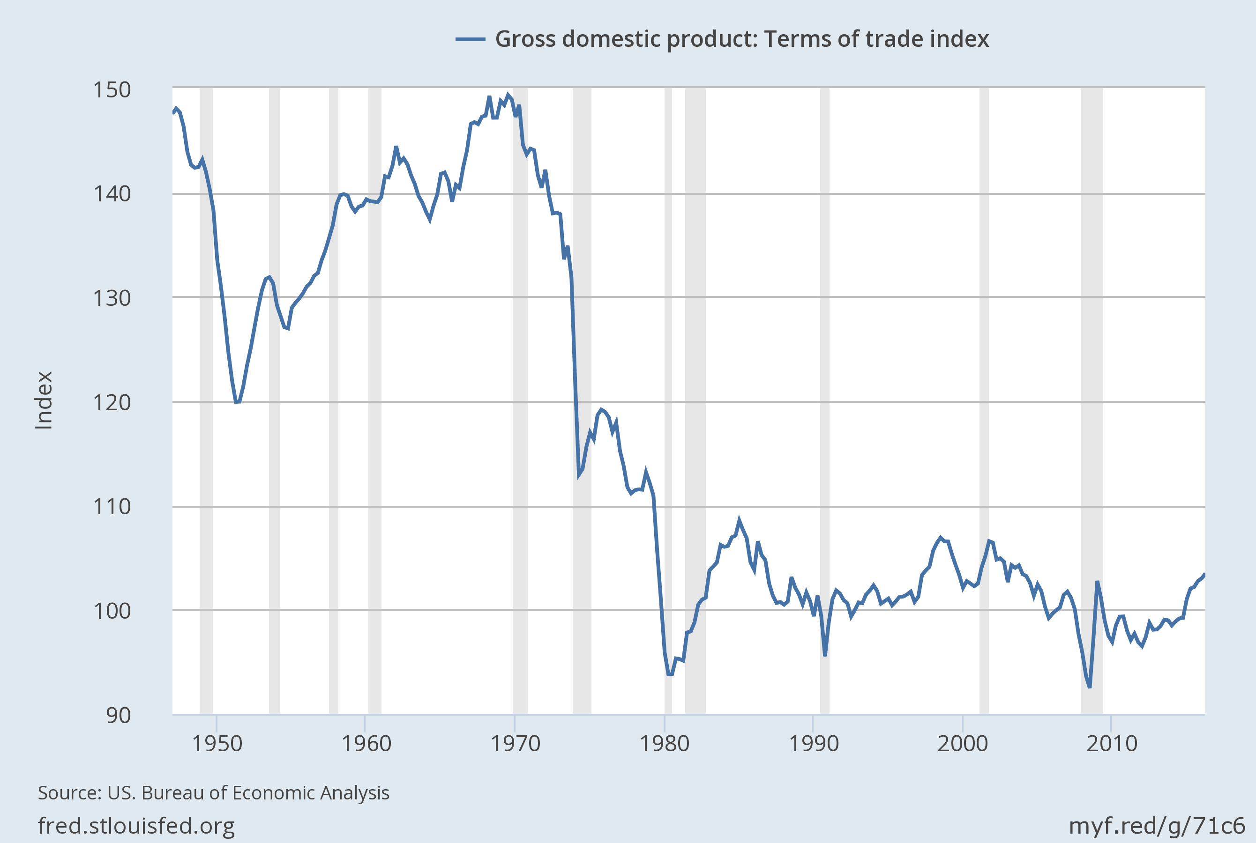
1. The terms of trade effects were bigger in the 1970s.

Slide 19
2. The shocks of the 1970s were accompanied by price controls and rationing.
Log Real Gas Prices (CPI)

Slide 20
Augmented Log Real Gas Prices (CPI)
with shadow cost of waiting in gas lines
Based on Ramey-Vine (2011)

Slide 21
3. Effects of U.S. shale revolution
Recall that the theoretical simulations implied a very different effect of oil price changes depending on whether a country was a net importer or exporter.
The natural question is: how has fracking changed the U.S. status?

Slide 22
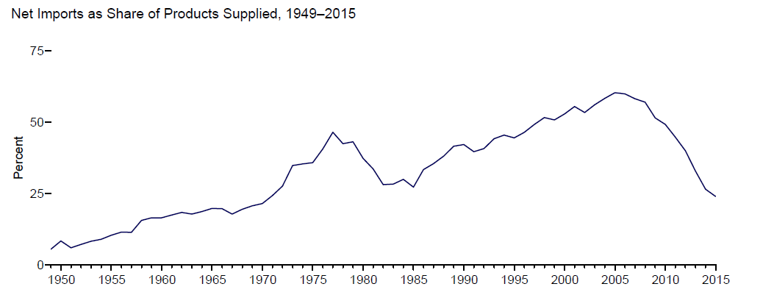
Petroleum: Net Imports Percent of U.S. Consumption
From Monthly Energy Review, Aug. 2016

Slide 23
Labor and investment effects
BK find no effects on unemployment, even by region, but large negative effects on investment, driven by the collapse of investment in oil the sector.
We would expect these kinds of results because oil is a low labor share, high capital share sector.
 | Aggregate economy | Natural resource extraction
Labor share | 0.64 | 0.13
Capital share | 0.36 | 0.49

Slide 24
Conclusions
Very nice case study analysis of the various potential channels.
I am not sure about the particular estimates, since they are based only on the authors’ assessment of the plausibility of counterfactuals and an equation that has changed over time.
However, I agree with their assessment of very little net effect.
  Special circumstances made the oil shocks of the 1970s particularly harmful.

