Slide 1
Brexit and Financial Stability: Macropru in action Donald Kohn, Robert S Kerr Senior Fellow, Brookings, and Member, Financial Policy Committee, Bank of England

Slide 2
The Financial Policy Committee
Our primary objective:
“The responsibility of the Committee in relation to the achievement by the Bank of its Financial Stability Objective relates primarily to the identification of, monitoring of, and taking of action to remove or reduce systemic risks with a view to protecting and enhancing the resilience of the UK financial system.”
Subject to that a secondary objective to:
“Support the economic policy of Her Majesty’s Government, including its objectives for growth and employment.”
- Bank of England Act 1998, as amended in 2012
Notes:
Annualized change in real GDP, quarter by quarter w/ recession shading—go back 50 yrs (1965-2015)

Slide 3
FPC actions before the Referendum
Identified & Monitored
“The Committee assesses that the risks around the referendum to be the most significant near-term domestic risks to financial stability”
- March 29 statement of results of March 23 meeting
The Committee identified the following channels through which the referendum could increase risks to the financial stability:
Capital inflows to finance a large current account deficit
Commercial real estate prices and financing
High level of UK household indebtedness
Fragility in market liquidity
Weak global growth and risks to euro area
Actions
FPC supported more intensive (PRA) supervision of exchange rate exposure, and LTRO operations and liquidity provision (by Bank) to ensure that any adjustments would be orderly
Notes:
Annualized change in real GDP, quarter by quarter w/ recession shading—go back 50 yrs (1965-2015)

Slide 4
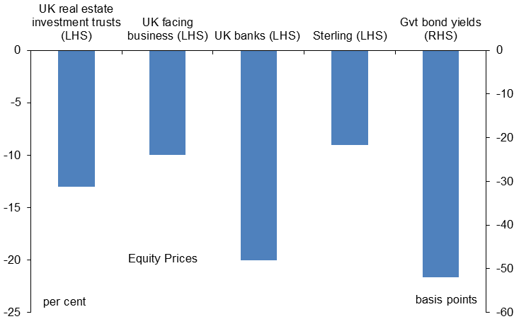
Market reactions to the Referendum
Referendum to meeting on July 1
In addition:
Sterling more volatile
Outflows from CRE investment funds and share prices
Possible gating of funds
But market functioning holds up
Notes:
Annualized change in real GDP, quarter by quarter w/ recession shading—go back 50 yrs (1965-2015)

Slide 5
What we did: Damping procyclicality
Release the bank countercyclical capital buffer of 0.5% of risk-weighted assets.
→ WHY?
To cushion a possible negative shock to growth by increasing banks’ capacity for lending to UK households and businesses.
Notes:
Annualized change in real GDP, quarter by quarter w/ recession shading—go back 50 yrs (1965-2015)

Slide 6
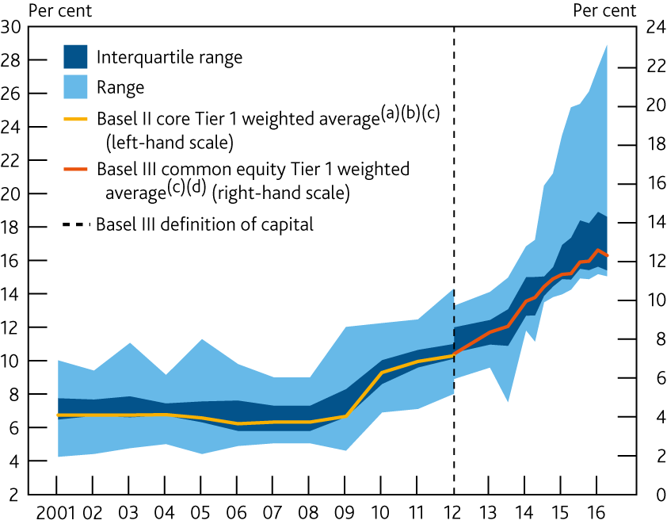
What we did: Damping procyclicality
Release the bank countercyclical capital buffer of 0.5% of risk-weighted assets.
WHY WERE WE COMFORTABLE DOING THIS?
Capital margins built up over previous years—buffers are there to be used when risks crystallize
Notes:
Annualized change in real GDP, quarter by quarter w/ recession shading—go back 50 yrs (1965-2015)

Slide 7
What we did: Damping procyclicality
Release the bank countercyclical capital buffer of 0.5% of risk-weighted assets.
WHY WERE WE COMFORTABLE DOING THIS?
Capital margins built up over previous years—buffers are there to be used when risks crystallize
Stress test framework had helped to calibrate the appropriate macroprudential capital levels in a stress
Notes:
Annualized change in real GDP, quarter by quarter w/ recession shading—go back 50 yrs (1965-2015)

Slide 8
What we did: Damping procyclicality
Release the bank countercyclical capital buffer of 0.5% of risk-weighted assets.
WHY WERE WE COMFORTABLE DOING THIS?
Capital margins built up over previous years—buffers are there to be used when risks crystallize
Stress test framework had helped to calibrate the appropriate macroprudential capital levels in a stress
Ample bank liquidity and enhanced BoE facilities.
Notes:
Annualized change in real GDP, quarter by quarter w/ recession shading—go back 50 yrs (1965-2015)

Slide 9
What we did: Get out of the way of monetary policy
Exempt central bank deposits from the exposure measure—the denominator of the leverage ratio.
Leverage ratio should not increase required capital when the MPC took actions to increase the amount of reserves.
Leverage ratio would be recalibrated in 2017 to avoid this decision reducing required capital overall.
Notes:
Annualized change in real GDP, quarter by quarter w/ recession shading—go back 50 yrs (1965-2015)

