Slide 1
Discussion of “Rules versus Discretion:
A Reconsideration” by Narayana Kocherlakota
Alan S. Blinder
Brookings Institution and Princeton University
BPEA, September 15, 2016

Slide 2
This is two mini-papers
A theoretical discussion of why discretion is better than rules.
A practical discussion of why the Fed was too timid in 2009 and 2010.
And, implicitly, after that as well.
The (non-missing) link: The Fed’s timidity was, in large measure, due to slavish adherence to the original Taylor rule.

Slide 3
Quick overall evaluation
Critiques by an insider are extremely valuable—and rare. So thank you!
My first reaction was to jump for joy. But then I realized two things:
The real issue is comparing somewhat incorrect rules to imperfect use of discretion. (Tough to do mathematically—we need human judgment!)
The link via the Taylor rule is a bit tenuous since R was constrained to “0”.
The only Taylor-rule issues were when “liftoff” would occur and what path R would follow thereafter.
The November 2009 Bluebook had liftoff in 2012.
The November 2010 Tealbook had liftoff in 2014.
In the end, I’m still joyful--but not quite jumping.

Slide 4
paper #1 rules vs. discretion: theory

Slide 5
The traditional theoretical tradeoff
Inflation bias → rules
Private information → discretion
Thank heaven NK said “non-rulable information” rather than “private information”!

Slide 6
The inflation bias issue
Kocherlakota’s version: π_{CB} > π_{SOC}
But does this idea make any basic sense?
Rogoff’s (1985) “conservative central banker” would have π_{CB} < π_{SOC}.
Furthermore:

Slide 7
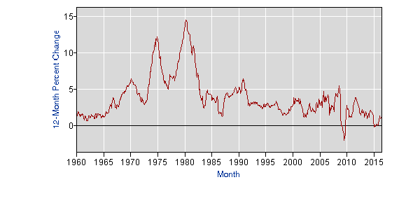
The inflation bias issue
Barro and Gordon (1983) and Kydland and Prescott (1977) sought to explain the rising inflation of, say, 1965-1980. But:
History since 1980 has been rather different.

Slide 8
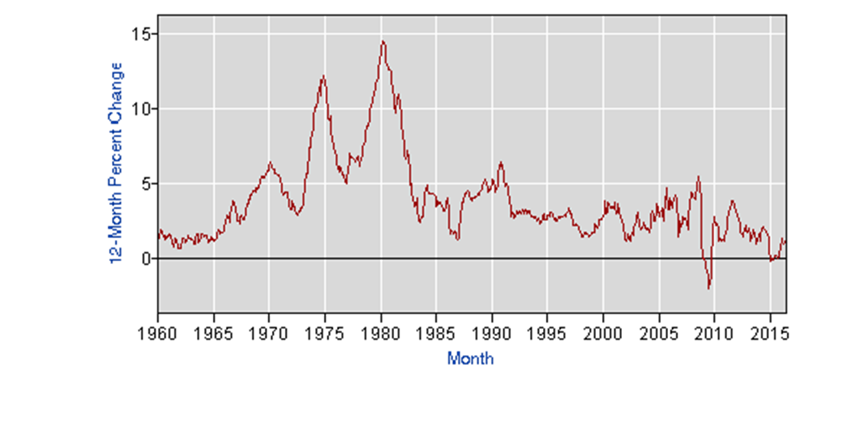
The inflation bias issue
Barro and Gordon (1983) and Kydland and Prescott (1977) sought to explain the rising inflation of, say, 1965-1980. But:
History since 1980 has been rather different.
The sharp disinflation was a result of discretion (e.g., Volcker’s), not of rules.
The theory predicts inflation that is too high, not rising inflation.
Vietnam + supply shocks provide a more convincing theory for 1965-1980—and what followed.

Slide 9
Kocherlakota’s main conclusions
(supposing both bias and non-rulable info exist)
It’s not that “rules are better than discretion” when there is inflation bias.
It’s that very, very good rules can be better than discretion if the inflation bias is relatively large and the variance of rulable shocks is relatively large.
Kocherlakota argues for small inflation bias at the Fed. I agree based on:
Natural selection of central bankers
Oaths of office are “commitment devices.”
There is obviously a lot of non-rulable information. The question is: Is it quantitatively important.
My answer: At certain crucial times, YES!

Slide 10
two other thoughts
We probably don’t live in a stationary environment. → undermines the case for rules.
Despite the indubitable brilliance of FOMC members, discretion is probably not practiced perfectly. → undermines the case for discretion

Slide 11
paper # 2: history: The fed’s “errors”
Specifically, being too timid in 2009 and 2010 (after R hit “zero”)

Slide 12
The two most important tables (pp. 6-7)
Aspirations
58% after 3 years
57% after 3 years
29% after 3 years (core was 1.3)
50% after 3 years (core was 1.0)

Slide 13
Kocherlakota’s basic case
These are pretty low aspirations → the FOMC was “giving up” too easily.

Slide 14
Kocherlakota’s basic case
These are pretty low aspiration levels → the FOMC was “giving up” too easily.
At the meetings, Board staff offered more aggressive options on QE and/or forward guidance, but no FOMC participant supported them.
I knew the FOMC was a bit hawkish then, but not a single member?

Slide 15
Some Evidence of a hawkish fomc
August 2007 statement: “the Committee's predominant policy concern remains the risk that inflation will fail to moderate as expected”
Bernanke testimony, July 2009: “The FOMC has been devoting considerable attention to issues relating to its exit strategy,…”
November 2009 meeting: Two participants favored a higher rate path than the Taylor rule; no one favored a lower path. (p. 8, fn 14)

Slide 16
Kocherlakota’s basic case
These are pretty low aspiration levels → the FOMC was “giving up” too easily.
At the meetings, Board staff offered more aggressive options on QE and/or forward guidance, but no FOMC participant supported them.
There were perhaps reasons to worry about more aggressive QE, but basically no reasons to worry about more aggressive forward guidance.
Well, what about markets not understanding the conditionality?

Slide 17
Kocherlakota’s basic case
These are pretty low aspiration levels → the FOMC was “giving up” too easily.
At the meetings, Board staff offered more aggressive options on QE and/or forward guidance, but no FOMC participant supported them.
There were perhaps reasons to worry about more aggressive QE, but basically no reasons to worry about more aggressive forward guidance.
“… [more] stimulative steps received essentially no support within the FOMC—at least in part because they would have led to a larger deviation from… the prescriptions of the Taylor rule. “ (p. 12)

Slide 18
The staff taylor rule at the time
R = 2.5 + π – 1.1(U-U*) + 0.5(π – 2)
Note: This equation was not estimated.
Note: No R_{t-1} term!
Note: 2.5% seems a bit high for the natural real rate.
U3 instead of GDP gap
Core PCE instead
of GDP deflator

Slide 19
Technological regress?
In my day (a long time ago!), we saw results from n Taylor rules.
U vs. GDP gap
Different U measures
Different π measures
Different coefficients
With and without R_{t-1} (if estimated, with)
The range of R’s thereby produced was normally wide!

Slide 20
My conclusions
I was pretty shocked to learn that one particular Taylor rule held that much sway.
But remember, R was constrained to “zero” all this time. So how important was it?
I agree with Kocherlakota that the Fed was too timid/hawkish, but...
But: Once the funds rate hit “zero,” and after early QE1, they were down to pretty weak instruments.
But: We should grade them on a curve: Most other CBs did worse.
So I come here not to bury Messrs. Bernanke and Kohn in criticism, but to praise them.

