Slide 1

Competition: A means of improving healthcare productivity in the UK? Carol Propper Imperial College London May 2016 Brookings Institute

Slide 2
The background: the productivity challenge
UK healthcare sector characterised by growth in expenditure over time long period
Tends to outstrip GDP growth (as in other countries)
Many estimates of productivity growth in sector are low

Slide 3
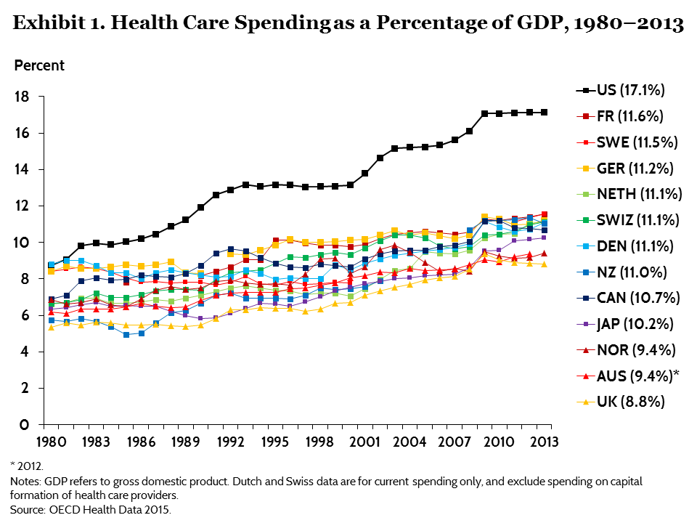
The healthcare sector

Slide 4
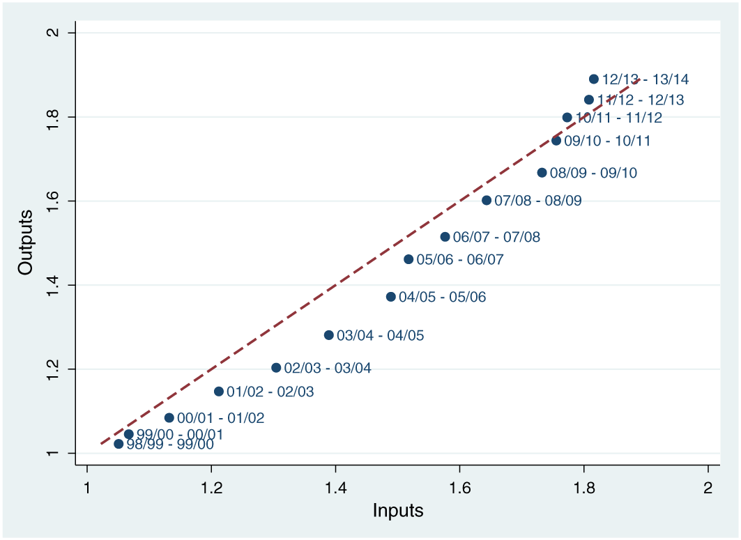
Productivity Growth in the English National Health Service from 1998/1999 to 2013/2014
NHS Productivity 1998-2013
Health Economics hec.3338, 4 APR 2016 DOI: 10.1002/hec.3338 http://onlinelibrary.wiley.com/doi/10.1002/hec.3338/full#hec3338-fig-0008
Notes:
Over period 1998-2013 NHS output increased by 88:96% and inputs by 81:58%, delivering overall total factor productivity growth of 4:07% over 15 year period

Slide 5
Greater competition in the healthcare sector
Is competition one way to address this challenge?
UK (England) has been a pioneer in use of pro-market reforms in formerly heavily centralised and regulated systems
Several other European and OECD countries have also had major pro-market reforms in healthcare
Lessons from the UK experience

Slide 6
Outline
Brief overview of reforms
Evaluation of impact on choice and outcomes
Reflections and lessons for future

Slide 7
UK reforms
Two waves of pro-market reforms
Part of pro-market reforms in general economy under Thatcher administration in 1990s
Labour administration mid-2000s which continued until around 2012 under Coalition administration

Slide 8
The Blair pro-choice reforms
Blair regime started with ‘co-operation’ and targets; mid-2000s shifted to policy of ‘choice and competition’
Key elements of the reform
Focus on secondary care
Freedom for patients to choose hospital of care
Shift from selective contracting to DRG type pricing (for around 70% of hospital activity)
Greater autonomy for well performing hospitals (retain some surpluses; greater freedom over investment decisions)

Slide 9
What happened?
Did the reforms change behavior and market structure?
Did this have any effect on outcomes, processes, productivity, equity?

Slide 10
Behaviour and market structure: choice
Patient knowledge of choice
Around 50% of patients recalled being offered choice within two years of the reform but also a view from some GPs that their patients did not want (or need) choice
Increasing evidence that patients can choose on the basis of quality (as well as distance)
From choice of GPs; elective hip replacement surgery; heart surgery (CABG)
Better hospitals attracted more patients post-reform (CABG surgery; hip replacements)

Slide 11
Better hospitals attracted more patients (Gaynor et al)
Imperial College Business School ©
Source: Gaynor et al Free to Choose
Notes:
11

Slide 12
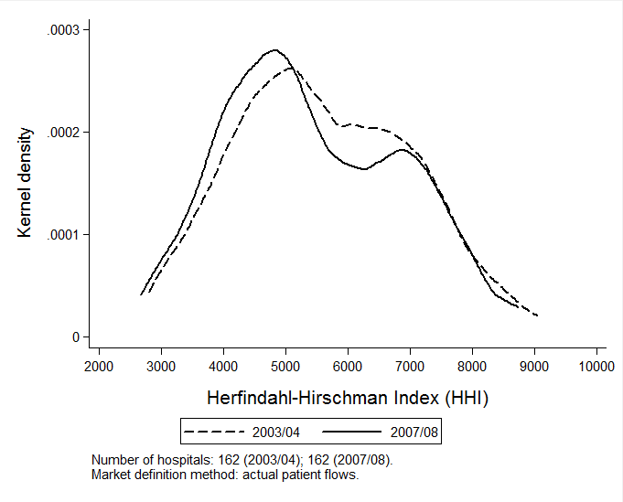
Change in market structure (actual provider HHI)

Slide 13
The impact on quality and process
Quality (most evidence)
(1) D-i-d studies
Mortality rates - fell and fell by more in less concentrated markets (AMI - 2 studies, change pre-dated policy, 1 study; heart surgery - hospitals with higher quality elasticity has higher falls in mortality)
Other measures of patient gain – no clear effect and/or positive effects
(2) Structural studies
Mortality fell, patient utility rose by around 8% (CABG); hospital elasticity with respect to quality increased (hip replacement)

Slide 14
The impact on quality and process
Productivity
Less evidence
Length of stay fell in less concentrated markets post- reform
No evidence of greater spending
Access/inequality
No impact on waiting times
No differential effects by income (deprivation) of local area

Slide 15
How did the reforms bring gains?
Relatively little study of the mechanisms by which competition might bring benefits
One approach has been to study the relationship between competition and management

Slide 16


Competition and management (Bloom et al 2010) Competition and Management in Public Hospitals

Slide 17
Motivation
Management has been shown to result in greater firm productivity
Economies which are competitive have better management
Is this the case in hospitals?

Slide 18
Bloom et al (2015) use well-tried measure of management quality and examine relationship with competition
Find that better management in England is
Associated with a range of better outcomes (quality, financial performance, waiting times, staff satisfaction and regulator ratings)
Management is better in hospitals facing more local competition

Slide 19
MY (co-author’s) FAVOURITE QUOTE:
Don’t get sick in Britain
Interviewer : “Do staff sometimes end up doing the wrong sort of work for their skills?
NHS Manager: “You mean like doctors doing nurses jobs, and nurses doing porter jobs? Yeah, all the time. Last week, we had to get the healthier patients to push around the beds for the sicker patients”

Slide 20
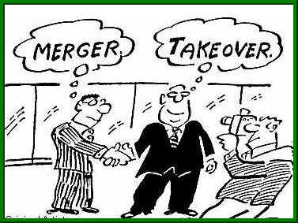
Evidence from UK Hospital consolidation

Slide 21
Evidence from UK Hospital consolidation
US evidence: consolidations raise prices, mixed impact on quality, reduce costs only slightly (Vogt 2009)
Is this the same for a public system?
1997 onwards UK experienced a wave of hospital reconfigurations
Over half of acute hospitals were involved in a reconfiguration with another trust
Median number of hospitals in a market fell from 7 to 5
What was the impact on hospital production?

Slide 22
Gaynor et al (2012) find that consolidations resulted in:
Lower growth in admissions and staff numbers but no increase in productivity
No reduction in deficits
No improvement in quality
Summary – mergers costly to bring about with few visible gains other than reduction in capacity

Slide 23
What do we know from the UK experiment?
Impact of reforms appears positive
Patients and hospitals appear to have responded
Better hospitals attract more patients
Quality rose without an increase in expenditure
Some of this might be due to increased managerial effort
Merger policy appears to have opposite effect
But ……

Slide 24
Lessons and emerging Issues
Design issues in maintaining competition
Need to ensure mergers (networks) do not remove all competition and that market regulation does not become command and control by another name
Large political push back
Impact on overall expenditure is small; competition between public hospitals is seen as privatisation; choice is seen as a luxury in tough financial times
Similar responses in other European countries where equity concerns limits amount of competition that is possible so effects are small

Slide 25
References
Bloom, Nick, Propper, Carol, Seiler, Stephan and Van Reenen, John (2015) "The Impact of Competition on Management Quality: Evidence from Public Hospitals". Review of Economic Studies 82(2): 457-489
Cooper et al (2011) Does Hospital Competition save lives: Evidence from the NHS. Economic Journal 212, 554 ( August 2001).
Gaynor, M, Moreno Serra, R and Propper, C (2012) Death By Market Power: reforms, competition and the NHS. American Economic Journal: Economic Policy 2013, 5(4): 134–166
Gaynor, M, Laudicella, M, Propper, C. (2012). Can Governments do it better? Merger Mania and the Outcomes of Mergers in the NHS Journal of Health Economics 31(3): 528-543
Gaynor, M, Propper, C, Seiler, S (2012) Free to Choose: Reform and Demand Responsiveness in the English NHS www.nber.org/papers/w18574
Propper, C. Competition, Incentives and the English NHS (2012) Health Economics 21:33-40
Propper, C, Burgess, S, Gossage, D (2008) Competition and Quality: evidence from the NHS Internal Market 1991-99. Economic Journal 118, 138-170.
Wynand P.M.M. van de Ven and Frederik T. Schut, "Universal Mandatory Health Insurance In The Netherlands: A Model For The United States?," Health Affairs, Volume 27, Number 3, May/June 2008
Rosenau, Pauline; Lako, Christiaan (2008), [http://jhppl.dukejournals.org/cgi/content/abstract/33/6/1031 "An Experiment with Regulated Competition and Individual Mandates for Universal Health Care: The New Dutch Health Insurance System"], Journal of health politics, policy and law 33 (6): 1031–1055, doi:10.1215/03616878-2008-033, PMID 19038869
Centre for Health Economics (York University), research papers by Gutacker CHE Paper 111; Siciliani et al CHE Paper 123.

