Slide 1
Global Payment and Productivity in Health Care
Michael Chernew

Slide 2
Productivity
Ideal outcome: Health
Ideal input: real resources
Spending is a proxy
Price declines increase productivity
Productivity: Health per $
How much can we lower spending with same health
Could also improve health with same spending or some combination of
health and/ or spending improvement

Slide 3
A Lot of Room for Savings
Source: Rose, Zaslavsky, McWilliams. 2016. “Variation in Accountable Care Organization Spending and Sensitivity to Risk Adjustment: Implications for Benchmarking.” Health Affairs 35(3):440-448

Slide 4
Pioneer ACOs Reduce Spending
Spending category | Quarterly mean, $ | Differential change from 2009-11 to 2012 for ACO group vs. control, $ | Savings, %
Total | 2,456 | -29.2* | -1.2
Acute inpatient | 911 | -13.5* | -1.5
Total outpatient | 793 | -6.9 | -0.9
Office | 405 | 7.3 | +1.8
Hospital outpt dept | 388 | -14.2* | -3.7
Poste-acute (SNF/IRF) | 271 | -8.7* | -3.2
*P<0.05
Source: McWilliams, J. Michael, et al. "Performance Differences in Year 1 of Pioneer Accountable Care Organizations." New England Journal of Medicine (2015).

Slide 5
Greater savings from low value care
Differential reduction of 0.8 low-value services per 100 beneficiaries for ACOs (vs. control)
1.9% differential reduction in low-value service quantity
4.5% differential reduction in spending on low-value services
Greater reductions for ACOs providing more low-value care
Source: Schwartz et al. “Change in Low-Value Services in Year 1 of the Medicare Pioneer Accountable Care Organization Program." JAMA Internal Medicine 2015.

Slide 6
Pioneer ACOs have Null or Positive Impact on Quality
Quality Measure | Annual mean | Differential change for ACO group vs. control
30-day readmissions, no. | 0.26 | 0.00
Hospitalizations for ACSCs, no. | 0.06 | 0.00
CHF | 0.02 | 0.00
COPD | 0.01 | 0.00
CVD and DM | 0.02 | 0.00
Mammography, % | 55.2 | 0.0
Preventive services for DM, %
A1c testing | 73.1 | 0.5*
LDL testing | 77.4 | 0.5*
Eye exams | 55.2 | 0.8*
Received all 3 | 38.5 | 0.8*
*P<0.05
Source: McWilliams, J. Michael, et al. "Performance Differences in Year 1 of Pioneer Accountable Care Organizations." New England Journal of Medicine (2015).

Slide 7
ACO Improve Patient Experiences (Pioneer and MSSP)
S
NS
NS
Source: McWilliams, J. Michael, et al. "Changes in Patients' Experiences in Medicare Accountable Care Organizations." New England Journal of Medicine 371.18 (2014): 1715-1724.

Slide 8
ACOs Improve Access (Pioneer and MSSP)
Source: McWilliams, J. Michael, et al. "Changes in Patients' Experiences in Medicare Accountable Care Organizations." New England Journal of Medicine 371.18 (2014): 1715-1724.

Slide 9
MSSP ACO Results
Lower spending
In 2013, $144 per beneficiary differential change in mean total annual Medicare spending in 2012 cohort vs control
1.4% estimated savings
Only $3 per beneficiary differential change in 2013 cohort vs. control
No change in quality
No differential change in use of low value services
McWilliams, Hatfield, Chernew, Landon, and Schwartz. 2016. “Early Performance of Accountable Care Organizations in Medicare.” NEJM

Slide 10
Alternative Quality Contract Reduced Spending
2009 AQC Cohort 2010 AQC Cohort 2011 AQC Cohort 2012 AQC Cohort
Source: Song, Zirui, et al. "Changes in health care spending and quality 4 years into global payment." New England Journal of Medicine 371.18 (2014): 1704-1714.

Slide 11
Result Decomposition
About half savings due to price (referrals)
Utilization effects on
Stenting
Advanced imaging
Equivocal results for orthopedic services
Few impacts on prescription drugs

Slide 12
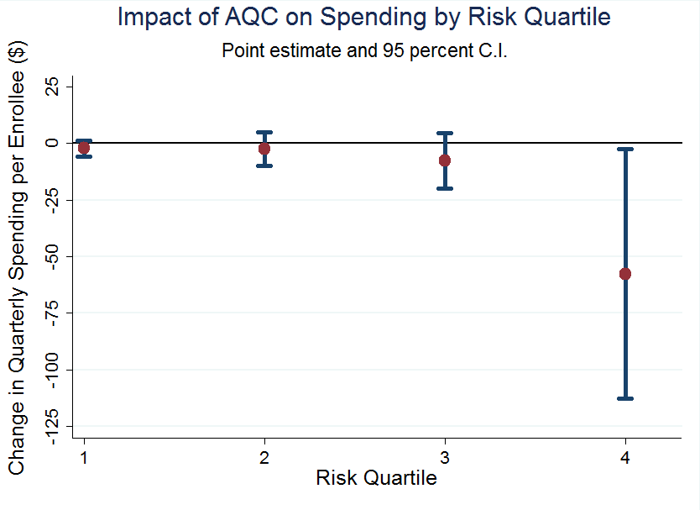

Slide 13
Episode Payment
Many implementation challenges (Hussey et al, 2011)
No consistent quality impact BPCI^{1, 2}
Some, but mixed, evidence of savings
Some lower spending in episodes with post-acute care²
For episodes w/ cardiovascular procedures and joint replacement, hospitals saw episode costs decrease by an average $300 (Medicare Acute Care Episodes 2009)
For CABG episodes, found 5% decrease in costs within Geisenger integrated delivery system (Casale et al, 2007)
Some evaluations show no savings
¹ Econometrica, Inc. “Evaluation and Monitoring of the Bundled Payments for Care Improvement Model 1 Initiative.” July 2015.
² Lewin Group. “CMS Bundled Payments for Care Improvement Initiative Models 2-4: Year 1 Evaluation & Monitoring Annual Report.” February 2015.

Slide 14
End

