Slide 1
Nuclear Arms Control in 2016
Brookings Arms Control and
Non-Proliferation Initiative
February 2016

Slide 2
Introduction
This presentation describes key nuclear arms control issues as of early 2016:
What the Obama Administration has achieved
What has hindered further nuclear reductions
Issues for future negotiations

Slide 3
What the Obama Administration has Achieved

Slide 4
Main Achievements
New START signing and implementation
Nuclear Security Summit process
Joint Comprehensive Plan of Action regarding Iran nuclear program

Slide 5
New Strategic Arms Reduction Treaty (New START)

Slide 6
New START
Signed in April 2010 in Prague
Entered into force in February 2011

Slide 7
Main Treaty Provisions
U.S. and Russia limited to no more than
700 deployed strategic delivery vehicles
800 deployed and non-deployed launchers
1550 deployed strategic warheads
Limits to be implemented by February 2018
Verification measures include data exchanges, notifications, on-site inspections

Slide 8
Deployed Strategic Delivery Vehicle (SDV) Limit
700 deployed SDVs
Intercontinental ballistic missiles (ICBMs)
Submarine-launched ballistic missiles (SLBMs)
Nuclear-capable bombers
“Deployed” missiles are in silos or launch tubes on submarines

Slide 9
Deployed/Non-Deployed Limit
800 deployed and non-deployed ICBM/SLBM launchers and bombers
“Non-deployed” launchers are ICBM silos or launch tubes on submarines that contain no missile

Slide 10
Deployed Warhead Limit
1550 warheads on deployed SDVs
All warheads, nuclear or otherwise, on deployed ICBMs/SLBMs count
Each deployed nuclear-capable bomber counted as one warhead
Arms control has historically given bombers more lenient counting rules

Slide 11
Treaty Implementation
Since treaty entered into force in 2011:
10 data exchange updates
Over 10,200 notifications exchanged
As of late-January 2016 each side had conducted 18 of 18 inspections permitted during treaty year 5 (began February 2015)

Slide 12
New START Numbers, October 2015
New START Limit U.S. Russia
Deployed SDVs (700) 762 526
Deployed warheads (1550) 1538 1648
(Limits take full effect in February 2018)

Slide 13
Expected U.S. Force When New START Fully Implemented
New START Limits
700 1550
SDVs Warheads
ICBM systems 400 400
SLBM systems 240 1090
Bombers 60 60

Slide 14
Nuclear Security
Summit (NSS) Process

Slide 15
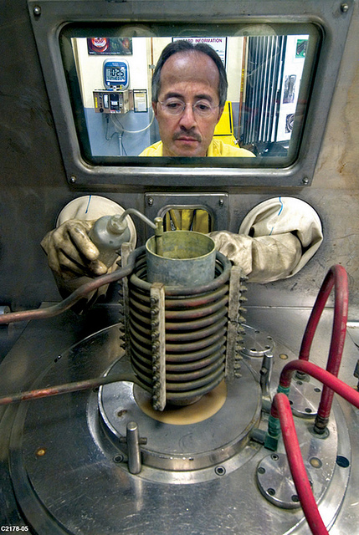
History
Obama initiated NSS to improve security of nuclear materials
Summits held
2010 – Washington
2012 – Seoul
2014 – The Hague

Slide 16
NSS Goals
Reduce amount of dangerous nuclear material: highly enriched uranium (HEU) and plutonium
Improve security of nuclear and other radioactive material
Enhance international cooperation on nuclear security

Slide 17
Achievements
53 countries participated
12 of 22 NSS participating countries that had HEU are now HEU-free
Several others secured or removed some HEU
35 countries signed joint statement binding them to strengthen nuclear security
Measures to counter nuclear smuggling

Slide 18
What’s Next for NSS Process?
Fourth and final NSS to be held in Washington March 31-April 1, 2016
Will likely seek to create global nuclear security architecture, formalizing the role of bodies including:
International Atomic Energy Agency (IAEA)
Global Initiative to Combat Nuclear Terrorism
Global Partnership Against the Spread of Weapons and Materials of Mass Destruction

Slide 19
Joint Comprehensive Plan of Action (JCPOA)

Slide 20
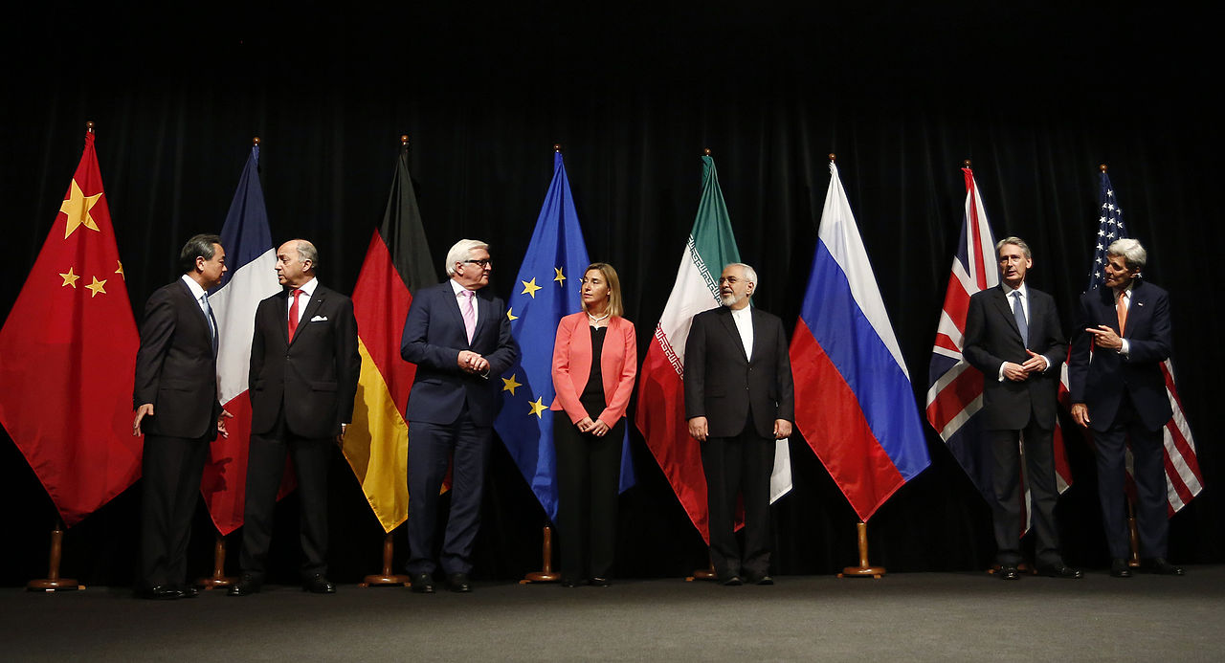
JCPOA
Signed July 2015 in Vienna
Took effect in October 2015
Iran nuclear commitments met; sanctions suspended in January 2016

Slide 21
Main Iranian Commitments
Reduce stockpile of low-enriched uranium (LEU) to less than 300 kg, for 15 years
Enrichment capped at 5060 centrifuges and 3.67% for 10-15 years
Modify Arak reactor so that it cannot produce weapons-grade plutonium
Not engage in activities associated with nuclear weapons development

Slide 22
Impact of JCPOA
Lengthens breakout time via uranium path to at least 1 year for at least 10 years
Blocks plutonium path to nuclear weapons
Provides unprecedented access to and monitoring of Iran’s nuclear program
Prevents a nuclear-armed Iran for at least 15 years and perhaps indefinitely

Slide 23
U.S. Commitments
With IAEA verifying Iran has completed agreed nuclear measures and provisionally applied Additional Protocol, U.S. has:
Suspended nuclear-related sanctions via waivers and executive orders
Reserved right to impose new sanctions for terrorism, human rights and missile reasons
Maintained primary sanctions prohibiting U.S. companies from engaging with Iran

Slide 24
What Has Hindered Further Nuclear Reductions?

Slide 25
U.S. Views on Next Steps
Obama in 2013 proposed further reductions to one-third below New START levels and cuts to non-strategic nuclear weapons
But Russia links additional cuts to resolution of other issues
Russian military action against Ukraine brought U.S.-Russia relations to low point

Slide 26
Russian Views
Little enthusiasm for further reductions
Link further cuts to resolution of Russian concerns on issues such as:
U.S. missile defense in Europe
U.S. non-strategic nuclear weapons in Europe
Advanced conventional weapons
Multilateralization of nuclear reductions

Slide 27
U.S. Missile Defense in Europe
4 ships with SM-3 missile interceptors based in Spain
Supporting radar deployed in Turkey
SM-3s deployed on land (“Aegis Ashore”)
Romania (2015)
Poland (planned, 2018)

Slide 28
Missile Defense
Russians link further nuclear reductions to resolution of missile defense concerns
Claim U.S. missile defense in Europe directed against Russia
U.S. says its missile defense directed against rogue states such as Iran and poses no threat to Russia’s strategic missiles

Slide 29
U.S. Non-Strategic Nuclear Weapons (NSNW) in Europe
U.S. believed to deploy some 200 B61 nuclear bombs in Europe
At 6 air bases in Italy, Belgium, Germany, Netherlands & Turkey
Russians say B61s must be withdrawn before NSNW negotiations

Slide 30
Bilateral vs Multilateral
U.S. believes there should be one more round of bilateral U.S.-Russia nuclear arms reductions
U.S. and Russian nuclear arsenals many times larger than any that of any third state
Russia says next negotiation should bring in other nuclear weapons states

Slide 31
World’s Nuclear Powers, 2015
Country | Military Stockpile*
U.S. | 4700
Russia | 4500
France | 300
China | 260
UK | 215
Israel | 80
Pakistan | 120-130
India | 110-120
North Korea | <10

Slide 32
Issues for Future Negotiations

Slide 33
Potential Items for Negotiation
Further reductions in nuclear forces
INF Treaty compliance
Comprehensive Nuclear Test Ban Treaty
Resolving questions on missile defense
Advanced conventional weapons
Multilateralization of arms control

Slide 34
Further Reductions in
Nuclear Forces

Slide 35
Modernization Plans
Russia modernizing strategic nuclear forces, including ICBMs, SLBMs, bombers and submarines
Now midway through program
U.S. planning modernization, including submarines, ICBMs and bombers
U.S. modernization begins in earnest in 2020s; spending at highest levels 2021-2035

Slide 36
New Bilateral Negotiations Possible?
Downturn in U.S.-Russia relations makes further bilateral negotiations difficult
Some analysts believe Russia will seek new talks before New START expires in 2021
Will tight defense budgets in one or both create incentive to negotiate?
Many issues if negotiations resume

Slide 37
Strategic Nuclear Reductions
Should sides go beyond New START limits?
Obama in 2013 proposed one-third cut
Revisit bomber weapon counting rule?
Bombers can carry more than one weapon
Limit reserve strategic warheads?
U.S. willing if Russia ready to limit non-strategic nuclear weapons

Slide 38
Time to Include All Weapons?
Many analysts believe next round should include all U.S., Russian nuclear weapons:
Deployed strategic warheads
Non-deployed (reserve) strategic warheads
Non-strategic (tactical) nuclear weapons
U.S. allies, Congress want non-strategic nuclear weapons constrained

Slide 39
Estimated U.S., Russia Nuclear Warhead Levels, 2015
U.S. Russia
(Stockpile) (~4700) (~4500)
Deployed strategic * ~1900 ~1780
Non-deployed (reserve) strategic ~2620 ~700
Non-strategic (total) ~500 ~2000
Retired warheads ** ~2200 ~3000
Total warheads ~7200 ~7500
* Estimated actual number, not New START accountable number
** Retired warheads have been removed from stockpile and await dismantlement

Slide 40
Key NSNW Arms Control Issues
Reduce/limit warheads or delivery systems?
Delivery systems have conventional roles
Seek to apply global or regional limits?
NSNW portability an argument for global limits
Verification challenges

Slide 41
Possible Confidence- Building Measures
Transparency regarding numbers, types, locations and status of NSNW
Codify “demating” (separation) of warheads from delivery systems
Relocate/consolidate NSNW to sites away from NATO-Russia border
Asian states want no NSNW relocation to Asia

Slide 42
Single Limit on All Nukes?
Some suggest next treaty limit all U.S. and Russian nuclear weapons
Could have sub-limit on deployed strategic warheads, the most readily usable
Retired weapons to be treated separately
Example:
Overall limit of 2500 nuclear warheads
Sub-limit of 1000 deployed strategic warheads

Slide 43
INF Treaty Compliance

Slide 44
INF Treaty Issues
1987 Intermediate-Range Nuclear Forces (INF) Treaty bans U.S., Russian land-based missiles with ranges of 500-5500 km
U.S. says Russia violating treaty by testing prohibited ground-launched cruise missile
Few details made public
Russia denies any violation

Slide 45
Russian INF Counter-Charges
U.S. using INF missiles as missile defense test targets
U.S. says treaty permits this
U.S. arming unmanned aerial vehicles (UAVs)
U.S. says UAVs different from cruise missiles
Putting Aegis Ashore in Romania, which could launch ground-launched cruise missiles
U.S. says not possible

Slide 46
INF Treaty Compliance
Critical to bring Russia back into full compliance with INF Treaty
U.S. preparing countermeasures
If Russia remains non-compliant, little chance Senate would ratify any new treaty
New Russian INF missile, if deployed, would target Europe and Asia, not U.S.

Slide 47
Possible INF Solution?
Sides agree INF missiles can be used as missile defense targets and that UAVs are not cruise missiles
Would be attractive to both militaries
U.S. offers transparency to show Aegis Ashore can not launch cruise missiles in return for Russian transparency to assure that Russia back in compliance

Slide 48
Comprehensive Nuclear Test Ban Treaty (CTBT)

Slide 49
CTBT Status
CTBT, signed in 1996, would ban all nuclear tests worldwide
Entry into force requires ratification by 44 “nuclear-capable” states
Only 36 have done so; 8 others, including U.S. and China, have not yet ratified
Little prospect Senate will ratify in near future

Slide 50
Reasons to Ratify
Senate did not ratify CTBT in 1999 due to concerns about verifiability and reliability of U.S. nuclear stockpile
Since then:
Verification means improved, including with International Monitoring System
Stockpile Stewardship Program provides confidence in U.S. weapons without testing
CTBT would lock in U.S. nuclear knowledge advantage

Slide 51
Interim Steps on CTBT?
Sept 24, 2016 is CTBT’s 20th anniversary
Some suggest UN Security Council urge CTBT entry into force, make International Monitoring System permanent
Others suggest U.S., Russia, UK, France, China, India and Pakistan affirm commitment not to test
Only North Korea has tested since 1998

Slide 52
Missile Defense (MD) Issues

Slide 53
Missile Defense Dilemma
U.S. MD deployments over next decade will not threaten Russian strategic missiles
Number of interceptors with velocity to engage strategic missile warheads too low
SM-3 interceptors too slow
But Russia insists on treaty to limit MD
Non-starter for U.S., Senate would not ratify

Slide 54
Transparency Agreement?
Under transparency agreement, U.S. and Russia would exchange data on:
Current numbers of missile interceptors, launchers, radars, etc.
Projected numbers for next 10 years
Would allow each to judge whether other’s missile defense posed problem
Russia thus far not interested

Slide 55
Advanced Conventional Weapons

Slide 56
Limiting Advanced Conventional Weapons
New START limits cover all warheads on ICBMs, SLBMs
Any future conventional warheads would thus be captured by treaty
If either side develops hypersonic glide vehicle, numbers would be modest
Hypersonic glide vehicles might be limited in side agreement

Slide 57
Cruise Missiles
Conventionally armed cruise missiles pose more difficult question
Key element of U.S. force projection
Russia catching up (Syria, 2015)
Verification challenges
Start with U.S.-Russia discussion of cruise missiles’ impact on strategic balance?

Slide 58
Multilateralization

Slide 59
U.S., Russia and the Rest
Nuclear arms reductions should not forever remain just a U.S.-Russia process
As U.S., Russian numbers come down, third countries will need to join in reducing
But third countries now resist, noting U.S., Russian nuclear stockpiles much larger than any third-country arsenal

Slide 60
Involving Others
Given differences in arsenal sizes, hard to negotiate limits
Russia, U.S. unready for equality with others
Explore readiness of others (at least China, UK and France) to commit to no build-up as long as U.S. and Russia are reducing?
Might also provide basic data on arsenals

Slide 61
Sources
Slide 11: “Latest New START Data Shows Nuclear Posture—and Nuclear Posturing,” ACA, 2015 https://www.armscontrol.org/blog/ArmsControlNow/2015-10-13/Latest-New-START-Data-Shows-Nuclear- Posture%E2%80%94and-Nuclear-Posturing
Slide 11: U.S. Department of State, “New START,” 2016 http://www.state.gov/t/avc/newstart/index.htm
Slide 12: U.S. Department of State, “New START Treaty Aggregate Numbers of Strategic Offensive Arms,” 2016 http://www.state.gov/t/avc/rls/250940.htm
Slide 13: Woolf, Amy, “U.S. Strategic Nuclear Forces: Background, Developments, and Issues,” CRS, November 2015, p. 12, https://www.fas.org/sgp/crs/nuke/RL33640.pdf
Slides 15-7: “Nuclear Security Summit at a Glance,” ACA, 2014 https://www.armscontrol.org/factsheets/NuclearSecuritySummit
Slide 20: Bundesministerium für Europa, Integration und Äusseres, "Iran Talks Vienna 14 July 2015” (19067069963), 2015 https://commons.wikimedia.org/wiki/File:Iran_Talks_Vienna_14_July_2015_(19067069963).jpg
Slide 29: Kristensen, Hans M., “Non-Strategic Nuclear Weapons,” FAS Special Report, May 2012 https://fas.org/_docs/Non_Strategic_Nuclear_Weapons.pdf
Slide 29: Kristensen, Hans M., “Estimated Nuclear Weapons Locations 2009,” FAS, November 2009, http://www.fas.org/blog/ssp/2009/11/locations.php
Slide 31: “Status of World Nuclear Forces,” Federation of American Scientists, 2015 https://fas.org/issues/nuclear-weapons/status-world-nuclear-forces/
Slide 35: “Russia to spend $34.8 bln on Armed Forces in 2016 — draft budget ,” ITAR-TASS, 2015 http://tass.ru/en/defense/832892\
Slide 39: Kristensen, Hans M., “Obama Administration Releases New Nuclear Warhead Numbers,” FAS, April 2015 https://fas.org/blogs/security/2015/04/nukenumbers2015/
Slide 39: “Status of World Nuclear Forces,” FAS, September 2015 http://fas.org/issues/nuclear-weapons/status- world- nuclear-forces/
Slides 49-51:“Comprehensive Test Ban Treaty (CTBT),” ACA, 2015 http://www.armscontrol.org/taxonomy/term/45

