Slide 1
ACA Sustainability, Productivity Growth and the Complex Relationship between Medicare and Private Provider Payments
Louise Sheiner
Hutchins Center on Fiscal and Monetary Policy
The Brookings Institution
Lsheiner@brookings.edu
Presented July 21, 2015 at the Altarum Institute CSHS Symposium – New Dimensions on Sustainable U.S. Health Spending

Slide 2
Background: Productivity Adjustments in the ACA
ACA lowered statutory updates from:
Changes in input cost (old statutory)
to
Changes in input cost less Economy-wide multi-factor productivity growth (MFP)
Affects all Part A providers and most non-physician Part B providers

Slide 3
Are these cuts sustainable?
Trustees have been issuing “illustrative alternative “ in case ACA cuts not sustainable
What does sustainability mean?
Enough to maintain current level of services?
Enough to ensure that Medicare patients keep getting the same level of care as private-pay patients?

Slide 4
Why the worry?
Measured health productivity is lower than economy-wide productivity → need real price increases over time just to maintain constant level of service.
Worry that Private reimbursements and Medicaid will rise at a faster pace. → Medicare patients will have increasingly hard time finding quality care.
Law change suggests updates will be much tighter in future than past, meaning access problems will be worse in future.

Slide 5
Three Questions
Are updates sufficient to cover costs of constant quality health care?
Is health sector MFP>=economy-wide MFP?
If so, then ACA updates won’t result in actual deterioration in quality
Is this a break from the past, or is this just putting in the baseline what had already happened on ad hoc basis?
Will Medicare payments keep up with private payments?
- Medicare payments could deteriorate relative to private even if health sector MFP very high.
- If quality of health bundle increases and private payment rates increase, then Medicare payment might not cover THOSE costs

Slide 6
Is Health-Sector Productivity Growth Really So Low?
Many people believe the health sector subject to Baumol Cost Disease.
Classic example: string quartet: no productivity increases.
If economy-wide productivity>health care productivity, then wages will increase faster than productivity in health sector, and relative prices will rise
Seems far-fetched, given how rapid technological change is in the health industry.
Labor–saving technologies? Transfer from inpatient to outpatient, laparoscopic surgery, electronic monitors, etc.
More likely, estimates of MFP understated because they don’t take into account quality improvements.

Slide 7
Implications for sustainability
If productivity growth in the health sector < economy-wide MFPR, relative prices will rise faster than Medicare updates
Medicare payments will fall below cost of maintaining constant bundle of services
Either Medicare beneficiaries will have less access or more cost shifting, putting pressure on politicians to undo cuts
BUT,
If productivity growth actually >= economy-wide MFPR, ACA updates sufficient to finance constant or even growing quality of care

Slide 8
Are ACA cuts really a break from the past?
Although pre-ACA law specified updates equal to market basket, in practice, there were constant ad hoc downward adjustments.
Actual Medicare reimbursement growth relative to GDP deflator:
ACA not much of a deviation from past history, suggesting:
Access may not be a problem
But, savings may not be as large as estimated by OACT either

Slide 9
Medicare and Overall Excess Cost Growth about the Same, even with these updates

Slide 10
But Hospital Payment Ratios Medicare to Private are Very Low Now

Slide 11
Implications for Sustainability
Very clear that ad hoc adjustments in the past made the ACA change much less drastic than simply comparing change in law
Overall excess cost growth between Medicare and non-Medicare similar, suggesting that average private reimbursement levels not that different from Medicare
But hospital reimbursement rates lower (as measured by hospital PPIs, not shown) and ratio of payment/cost at all time low

Slide 12
What is likely trajectory of private reimbursements over long run?
Regardless of productivity growth, Medicare beneficiaries might have access problems if Medicare reimbursements decline sharply over time relative to private
With private health spending growth expected to decline over time, what should we expect for private reimbursement rates?

Slide 13
Trustees: Medicare prices deteriorate relative to private
Assumes MFP in health MFP<economy-wide
So health relative prices increase over time
Assume private prices increase at assumed rate of relative price inflation.
Then ratio of Medicare to private hospital payments declines from 70% to about 40% over 75 years.

Slide 14
Health Spending Growth
Health Spending = Price per service*Number of services
H = P * N
Price per service = price per unit of quality * quality units per service
P = C * Q
Growth rate of health spending
h = p + n = c + q + n
The quantity of health consumed over time increases because people have more procedures (n increases) and because each procedure is more intense (uses better imaging, better drugs, better techniques, more skilled labor) (q increase).
In general, n increases because q increases: procedure use increases because offers more

Slide 15
Measured vs Actual Relative Medical Price Inflation
p = c + q is the observed rate of medical price inflation
c is the “true” rate of relative medical price inflation– the change in the cost of producing a fixed medical outcome over time
If medical productivity<economy MFP, c>0
If medical productivity>economy MFP, c<0
q is the rate of increase in health services quality
Can easily have p>0 but c<0

Slide 16
How is non-Medicare p likely to evolve over time?
If health spending is to slow, it will likely involve both a reduction in q and a reduction in n
It might be difficult to lower n without lowering q (reductions in n would also make investments in new technologies less profitable, thereby lowering q and hence p)
Thus, private p is likely to fall over time

Slide 17
2014 Trustees Assumptions Health care productivity .4% per year economy-wide = 1.1% Private prices increase .7% per year

Slide 18
Alternative 1 Prices rose.7 percent in past, but some of this reflected quality; private sector prices decline going forward

Slide 19
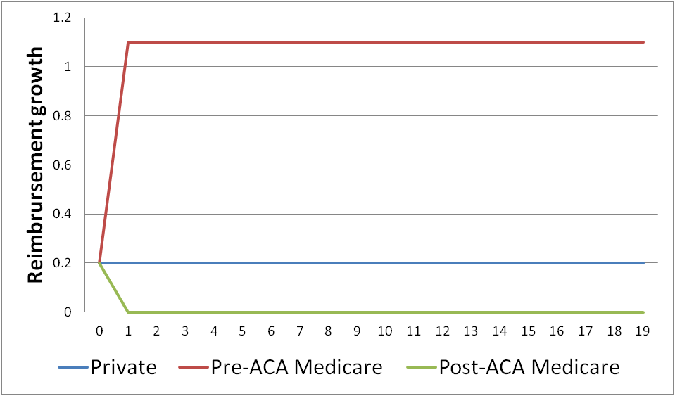
Alternative 2 All prices rose .2 percent in past, (actual Medicare reimbursement)

Slide 20
Alternative 3 Prices rose .2 in past, but quality improved; over time, quality improvement slows

Slide 21
Starting with Medicare/Private Ratio = 67%
Assumption about private prices | Post-ACA ratio of Medicare to non-Medicare prices after 75 years
(1) Private prices rise .7 percent per year | 40%
(2) Private prices slow from .7 percent to 0 percent over 75 years | 51%
(3) Private prices rise .2 percent per year | 58%
(4) Private prices slow from .2 percent to 0 percent over 75 years | 62%

Slide 22
Relationship between Medicare and other health spending? Three Channels
Lower Medicare reimbursements increase private bargaining power, lower private reimbursements
Investment decisions (new services, technology, etc.) depend on expectation of both private and Medicare reimbursements. Tighter reimbursements lower expected return, lead to lower investment, eventually lower private payments
Cost shifting/Volume shifting: Cost shifting implies low Medicare price -> High private price. Limited evidence.
Volume shifting: providers try to shift patient base toward private pay when Medicare reimbursements decline. Some evidence.

Slide 23
Implications?
Cuts sustainable:
ACA cuts simply continued actual practices of the past.
These practices maintained ratio of Medicare to private spending.
Implies Medicare and private spending will continue to increase at the same rates going forward, on average.
On the other hand
Fact that Medicare/Private payment ratios at the lowest point since 1980 makes one wonder whether some reversal is required.
However, MEDPAC finds NO access problems for Medicare beneficiaries.

Slide 24
Conclusions
Thinking about sustainability very difficult
We don’t know actual productivity growth of health sector
We assume private health spending growth will slow over time, but we don’t know how that will happen
We don’t have a great understanding of the relationships between Medicare reimbursement and private reimbursements or private spending

