Slide 1
GENERATION UNBOUND
Drifting into Sex and Parenthood without Marriage
Isabel Sawhill
Senior Fellow, Brookings Institution
May 12, 2016

Slide 2
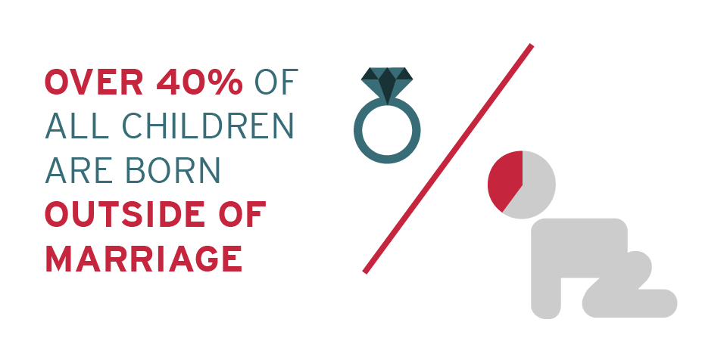
A Large Proportion of Births Occur Outside of Marriage
Source: “Births to Unmarred Women” Child Trends Data Bank. (July 2014).
Notes:
Let’s begin with a couple of key facts. Marriage is disappearing and more and more babies are born outside of marriage. Right now, the proportion born outside of marriage is about 40 percent. It’s higher than that among African Americans and lower than that among the well-educated. But it’s no longer an issue that just affects the poor or minority groups. Half of younger Americans are having children outside marriage and they are not all poor and they are definitely not all from communities of color.

Slide 3
What is Driving the Change in Family Structure?
Improving Opportunities for Women
Declining Economic Prospects for Men
Changing Social Norms
Notes:
So, what’s going on; why is this happening? I think there are three reasons. (see slide) Of these three, I think improving opportunities for women is the most fundamental because it is transforming marriage from an institution that supported economically dependent women and children to an institution that is undertaken for other reasons such as raising children or sharing life’s experiences. But because its economic rationale has shrunk, it’s now a choice and not a necessity.
Although people are marrying less (or marrying much later) they are still having sex, and sex produces children although as I will show you in a moment, most of these births are unplanned. And even if the young couple is romantically involved, and perhaps cohabiting at the time the baby is born, these relationships are short-lived and we now have not only a growing number of single parent families, but lots of young adults with multiple partners and very complicated and unstable living arrangements for children.

Slide 4
Why it Matters
Children fare better in stable two-parent families
Family breakdown leads to more child poverty, inequality, less social mobility
Child poverty rates are five times higher in single-parent families vs. two-parent families
My estimate is that the child poverty rates have increased by about 5 p.p. or by about 25 percent since 1970 because of changes in family structure
Notes:
Does all of this matter? I think it does. And here’s why: (see slide)
Children fare better in two parent homes
Child poverty rates 5x higher
Family breakdown leads to more inequality, poverty, and less social mobility
My estimate is that the child poverty rates have increased by about 5 p.p. or by about 25 percent since 1970 because of changes in family structure

Slide 5
Does poverty → family breakdown
Chicken and Egg
OR
Does family breakdown → poverty?
(It’s both!)
Notes:
That 5 p.p. figure is adjusted for what we often call selection effects. That is, the breakdown of the family leads to more poverty but poverty also is one cause of the breakdown. We have here a classic chicken and egg problem.

Slide 6
What to Do: Two Visions
“
The truth is, the greatest tool to lift children and families from poverty. . . isn’t a government spending program. It’s called marriage.
”
“
Children are not rugged individualists. . . All of us, whether we acknowledge it or not, are responsible for deciding whether our children are raised in a nation that doesn’t just espouse family values but values families and children.
”
Notes:
So what should we do?
Conservatives say bring back marriage. The problem with this solution is that we don’t know how to do it. Nothing we’ve tried so far has moved the needle very much.
Liberals say the problem is poverty and we need to provide more assistance to the most disadvantaged. The problem with this solution is that – whatever its merits for all kinds of other reasons – one has to wonder if it can keep pace with the need. Take the two largest safety net programs. One is FS. The growth of the program which has cost about $44 billion since 1970 has reduced child poverty by 3 p.p. The EITC which has cost about $90 billion has reduced child poverty by 7 p.p. So together they have done more to reduce poverty than changes in family structure have done to increase it. But its still a tug of war and an expensive one to boot.

Slide 7
Can Social Policy Keep Pace with Increased Need?
Entering poverty
(due to family breakdown)
Total – 7 p.p.
Adjusted – 5 p.p.
POVERTY
Leaving poverty
(due to social programs)
SNAP – 3 p.p.
EITC – 7 p.p.
Notes:
Some of you may know the apocryphal story of the guy who was standing by a river…

Slide 8
Another Solution: Reduce the Breakdown of the Family by
Changing Drifters into Planners
Notes:
Now I want to suggest a third alternative that doesn’t involve bringing back marriage and doesn’t involve providing more assistance to low-income families, although it is in no way inconsistent with either. In fact, if it works it will greatly enhance the success of the other two approaches.
I call it changing drifters into planners. Too many people are drifting into sex and parenthood outside of marriage.

Slide 9
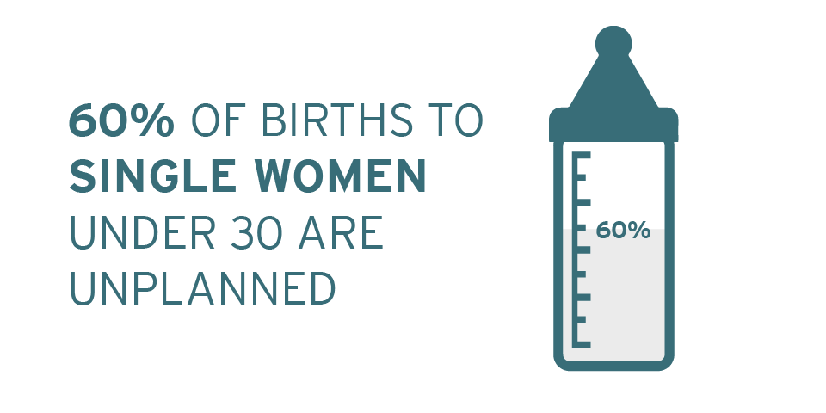
Drifting into Parenthood is Common
Source: Zolna, Mia, and Laura Duberstein Lindberg. Unintended pregnancy: Incidence and outcomes among young adult unmarried women in the United States, 2001 and 2008. Alan Guttmacher Institute, 2012.
Notes:
To understand why I use the word “drifting” you need to know one crucial, and to many people surprising, fact. Drifting among young single adults is very common. A majority of unmarried women under 30 drift into parenthood. Most of their pregnancies are unplanned, and although some will have abortions, 60 percent of the births to this group are unplanned – according to the women themselves.

Slide 10
Less Advantaged Women Have Highest Rates of Drifting
Race/Ethnicity
Poverty Line
Source: Karpilow, Quentin, Jennifer Manlove, Isabel Sawhill, and Adam Thomas. “The Role of Contraception in Preventing Abortion, Nonmarital Childbearing, and Child Poverty.” Paper presented at APPAM, November 2013.
Notes:
Unplanned pregnancy rates are especially high among less advantaged women.

Slide 11
Why So Much Drifting?
Young adults not using birth control or using inconsistently
Not using most effective methods
Long-acting reversible contraceptives (IUDs, implants) change the default from getting pregnant to not getting pregnant
Notes:
Why so much drifting

Slide 12
IUDs Are Much More Effective Than Other Forms of Birth Control
How we got these numbers: Data is from Trussell (2011). The probability that a person doesn't pregnant at all over a given period of time is equal to the success rate of her contraceptive method raised to the power of the number of years she is using that method. We then subtract this multi year "success rate" from 100% to get the failure rate (graphed above). This assumes that there is an equal chance of not getting pregnant in every year of condom use and that successful users and failed users (where success is not getting pregnant during a year using birth control) have the same rate. The assumption is reasonable given that figures we use are the figure for a “typical” user of some type of contraceptive.
Notes:
IUDs are much more effective than other forms of contraception

Slide 13
Changing the Default: Evidence
Colorado Family Planning Initiative
St. Louis: The CHOICE Project
Iowa Initiative to Reduce Unintended Pregnancies
UCSF Bixby Center Initiative
Delaware (no results yet)
Notes:
If we provided IUDs at no cost and with good counselling would women use them and would it make a difference? Yes. Choice, CO, Iowa, UCSF project

Slide 14
Colorado Family Planning Initiative, 2009-2014
Use of LARCs | Increased six-fold from 4% to 30% of clients in Title X clinics
Teen birth rate | Decreased by 48%
Young adult (20-24) birth rate | Decreased by 20%
Abortion rate for each group | Decreased by roughly the same amount
Return on investment (state savings for every dollar spent) | $5.85
Notes:
IUDs are much more effective than other forms of contraception

Slide 15
CHOICE Project, St. Louis, 2006-2010
Source: Birgisson, Natalia E., et al. “Preventing Unintended Pregnancy: The Contraceptive CHOICE Project in Review.” Journal of Women’s Health 24(2015): 349-353.

Slide 16
CHOICE Project, St. Louis, 2006-2010
Note: N = 9,256.
Source: Birgisson, Natalia E., et al. “Preventing Unintended Pregnancy: The Contraceptive CHOICE Project in Review.” Journal of Women’s Health 24(2015): 349-353.

Slide 17
UCSF Bixby Center Initiative (provider training only)
 | Treatment Clinics | Control Clinics
Received counselling | 71% | 39%
Chose a LARC | 28% | 17%
Pregnancy rate (within 12 months) | 8% | 15%
Note: Cluster randomized trial, 40 clinics in 15 states. Results for women seeking family planning services only. No significant difference if woman was offered a LARC after an abortion.
Source: Harper, Cynthia C. et al. “Reductions in pregnancy rates in the USA with long-acting reversible contraception: a cluster randomized trial.” The Lancet 386(2015): 562-568.

Slide 18
LARC Use: Low but Rising Rapidly
Source: Centers for Disease Control and Prevention, National Health Statistics Reports, No. 86, November 10, 2015, Table 2.
Notes:
LARC use is still very modest in the U.S. but rising rapidly thanks to projects like these and a lot of media attention.

Slide 19
Why Not More Utilization?
Women don’t know about LARCs or think they are unsafe
Providers aren’t trained
High upfront cost
Political opposition

Slide 20
The Way Forward
A change in social norms
Old norm: don’t have a child outside of marriage
New Norm: don’t have a child until you want to be a parent
Empower young adults to achieve this new norm via education and access to contraception, especially the most effective forms
Combine with effective social programs that create greater opportunity and motivation to avoid an unplanned birth

