Slide 1
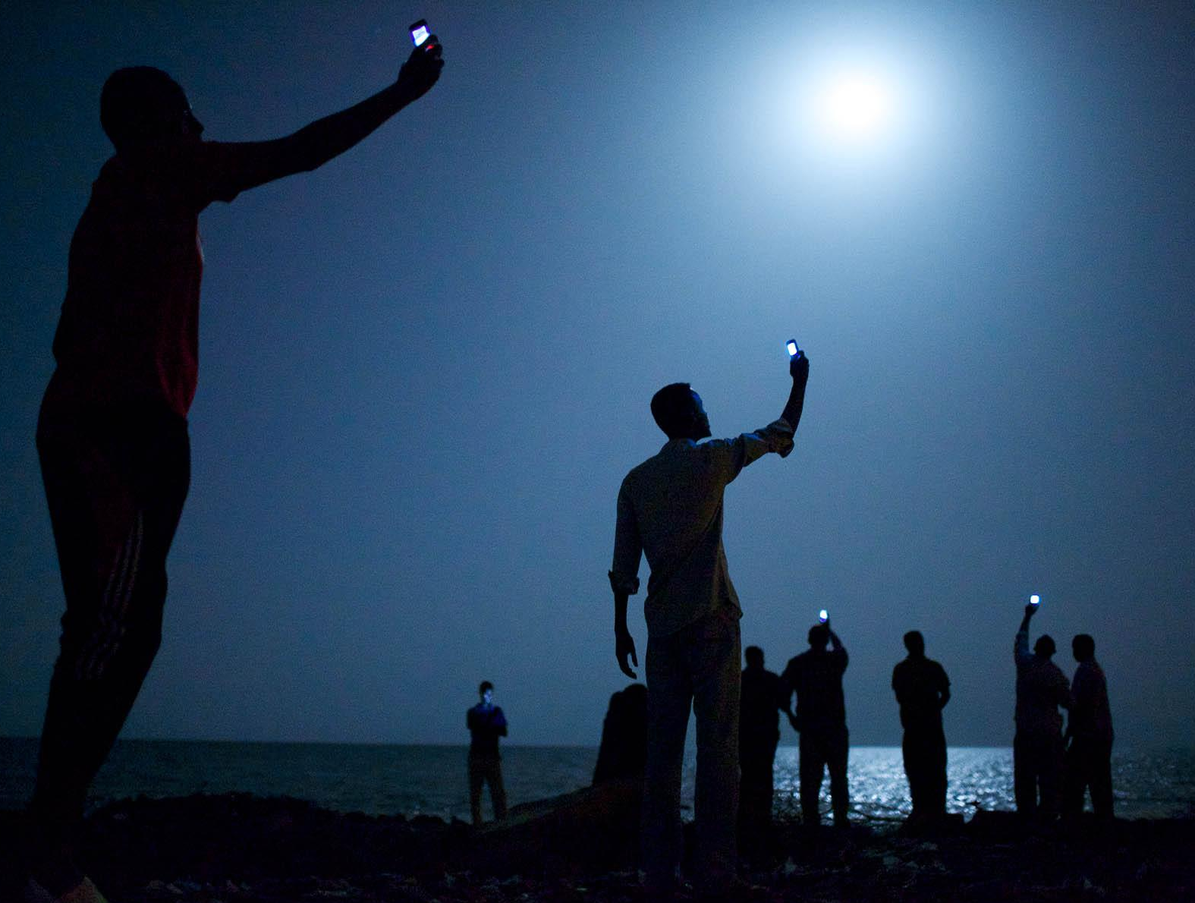



#wdr2016
www.worldbank.org/wdr2016

Slide 2
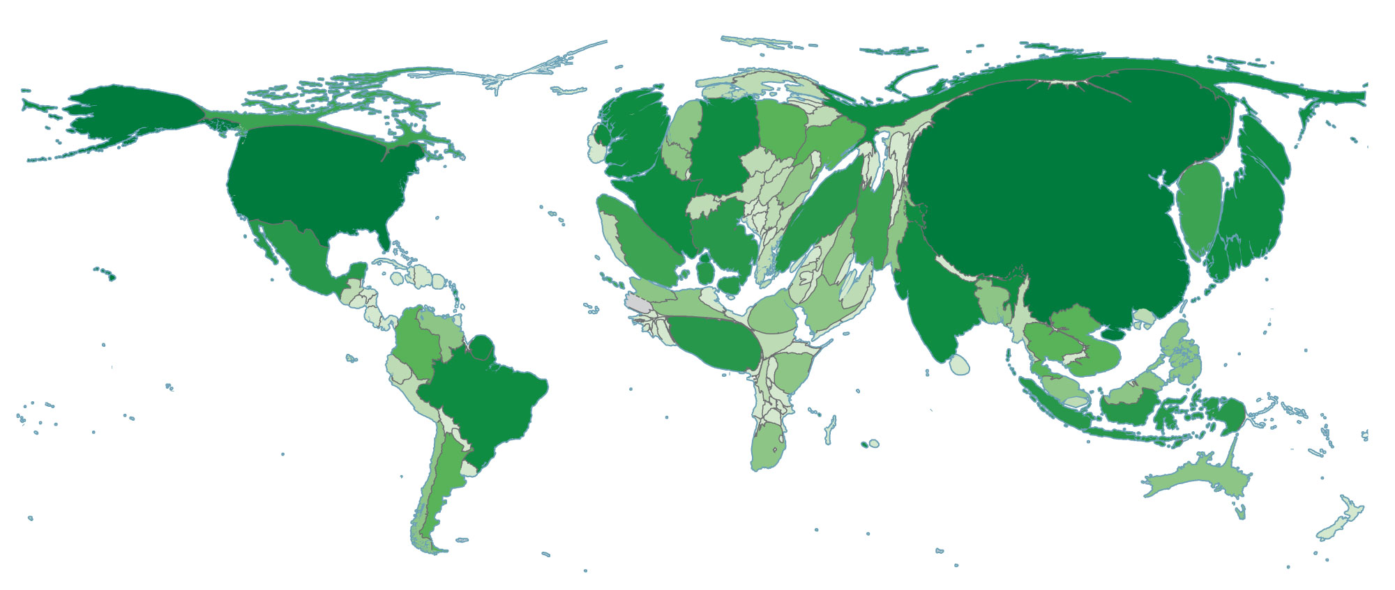
Digital technologies have spread rapidly
The world, based on internet population (2014)
SOURCE: World Bank. Data at http://bit.do/WDR2016-MapO_1.

Slide 3
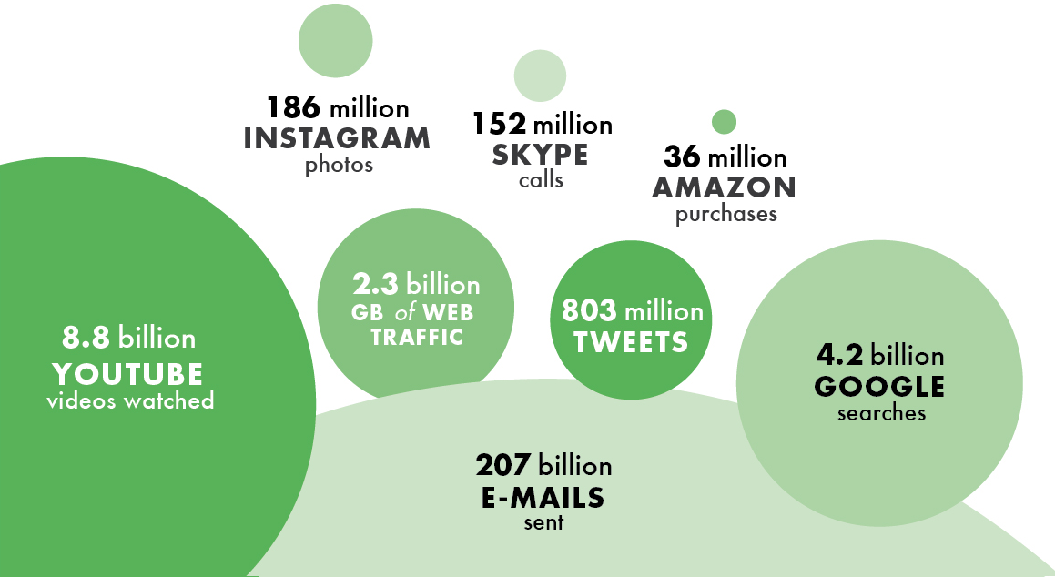
Digital revolution has brought many private benefits
A typical day in the life of the internet
SOURCE: WDR 2016 team; http://www.internetlivestats.com/one-second/ (As compiled on May 29, 2015)

Slide 4
But are countries reaping sizable digital dividends?
DIGITAL DIVIDENDS
Growth
Jobs
Services
Business
People
Government
AGENTS
Are the benefits reaching everyone, everywhere?
Notes:
Helps businesses to grow, people to find work and entrepreneurial opportunities, and governments to provide better services.

Slide 5

Digital technologies are transforming BUSINESS
DIGITAL MARKETPLACE
Number of small & medium
enterprises on Taobao (Alibaba):
5 MILLION
& COUNTING
SOURCE: http://www.alizila.com/chinas-online-cowboy-rounds-buyers

Slide 6
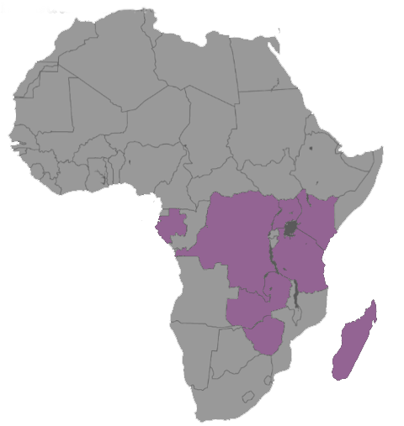
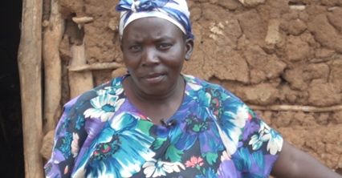
Digital technologies are transforming PEOPLE’S LIVES
DIGITAL PAYMENTS
Number of mobile money
accounts worldwide:
300 MILLION
& COUNTING
(end of 2014)
Where mobile money accounts outnumber
bank accounts
SOURCE: John Owens, Alliance for Financial Inclusion, June 2013.
Notes:
“Transforming people” sounds a bit odd. Kind of what the Soviets and Cambodians tried to do.

Slide 7
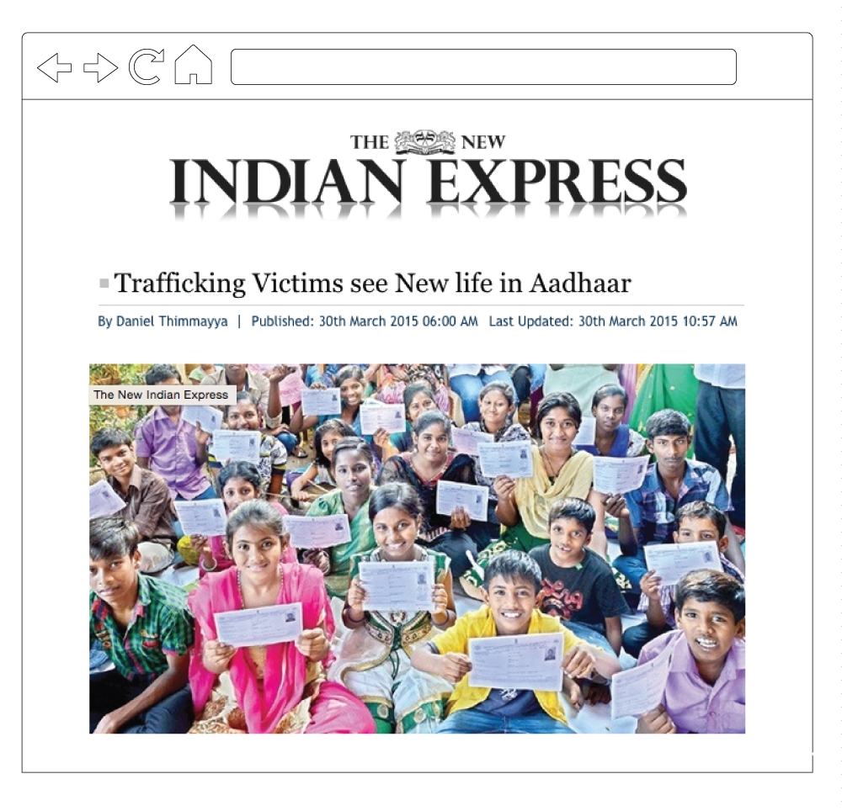
Digital technologies are transforming GOVERNMENT
DIGITAL IDENTITY
Indians with digital identity:
950 MILLION
& COUNTING
SOURCE: http://www.newindianexpress.com/cities/chennai/Trafficking-
Victims-see-New-life-in-Aadhaar/2015/03/30/article2737396.ece

Slide 8
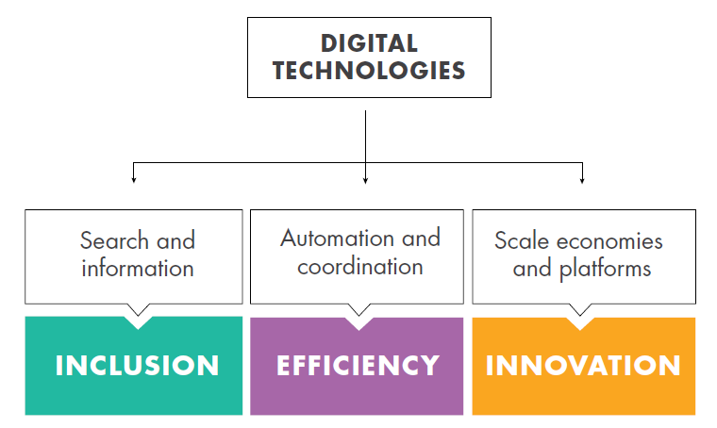
The main mechanisms to promote development
Expand the information base, lower information costs and create information goods
SOURCE: WDR 2016

Slide 9
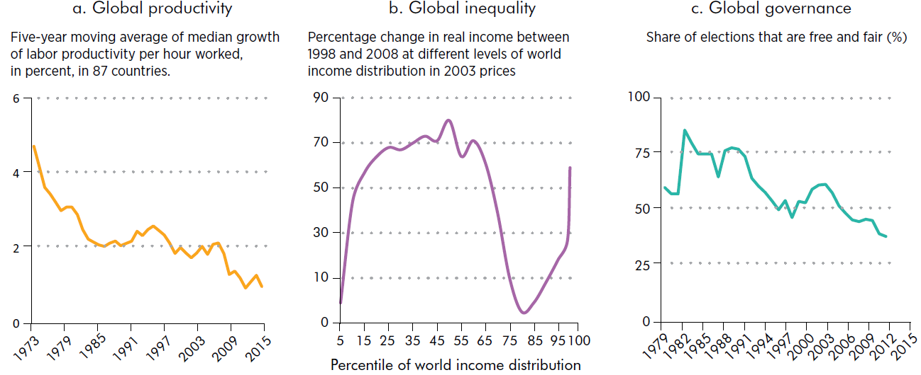
Then why the deep pessimism surrounding the global economy?
-10
Business
People
Governments
Not because of digital technologies, but in spite of them
SOURCE: Total Economy Database, Conference Board; and WDR 2016 team;
Christoph Lakner and Branko Milanovic 2013; Bishop and Hoeffler 2014.

Slide 10




1. A significant digital divide remains
6 BILLION without BROADBAND
4 BILLION without INTERNET
2 BILLION without MOBILE PHONES
0.4 BILLION without A DIGITAL SIGNAL
Divides persist between and within countries—in access and capability
SOURCE: WDR 2016 team based on Research ICT Africa and ITU data

Slide 11
Digital technologies tend to be:
Productivity-biased
Skills-biased
Voice-biased
Limiting the aggregate gains from the digital revolution
SOURCE: WDR 2016 team based on Research ICT Africa and ITU data

Slide 12
2. Digital technologies hold benefits as well as risks
with
complements
INNOVATION
EFFICIENCY
INCLUSION
DIGITAL
TECHNOLOGIES
CONCENTRATION
INEQUALITY
CONTROL
without
complements
What are those complements?

Slide 13
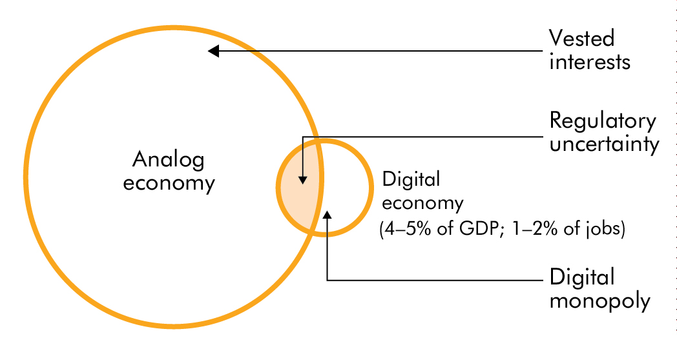
Scale without COMPETITION
→ lower digital adoption and growing divergence
SOURCE: Eurostat, circa 2014,.WDR 2016 Team

Slide 14
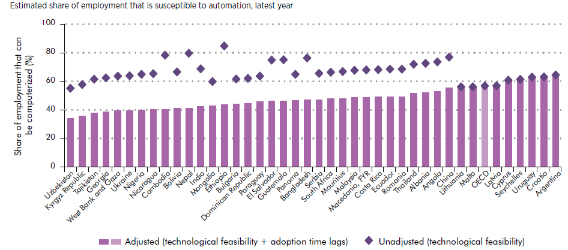
Automation without SKILLS
→ polarized labor markets and greater inequality
SOURCE: World Bank. Data at http://bit.do/WDR2016-MapO_1.

Slide 15



Information without ACCOUNTABILITY
→ greater state control and elite capture
CHANNELS | IMPACT | OUTCOMES
Informing citizens | High | GOVERNMENT CAPABILITY
Automating tasks | Medium
Citizens feedback | Medium
Provider management | Low
Free and fair elections | High | CITIZEN EMPOWERMENT
Informed voting | Medium
Collective action | Low
SERVICE DELIVERY
INCLUSION
EFFICIENCY
INNOVATION
SOURCE: WDR 2016 Team, Pew Research

Slide 16
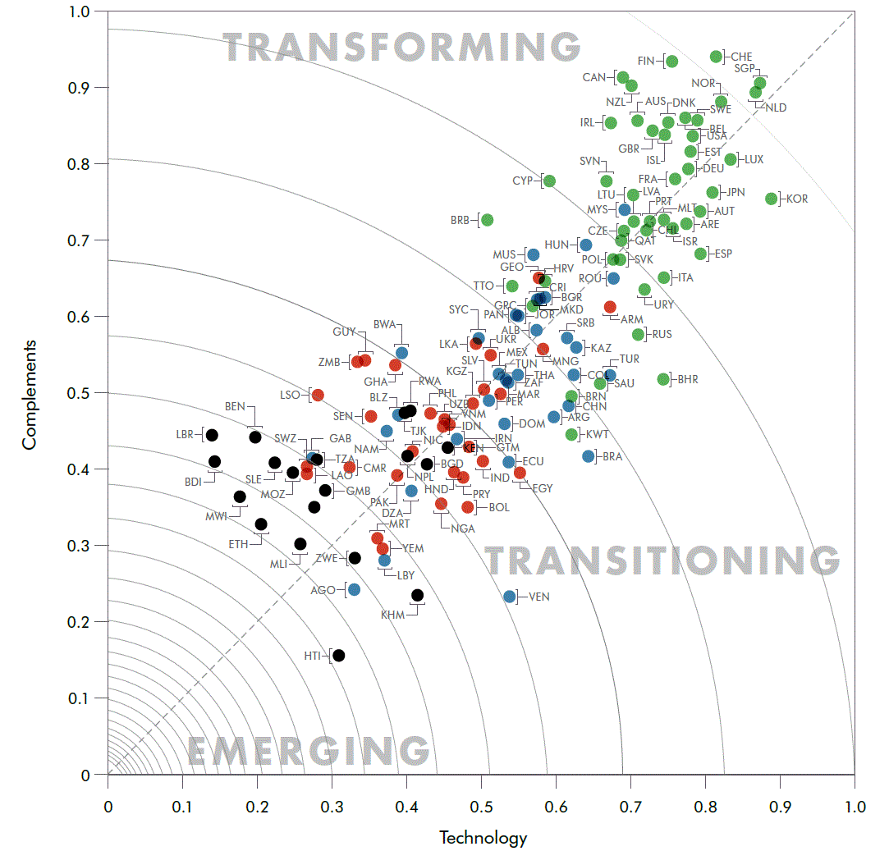


Race between technology and complements
Complements
Complements: Index of quality of institutions, skills and regulations.
Technology: Digital adoption index - businesses, people and governments.
Technology
SOURCE: WDR 2016 team. For more details see figure 5.3 in the full Report.

Slide 17
The WDR 2016 proposes policies at three levels
SECTORAL
NATIONAL
GLOBAL
Notes:
Chapter 4, 5 and 6 (half of the Report) are about policies

Slide 18
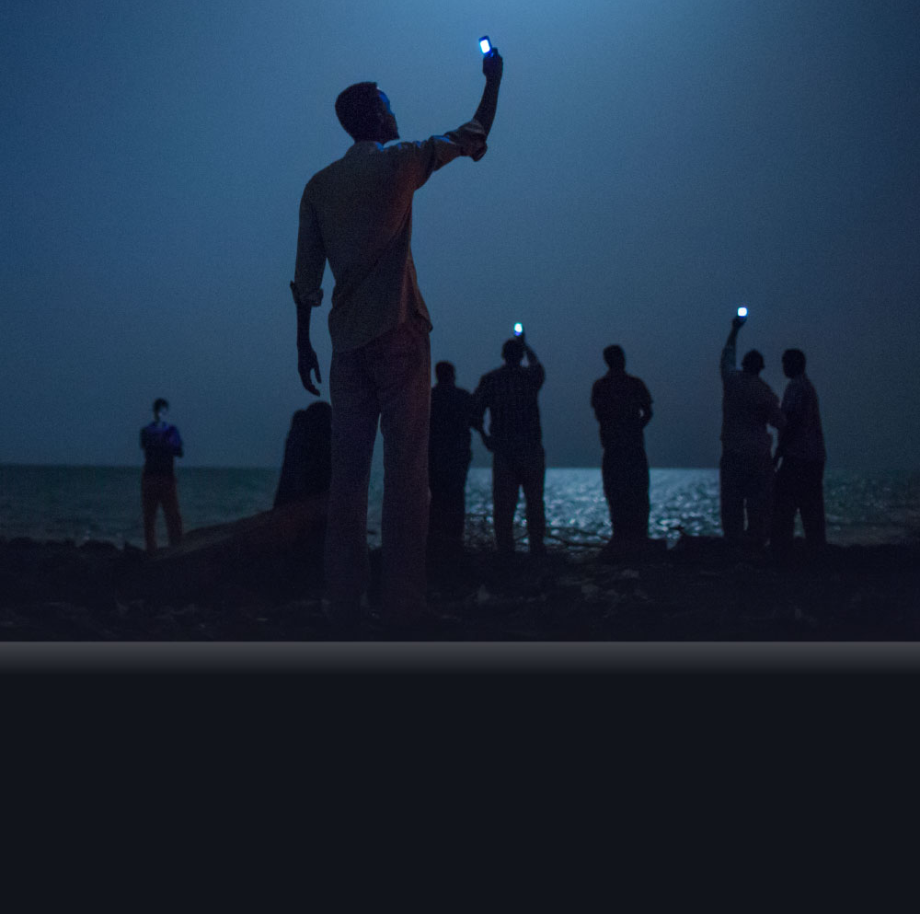
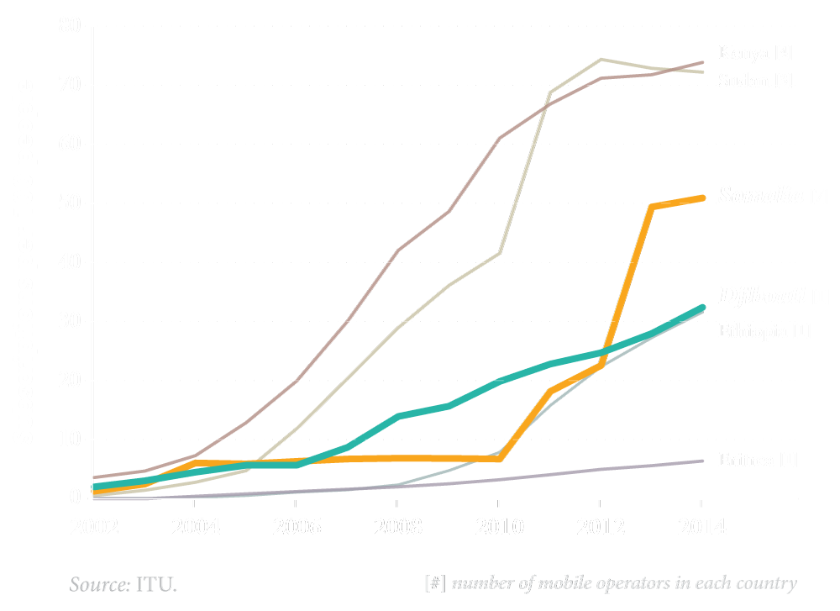
SECTORAL
POLICIES
Making internet access
universal, affordable, open and safe
SUPPLY SIDE ISSUES
Competition policy
Public-private partnerships
Effective telecom &
internet regulation
Mobile cellular subscriptions in the Horn of Africa

Slide 19
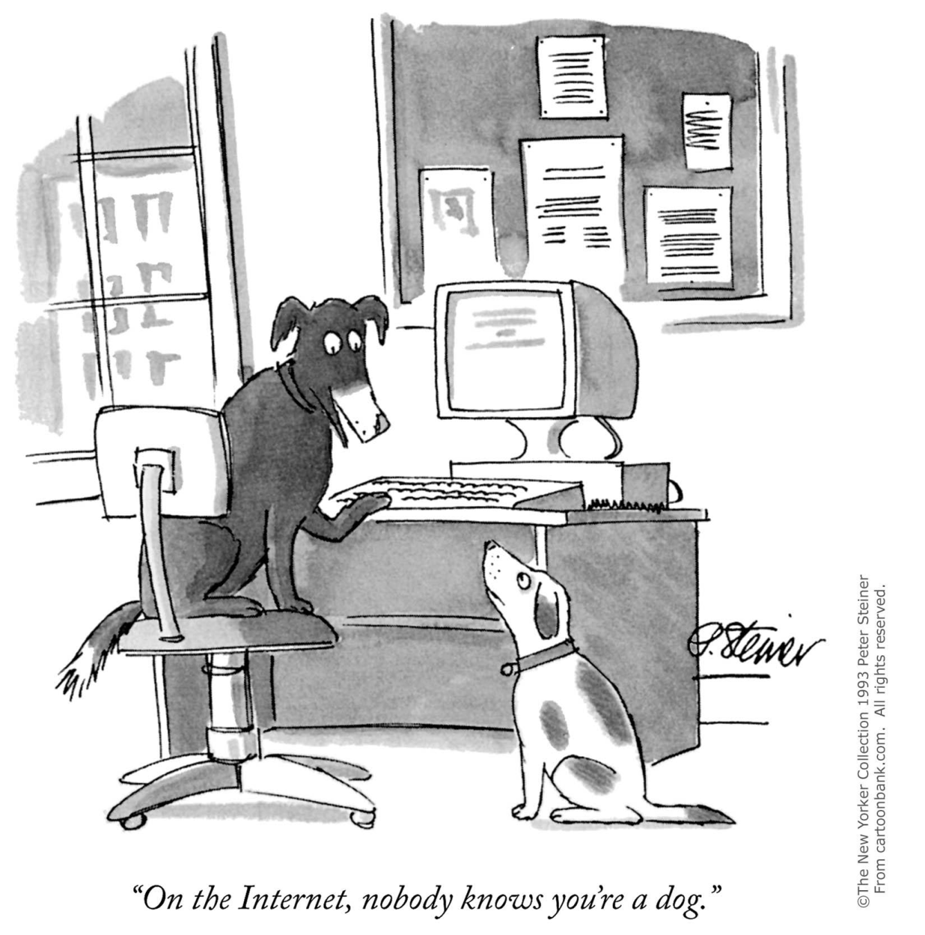
Making internet access universal, affordable, open and safe
SECTORAL
POLICIES
1993
DEMAND SIDE ISSUES
Protecting personal privacy
Cybersecurity
Censorship and content filtering
“On the Internet, nobody knows you’re a dog.”
2014
“Now Google and its like are surveillance machines that know not only that you’re a dog but whether you have fleas and which brand of meaty chunks you prefer.” (Economist)

Slide 20
NATIONAL
PRIORITIES
Analog foundations for
a digital economy
SOURCE: WDR 2016 team.
Notes:
Lay the foundations
Make sure everyone can take advantage
Deal with wicked problems

Slide 21
GLOBAL
COOPERATION
International consensus on
cross-border issues
A governance model for an open and safe internet
Removing barriers to a global digital market
Leveraging information for sustainable development
  Get wired
  Build platforms
  Go global

Slide 22
  Connectivity + Complements → Digital Dividends
  Digital development strategies need to be broader
  than ICT strategies
    Regulations that allow firms to connect and compete
    Skills that leverage technology
    Institutions that are accountable and capable
  Digital technologies add two important dimensions
    They amplify the impact of good (and bad) policies → Failure to reform means falling further behind
    While not a short-cut to development, they can be an accelerator, by raising the quality of complements
  The payoff
    Increasing digital dividends:
    Faster growth, more jobs and better services
www.worldbank.org/wdr2016

Slide 23
www.worldbank.org/wdr2016

