Slide 1

Promoting Continuous Manufacturing in the Pharmaceutical Sector
The Brookings Institution • Washington, DC
Monday, October 19th, 2015

Slide 2
Promoting the Adoption of Advanced Manufacturing in the Pharmaceutical Industry: the FDA Perspective
Promoting Continuous Manufacturing in the Pharmaceutical Sector
The Brookings Institution • Washington, DC
October 19th 2015
Janet Woodcock, M.D.
Director
Center for Drug Evaluation and Research, FDA

Slide 3
Outline
CDER’s Office of Pharmaceutical Quality (OPQ) Goals
FDA Initiatives and Ongoing Activities to Modernize Pharmaceutical Manufacturing
Moving Forward

Slide 4
CDER’s Office of Pharmaceutical Quality
Moving Towards 21st Century Quality Vision
  “A maximally efficient, agile, flexible pharmaceutical manufacturing sector that reliably produces high-quality drugs without extensive regulatory oversight”
Current Challenges Related to Product Quality
  Product recall and batch rejection data indicating relatively high occurrences of quality-related issues
  Critical drug shortages caused by supply disruption related to product or facility quality
  Increasing number of post-approval supplements
  Relatively slow adoption of emerging technologies in pharmaceutical manufacturing

Slide 5
OPQ’s Goals
Provide seamless integration of review, inspection, surveillance, and research across the product lifecycle
Assure that all human drugs meet the scientifically-sound quality standards to safeguard clinical performance
Enhance science- and risk-based regulatory approaches
Transform product quality oversight from a qualitative to a quantitative, expertise-based assessment
Encourage development and adoption of emerging pharmaceutical technology
  FDA has identified continuous manufacturing as an emerging technology

Slide 6
FDA’S PARTICIPATION To Date: BACKGROUND AND ONGOING INITIATIVES

Slide 7
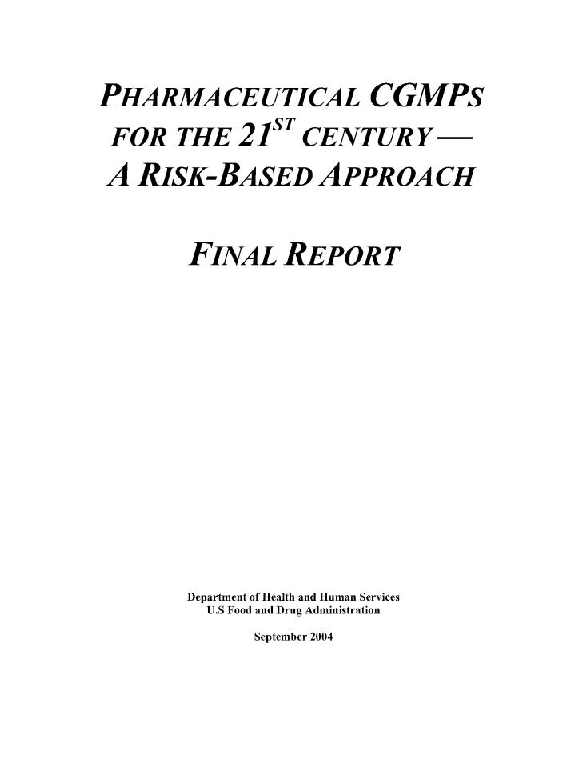
FDA 21st-Century Initiative (2004)
Encourage the early adoption of new technological advances
Encourage implementation of risk-based approaches
Promote modern quality management techniques across industry
Facilitate industry-wide implementation of quality systems approaches
Outreach and collaboration with industry
Introduce new manufacturing science into regulatory paradigm
Harmonize concepts internationally
Objectives (partial list):
Goals (partial list):

Slide 8
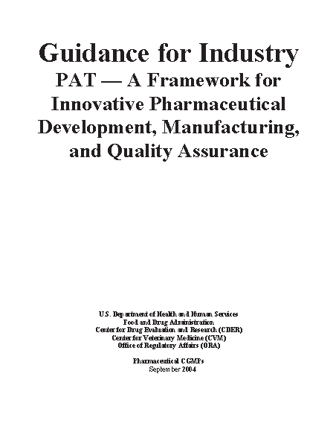
PAT Guidance (2004)
The goal of Process analytical technology (PAT) is to enhance understanding and control the manufacturing process, which is consistent with our current drug quality system: quality cannot be tested into products; it should be built-in or should be by design
A desired objective of the PAT framework is to facilitate the design and development of well understood processes that will consistently ensure a predefined quality at the end of the manufacturing process

Slide 9
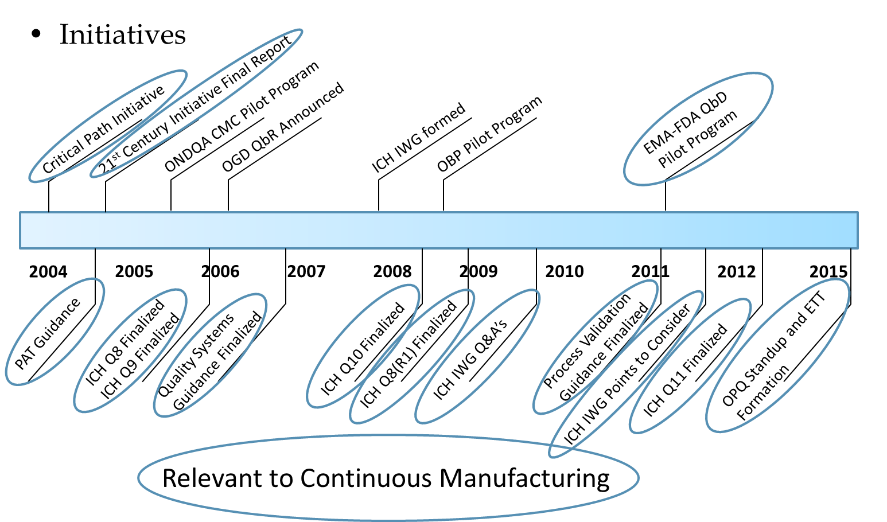
Quality Related Guidance and Initiatives

Slide 10
FDA View of Continuous Processing for Pharmaceuticals
FDA supports continuous processing for pharmaceutical manufacturing
  Offers potential quality advantages in both development and manufacturing
No specific FDA regulations or guidance exist about continuous manufacturing, other than the definition of “lot”
Continuous pharmaceutical manufacturing is consistent with FDA Quality Initiatives
  More modern manufacturing approach
  Potential to improve assurance of quality and consistency of drugs
  Enables quality to be directly built into process design

Slide 11
FDA Training on Continuous Manufacturing
Partnering with NIPTE for a 40 hour on-line training session
Visits to academic institutions to observe continuous manufacturing set-up
Visits to industry and vendor sites of development and manufacturing facilities with continuous manufacturing

Slide 12
Emerging Technology Team (ETT)
  A small cross-functional team with representation from all relevant CDER and ORA review and inspection programs
Vision
  Encourage the adoption of innovative technology to modernize pharmaceutical development and manufacturing
Objectives
  To serve as a centralized location for external inquiries on novel technologies and to provide a forum for firms to engage in early dialog with FDA regarding innovation
  To ensure consistency, continuity, and predictability in review and inspection
  To help establish review and inspection standards and policy, as needed
  To identify and evaluate roadblocks relating to existing guidance, policy, or practice

Slide 13
OPQ Regulatory Science Program on Continuous Manufacturing
Collaborative research with academia
  Research on flow reactors for drug substance synthesis and online monitoring
  Development of process modeling tools to support risk assessments for continuous manufacturing processes
BARDA-FDA Continuous Manufacturing Innovations Initiative aims at supporting industrial implementation
  Broad Agency Announcement on Continuous Manufacturing: https://www.fbo.gov/?s=opportunity&mode=form&id=19f4a4e1745fe86550731f1fcd0dcdde&tab=core&_cview=1

Slide 14
Moving Forward
The FDA can play a significant role in facilitating the implementation of emerging technologies
It is clear, however, that FDA cannot alone address the modernization of the pharmaceutical manufacturing base
The successful modernization of the pharmaceutical manufacturing sector to address the challenges to quality will take a collaborative effort among industry, academia, government funding agencies, and regulatory bodies

Slide 15
Panel 1: Discussion topics
Integrated Continuous Biomanufacturing
Brookings Institute Workshop
September 19, 2015

Slide 16
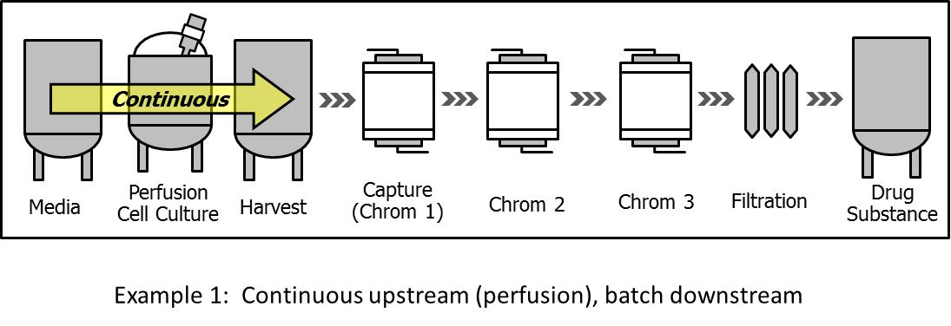
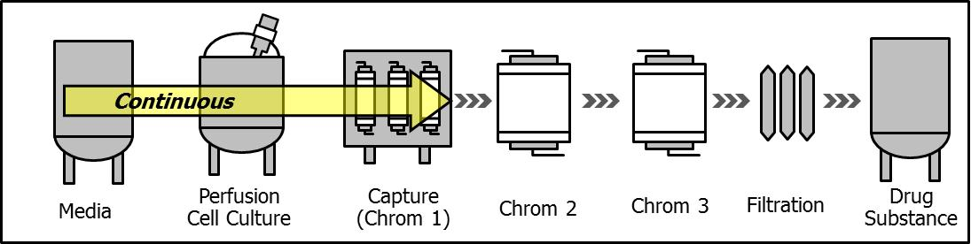
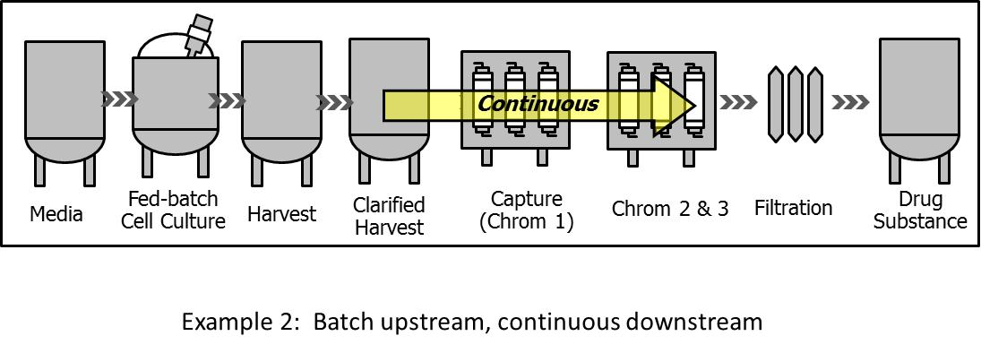
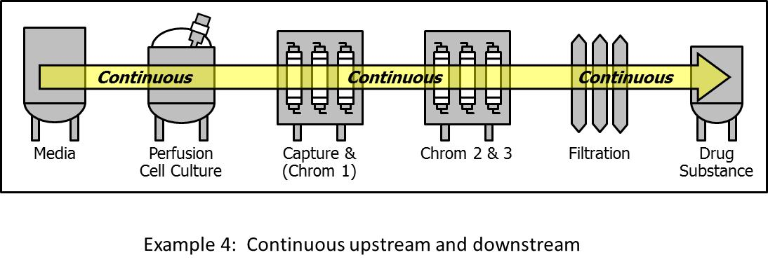
History of Continuous Biomanufacturing and Emergence of the “Dominant” Design
Continuous upstream (perfusion), batch downstream
Continuous upstream + capture, batch downstream (post capture)
?
Dominant design
Batch upstream, continuous downstream
“End-to-end” continuous, integrated upstream and downstream
16
J PHARM SCI (2015) 104: 813–820

Slide 17

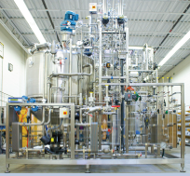
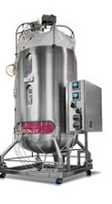
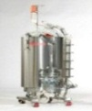

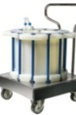
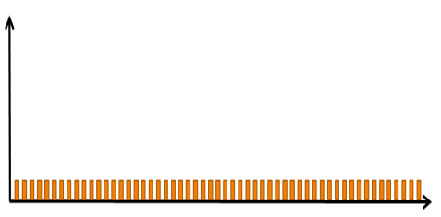
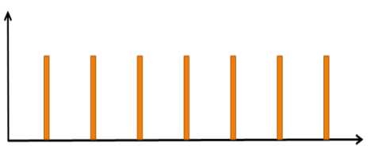
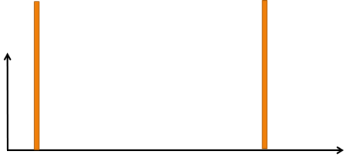
Where are we going?
Evolution of bioprocessing in the global biotech industry
fully continuous
USP
>1,0000L
2,000L
500L
DSP
>100L
<2L
Smaller processing batch size
Frequency of operation
(degree of continuity)
20-50L
hour/s
day/s
week/s
1990s
Present
Future
Large fed-batch/batch
Smaller volume/multi-cycle
Continuous
Biotech & Bioeng (2015) 112: 648-651

Slide 18
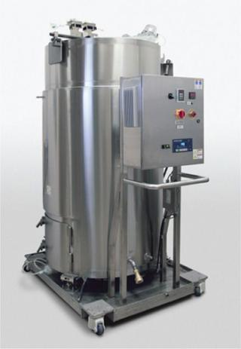
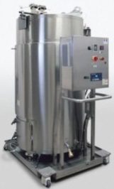

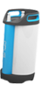
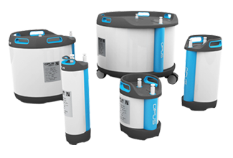
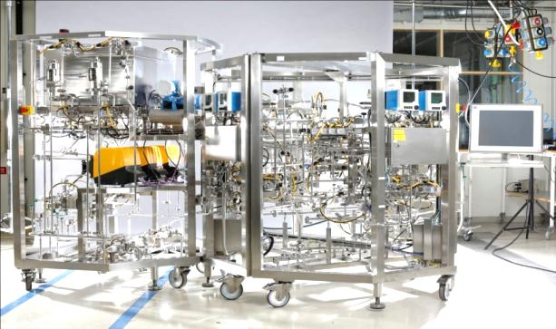
Integrated Continuous Platform Capacity Potential (kg FDS/year)
Broad capacity range (10-x1,000kg/yr) through changing the disposable elements
2,000L
(400-2,000 kg)
500L
(100-500 kg)
50L
(10-50 kg)
Upstream
Single Use Bioreactors
10 kg
100 kg
1,000 kg
4,000 kg
Downstream
Disposable columns
10 cm
(10-100 kg)
20 cm
(100-1,000 kg)
45 cm
(500-4,000 kg)
Assumptions:
SPR = 20-40 pg/cell/day (stable), Cell Density = 50-150e6 cells/mL
DSP yield = 70%, Capacity utilization = 80%
Bioreactor size = Annual FDS throughput, e.g. 2 x 2,000 L = 4,000 kg

Slide 19
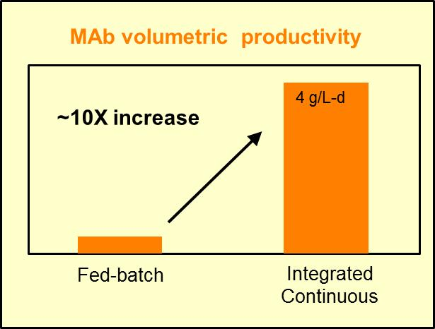
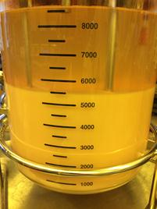
Integrated Continuous Biomanufacturing:
A universal platform for various therapeutic modalities
Universal: Any protein, rec vaccine
Steady state
Product consistency
Functionally closed (end-to-end)
Fully disposable
Advanced PAT, control strategy, RTR
Low cycle times (hours to DS)
Low footprint, portable, modular
Fully standardized
Low OPEX/CAPEX
At 4 g/L-d one 500L reactor will produce ~560kg/y crude harvest
Processing time of 22 hrs to DS achieved
CHO cell densities of >120e6 cells/mL maintained at steady state
| 19

Slide 20
Key discussion topics: Biotech
Should we target the development of a single universal platform for most modalities (the “dominant design”)?
Is fully continuous flow really needed? (uninterrupted flow, as in pharma)
What is the best path towards RTR? (more PAT, less modeling; less PAT, more modeling; balance of both)
Is the “end-to-end” integrated continuous biomanufacturing seen as the targeted architecture of the future?
Is higher product quality homogeneity, which is typical for continuous bioprocessing, an advantage?
Should we seek synergy between CM and synthetic biology?

Slide 21
Promoting Continuous Manufacturing in the Pharmaceutical Sector
The Brookings Institution • Washington, DC
Monday, October 19th, 2015

Slide 22
Chemical Industry Experience
Most laboratory analytical instruments were portabilized and taken to production facilities
All process streams were characterized
It showed that many assumptions on reaction rates, mechanisms, heat and mass transfer were incorrect
The impact was an increase in yield and quality when reactions were understood and controlled
Mel Koch
CPAC

Slide 23
Importance of Raw Material, Nutrient, and Excipient Characterization
This is of equal – or even more – importance than process characterization
Proper characterization here – and studying the affects of changes in the quality on the process and product – is key to running a consistent process.
Specifications developed here are important in the purchasing of these materials
Mel Koch
CPAC

Slide 24
This experience emphasizes the recommended steps in the FDA’s program for Quality by Design (QbD)
  Target the product profile
  Determine critical quality attributes (CQAs)
  Link raw material attributes and process parameters to CQAs and perform risk assessment
  Develop a design space
  Design and implement a control strategy
  Manage product lifecycle, including continual improvement
Effective Process Analytical Technology (PAT) - involving
sampling, monitoring, and data handling - is the
key to achieving this.
Mel Koch
CPAC

Slide 25
Promoting Continuous Manufacturing in the Pharmaceutical Sector
The Brookings Institution • Washington, DC
Monday, October 19th, 2015

Slide 26


Promoting Continuous Manufacturing in the Pharmaceutical Sector
IV. Building Stakeholder Collaborations to Facilitate Implementation of Continuous Manufacturing
D. Keith Roper
    Program Leader: Engineering Research Centers
  Network for Computational Nanotechnology
    Program Director: Integrative Strategies for Understanding Neural and Cognitive Systems
    NSF Research Traineeship Program
Engineering Education and Centers Division
Engineering Directorate

Slide 27
Continuous Pharmaceutical Manufacturing
Models for success
Current challenges
NSF/ENG investments
Advances from NSF support
Emerging Opportunities

Slide 28


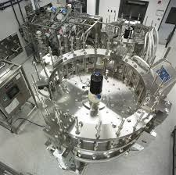
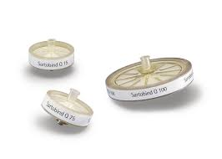
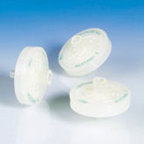
Models for Success: ca. 1992
Discovery → Tools → Processes
Stacked Membrane Discovery
  Coherent vs. incoherent dissipation
  Improved Bioproduct Recovery
      Rapid kinetics
  Enhanced Bioprocess Economics
      Reduced energy, operating time
Adsorptive Membrane Tools
  Ionic, affinity adsorption
  Advanced Bioprocessing
  Virus Filtration
      Log removal
    Scaleability, validatability
Roper & Lightfoot J. Chromatogr. A. 702(1-2) (1995) 3-26.
Seader, Henley, & Roper. Separation Process Principles, Chemical and Biochemical Operations. 2010. 3rd Ed. John Wiley & Sons, Inc. Hoboken NJ

Slide 29




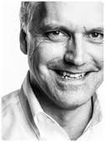
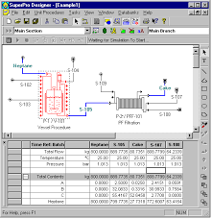
Models for Success: 1992 - today
Processes → Modeling → Manufacturing
BioProcess Modeling
  Predictable Bioprocess Design
      Rapid what-if scenarios
  Speed Bioprocess Development
      Reduce development costs
      Reduced time-to-market
Bioprocess Engineering Center (BPEC)
  MIT – Academic Lead
      Danny Wang - Director
  Merck VBR&C – Industry Partner
      John Aunins - Liaison
Anna Hagen
Director, Merck
Hepatitis A Vaccine Purification Process
John Aunins
Exec VP, Series
HIV-1 protease inhibitor
Shanklin, T., Roper, D.K., Yegneswaran, P.K., and Marten, M.R., Biotechnol Bioeng. A . 72(4) (2001) 483-489.
Shanklin, T., Yegneswaran, P.K., Roper, D.K., Yegneswaran, P.K., and Marten, M.R., Pharmaceutical Online, March 5, 1999.

Slide 30
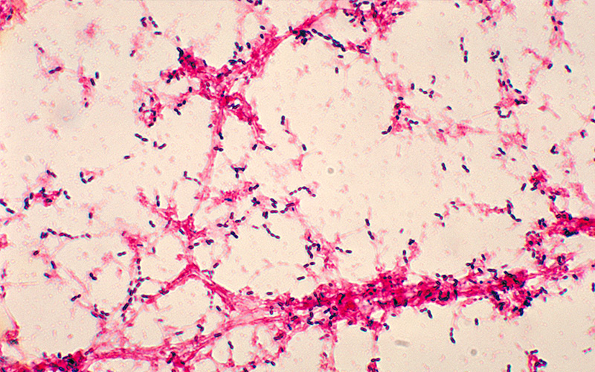

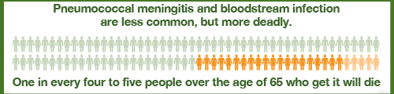
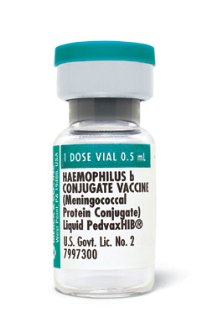
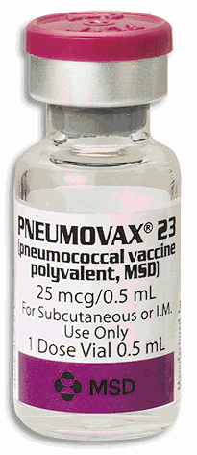
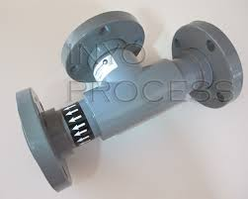
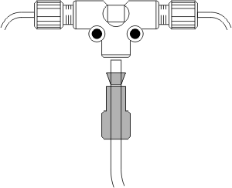
Models for Success: 1994 - today
Continuous Biopharmaceutical Manufacturing
Pneumococcal disease
  Pneumonia
      1 million/yr in U.S. - 7% die
      1 million children worldwide die
  Meningitis / sepsis
      25% over 65 yrs die
Vaccine BioProcess R&D
  New Pneumovax Process
      23 serotypes
  Polysaccharide
      Alcohol precipitation
      T-mix skid
      Continuous Process Control
Roper, D.K., “Basis of Design Document and Process Skid Package Specification for Pilot Pneumovax Tee-Mix Skid”, Merck BPR&D, 10 March 1997.
Lander, R., M. Gayton, D.K. Roper and A.L. Lee. “Basis of Design Document for New Pneumovax®23… “, Merck BPR&D, 10 October 1995.

Slide 31
Current Challenges
Continuous Pharmaceutical Manufacturing
MARKET
$300 billion pharmaceutical sales (U.S., 2009): 37% increase over 2003
  40% percent of worldwide pharmaceutical market.
  US produces 39% of world’s pharmaceuticals
$1.7 billion cost to bring a single new drug to market
PROCESS – STRUCTURE – FUNCTION RELATIONS
Organic, small-molecule APIs
  granular solids or powders - marginal H₂O solubility
  fillers, disintegrants, surfactants, release agents, coatings assist release
  Formulation: powder mixing, size reduction, granulation, drying, coating, tableting
    Trial and error: quantitative models lacking
REGULATORY
Quality assurance: recipe adherence, batch sampling
  Quality by Design (QbD): FDA initiative
  Facility design, operation; material property analysis; process control

Slide 32
NSF/ENG Investments
Continuous Pharmaceutical Manufacturing
CENTER FOR STRUCTURED ORGANIC PARTICULATE SYSTEMS (CSOPS)
$33,176,762 investment through 2015
ENGINEERED SYSTEMS
  direct compaction of active pharmaceutical ingredients
  manufacture of strip films to increase bioavailability of low-solubility actives
  development of multilayer dosage technologies: drop-on-demand
FUNDAMENTAL RESEARCH
  particulate structures - at interfaces and in colloidal solutions
    thermodynamics, kinetics, and mechanics of particulate interactions
    micro- to nano-scale characterization
  predictive design and scale-able control of manufacture of APIs
ENABLING TECHNOLOGIES
  algorithmic toolbox: control, optimization, and informatics
  multi-scale models: processing, structure, material properties of APIs.
  simulate multiphase transport of APIs.
  reduced-order models for rapid inline monitoring and control of pharmaceutical manufacturing processes.

Slide 33
NSF/ENG Investments
Continuous Pharmaceutical Manufacturing
STRUCTURED PARTICULATE SYSTEMS - CBET, EEC, IIP
$11,217,134 investment through 2015
ENGINEERING RESEARCH
  Deterministic and stochastic transport of suspended particles in periodic systems
  Response of novel suspensions of magnetic nanoparticles to time varying magnetic fields
  dynamics of magnetic nanoprobes in polymer melts
  magnetically and thermally active nanoparticles for cancer treatment
CYBERPHYSICAL SYSTEMS
  Multi-scale modeling and analysis of reactive granulation processes
  cyber-enabled engineering of pharmaceutical products
PARTICLE SYSTEMS TECHNOLOGY: TRANSFER TO PHARMA MANUFACTURING
  Integrated Systems for manufacture of pharmaceuticals (I-Corps)
  Center for pharmaceutical processing (I/UCRC)
  Multi-scale modeling to predict granule property evolution in mixer granulators (GOALI)
  Cellulose formulations to enhance solubility and improve drug delivery (AIR)

Slide 34
NSF Investments
Continuous Pharmaceutical Manufacturing
STRUCTURED PARTICULATE SYSTEMS - DMR, EHR, etc.
$4,171,907 investment through 2015
RESEARCH
  polysaccharide derivatives for enhanced drug delivery
  integrated research in nano-pharmaceutical engineering and science
INSTRUMENTATION
  near infrared chemical imaging spectrometer to study novel organic composites cyber-enabled engineering of pharmaceutical products
WORKFORCE DEVELOPMENT
  research experiences for undergraduates and teachers in functional and nanostructured materials

Slide 35
Advances from NSF Support
Continuous Pharmaceutical Manufacturing
ENGINEERED SYSTEMS RESEARCH
Predict drug dissolution based on tablet morphology, composition, and processing
Physical stabilization in the amorphous state of poorly soluble APIs
  405 peer-reviewed journal articles, 223 conference proceedings
  181 peer-reviewed articles, 77 conference proceedings (associated support)
  or sponsored projects to CSOPS researchers
KNOWLEDGE TRANSFER TO INDUSTRY
Dry compaction INSPIRE Test Bed
  models and processes transferred to J&J, Johnson/Janssen in Puerto Rico
  pilot activities with Eli Lilly
48 invention disclosures, 26 total patent applications filed,
eight patents awarded, one license issued, one start-up company
INDUSTRY ENGAGEMENT
>30 industrial leaders in pharmaceutical manufacturing and equipment development
~$10M support for associated projects (FY2014)
neutral forum for industry/FDA interactions relevant to continuous manufacturing

Slide 36
Advances from NSF Support
Continuous Pharmaceutical Manufacturing
FUTURE PHARMACEUTICAL WORKFORCE
Degreed professionals: 66 PhD, 30 MS, 13 BS (1/2 employed by industry)
New degree programs, one new certificate program,
50 new courses, 15 textbook chapters, and 64 course modules
RET engaging high school teachers from industry conduct research at university
BROADENING PARTICIPATION
Women in CSOPS leadership, faculty, post-docs and students at all levels more than doubles corresponding national averages.
Underrepresented minorities and Hispanic/Latino participants have been at or above national levels
REGULATORY ADVANCES
Introduced scientific first principles, demonstrated advanced modeling and control (including closed loop operations) of continuous pharmaceutical manufacturing.
FDA engaged CSOPS researchers to develop model-assisted batch processing or flowsheet modeling;
CSOPS director Fernando Muzzio serves on the FDA’s Science Advisory Board.
NJIT may build a stripfilm facility at FDA.
Invited to coordinate advice to FDA

Slide 37
Emerging Opportunities
Continuous Pharmaceutical Manufacturing
ENGINEERING RESEARCH
Predictive design, characterization, and control of pharmaceutical products based on understanding of process/structure/function relationships
Prediction of product performance based on material properties and process parameters
ENABLING TECHNOLOGIES
algorithmic toolbox that supports control, optimization, and informatics including models and processes for continuous manufacturing
ENGINEERED SYSTEMS
Bio pharmaceutical process: ‘upstream’ and ‘downstream’
Emerging nano- and electro-ceuticals
Multi-scale, multi-faceted analysis
  Integrate reduced-order process models with physiologic, pharmacokinetic models
Co-adaptive, closed-loop, bidirectional interfaces for drug delivery

Slide 38
Emerging Opportunities
Continuous Pharmaceutical Manufacturing
WORKFORCE DEVELOPMENT
FDA/NSF Scholar in Residence at FDA
  1 yr support for faculty or postdocs to research, collaborate intramural FDA labs
  1-4 semesters (F/T or P/T) graduate student mentored by academic and FDA
  Summer or 1-2 semester support for undergraduate students, mutual mentors
  Current program focuses on medical devices
Joint NSF/(FDA) support of Center-scale activities or interactions
Joint NSF/(other federal agency support) for joint calls for proposals.
Joint working group: identify opportunities of mutual interest/support
  ENG: vision reset for manufacturing research
ERC Program (UIDP) Workshop (Jan/Feb 2016)
  Post-ERC workforce development initiatives
International Institute for Advanced Pharmaceutical Manufacturing
  Continuous Manufacturing and Crystallization Consortium (CMAC) in the UK
  Research Center for Pharmaceutical Engineering (RCPE) in Germany
  Ghent University in Belgium

Slide 39
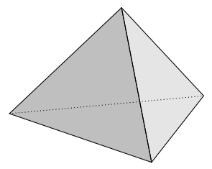
Translational Institute: integrate research/development
Vision – Realization
Discoveries
Technologies
Proofs of Principle
Interactive Dialogue
Opportunities
Research Participants
Leadership
Faculty
Students
Administration
Program Staff
Administration
Program Leader
Program Director
Program Staff
Best Practices
Technology Sector
Advisory Boards Initial Reviewers
Industry, Science, Admin Periodic Visitors
Innovation Partners
Seminar Speakers
Adapt/Refine
© K. Roper Oct 2015

Slide 40


Workforce Development Span
Precollege
Undergrad
Graduate
Professional
Curriculum: core & advanced
Modules / e-modules
Internships
Degree/certificate programs
Research Experience for Undergrads (REU)
Short Courses
High School Young Scholars
Workshops, Seminars
Engineering camps, fairs, lab tours
International experiences
Mentoring
Research Experiences for Teachers (RET)
Websites – Social Media
© 2014 D.K. Roper
Notes:
The education program in a mature ERC includes a variety of activities that span precollege, undergraduate, graduate, and professional spheres. Contributions from industry partners (in orange) and contributions to precollege students (in green) are important components of these programs.

Slide 41
Cyberinfrastructure
HUBzero ®
open source software platform for creating dynamic web sites that support scientific research and educational activities
Over 300,000 users annually (8% industry)
Simulation tools (secure environment)
Research and collaboration
  Groups, question board,more
Teach and learn:
  Topic-specific materials, tool-powered curricula, simulations
Research and collaboration
  Groups, question board,more
Share and publish tools and research
  Easy upload process
User support

Slide 42

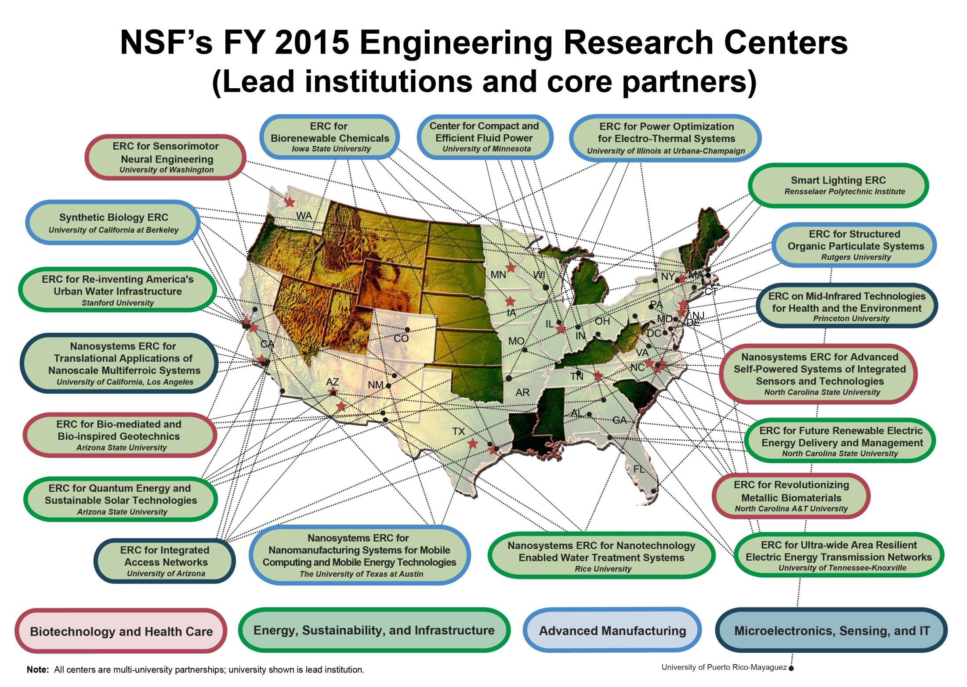

Slide 43
NSF Support Mechanisms
I Corps – single PI/mentor/mentee $50K/6 mo
EpiCenter: Nat’l Center for Engineering Pathways to Innovation
Sept 21, 2015 – proposals due (Tina Seelig)
Travel stipends ($10M/5 yrs – EHR/DUE and ENG/EEC)
Partnerships for Innovation (PFI)
Accelerating Innovation Research (AIR)
Technology Translation (TT): single PI, $200K/1.5y
Research Alliance: $800K/3y
Building Innovation Capacity (BIC): $800/3y
SBIR/STTR
Phase I STTR $225K/1 yr
Phase I SBIR: $150K/6 mo
GOALI: grant opportunities for academic liaison with industry
Industry/University Cooperative Research Centers (I/UCRC)

Slide 44



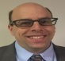







Division of
Engineering Education and Centers
Mario Rotea
Division Director
Vacant
Science Analyst
Don Millard
Deputy Division Director
Centers – ERC, NCN
ENG Education
ENG Workforce
Alisha Lynn Williams Operations Specialist
Keith Roper ERC, NCN
Elliot Douglas
Mary Poats
RET, NUE
Administrative Staff
Program Directors ERC
AAAS Fellows
James Moore Broadening Participation
Marshall Horner Acting Operations Specialist
Deborah Jackson ERC
Daphney Jean
AAAS Fellow
LaTanya Sanders-Peak Program Specialist
Carmiña Londoño ERC
Pamela Hanson
AAAS Fellow
Shalika Walton Program Specialist
Kathryn Hoppe
Einstein Fellow
Susan Watson Program Specialist
Tammie Jennings Program Specialist

Slide 45
Promoting Continuous Manufacturing in the Pharmaceutical Sector
The Brookings Institution • Washington, DC
Monday, October 19th, 2015

