Slide 1
China’s Image in Africa, Europe and Latin America
Richard Wike
Director of Global Attitudes Research

Slide 2
Favorability ratings for china

Slide 3
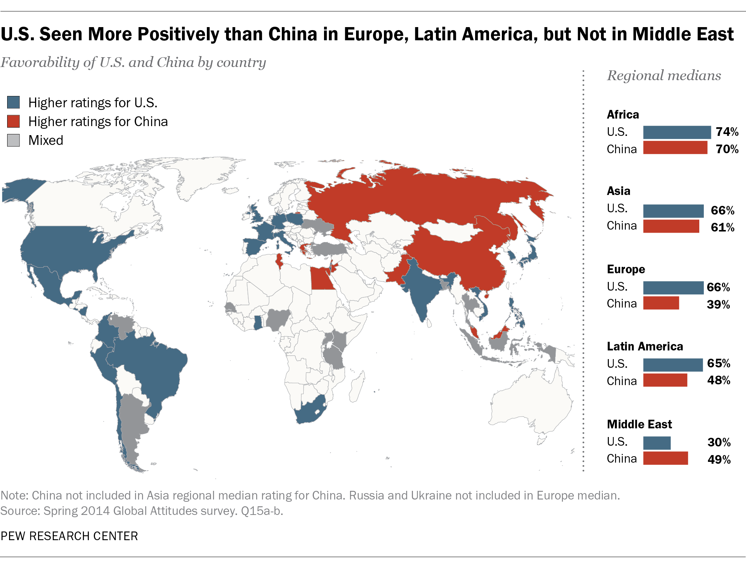

Slide 4
Views of China in Europe

Slide 5
Views of China in Latin America

Slide 6
Views of China in Africa

Slide 7
European Views on China by Age
Favorable views of China
 | TOTAL | 18-29 | 30-49 | 50+ | Youngest-oldest gap
 | % | % | % | %
France | 47 | 61 | 48 | 41 | +20
UK | 47 | 60 | 48 | 40 | +20
Spain | 39 | 50 | 40 | 34 | +16
Greece | 49 | 55 | 49 | 47 | +8
Poland | 32 | 35 | 34 | 29 | +6
Germany | 28 | 33 | 25 | 30 | +3
Italy | 26 | 27 | 30 | 24 | +3

Slide 8
Latin American Views on China by Age
Favorable views of China
 | TOTAL | 18-29 | 30-49 | 50+ | Youngest-oldest gap
 | % | % | % | %
Mexico | 43 | 52 | 45 | 32 | +20
Brazil | 44 | 53 | 43 | 36 | +17
Venezuela | 67 | 72 | 70 | 57 | +15
Peru | 56 | 65 | 54 | 51 | +14
Nicaragua | 58 | 61 | 62 | 49 | +12
Colombia | 38 | 45 | 38 | 33 | +12
Chile | 60 | 63 | 64 | 52 | +11
El Salvador | 48 | 51 | 50 | 41 | +10
Argentina | 40 | 40 | 45 | 35 | +5

Slide 9
African Views on China by Age
Favorable views of China
 | TOTAL | 18-29 | 30-49 | 50+ | Youngest-oldest gap
 | % | % | % | %
Nigeria | 70 | 76 | 66 | 62 | +14
Senegal | 71 | 75 | 70 | 61 | +14
Uganda | 61 | 63 | 61 | 59 | +14
South Africa | 45 | 49 | 48 | 35 | +14
Tanzania | 77 | 80 | 78 | 67 | +13
Ghana | 61 | 66 | 60 | 56 | +10
Kenya | 74 | 74 | 76 | 71 | +3
Note: Sample size for Nigerians 50 and older is less than 100.

Slide 10
China’s economic impact

Slide 11
Views of China’s Growing Economy in Europe
Overall, do you think China’s growing economy is a good thing or a bad thing for our country?

Slide 12
Views of China’s Growing Economy in Latin America
Overall, do you think China’s growing economy is a good thing or a bad thing for our country?

Slide 13
Views of China’s Growing Economy in Africa
Overall, do you think China’s growing economy is a good thing or a bad thing for our country?

Slide 14
Feelings in Africa on China’s Growing Economy
China’s growing economy is a good thing for our country

Slide 15
Is China a threat?

Slide 16
Global Threats – Europe
Median saying each is a major threat to their countries
Note: Median of 9 European countries: UK, France, Germany, Italy, Spain, Greece, Poland, Czech Rep. & Russia. 2013 data.

Slide 17
Global Threats – Latin America
Median saying each is a major threat to their countries
Note: Median of 7 Latin American countries: Argentina, Bolivia, Brazil, Chile, El Salvador, Mexico & Venezuela. 2013 data.

Slide 18
Global Threats – Africa
Median saying each is a major threat to their countries
Note: Median of 6 African countries: Ghana, Kenya, Nigeria, Senegal, South Africa & Uganda. 2013 data.

Slide 19
Is China a Partner, Enemy, or Neither?
Median saying China is more of a …
Note: Europe median includes UK, France, Germany, Italy, Spain, Greece, Poland, Czech Rep. & Russia. Latin America median includes Argentina, Bolivia, Brazil, Chile, El Salvador, Mexico & Venezuela. Africa median includes Ghana, Kenya, Nigeria, Senegal, South Africa & Uganda. 2013 data.

Slide 20
Considering Other Countries
In making int’l policy decisions, __ takes into account your country’s interests a great deal/fair amount
Note: Europe median includes UK, France, Germany, Italy, Spain, Greece, Poland, Czech Rep. & Russia. Latin America median includes Argentina, Bolivia, Brazil, Chile, El Salvador, Mexico & Venezuela. Africa median includes Ghana, Kenya, Nigeria, Senegal, South Africa & Uganda. 2013 data.

Slide 21
Chinese soft power

Slide 22
American vs. Chinese Soft Power – Latin America
Median positive view in Latin America of …
Note: Median includes Argentina, Bolivia, Brazil, Chile, El Salvador, Mexico & Venezuela. 2013 data.

Slide 23
American vs. Chinese Soft Power – Africa
Median positive view in Africa of …
Note: Median includes Ghana, Kenya, Nigeria, Senegal, South Africa & Uganda. 2013 data.

Slide 24
Products Made in China as Safe as Elsewhere?
Note: 2008 data.

Slide 25
Globally U.S., France Seen as Respecting Personal Freedom, Low Marks for China, Russia
Does the government of ___ respect the personal freedoms of its people?
Note: Percentages are global medians saying “yes.”
*Not asked in China.

Slide 26
China Respect for Personal Freedoms – EU
Do you think the government of China respects the personal freedoms of its people?

Slide 27
China Respect for Personal Freedoms – Latin America
Do you think the government of China respects the personal freedoms of its people?

Slide 28
China Respect for Personal Freedoms – Africa
Do you think the government of China respects the personal freedoms of its people?

Slide 29
Rating China and Its People in the West
Favorable views of …
Note: 2008 data.

Slide 30
The global balance of power

Slide 31
U.S. Greater Influence than China in Latin America
__ has a great deal/fair amount of influence on country
Note: 2013 data.

Slide 32
It Is More Important to Have Strong Ties with …
Note: 2013 data.

Slide 33
U.S. and China Influential in Africa
__ has a great deal/fair amount of influence on country
Note: 2013 data.

Slide 34
It Is More Important to Have Strong Ties with …
Note: 2013 data.

Slide 35
U.S. (Mostly) Still Considered Top Economy
Today, which one of the following do you think is the world’s leading economic power?
Note: Median percentages by region.

Slide 36
Europeans Say It Is China
Today, which one of the following do you think is the world’s leading economic power?
 | U.S.
 | 2008 | 2014 | Change
 | % | % | %
Spain | 42 | 31 | -11
UK | 44 | 34 | -10
France | 44 | 37 | -7
Germany | 25 | 20 | -5
 | China
 | 2008 | 2014 | Change
 | % | % | %
 | 24 | 49 | +25
 | 29 | 49 | +20
 | 31 | 51 | +20
 | 30 | 49 | +19

Slide 37
Globally, China Seen Replacing U.S. as World Superpower
Which comes closer to your view?
Note: Median percentages based on the 20 countries surveyed in both 2008 and 2014.

Slide 38
Europeans, Latin Americans, Africans See China Replacing U.S. as Top Superpower
Which comes closer to your own view?
Note: Median percentages by region.

Slide 39

All Pew Research Center reports and data are available online at www.pewresearch.org

