Slide 1
Everyone does it but no one talks about it: how to use social media to proliferate masturbation discourses
Dr. Yuxin Pei
Associate Prof. at Sun Yat-sen U.
Fulbright Visiting Scholar at USC
Yuxin.pei@fulbrightmail.org

Slide 2
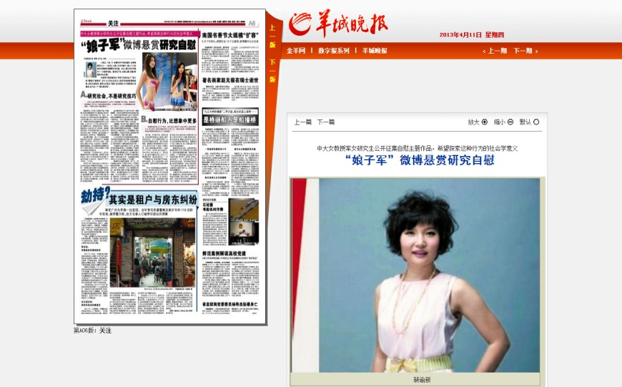
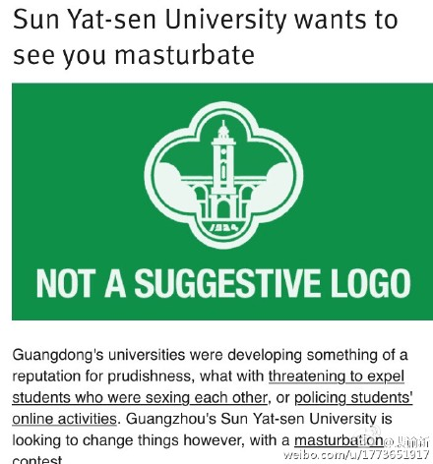
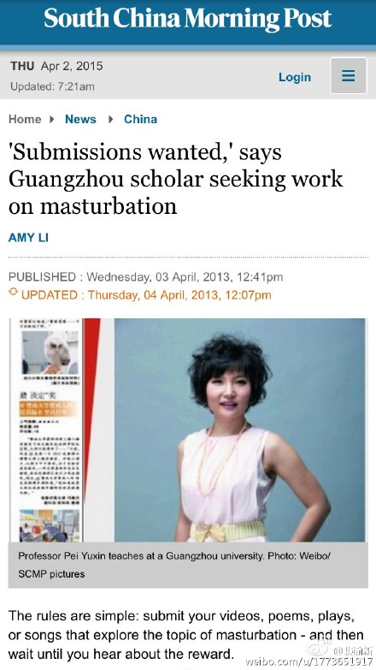
Seeking
work
on
masturbation
?
Not an April fools’ joke

Slide 3
Controversial points about the project
Academic or pornographic?
Educational or solicited?

Slide 4
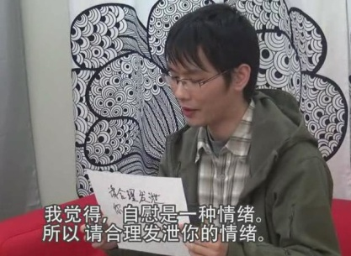
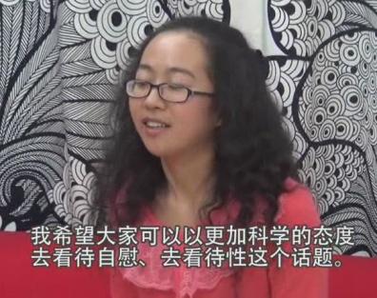
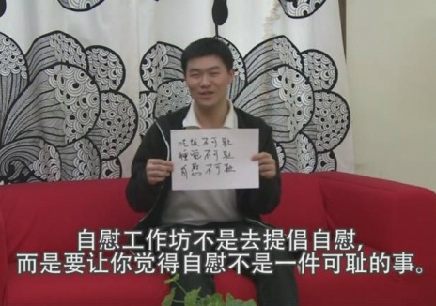
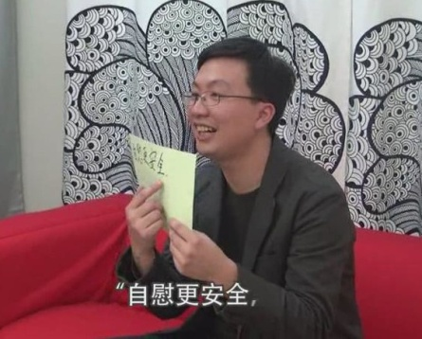
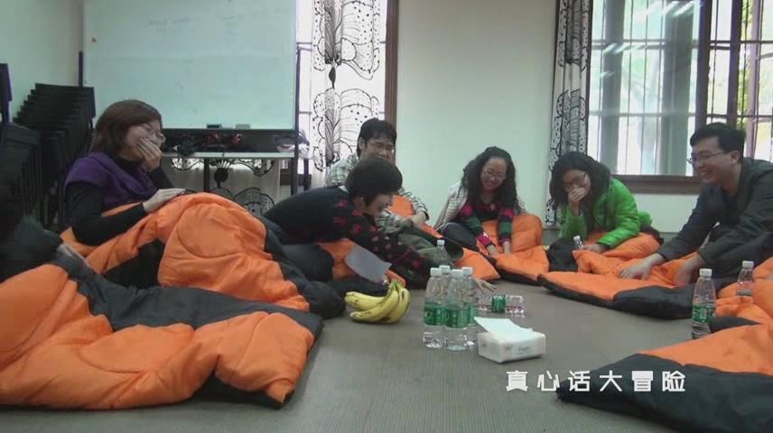
Feedback from participants and followers
Online: Weibo “masturbation research group”
Offline
Workshops
Focus groups
Individual interview

Slide 5
What if we just talk…..

Slide 6
Sexual Scripts
“only men do it”
“one drop of semen
=10 drops of blood”
“Frequency,
frequency,
frequency”
Desires on its own no consideration on relationships or reproduction?
A sign of sexual dissatisfaction?
Use up sexual energy and less left for partners or life?
Double standard?

Slide 7
What we have found
Sexual drives and sexual pleasure;
Body positivity and self-love;
New forms of sexual subjectivity within pornographic cultures, especially LGBT cultures;
New level of intimacy.

Slide 8
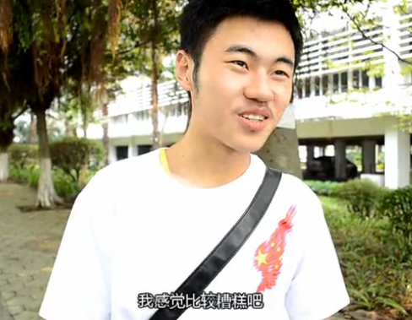
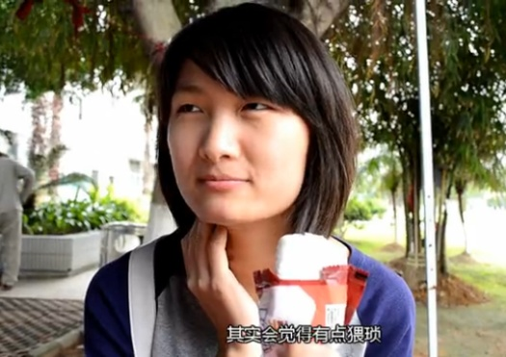
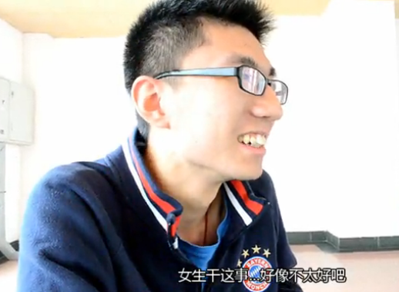
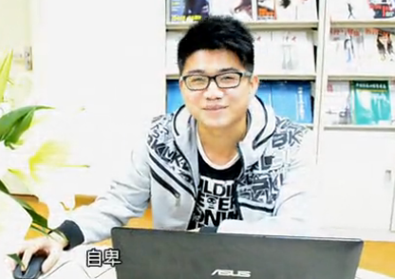
Femininity, masculinity, relationships, sexual pleasure, body image, gender, double standard, love, marriage, self development

Slide 9
Thank you
感 谢 聆 听

