Slide 1
The Silent Change– Transsexuals’ Marriage Rights from the Perspective Of Chinese Law
Guo Xiaofei
China University of political Science and Law

Slide 2

W v. Registrar of Marriages
In November 2008, W was refused at the Marriage
Registration Office when she applied for marriage
with her male partner.

Slide 3
W v. Registrar of Marriages
On May 13th, 2013, the Hong Kong Court of Final Appeal
Overturned the previous decisions, and granted transsexual
people the right to marry in their acquired sex with a person
of the different sex.
The meaning of “female” should include male-to-female
transsexuals who have undergone sex reassignment surgery
and have been confirmed by the health department concerned.

Slide 4
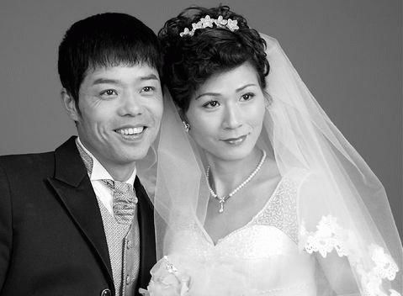
The Silent Change in Mainland China
The transsexuals’ right to marry was secured through
“a silent change”— without any legal advocacy from
transsexual communities, any debates and hearings in
the legislature, or any landmark cases in the judiciary.

Slide 5
The Silent Change in Mainland China
“If a person’s biological sex is consistent with his or her
certification of household registration, then the marriage
registration is legal. As long as transsexuals have completed
the sex reassignment surgery, and as long as they have
changed their sex on the household register through legal
procedures, or in other words, as long as their bodies and the
papers are consistent, their marriages are lawful. Law lives
in the present; if the subjects of the marriage are a man and
a woman, definitely they can get married.”

Slide 6
Hong Kong: The Fear for Same-sex Marriage
Firstly, if transsexuals are allowed to use their sex by
choice in marriage, then this may open a door for
same-sex marriage in Hong Kong;
Secondly, the essence of marriage is procreation, which
is particularly important in Hong Kong — a typical Chinese
society. Thus, it is not easy to recognize transsexuals’
right to marry.

Slide 7
Conclusion
In Hong Kong, the fear for same-sex marriage has been
underlying the debates over transsexuals’ right to marry,
while generally in Mainland China, governments and
courts do not see this link.

Slide 8

Gao Tingting v. Dongfang Hospital

Slide 9
Gao Tingting v. Dongfang Hospital
A lawful marriage should only consist of two people of
different sexes, and the same-sex marriage that is resulted
from the sex change of one partner is not protected by the
marriage law. However, this should not become the reason
for prohibiting the sex reassignment surgery of a married
person. The object of law is behavior, rather than the
results of certain behavior. Therefore, absent any
prohibitory rules, we cannot deny the legality of the
behaviors only because of its possible illegal consequences.
In Gao’s case, having sex reassignment surgery is a lawful
disposal of her own body, rather than a spousal right. Hence,
the court would not deny a person’s right to body disposition
solely because it may affect his or her spouse’s status.

Slide 10
Why?
1. Transsexuals’ right to marriage was only recognized within the framework of different-sex marriage;
2. The social movements campaigning for same-sex marriages in Mainland China have not yet been strong enough to force the government to defend the purity of “traditional marriages”.
3. In fact, in Mainland China, religious forces are also suppressed, and they have not had the chance to actively defend traditional marriage.

Slide 11
The Dialectic of Progress & Backwardness
In modern societies, it is the psychiatrists who decide the
the pathologization or de-pathologization of LGBTI people,
it is the legal professionals who determine the legality of
gay sex, and it is the state apparatus and the expert system
that have the final say with regard to trans people’s sex and
to whether they Have to undergo all stages of surgery
before they could legally marry.

Slide 12

Sex change operations and technology management standards (Trial Implementation)
- Issued by the General Office of the Ministry of Health

Slide 13
(1).Having been requiring for sex change for at least 5 years
without indecisiveness;
(2).Having received psychological or psychiatric treatment
for more than 1 year without effect;
(3).Not being in marriage;
(4).Being more than 20 years old with full civil capacity;
(5).Without contraindications to surgery;

Slide 14
Will these “professional” detailed
standards really be more progressive
than the judgment of Gao’s case?

Slide 15
Thank you for your attention.

